Slide 1
Access Point Localization using Local Signal Strength Gradient
Dongsu Han *, David Andersen *,
Dina Papagiannaki †, Michael Kaminsky †,
Srinivasan Seshan *
*Carnegie Mellon University
† Intel Research Pittsburgh

Slide 2
Localizing the signal source
High
Low
Signal strength
GPS
802.11 Mobile User Localization (PlaceLab)
Inferring interference,
coverage
Finding
Rogue APs
Notes:
So here is the problem of access point localization. We have a access point that is transmitting a signal. And we have a small device that is equipped with a GPS and a signal strength meter. The signal strength meter tells you the level of signal strength when you receive a signal from the AP. Now the device moves around and measures signal strength from many different locations and it generates a field of measurements.
Now when you have this measurement, one of the most basic things that you want to do is to locate the access point.
This problem has many applications and shows up in various contexts. For example, mobile user localization systems often rely on the location of the access point in order to localize clients. So with better location of the AP, you can localize the clients better. Finding rouge APs and inferring interference and coverage of APs are some of the other applications.

Slide 3
5th Ave
Beeler St
Forbes Ave
Notes:
So what’s difficult about this problem?
If we can uniformly sample across the space, we can take average location and locate the AP there.
This is exactly what centroid or weighted centroid does . It computes the center of mass of the measurements.
However, in the real world we often cannot perform uniform sampling because the path of the measurement is usually constrained by the road.
Now because of this sampling bias, most of the measurements fall in the right side of the AP. So the center of mass shifts. In general, centroid is not a good approach because it suffers from sampling bias which is very common in this type of measurements.
Another approach is trilateration. If you know the distance to the AP from three or more different locations, you can determine the location of the AP. And We can infer the distance from the signal strength because in free space signal strength strongly correlates with distance.

Slide 4
5th Ave
Beeler St
Forbes Ave
Notes:
But, the in real world, we have buildings and structures that block the signal. And this break the correlation between distance and signal strength because signal strength attenuates as the signal goes through buildings.
Let’s take a look at the three measurement point. Although they are equidistant from the AP, they all have different signal strength.
Now if you naively apply trilateration, it fails

Slide 5
5th Ave
Beeler St
Forbes Ave
Notes:
Signal strength attenuates when signals go through buildings and structures. This creates non-uniform attenuation in space, and destroys the correlation between the distance and the signal strength.
For example, if you look at the three measurement point, although they are equidistant from the AP, they all have different signal strength.
Now if you naively apply trilateration, it fails

Slide 6
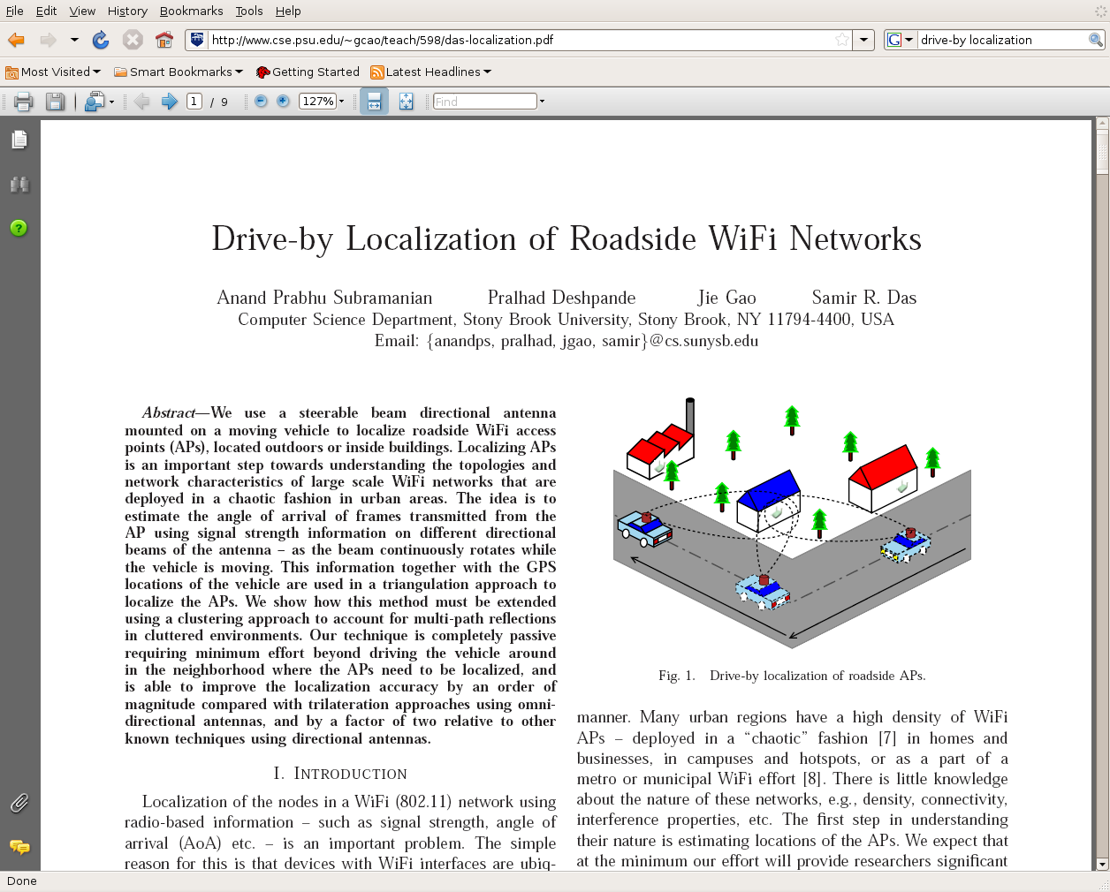
Localization: State of the art
Traditional approaches
A new approach
Centroid/Weighted Centroid
Trilateration
Directional antenna
d1
d0
Image source:
Drive-by Localization of Roadside WiFi Networks
d2
INFOCOM ‘08
Notes:
So far we have looked at the traditional approaches that use signal strength information, weighted centroid and trilateration. While they work in certain cases, they do not work well in the presence of sampling bias and non-uniform attenuation.
Here we have a different approach which does not suffer from those problems. Let’s take a look at the directional antenna approach.

Slide 7
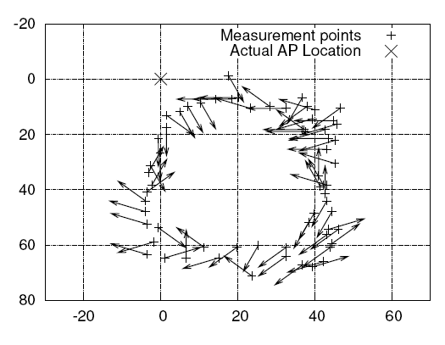
Directional Antenna
Angle of Arrival (AoA) based
Uses steerable beam directional antenna
More accurate
Requires extra hardware
Expensive to determine the incident angle
Beam width too large
Image source:
Drive-by Localization of Roadside WiFi Networks
INFOCOM ‘08
Notes:
Directional antenna approach uses AoA information.
For each location, it measures the incident angle of signal using the steerable beam directional antenna.
Because the AoA, is less affected by the environment than the signal strength, it give us a more accurate result.
However, it has problems.
First it requires extra hardware. And each measurement is more 5expensive because you have to scan through all the directions and find out the direction that gives you the best signal strength to determine the angle. Furthermore, the beam width of the directional antenna is large so you have a large margin of error for each measurement. That requires to have many measurement points.
But again the approach itself is valid because it takes advantage of the more stable property of signal propagation. So we are going to take this approach but we are just going get there from just the signal strength information.

Slide 8
Gradient Approach
5th Ave
Beeler St
Forbes Ave
Notes:
Here’s our approach called gradient.
Even in the presence of non-uniform attenuation, we believe that there still is a contiguous area in which the signal propagation is free-space like. After all, streets are largely open space. We want to identify those areas. ( and find the direction of the strongest signal. And that will give us the direction of the access point. ) and inside this region if we point an arrow towards the stronger signal, this gives us the direction of the ap.

Slide 9
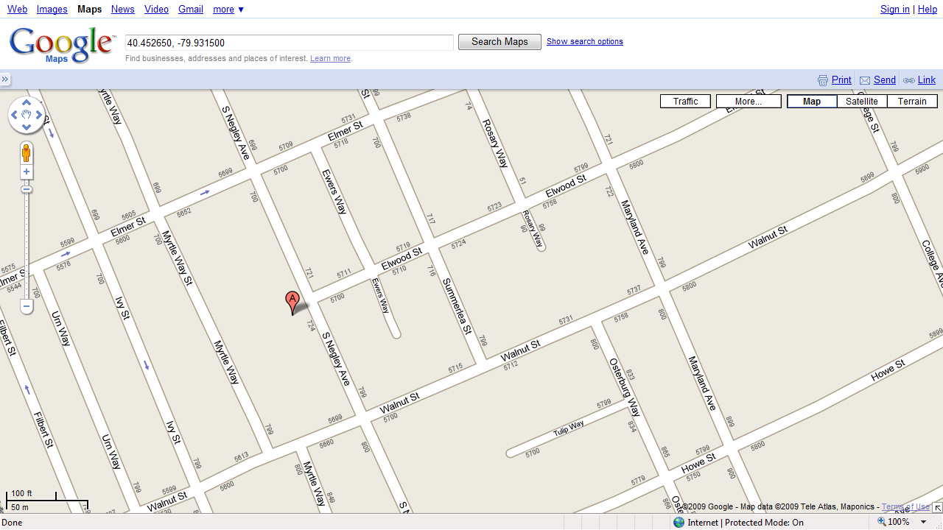
Gradient Approach
Access Point
Measurement
Wcentroid
50m error
Notes:
Let’s now see if we can really apply this idea to a real measurement.
Because this measurement exhibit sampling bias and non-uniform attentuatitoin, Weighted centroid gives us 50m of error, which is off by half a block.

Slide 10
Gradient Algorithm
Phase 1: arrow drawing phase
Point an arrow towards the direction of strong signal using neighboring measurements
Adaptive window sizing
Phase 2: Combining phase
Find the location that minimize the error
Access Point
Measurement
AP
Notes:
Now we explain the details of our algorithm called gradient algorithm.
In free space, signal strength decreases as RF signal travels.
But the problem is different levels of shadowing from obstruction, which makes the signal distribution distorted.
However, neighboring measurement tend to have gone through the same obstruction.
If you only consider the neighboring measurements, then distance is the main factor in determining the signal strength.
For each neighboring measurement, point arrows to the direction of stronger signal
Combine the arrows.

Slide 11
Gradient Algorithm
Phase 1: arrow drawing phase
Point an arrow towards the direction of strong signal using neighboring measurements
Phase 2: Combining phase
Combine the arrows
Access Point
Measurement
AP
Notes:
Based on this idea, we developed a localization algorithm called Gradient. In the first phase, we draw an arrow from each measurement point. For each measurement point, we draw an arrow towards the direction of strong signal using neighboring measurement. So first, we consider a measurement point and its neighbors, and we draw an arrow towards the direction of the stronger signal. And we repeat this for every measurement point.
Once we have all the arrows, we combine them to get the location of the access point.
This is the high level view, and Let’s take a look at these steps in more detail.

Slide 12
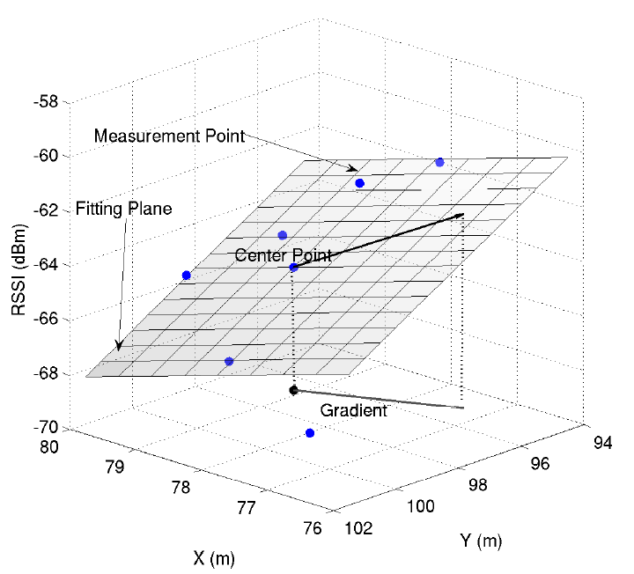
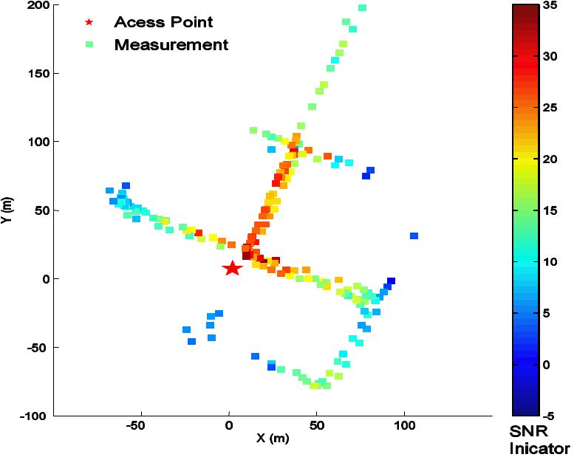
“Arrow-drawing” Phase
Arrow Drawing
Rationale
Neighboring measurements usually go through the same obstruction
Thus local measurements approximate free-space
In free-space, signal strength decreases as RF signal travels
Access Point
Measurement
Notes:
Here’s how we draw an individual arrow. Given a measurement point, we take the near-by measurement

Slide 13
Defining “neighboring measurements”
Window size
Signal Strength
Arrows are sensitive to the “window size”.
Balance between averaging and “local free-space” assumption
The optimal value depends on the environment →No one-size-fits-all value
x
AP
Notes:
Let’s now see how we define the neighboring measurements. We need to define a small area we consider in order to draw an arrow. We call this area window and the width of the window window-size.
If the window size is too small, few near-by measurements would fall inside the region. And small error would throw off the arrow towards the wrong direction.
Ideally, we would like it to be large enough to capture a single trend and average out the error.
However, if the it is too large, the window captures more than one trend making the linear fit less accurate. So by window sizing we want to achieve the balance between the idea of averaging and the local free-space assumption. It turns out that the optimal value depends on the environment including the level of noise, density of measurements and layout of roads and buildings. So there’s no one-size-fits-all value to this, and we cannot predetermine the value of window size.

Slide 14
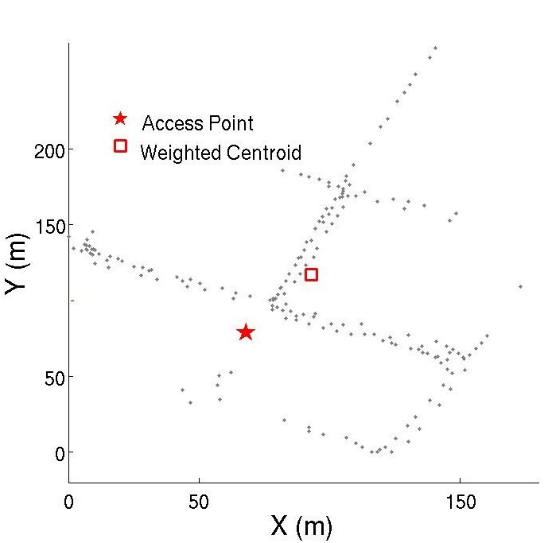
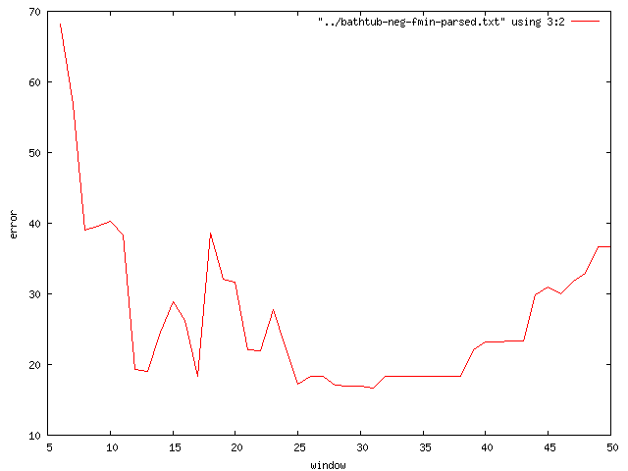
Adaptive window sizing
Start from 1m
Estimate the location of the AP
Increase the window size
Repeat until 5 estimates converge in a 5m area
Window size
wcentroid
Localization error(m)
Gradient Algorithm Stops here
Window size
Notes:
So we vary the window size from 1 and increase it by one, until 5 consecutive estimates converge in a circular region of 5 meter in radius.

Slide 15
Combining Phase
Combines the angular information to locate the AP
Each arrow has some amount of error
Find the location that minimize the weighted squared sum of angular errors
Minimize
Σw_{i}(AngularError_{i})²
where w_{i} = (SNR)_{i}
Angular Error
Optimization problem
Estimated Location
Notes:
Let’s move on to 2nd phase and take a look at how we actually combine the arrows.
When we have the arrows, we would like them to converge at a single location. But they don’t necessarily converge, because each arrow has some amount of error.
But given a location of the access point, we can calculate the error associated to the location. And We pick a location that minimizes the error to locate the AP. The error term we minimize is the weighted square sum of angular errors, and the angular error is defined as the angular difference between the arrow and the estimated location of the AP.
This is just an optimization or search problem, which many tools can solve.

Slide 16
Evaluation: Real-world data collection
Area: Residential neighborhood(Squirrel Hill)
Wardrive pattern: scan both sides of the road 2~3 times travelling at about 20mph
Ground truth (25 AP locations)
SSIDs w/ addr
<12Techview>
SSIDs w/ names
<Johnson>
Known APs
Whitepages.com
Address
GPS coordinates
Adjustment
http://www.cs.cmu.edu/~dongsuh/localization/
Notes:
Let’s now move on to the evaluation. For evaluation, we did measurement in a residential neighborhood in Pittsburgh.
We used that as the location of the AP.

Slide 17
Evaluation
Comparison with alternative methods
Centroid
Weighted Centroid
Trilateration (parameter calculated from ground truth)
Data Set: 25 APs | Gradient | Weighted Centroid | Centroid | Trilateration
Mean Error | 34 m | 39 m | 43 m | 1km
Median Error | 33 m | 38 m | 39 m | 98 m
Maximum Error | 59 m | 89 m | 123 m | 10km
Standard Deviation | 14 m | 20 m | 27 m | 2.7 km
12% improvement in mean, 30% in SD, MAX
over weighted centroid
Notes:
The table shows the mean, median, maximum and sd of error for all 4 algorithms evaluated on the set of 25 Aps. I would like you to note that gradient algorithm has a lot more room for improvement because we only incorporated the basic ideas, and these ideas may be implemented with better techinques.
The gradient algorithm out-performs the alternatives by all 4 standards. Compared to the second best, weighted centroid,
It turns out that

Slide 18
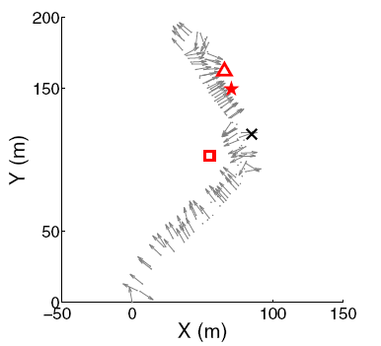
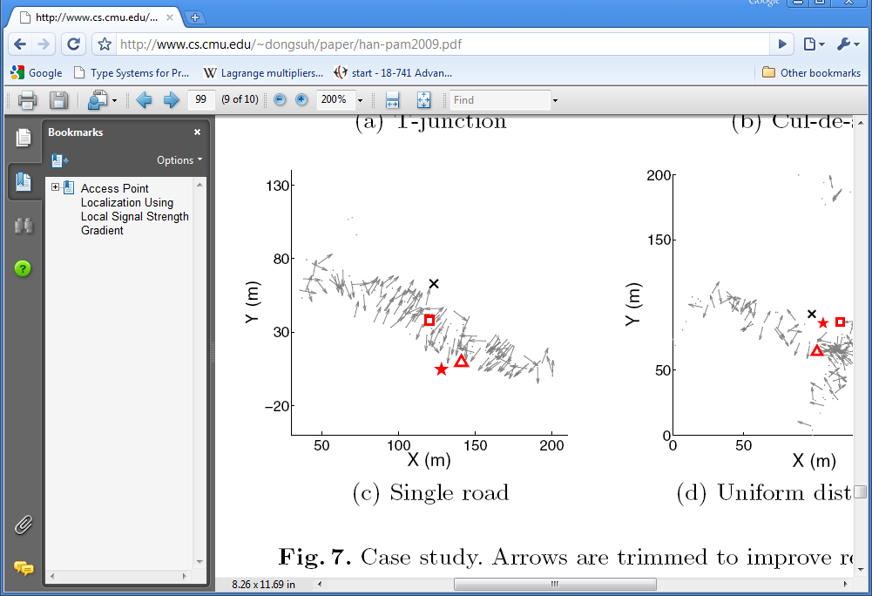
Example Results
Gradient
WCentroid
Access
Point
Gradient
Notes:
Here’s a couple of example where gradient performs particularly better than weighted centroid. Both of these cases exhibit strong sampling bias and non-uniform attentuation. If you look at the signal strength distribution, it’s very skewed towards one side of the access point.

Slide 19
Conclusion
Gradient algorithm extracts directional information from local signal strength variation.
The approach takes advantage of the more fundamental property of signal propagation.
Gradient algorithm is accurate and is robust to systemic biases that occur in the real world.
Gradient algorithm out-performs other algorithms and has a small variance in performance.

Slide 20
Backup slides

Slide 21
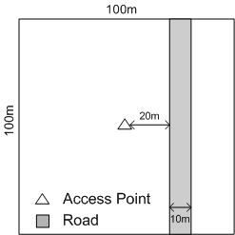
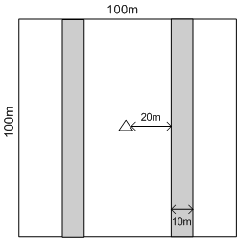
Why Weighted Centroid Fails
Sampling bias
Non-uniform shadowing
-10dB
-30dB
-20dB
>20m error
16m error

Slide 22
Comparison
Notes:
12 % , 33%, 1.4 improvement in sd of error.

Slide 23
Example Results
Gradient
AP
Weighted Centroid

Slide 24
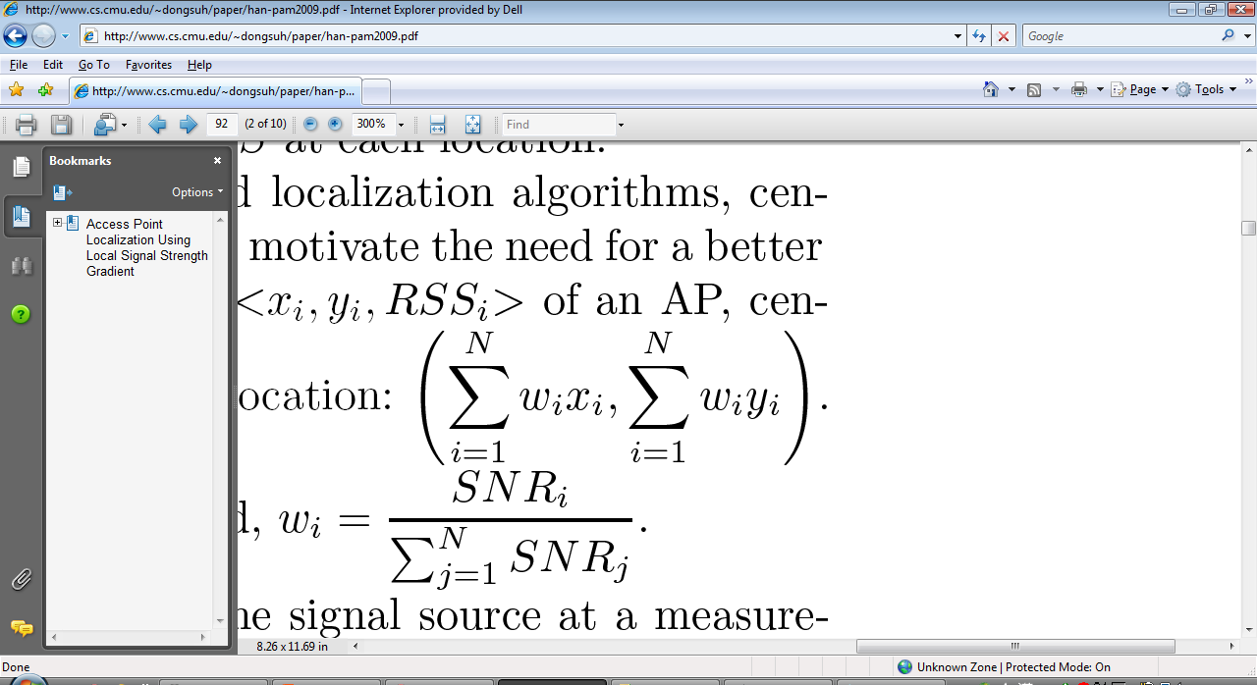
Weighted Centroid
Weighted Averaging
{(x_{i}, y_{i}, RSSI_{i})}
Weights reflect the signal strength
Always locates the AP inside the enclosing area that contains measurement points

Slide 25
Gradient Algorithm- Intuition
Wcentroid
50m error

Slide 26
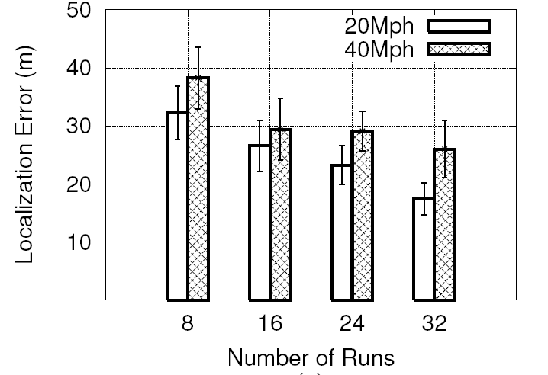
Indirect Comparison
Directional Antenna
Gradient
Data Set: 25 APs | Gradient
Mean Error | 34 m
Median Error | 33 m
Maximum Error | 59 m
Standard Deviation | 14 m
Median 32 m

