Slide 1

RFDump: An Architecture for Monitoring the Wireless Ether
Kaushik Lakshminarayanan
Samir Sapra
Srinivasan Seshan
Peter Steenkiste
Carnegie Mellon University

Slide 2

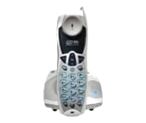
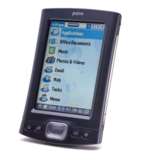
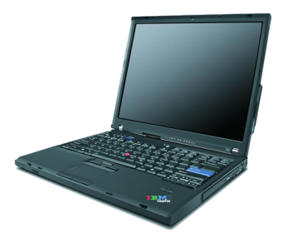
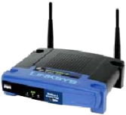
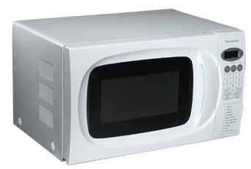
Popularity causes crowding
Wireless – 2.4 GHz ISM band – Unlicensed
802.11, Bluetooth, ZigBee, Microwave oven
Packet
Packet
Packet
Packet
Packet
ACK
How do we troubleshoot such problems?

Slide 3
How do existing sniffers work?
Wired networks
How do we bootstrap in wireless?
Tcpdump, Ethereal
Application
Application
Application
Presentation
Presentation
Presentation
Session
Session
Session
Transport
Transport
Transport
Network
Network
Network
Sniffers
Data Link
tcpdump
802.11 MAC
?
Data Link
NIC
Physical
802.11 NIC
802.11 PHY
802.11+BT+microwave+..

Slide 4

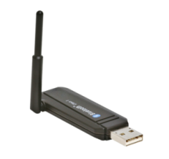
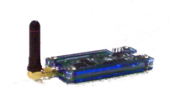
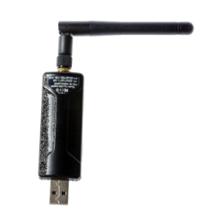
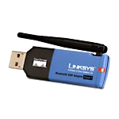
Multi-dongle approach
Cumbersome
Sniffers don’t expose physical layer information
Don’t capture inter-protocol interactions
Application
Application
Presentation
Presentation
Session
Session
Transport
Transport
Network
Network
tcpdump
ZigBee
hcidump
BT MAC
802.11 MAC
802.11
802.11 NIC
802.11 PHY
BluetoothNIC
BT PHY
Bluetooth
How do we enable such fine-grained analysis?

Slide 5
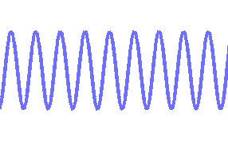
Software-Defined Radio (SDR): An enabler
Analog signal
SDR Hardware
Software
Samples
Exposes physical layer information
Supports programmable analysis modules

Slide 6
SDR: Challenges
ZigBee, Bluetooth, 802.11 or Noise
Analog signal
SDR Hardware
Software
Samples
How do we process 256 Mbps of information?
Real-time
Multi-protocol, Extensibility
How to differentiate between samples?

Slide 7
Outline
Motivation
Design of RFDump
Implementation
Evaluation

Slide 8
A naïve solution: Demodulate all
Protocol Extensible
Real-time
Demodulation is costly
All demodulators process everything!
How to make it more efficient?
802.11 demodulator
802.11 demodulator
Bluetooth demodulator
SDR
ZigBee demodulator
Bluetooth demodulator
… demodulator
SDR
ZigBee demodulator
ZigBee
802.11
… demodulator
Bluetooth
Noise
Demodulator | CPU time
802.11b 1Mbps | 0.6x
Bluetooth | 0.7x
}
5 demodulators → 3x

Slide 9
A better solution: Energy filter
802.11 demodulator
Demodulators do less work
Only when medium utilization is very low
What if medium utilization is very high
Real-time
Need fast demultiplexing
Bluetooth demodulator
SDR
Energy
Filter
ZigBee demodulator
ZigBee
802.11
… demodulator
Bluetooth
Noise

Slide 10
RFDump: High-level idea
802.11 demodulator
Fast detector – map signal to protocol
Protocol extensible
Real-time
Detectors can be faster
Can tolerate false positives
Can tolerate delay
Bluetooth demodulator
SDR
Energy
Filter
Fast detector
ZigBee demodulator
ZigBee
802.11
… demodulator
Bluetooth
Noise

Slide 11
How do we detect protocols?
Packet
MAC-level ACK
Timing
802.11 – Interframe Space (SIFS, DIFS)
Bluetooth – TDD slots
Phase
802.11b 1Mbps – DBPSK
Bluetooth – GMSK
Frequency (Channel width)
802.11b – 22 MHz
Bluetooth – 1 MHz
SIFS
Time
Q
Q
Packet
MAC-level ACK
I
Time
I
SIFS
Constellation
diagram
802.11b
Bluetooth
Frequency
22 MHz
1 MHz

Slide 12
How to make detection fast?
Samples
(fine)
Metadata
(coarse)
802.11
SIFS/DIFS
Start and end of frames
Peak detector
Bluetooth
Slot time
Light-weight
5% real-time
ZigBee
Slot time
Protocol-agnostic
Protocol-specific
Detection stage

Slide 13
RFDump: Putting the pieces together
Timing Analysis
802.11b
(1 Mbps)
Filter
802.11b
(1 Mbps)
demodulator
Yes
802.11 SIFS/DIFS
802.11 demodulator
Peak detector
M
Bluetooth TDD Slot
802.11b
(2 Mbps)
Filter
802.11b
(2 Mbps)
demodulator
ZigBee Slot time
Bluetooth demodulator
SDR
Energy
Filter
Fast detector
Energy
Filter
Energy
Filter
SDR
SDR
Phase Analysis
ZigBee demodulator
Yes
ZigBee
demodulator
DBPSK
ZigBee
Filter
… demodulator
QPSK
BT Filter
Bluetooth demodulator
GFSK
Protocol-agnostic
Protocol-specific
In-depth
analysis stage
Detection stage

Slide 14
Implementation
GNU Radio and USRP SDR platform
Fast detectors – 802.11b (1 Mbps) and Bluetooth
Limited by USRP1 8MHz bandwidth

Slide 15
Evaluation
Are the detectors accurate?
Microbenchmarks (CMU wireless emulator)
Do they have false positives?
Traffic mix (CMU wireless emulator)
Are the detectors fast?
Different loads

Slide 16
Bluetooth detection accuracy
6000 L2CAP pings between 2 Bluetooth nodes
Packet Miss
Rate
Good region
Accurate at low SNRs
SNR (dB)
Very accurate at high SNRs

Slide 17
Traffic mix detection accuracy
Bluetooth and 802.11b 1 Mbps (1000 packets)
Detector | Packet miss rate (%) |  | False positive rate (%)
 | 802.11b | Bluetooth | 802.11b | Bluetooth
Timing | 1.8 | 2.4 | 0.07 | 0.7
Phase | 1.8 | 1.2 | 1 | 0.2
Low packet miss rate
Low false positive rate

Slide 18
How fast is detection?
8 demodulators for Bluetooth, 1 for 802.11
CPU time
Real time
Good region
Medium Utilization (%)
Fast detection even at high loads

Slide 19
Related work
802.11 connectivity diagnosis
ClientConduit (Mobicom ‘04), WiFiProfiler (MobiSys ‘06)
802.11 performance diagnosis (Enterprise networks)
Jigsaw (SIGCOMM ‘06, 07), Wit (SIGCOMM ‘06), DAIR (NSDI ’07)
MOJO (MobiSys ‘06)
Detection
Many – recently, WhiteFi (SIGCOMM ‘09)
SDR Performance
Sora (NSDI ‘09), Split-functionality approach (NSDI ‘09)

Slide 20
Summary
Wireless is ubiquitous
Hard to diagnose protocol/device interactions
Built RFDump tool for monitoring
Efficient (light-weight detection modules)
Accurate
Extensible (SDR)
Scalable (protocol-agnostic detection modules)

Slide 21
Future Work
Extend to USRP 2 to overcome the limitations of USRP 1
Wireless Diagnosis
Interference detection
Interference cancellation
Dynamic Spectrum Access

Slide 22
Timing vs Phase
Phase analysis
More accurate at high SNRs
More expensive than timing
Cannot detect when collisions easily
Timing analysis
More accurate at low SNRs
Very light weight
Cannot detect 802.11 broadcast packets in low contention
Can use signal strength to detect collisions

Slide 23
OFDM
Could not experiment due to 8 MHz constraint
Mix of frequency and phase/amplitude
Subcarriers
Modulation scheme

Slide 24
Evaluation - Accuracy
802.11b Microbenchmark (Wireless Emulator)

