Slide 1
Enabling MAC Protocol Implementations on Software-defined Radios
George Nychis, Thibaud Hottelier, Zhuochen Yang,
Srinivasan Seshan, and Peter Steenkiste
Carnegie Mellon University

Slide 2
Wireless Media Access Control Protocols
No single one-size-fits-all MAC
definition of performance, and how to achieve it, varies greatly
Wireless MACs: extremely diverse
long-haul, mesh, lossy, dense, mobile …
Novel fundamental wireless optimizations:
MIXIT, PPR, Successive IC, ZigZag, …
How can we easily implement diverse MAC protocols and optimizations?
Notes:
- What is the big *hype* about Wireless MACs?
The truth is, accessing the shared wireless medium to achieve the greatest level of performance is application dependent
There is no “one-size-fits-all” MAC that can achieve the greatest performance in every application, how to achieve performance varies greatly by application
long-haul networks need a MAC protocol that is delay insensitive, whereas mobile networks can often define the optimal MAC as a “power” conservation protocol.
Along with this diverse set of MAC protocols, we have seen a recent increase in novel fundamental wireless optimizations proposed such as:
MIXIT, which looks to optimize mesh networks
Partial Packet Recovery for lossy networks
Successive Interference Cancelation for dense networks
and ZigZag for dense networks with hidden terminals
So, with all of this increased activity in wireless protocols, how can we implement a diverse set of MAC protocols?

Slide 3
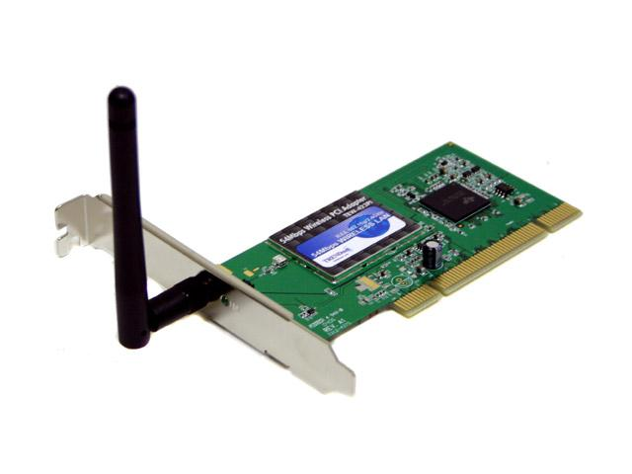
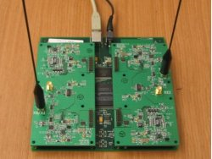
Current MAC Protocol Development
Wireless NICs
Software Radios
High Performance (DSP)
Low cost ($30)
Closed source
most of the MAC
Fixed functionality:
Physical layer, 2.4GHz
Various open source platforms
Fully reprogrammable
and various frequencies!
Higher cost ($700-$10K)
Lower performance (GPP)
large delays
Notes:
there are two common approaches to implementing MAC protocols, the first is the use of Wireless NICs, such as the cards found in your laptop or desktop
NICs achieve a high level of performance by implementing the physical layer on a digital signal processor
and they are extremely low in cost, typically around $30 a card
the first downside to NICs is that they are closed source; although the MAC is implemented in software, we do not have access to it
the second downside is that there is some fixed functionality implemented on the DSP that cannot be changed, such as the PHY
and we cannot change the frequency band of the card, such as 2.4GHz
even if we obtain special rights to access the source code of the MAC, it is often low level microcode specific to the embedded architecture, making it difficult to modify
therefore, the community has begun using software-defined radios for wireless research
the two driving points behind SDRs is that there are various open source platforms
and to make that even more attractive as a claim, the whole physical and MAC layers are implemented in that software we have access to
therefore, the radio is fully reprogrammable and most SDRs provide a large range of frequency bands we can tune to
the downside to SDRs are that they can be higher in cost, ranging from $700 for a USRP and $10K for a WARP SDR
the second downside of SDRs, which we address in this talk, is their lower performance due to the implementation being on a GPP with large delays
- we will come back to this in a few slides

Slide 4

Implementing MACs on SDRs
Various projects using SDRs for evaluation:
MIXIT, PPR, Successive IC, ZigZag …
The above all use GNU Radio + USRP:
“extreme” SDR→ all processing in userspace
great as a research platform (PHY+MAC)
No high-performance MAC protocol implemented on GNU Radio & USRP
Notes:
So, all of the recent wireless optimizations I had mentioned in the opening slide have in fact used software-defined radios for these reasons
In fact, they all use the same SDR: GNU Radio plus the USRP which is considered an “extreme” SDR,
a radio in which all processing, the physical layer and MAC layer, are done in userspace on a GPP
this is a great SDR as a research platform as it is easily modifiable and developed in a high language: C++
GREAT! A platform easy to develop on and fully flexible, but as soon as one starts to look in to develop a MAC protocol, they quicly realize that there has been no high-performance MAC implementation on the platform
this immediately raises a red flag that MAC implementations, even on the easy-to-develop extreme SDR, is in fact challenging

Slide 5
Outline of the Talk
Why MAC implementation on SDRs is challenging
How to overcome SDR limitations, enabling high-performance and flexible MAC implementations
A novel approach: Split-functionality API
Present evaluation of the first high-performance MACs on an extreme architecture
Implications and Conclusions
Notes:
So as an outline for the rest of my talk, I am going to explain why MACs are challenging in software-defined radios
I am then going to present a novel approach: a split-functionality API, that enables high-performance and flexible MAC implementations
to provide confidence to this approach, we implement the first high-performance MACs on an extreme SDR architecture using the proposed API
I will then provide implications of our API and how it can be applied to other architectures, and then conclude the talk

Slide 6

“Extreme” SDR Architecture
CS
SIFS
DIFS
ACK-TO
802.11
<10μs
10μs
28μs
22μs
25μs
1ms
Medium
Simply packing the
samples takes too
long for an ACK!
negligible
25μs
+
15ns
120μs
Userspace
Modulation,
Framing
+
ADC
FPGA
Bus (USB)
Kernel
Front End
Antenna
DAC
Notes:
So, as promised, I am going to describe why high-performance MAC implementations are challenging on SDRs
to do so, I’m first going to describe the architecture from the bottom up
as shown, the medium has a continuous signal being transmitted
this signal is fed in to the frontend which takes approximately negligible time
approximately 15ns for a discrete sample of the medium to enter the FPGA
approximately 25us for the same to be packed in to a block with other samples
then 120us across a USB bus, 25us through the kernel, and 1ms max to userspace based on scheduling
if we consider the timing requirements of a CSMA protocol like 802.11, simply packing the samples in to a block in the FPGA takes longer than the ACK timeout period
we haven’t even gotten to the host to demodulate yet!
This shows that the architecture is clearly too high in delay to run the MAC solely in userspace for performance reasons

Slide 7
Solutions to Bypass Delay
Common: move the layers closer to the frontend
WARP: PHY+MAC on the radio hardware
SORA: PHY+MAC in kernel, core ded., SIMD, LUT
Completely viable solutions, but:
costly (hardware is more complex, WARP: $10K+)
can require special toolkits (e.g., XPS)
requires embedded architecture knowledge
portability and interface (SIMD, PCI-E)
Notes:
There have been several solutions to bypass this delay, the most common being the movement of the layers closer to the front end
the WARP SDR moved both the PHY and the MAC on to the radio hardware for performance reasons
SORA, which was the previous talk, moved the PHY and MAC to the kernel, used core dedication and other techniques to increase performance of the physical layer
These are all completely viable solutions to the problem, but there are a couple things to think about:
First: the more complexity we add to the hardware, such as moving the MAC and PHY to it, the greater the cost is going to increase
A single WARP board costs $10k, which the professors in the room might have to start sacrificing us poor students for
Second, when working on the hardware, it is likely to require special toolkits and embedded architecture knowledge
Lastly, wide use of SIMD instructions is low-level and in the future not going to be portable, as the new Intel and AMD ISA support for SIMD instructions are no longer compatable, for example
But again, these are extremely viable solutions

Slide 8
An Alternate Solution
Split-functionality approach, break all core MAC functions (e.g., carrier sense) in to 2 pieces:
1 small piece on the radio hardware (performance)
1 piece on the host (flexibility)
Then, develop an API for the core functions
logical control channel and per-block metadata
per-packet control of the functions & hardware
applicable to other SDR architectures
Notes:
We are presenting an alternate solution, one that can enable high-performance MAC implementations even on an extreme architecture, with inexpensive SDR hardware, such as the USRP at $700 a board (more grad students you can keep!)
The approach we take, is a split-functionality approach
We break all core MAC functions (such as carrier sense), in to two pieces:
One small piece on the hardware for performance reasons, and I say small such that we do not increase complexity and therefore cost
And one piece that runs on the host for flexibility of the platform
We then develop an API for implementing the core MAC functions, and ensure per-packet control of the functions and the radio hardware
to do so we implement a logical control channel, and per-block meta-data which will be seen in the following slides
as I will describe throughout the talk, the API is applicable to other SDR architectures, such as Sora

Slide 9
Indentifying the Core MAC Functions
Random Backoff
Building blocks of MAC protocols:
carrier sense
precision scheduling
backoff
fast-packet detection
dependent packet generation
fine-grained radio control
Difficult to claim that any list is correct and complete
reasonable first “toolbox”
Power Control
SIFS/DIFS
SIFS/DIFS
ACK
Synchronization
Synchronization
MIMO
MIMO
Frequency Hop
Guard Periods
Slot Times
Rate Adaptation
Beacons
Beacons
Carrier Sense
Notes:
The first challenge in our approach is determining what are the correct set of core mac functions, or building blocks, to enable the implementation of current and novel MAC protocols
On the right side, I have compiled a small list of techniques used by various MAC protocols
From these techniques, we determine a first set of buildings blocks which enables high-performance MAC implementations
These are:
carrier sense, precision scheduling, backoff, fast-packet detection, dependent packet generation, and fine-grained radio control
It is extremely difficult to claim that any list is correct and complete, but we believe this is a reasonable first toolbox, which we provide some confidence in by implementing two high-performance MAC protocols
I am going to talk about two of these functions in detail, and the rest I refer you to our paper for
The first I am going to talk about is precision scheduling

Slide 10
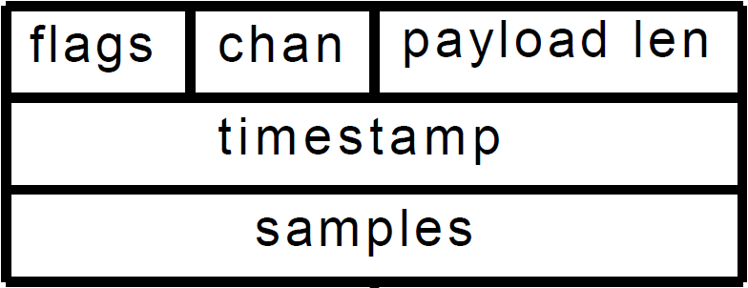

Precision Scheduling
Split-functionality API approach:
Scheduling on the host (flexibility)
Triggering on the hardware (performance)
requires a lead time that varies based on architecture
+
FPGA
clock
samples/bits/packet
Data
Bus (USB)
Timestamp=?
clock
Host Machine
Radio Hardware
Notes:
The way we implement precision scheduling using a split-functionality API is as follows
We first introduce per-block meta-data with samples in our architecture, but architecture independent this could be bits, or a full packet
we maintain flexibility by keeping the actual scheduling mechanism at the host, allowing the host to use the timestamp field to specify a precise time it wants the data to be transmitted
The block is sent across the bus and the radio hardware will inspect the per-block meta-data, and transmit the data when the clock is equal to the timestamp
The thing to note about this mechanism is that it requires a lead time for the data to be ready and scheduled, this will vary by architecture, but is approximately a millisecond on an extreme SDR, and microseconds on an architecture like SORA

Slide 11
Precision Scheduling
Split-functionality API approach:
Scheduling on the host (flexibility)
Triggering on the hardware (performance)
requires a lead time that varies based on architecture
Average measured error in TX scheduling using GNU Radio and USRP:
Split-func.
Kernel
Host
Precision
125ns
35μs
1ms
Notes:
To determine the greater precision achieved in scheduling, we continue to use our split-functionality mechanism, but we place the trigger in various locations:
We move it to the kernel for comparison, and to the host for comparison also
We then measure, with nanosecond precision, the variation from the target transmission time, and the actual transmission time
The average error measured for the host based mechanism is approximately 1ms
The average error measured from the kernel is approximately 35us, this varies from the SORA measurement because of buffering needed by the USRP to achieve greater bandwidth
And finally, our split-functionality mechanism achieves 125ns precision on the USRP
This is extreme precision in an SDR without sacrificing flexibility for protocol implementation

Slide 12
Revisiting the Core MAC Functions
Building blocks of MAC protocols:
carrier sense
precision scheduling
backoff
fast-packet detection
dependent packet generation
fine-grained radio control
Difficult to claim that any list is correct and complete
reasonable first “toolbox”
Notes:
so, I’ve described how we implement precision scheduling to maintain performance and flexibility
I am now going to talk about one more mechanism, fast-packet detection

Slide 13
Fast-Packet Detection
Goal: accurately detect packets in the hardware
The longer it takes to detect a packet, the longer a response packet takes (dependent packet)
Can be used to trigger pre-modulated DPs (ACKs)
Demodulate only when necessary (CPU intensive)
provides host confidence of a packet in the stream
not only detect a packet, but that it is for this radio
Can be used in other architectures:
SORA: used to trigger core dedication
Kansas SDR: battery powered, reduces consumption
Notes:
The main goal of fast-packet recognition is to accurately detect packets in the hardware, why do we want to do this?
The driving reason for this is:
The longer it takes to detect a packet, the longer it takes to generate a response to it, which we call a dependent packet
If it takes 100ms to simply detect a DATA packet, how can we even come close to generating an ACK within 22us?
We develop a mechanism from this for triggering fast pre-modulated dependent packets from the hardware, such as ACKs, which is detailed in the paper
Finally, this can be used for several other things.
It can be used to only demodulate when necessary since demodulation is very CPU intensive
This also provides confidence to the host that a packet is in the incoming stream of samples
It can be taken further to not only detect a packet, but that the packet is destined for the attached host’s MAC address. This is like power squelching plus plus. (power_squelching++;)
As I mentioned, we believe that our API can be useful to other architectures. For example:
It can be used in SORA’s architecture to trigger core dedication and save processing
The Kansas SDR is battery powered for field experimentation, and this can reduce power consumption

Slide 14
Fast-Packet Detection in Hardware
Perform signal detection using a matched filter
optimal linear filter for maximizing SNR
widely used technique in communications
flexible to all modulation schemes
cross-correlation of unknown & known signals
Incoming
sample stream
Modulated
framing bits
Notes:
To perform fast packet detection in hardware, we adopted a technique from the communications community called a matched filter
It is the optimal linear filter the maximizes the SNR to perform cross-correlation between an unknown and known signal
The unknown signal is the incoming signal, or sample stream
The known signal in our scenario is the modulated framing bits, such that we are correlating the unknown signal with the waveform representation of the framing bits

Slide 15
Packet Detection Host Setup
+
Modulator (GMSK)
x[t]
Framing Bits
01100110101
t
known signal
Host
Notes:
again, the maintain flexibility the host has full control over the split-functionality mecehanisms
To setup the matched filter, we provide an API, however I discuss the details here.
The host takes the framing bits, as shown, and passes them to the modulator which produces a discerete timeseries signal of the modulated framing bits
These samples are saved and considered the known signal for which we will perform correlation on

Slide 16
Packet Detection in Hardware
Radio Hardware (RX)
+
Matched Filter
unknown
Trigger
smpls
+
Yes
corr.
No
Host
known
FPGA
Notes:
For performance reasons, the second part of the matched filter is implemented on the radio hardware
The host configures the matched filter by sending the known signal over the control channel we implement, and then the receiver fills the unknown signal with the incoming sample stream
These samples are passed to a triggering mechanism which drops them until a match is found
The matched filter convolves the unknown signal with the known signal to produce a correlation score
if this correlation score exceeds a threshold, the trigger begins transferring samples to the host for demodulation
however, this trigger can also be used to generate pre-modulated dependent packets on the radio hardware, which you can find details of in the paper

Slide 17
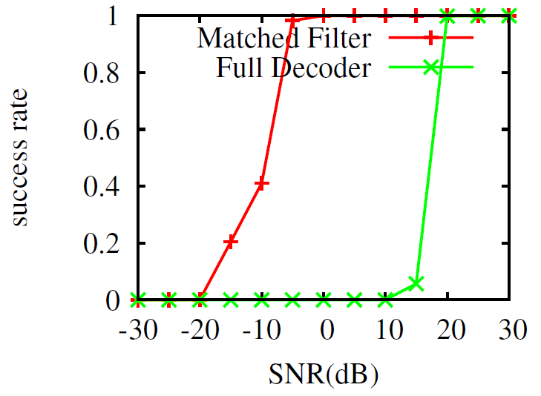
Fast Packet Detection Accuracy
Simulation: detect 1000 data packets destined to the host in varying noise using GMSK and the mfilter
Confirmed in real world (in paper)
100% accuracy detecting frames
<.5% false detections (i.e., falsely claiming an incoming packet)
Notes:
To determine the accuracy of the matched filter, ensuring that since we are using it to trigger samples to the host, that it does not miss-detect incoming packets
we perform a simulation in which we vary the SNR and measure the success rate of the matched filter versus the full decoder at detecting 1000 frames using the GMSK modulation scheme
On the X-axis we have the SNR in terms of dB, and on the y-axis the success rate. If the method detects all 1000 frames, it has 100% success
The most important property of this graph is that the curve for the matched filter is significantly separated from that of the full decoder, and that it is to the left of it.
this means that the matched filter can detect incoming packets in very high noise conditions, when even the full decoder will not be able to detect it
Therefore, the matched filter is an accurate mechanism for triggering demodulation
To provide further confidence in this, we perform a real world experiment, which can be found in our paper, in which the matched filter is 100% accurate in detecting incoming frames, and has less than a .5% false detection rate, which is when it falsely claims there was an incoming packet
To summarize the matched filter, it is an extremely accurate technique for detecting incoming frames that can be used for fast-dependent packet generation from the hardware, for triggering demodulation, and for us in other architectures such as SORA for triggering core dedication.

Slide 18
Revisiting the Core MAC Functions
Building blocks of MAC protocols:
carrier sense
precision scheduling
backoff
fast-packet detection
dependent packet generation
fine-grained radio control
… details in the paper!
Notes:
So, I’ve described our precision scheduling and fast-packet detection mechanisms. For details of carrier sense, backoff, dependent packet generation, and fine-grained radio control, I refer you to our paper.

Slide 19
Putting it all together…
Core MAC functions and the split-functionality API implemented on GNU Radio & USRP
“The proof is in the pudding” – we implement two popular MACs
802.11-like and Bluetooth-like protocols
shows ability in keeping flexibility
used to evaluate total performance gain
Notes:
OK, so we’ve implemented all of the core MAC functions using the split-functionality API on GNU Radio and the USRP, an extreme SDR which has suffered from it’s ability to support high-performance MACs
So, the saying goes: “the proof is in the pudding” … that was actually a comment made by an earlier reviewer of our work: show us the MACs
We implement two popular MACs on the architecture: an 802.11-like and Bluetooth-like protocol, which shows the feasibility of our approach at enabling MAC protocols, and we will show results for our total performance gain.

Slide 20
CSMA 802.11-like Protocol
Uses the following core functions:
Carrier sense, backoff, fast-packet recognition, and dependent packets
Compare host based-implementation to split-functionality implementation
host implements everything in GNU Radio (GPP)
Cannot interoperate with 802.11 due to limitations of the USRP, but possible with USRP2
Notes:
Our 802.11-like implementation uses the following core functions:
Carrier sense, backoff, fast-packet recognition, and dependent packets
We compare our split-functionality implementation with a host based implementation, where everything is implemented on the host processor
We call this an 802.11-LIKE implementaiton because it cannot interoperate due to limitations of the USRP, but we believe (and are exploring) an implementation on the USRP2

Slide 21
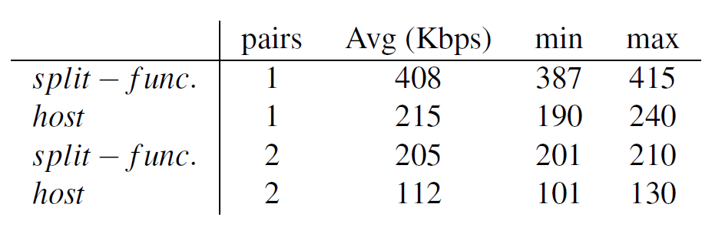
802.11-like Protocol Evaluation
USRP (SDR board) configuration:
Target bitrate of 500Kbps
Use 2.485GHz, avoid 802.11 interference
Ten transfers of 1MB files between pairs of nodes
Notes:
To evaluation the protocol, we configure the USRP to use a bitrate of .5Mbps, and 2.485GHz so as to avoid 802.11 interference. This is so that our results are not dependent on external interference
We perform ten 1MB file transfers between a pair of nodes, where a pair is 2 nodes: a sender and receiver
We find that the split-functionality approach achieves close to the theoretical maximum channel capacity given the MAC protocol and the physical layer, by achieving 408Kbps
One might initially think: this isn’t high performance. It’s not about the maximum bit-rate: that’s the performance of the physical layer. it’s about the ability of the MAC protocol to achieve its theoretical capacity given the physical layer. .5Mbps is a limitation of the PHY processing, which we believe techniques from SORA, such as core dedication can help improve.
As we increase the number of pairs, we believe that the gap between performance will begin to increase significantly, given that the host-based carrier sense mechanism will begin failing.

Slide 22
TDMA Bluetooth-like Protocol Design
TDMA-based protocol like Bluetooth:
Construct piconet consisting of a master & slaves
Slaves synchronize to a master’s beacon frame
650µs slot times
Compare split-functionality to host-based again
Bluetooth-like since the USRP cannot frequency hop at Bluetooth’s rate
Notes:
Now, I move on to the evaluation of our TDMA-based protocol: a Bluetooth-like implementation
Like bluetooth, we construct a piconet consisting of a master and slaves
A master would be similar to your cellphone, whereas a slave would be the bluetooth headset
We compare our split-functionality approach to a host-based approach again.
The protocol is bluetooth-like since the USRP cannot frequency hop at Bluetooth’s rate

Slide 23
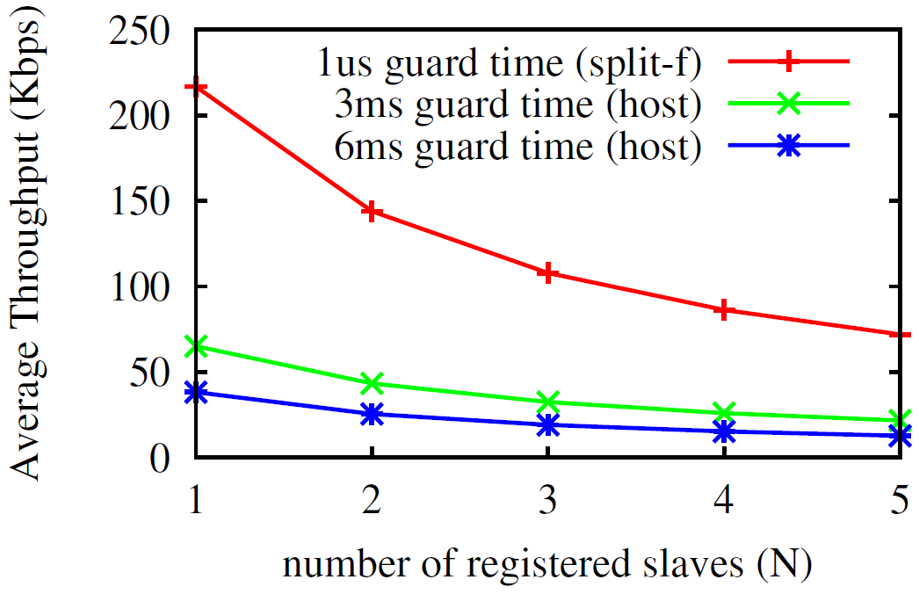
Bluetooth-like Protocol Evaluation
USRP: target bitrate of 500Kbps
Perform ten 100KB file xfers
Vary number of slaves
Vary guard time (needed to account for scheduling error)
Notes:
In our experiment, we configure the USRP to a target bitrate of 0.5Mbps again.
We perform ten 100KB file transfers, varying the number of slaves (such as the number of headsets) and vary the guard times needed to account for scheduling error.
Guard times are used in TDMA protocols to account for synchronization error, where a node cannot precisely transmit in to its time slot. In our paper, we show that this maximum error can be up to 9ms at the host
On the X-axis we have the number of slaves (e.g., nodes in the network) … and the Y-axis is the average throughput
By achieving tighter synchronization using the precision scheduling and backoff mechanisms implemented by our split-functionality API, we are able to again achieve close to the theoretical maximum capacity, and approximately 4x the throughput of the host-based implementation
However, I remind you that the importance is not the 4x throughput, that it was our ability to achieve close to the theoretical maximum capacity of the network given our wireless MAC and the physical layer.
This is a significant improvement, which further shows the feasibility of achieving greater performance from our API

Slide 24
Conclusions
The API developed enables a split-functionality approach:
maintains flexibility & performance
aspects applicable to other architectures
Identified core MAC functions suitable as a first “toolbox” that can be extended
First to implement high-performance MACs on an extreme SDR such as GNU Radio & USRP
Notes:
-In conclusion, we have presented an API which enables a split-functionality approach.
This approach maintains both flexibility and performance, and aspects of it are applicable to other architectures such as SORA
We also identified a first set of core MAC functions that can be further extended to increase the support of MAC implementations
Finally, we were the first to implement high-performance MACs on an extreme SDR such as GNU Radio and the USRP
Questions?

