Slide 1



Wifi-Reports Improving Wireless Network Selection with Collaboration
Jeffrey Pang (CMU)
Ben Greenstein (Intel Research Seattle)
Michael Kaminsky (Intel Research Pittsburgh)
Damon McCoy (University of Colorado)
Srinivasan Seshan (CMU)
Notes:
In this talk I will discuss how users can make better decisions about the wireless networks they use through collaboration.
This is joint work with Ben G and Michael K at Intel Research, Damon M at CU and my advisor srini.

Slide 2
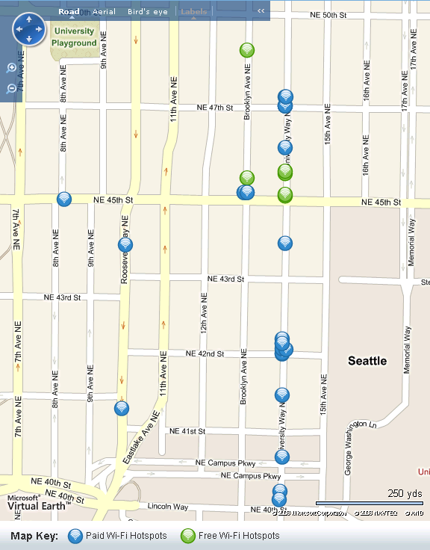
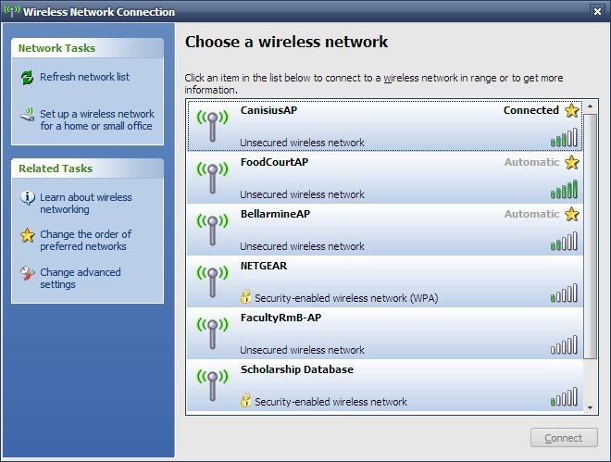

Problem: Commercial AP Selection
Jiwire.com
Hotspot database
$9.99
tmobile
$3.99
attwifi (ap 1)
Quality = ???
attwifi (ap 2)
linksys
Free!
seattlewifi
Free!
Free Public Wifi
Which networks will run my applications?
Which ones have good performance?
We often have many choices of wireless access points (APs), but little information about each
Notes:
Many of us have been in the situation where we are in a new area and want to find wireless connectivity. We might do this by looking up hotspots in a directory service like Jiwire.com. Or we might just open up our laptop and see lots of wifi access points or APs. But today, we can’t know the performance that we will get at these hotspots before we go to them and even then, we may have to pay money first. This is because we can only see the quality of the wireless link, not its backhaul connectivity or if it rate-limits users. Only then might we determine whether or not that the AP that we selected has poor performance or blocks our applications.

Slide 3
Goal: Provide More Information
Improved
Hotspot database
Bandwidth: 300 kbps Blocked ports: None
Bandwidth: 100 kbps Blocked ports: None
Bandwidth: 30 kbps Blocked ports: Email
tmobile
Bandwidth: 300 kbps Blocked ports: None
attwifi (ap 1)
Bandwidth: 100 kbps Blocked ports: None
Doesn’t work!
attwifi (ap 2)
Bandwidth: 300 kbps Blocked ports: None
Doesn’t work!
linksys
Doesn’t work!
Bandwidth: 100 kbps Blocked ports: Email, Skype
Bandwidth: 300 kbps Blocked ports: None
seattlewifi
Bandwidth: 5 Mbps Blocked ports: None
Free Public Wifi
Doesn’t work!
Doesn’t work!
Bandwidth: 300 kbps Blocked ports: None
I need to use VoIP so this is the best network for me
Doesn’t work!
Provide information about AP performance and application support
Notes:
Our goal in this talk is to provide users with more information. That is, we would like to annotate hotspot directories with performance information about each AP. In addition, if users cache part of this directory while mobile, we would like them to accurately determine the performance information about APs that are visible so they can pick the best one.

Slide 4
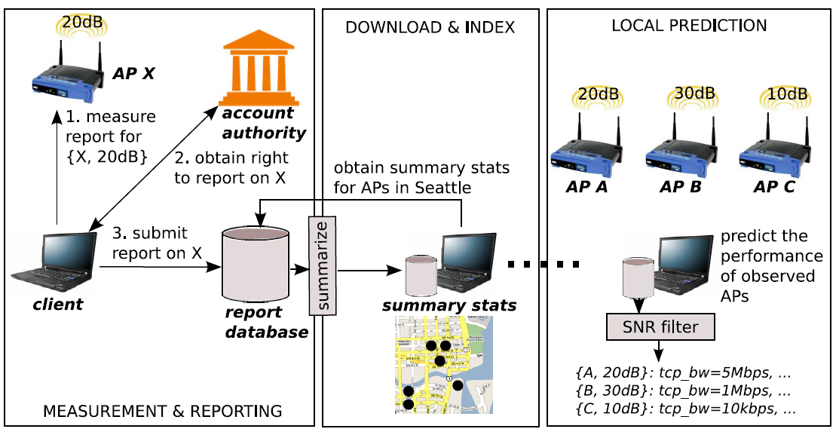
Goal: Wifi-Reports
Users automatically report on APs that they use
Notes:
One way to provide this information is to have users that use APs submit reports about them to a database. Future users can then obtain this information to predict their performance.
Our goal is to build such a system which we call wifi-reports. In such a system, first a client would measure the APs that he uses. Then, he would login to the service via an account authority, like Google. This account authority would give him the right to submit the report to a database where all reports would be summarized.
Future users can download and cache these summaries, like with the iPass hotspot client today. Then they can find the best APs nearby.

Slide 5







Design Challenges
Bob’s Report on AP5
Bandwidth: 300 kbps
Bob’s Report on AP3
Doesn’t work!
Bob’s Report on AP4
Doesn’t work!
Mallory’s Report on AP4
Bandwidth: 10 Mbps
Mallory’s Report on AP4
Bandwidth: 10 Mbps
Mallory’s Report on AP4
Bandwidth: 10 Mbps
Mallory’s Report on AP4
Bandwidth: 10 Mbps
Mallory’s Report on AP4
Bandwidth: 100 Mbps
Bob’s Report on AP2
Doesn’t work!
Bob’s Report on AP1
Doesn’t work!
Location Privacy: Authority/databases cannot link a user’s reports
Limited Influence: Only count 1 report per AP, per user
Location Context: Account for wireless channel conditions
Notes:
Any such reporting system raises several challenges.
First, because the use of an AP implicitly reveals a location where a user has been, if a user’s identity is attached to reports then they may worry that the account authority or database can track them, or that a third party that compromises the database can track them. Since we don’t want to disincentivize users from participating, we would like to reassure them that they can not be tracked and their location privacy will be protected. To do this, we need to ensure that a user’s reports can’t be linked together.
Second, since we are relying on users to submit reports, we also need to limit the influence of some users that might be malicious. For example, the owner of a hotspot might submit lots of reports that say it is great even if it is not. One way to limit influence would be to make sure that each user can only submit one report per AP.
Finally, since we are dealing with wireless APs, location and channel conditions will affect measured performance. So we need to take these conditions into account.

Slide 6
Talk Overview
Motivation
Why use reports? A measurement study
Wifi-Reports design
Wifi-Reports evaluation
Notes:
So there are a lot of practical challenges in building a system like this.
Therefore, the first thing we look in this talk is whether collaborative reports are needed at all. We performed a measurement study to see if commercial hotspots actually vary in performance. Second, I will describe the design of wifi-reports and how we can overcome these design challenges. Finally, I will present an evaluation of wifi-reports that demonstrates its practicality.

Slide 7
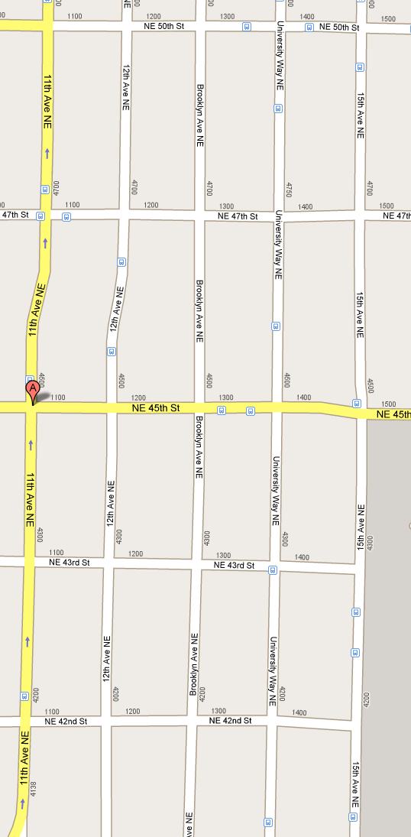
Would Reports be Useful?
Measurement Study
We built a Linux reporting client
Measures bandwidth, latency, etc.
We measured all APs visible from:
13 hotspots in the U-District, Seattle, WA
7 days at different times of day
Measurement procedure:
Sit near center of hotspot
Perform active measurements
shinka tea
tullys 1
starbucks 1
lounjin
yunnie bubble tea
oasis
tullys 2
sureshot
trabant
bookstore
Our study examines pay-for-access
networks and open networks
cafeontheave
starbucks 2
cafesolstice
Notes:
Reports would obviously only be useful if selecting the best AP isn’t already obvious given available information. Se to see whether these properties are true, we performed a small measurement study in one popular commercial district in Seattle over one week. We build a Wifi-Reports measurement client and then used it at each of 13 actual hotspots shown on this map. Note that unlike previous studies which typically measured only open access points using wardriving, we also measure all the pay-for-access networks that were visible.

Slide 8
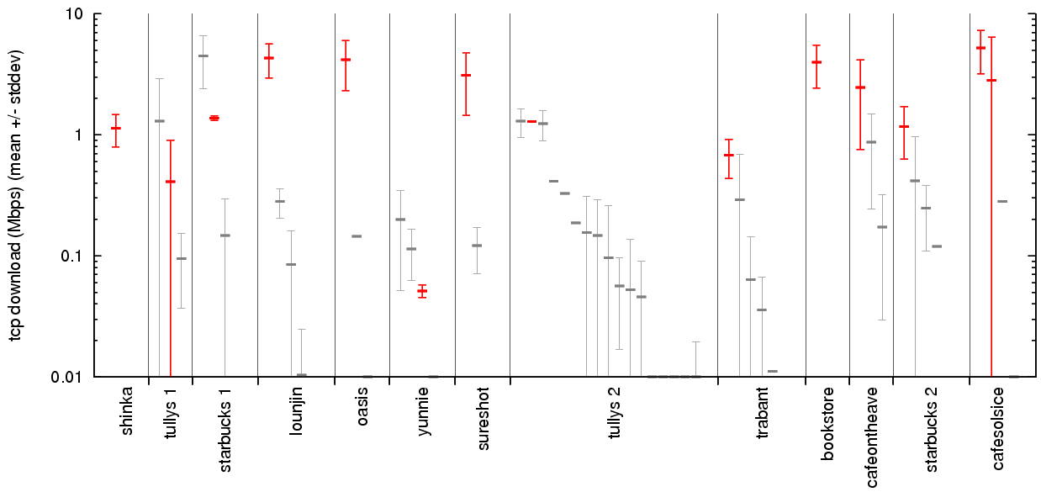
There is a Large Selection of APs
Bandwidth of commercial APs in Seattle (by location)
red = “official” AP
grey = other visible AP
Notes:
Here is one of the results from our study. The x-axis shows the locations where we performed our measurements. Each point shows the mean bandwidth of an AP that was measured at that location, the red point being the “official” AP for that hotspot. The error bars show one standard deviation. The first thing we notice is that there is a large selection of APs, even at a single location. Most locations have 3 or more choices.

Slide 9
There is a Variance in Performance
Bandwidth of commercial APs in Seattle (by location)
red = “official” AP
grey = other visible AP
Notes:
The second thing we notice is that there is a large variation in AP capacity, and this is mostly due to the capacity of the backhaul link or rate limiting. Even among just the official APs that we highlight here, the average bandwidth differs by almost 2 orders of magnitude.

Slide 10
The “Official” AP is not Always Best
Bandwidth of commercial APs in Seattle (by location)
red = “official” AP
grey = other visible AP
Notes:
Despite this we found that selecting the “best” AP to use is not always obvious. For example, even if we already chose a location to sit down at, at some locations, the official AP does not give the best performance. At the locations highlighted here, there is another AP that offers substantially better performance.

Slide 11
Most APs are not Open or Free
Bandwidth of commercial APs in Seattle (by location)
red = “official” AP
grey = other visible AP
Notes:
Unfortunately most of the APs are “pay-per-access” so users could not test APs beforehand without paying money. So choosing an AP blindly is probably going to result in sub-obtimal performance.

Slide 12
Measurement Summary
Measurement study of hotspots in Seattle
13 locations in one district over 1 week
Finding the best AP is non-trivial:
Large selection: 4 hotspot APs at each location, on average
Variable performance: AP bandwidth differs by up to 50x
Not obvious: official AP is not best at 30% of locations
Not testable: most APs cost money to use
⇒ Need historical data to choose the best AP
Notes:
So to summarize: We found that selecting the best AP to use is non-trivial because there is a large selection, they vary in performance substantially, the official AP is not always the best, and often, users cannot even test AP performance before paying money. So having historical reports help users make much better selections.

Slide 13
Talk Overview
Motivation
Why use reports? A measurement study
Wifi-Reports design
Wifi-Reports evaluation
Notes:
So given that we’d like to collect reports, I’ll now describe how we can address the design challenges I mentioned earilier to building such a system.

Slide 14
Design Requirements
Mallory’s Report on AP4
Bandwidth: 10 Mbps
Mallory’s Report on AP4
Bandwidth: 10 Mbps
Mallory’s Report on AP4
Bandwidth: 10 Mbps
Mallory’s Report on AP4
Bandwidth: 10 Mbps
Mallory’s Report on AP4
Bandwidth: 100 Mbps
Location Privacy: Authority/databases cannot link a user’s reports
Limited Influence: Only count 1 report per AP, per user
Location Context: Account for wireless channel conditions
Notes:
If we want to build a a report collection system then, we need to deal with the three challenges I mentioned at the beginning of the talk: how we can guarantee to users that their location privacy will be respected, how we can also limit the influence of individual users, and how we can take into account location context.

Slide 15



Threat Model
Account authority obeys protocol
violations can be detected
Prevents large-scale sybil attacks
e.g., signup requires credit card
e.g.,
Most clients are honest
Location Privacy: Authority/databases cannot link a user’s reports
Limited Influence: Only count 1 report per AP, per user
Location Context: Account for wireless channel conditions
Notes:
To meet the first two conflicting goals, we make three assumptions.
First, we assume that the account authority obeys the protocol I will describe, since violations can be detected.
Second, we assume that the account authority can prevent a single user from obtaining many different accounts. This might be done by requiring a hard to forge credential such as a credit card number. This solution is imperfect, but supports many reputation systems today.
Finally, we assume that most users are honest. That is, they just download our measurement client and automatically measure and report on APs that they use.

Slide 16

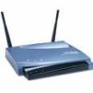
Straw men Protocols
Alice’s locations:
cafe1
tmobile #3 Bob’s Network Alcohol Anon Net
CMU
…
authenticate Alice
Location Privacy
submit: R
If Alice has already submitted
a report on cafe1 then abort,
else save the report
measure cafe1
Anonymous
Report on cafe1
Bandwidth: 5 Mb
Anonymous
Report on cafe1
Bandwidth: 100 Mb
Anonymous
Report on cafe1
Bandwidth: 100 Mb
Anonymous
Report on cafe1
Bandwidth: 100 Mb
Anonymous
Report on cafe1
Bandwidth: 100 Mb
Anonymous
Report on cafe1
Bandwidth: 100 Mb
Anonymous
Report on cafe1
Bandwidth: 5 Mb
submit: R
mix network
R ← report on cafe1
Limited Influence
Notes:
Given these assumptions, we first try some simple protocols. The first thing we might try is to submit the reports over a mix network…

Slide 17



Report Protocol
starbucks2
List of all APs
cafe1
cafe2
cafe1
cafesolstice
tmobile #4
AT&T #54
⋅⋅⋅⋅
…
authenticate and
download list of APs
{k_{cafe1}, k⁻¹_{cafe1}} ← new key pair
Blind the token k_{cafe1} ⇒ T_{blind}
{k_{cafe2}, k⁻¹_{cafe2}} ← new key pair
…
request: cafe1, T_{blind}
If Alice requested cafe1 before
then abort
else sign the token ⇒ S_{blind}
reply: S_{blind}
Unblind the signature ⇒ S_{cafe1}
measure cafe1
submit:
cafe1, S_{cafe1}, k_{cafe1}, R, S_{R}
Report on cafe1
Bandwidth: 5 Mbps
Report on cafe1
Bandwidth: 5 Mbps
Verify the signatures
Delete old reports signed with k_{cafe1}
mix network
R ← report on cafe1
Sign the report ⇒ S_{R}
Notes:
To achieve both properties, we need to do something less obvious. First we assume that the account authority has a list of APs in the system. We can build this list and update it in the same way that hotspot directories build their lists today, e.g., by having the owners of hotspots add them.
Now, at some point either before or after using APs, Alice logs in and downloads the list.
For each AP in the list…
For clarity, we’ll just look at the token for cafe1, we do the same thing for each one she generates. The idea is that we require alice to sign reports for cafe1 with this token. To achieve…
To get these properties with respect to the account authority… Alice blinds the token…
The account authority signs the token but makes sure Alice can only request one token for cafe1. Although cafe1 is revealed in the request, the AA has no information about what it just signed.
Alice unblinds…
Then when Alice wants to submit a report…
Of course, all this can be done automatically by a software client.

Slide 18
Report Protocol
authenticate and
download list of APs
{k_{cafe1}, k⁻¹_{cafe1}} ← new key pair
Blind the token k_{cafe1} ⇒ T_{blind}
request: cafe1, T_{blind}
If Alice requested cafe1 before
then abort
else sign the token ⇒ S_{blind}
cafe2
cafe1
reply: S_{blind}
Unblind the signature ⇒ S_{cafe1}
Location Privacy
Limited Influence
measure cafe1
Report on cafe1
Bandwidth: 5 Mbps
Report on cafe2
Bandwidth: 5 Mbps
submit:
cafe1, S_{cafe1}, k_{cafe1}, R, S_{R}
Verify the signatures
Delete old reports signed with k_{cafe1}
mix network
R ← report on cafe1
Sign the report ⇒ S_{R}
Notes:
Remember, Alice will get tokens for many different APs. The protocol achieves location privacy because the properties of the blind signature scheme ensure the account authority doesn’t know the actual value of the tokens each user has. The mix network prevents the database from determining who submitted which report. However, we still get limited influence because when requesting a token, a user names the AP it is for. Thus, even though the account authority doesn’t know what the token is, it can still regulate the number of tokens each user gets for each AP. And the database can determine which reports are signed with the same token.

Slide 19

Report Protocol
authenticate and
download list of APs
shinkatea
starbucks2
Problem: Asking for a token reveals the target AP
Solution: Ask for the tokens for all APs in a city
tullys
cafe1
request: cafe1, T_{blind}
UW
cafe2
…
reply: S_{blind}
APs in Seattle
measure cafe1
Report on cafe1
Bandwidth: 5 Mbps
Report on cafe1
Bandwidth: 5 Mbps
Report on cafe1
Bandwidth: 100 Mb
submit:
cafe1, S_{cafe1}, k_{cafe1}, R, S_{R}
Problem: Some users may submit bad reports
Solution: Robust summary functions (e.g., median)
mix network
Notes:
There are two details that we still need to deal with. First, obviously if Alice only requests tokens for APs that she visits, then the account authority still learns this information. So, instead, Alice requests tokens for all the APs in each city that she visits. This can be done before or after actually using APs. So the authority learns which cities she visits, but not any specific location.
Second, even malicious users can get one token for an AP. So we need some way to filter out these bad reports. To do this, the database can use summary functions that are robust to outliers, such as the median function for real valued metrics.

Slide 20
Design Requirements
Accounting for:
Signal quality
Report SNR
Time-of-day
Report time
Traffic contention
[Sundaresan 06]
[Vasudevan 05]
…
⇒ lots of summaries for each AP!
Location Privacy: Authority/databases cannot link a user’s reports
Limited Influence: Only count 1 report per AP, per user
Location Context: Account for wireless channel conditions
Notes:
To achieve the last goal, accounting for location context, there are a number of parameters that we might have to take into account when recording reports and formulating summaries. For example, to account for signal quality and noise, we can use the recorded signal-to-noise ratio or SNR to distinguish reports. To account for time-of-day effects, we can include the time in reports and use it to distinguish different summaries. Previous work shows how we can account for traffic contention caused by other wireless traffic by overhearing it.
While all of this could be done, it would mean that we need lots of different summaries for each individual AP, one for each different location context.

Slide 21

Design Requirements
Empirically, coarse SNR is good enough
(see paper for details)
Loss rate
SNR
Location Privacy: Authority/databases cannot link a user’s reports
Limited Influence: Only count 1 report per AP, per user
Location Context: Account for wireless channel conditions
Notes:
Fortunately, we found in our measurement study that just accounting for coarse signal conditions is good enough. That is, it is well known that the SNR-to-loss curve looks like this. So we basically want to differentiate between these three SNR regions.
To do this, we include the SNR in reports and have the database estimate the different regions for each AP.

Slide 22
Wifi-Reports: Other Details
Adding & removing APs
AP changes over time
Rate limiting reports
AP spoofing attacks
Eclipse attacks
Side-channel attacks
Collusion attacks
See paper
for details
Notes:
There are a number of other details I don’t have time to describe in this talk, such as how wifi-reports handles other types of attacks. But you can refer to our paper or ask me afterward.

Slide 23
Talk Overview
Motivation
Why use reports? A measurement study
Wifi-Reports design
Wifi-Reports evaluation
Notes:
Finally, I will present a subset of our evaluation results that shows that wifi-reports is practical.

Slide 24
Do Reports Improve AP Selection?
Hotspot databases (e.g., JiWire.com)
Obviously more useful with more information
What about selecting APs at a fixed location?
Traditional approaches: “official” AP, test all open APs [Nicholson 06], best SNR, etc.
Evaluate using our measurement study:
Question: Which approach predicts the best AP? (best = highest bandwidth, see paper for other metrics)
Ground truth = measurements at each location
Reports = measurements excluding the one being tested
Notes:
The first question we obviously ask is whether reports actually improve AP selection. Obviously, hotspot databases annotated with performance information would be more useful. But what about the traditional AP selection problem? Suppose we already sat down at a location; can reports help in this case? We compare wifi-reports to traditional approaches such as selecting the “offical” AP, actively testing all open APs and using the best, using the AP with best SNR etc. We would like to determine which approach predicts the best AP most often. To perform this evaluation, we used our measurement study to simulate the ground truth and reports that are submitted to wifi-reports.

Slide 25
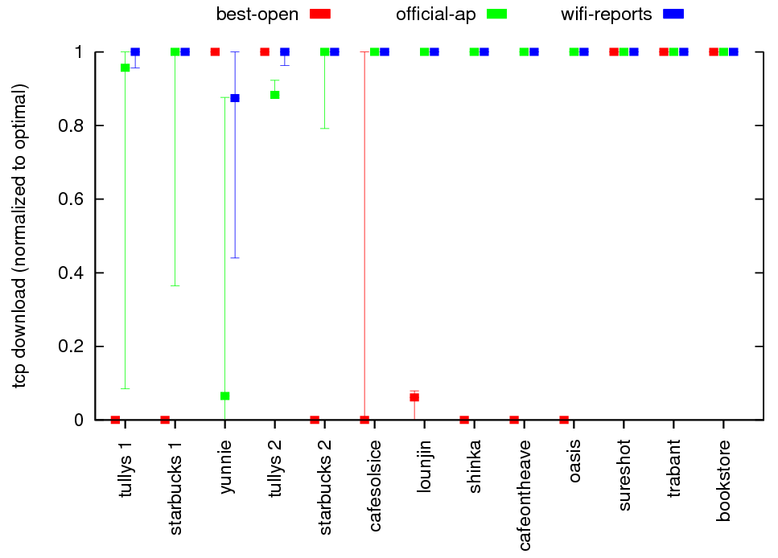
Reports Improve AP Selection
3rd quartile
Throughput (normalized to optimal)
median
1st quartile
Each error bar =
6-13 experiments
at each location
over 7 days
Location
Notes:
Here we are showing the throughput that each selection strategy achieves at each location in our measurement study. The y-axis shows the throughput achieved, normalized to the optimal, that is, if we had future knowledge about which AP was best. Remember that we have multiple measurements at each location, so the error bars here show the middle two quantiles of the bandwidth achieved over time. This graph only compares three approaches for brevity, but we compare against more in the paper.
The first thing we note is that testing all open APs and using the best one quite often doesn’t give us an AP to use at all. This is because in many cases, there is no open AP to use.
Second, always using the official AP performs better in most cases. But in some cases, shown here on the left, even the official AP achieves substantially subobtimal performance, sometimes by an order of magnitude.
In contrast, wifi-reports almost always achieves the optimal. Only at one location is it often subobtimal, but it still does better than choosing the official AP.

Slide 26
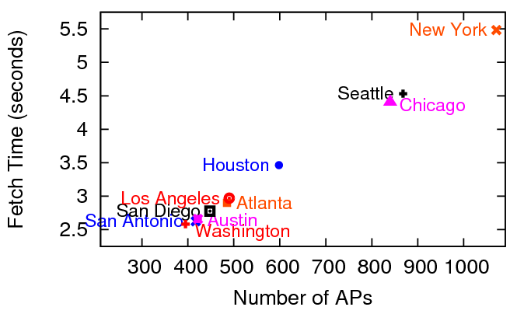
Overhead and Robustness
What is the overhead of obtaining tokens?
Implementation on single CPU server
Hotspot density estimated from JiWire.com
0.02 cents/city/user on Amazon EC2
Overhead is small.
Notes:
Our privacy preserving protocol obviously has some overhead. That is, the first time a user wants to report on an AP in a city, he has to fetch tokens for all the APs in that city. This graph here shows the time it takes to compute and download those tokens for the cities with the most APs, according to an existing hotspot directory. We see that even for the most dense city, New York, the overhead is only several seconds. Furthermore, we could parallelize the computation to make it faster --- the cost of doing this, say on Amazon’s EC2 compute service, would only cost 0.02 cents per user.

Slide 27
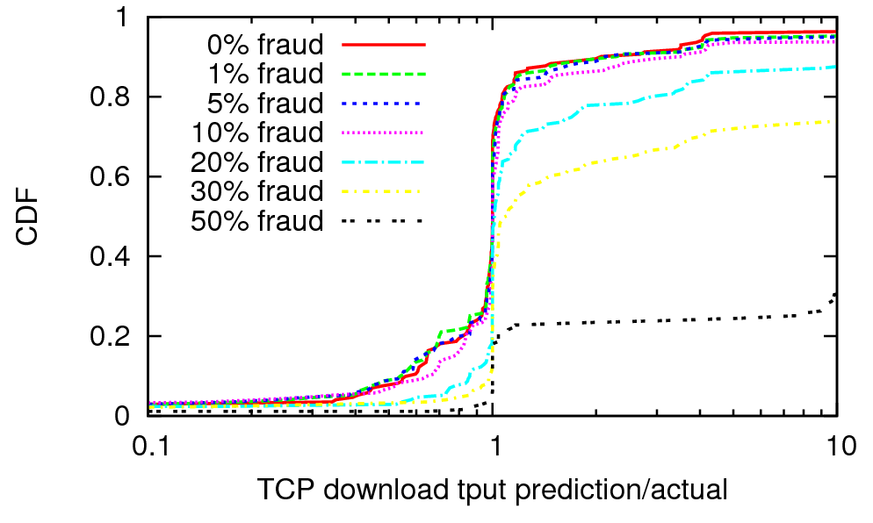
Overhead and Robustness
What is the overhead of obtaining tokens?
How robust are predictions to fraud?
ideal distribution
Implementation on single CPU server
Hotspot density estimated from JiWire.com
0.02 cents/city/user on Amazon EC2
Ground truth = measurement study
Fraud = report AP has infinite bandwidth
Overhead is small.
Robust to 10% fraud.
Notes:
Next we look at prediction accuracy in the face of fraud. That is, we simulate bad guys trying to boost the predicted bandwidth of an AP by saying that it has infinite bandwidth. This graph here shows how accurate predictions are as we increase the number of fraudulent reports for an AP. The x-axis shows the ratio of predicted and actual throughput, using our measurement study as the ground truth. If there was no fraud, we could get the red line, where our predictions are almost perfect 60% of the time.
But we see that even if 10% of reports are fraudulent, the distribution of ratios is still nearly identical, so even a simple summary function like median is robust to this amount of fraud in practice.

Slide 28
Summary & Future Work
Key results:
Selecting the best commercial APs is not easy
Using historical reports is close to optimal
We can obtain reports while preserving privacy, limiting fraud, and adjusting for channel conditions
Future work:
Wifi-Reports client for handsets
Wifi-Reports as a general urban sensing platform
Wifi-Reports data and tools:
http://www.cs.cmu.edu/~jeffpang/research.shtml

Slide 29
=== BACKUP ===

Slide 30
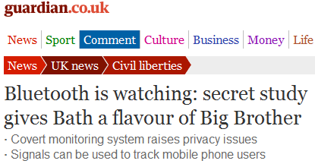
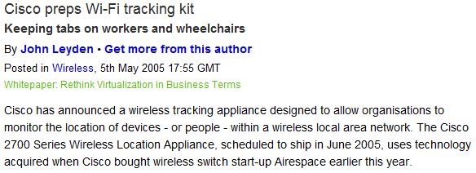



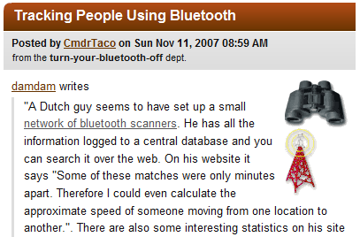
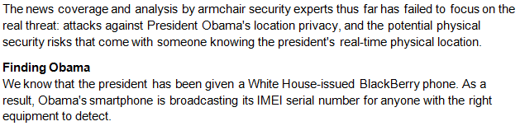
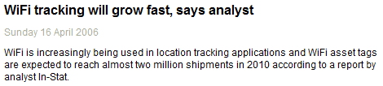


Location Privacy Threats
Notes:
These threats have recently drawn much concern because practically anyone can setup a surveillance network or location service to track users. We argue that the threats will only grow in the future as we become more dependent on wireless devices, location based services, and their use while mobile.

Slide 31




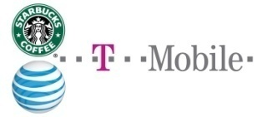




Who Should Care About Tracking?
End-users
CRA Grand Challenge: “Give computer end-users privacy they can control”
Service providers
Location databases can be compromised by third parties (e.g., AOL search debacle)
Device manufacturers
Privacy concerns about tracking can hurt sales (e.g., Intel CPUID debacle, Benetton RFID boycott)
Notes:
Now, there are obviously other ways that we can be tracked, for example by cell phone companies or by web pages. However, in each of these circumstances, we are trading our privacy for some useful service. Tracking by unknown eavesdroppers is concerning because we can not control who gets our information.
This should concern end-users just like they are concerned with web bugs tracking their web browsing habits. Service providers should be concerned because even if they protect their customer’s data, they can’t prevent other parties from tracking them while using their networks. And finally, history has shown that tracking concerns can hurt sales of products such as when Intel added a unique ID to their CPUs or when Benetton added radio identifier tags to their clothing.

Slide 32
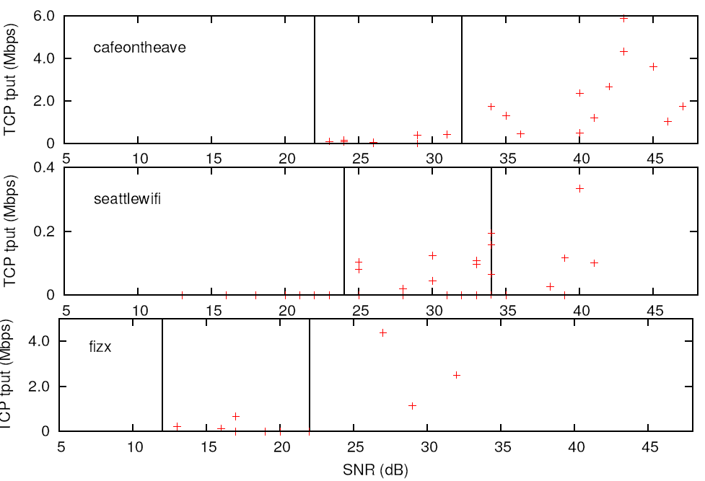
Estimating SNR Loss Regions
10 dB
Use throughput to estimate relative loss
Assume intermediate loss region is 10 dB
Find the “best fit” for the three regions
throughput
SNR (dB)
Loss rate
SNR
Notes:
We can have clients explicitly measure loss, but we found that using throughput measurements to estimate relative loss worked good enough as well. So to estimate these different regions, we took a very straight forward approach: we assume the intermediate loss region is 10 dB wide and then find the “best fit” for the boundaries between the regions.
A more sophisticated algorithm could do better, but we found that this simple approach worked good enough. By only distinguishing conditions by these three SNR regions, we only need three summaries per AP. Of course, for the few APs that have performance that varies substantially in other dimensions, the database can generate additional summaries to account for those as well, at the cost of some storage overhead.

Slide 33
Wifi-Reports
List of all APs
cafe1 = K_{cafe1}
…
cafe1
cafe1
cafesolstice
tmobile #4
AT&T #54
⋅⋅⋅⋅
{K_{cafe1}, K⁻¹_{cafe1}} =
official key pair for cafe1, …
authenticate and
download list of APs
{k_{cafe1}, k⁻¹_{cafe1}} ← new key pair
r ← random()
T_{blind} ← blind(K_{cafe1}, H(k_{cafe1}), r)
request: cafe1, T_{blind}
If Alice already requested cafe1
then abort, else:
S_{blind} ← sign(K⁻¹_{cafe1}, T_{blind})
reply: S_{blind}
S_{cafe1} ← unblind(K_{cafe1}, S_{blind}, r)
verify(K_{cafe1 ,} S_{cafe1}, H(k_{cafe1})) = 1
measure cafe1
database
submit:
cafe1, S_{cafe1}, k_{cafe1}, R, S_{R}
Report on cafe1
Bandwidth: 5 Mbps
Report on cafe1
Bandwidth: 5 Mbps
verify(K_{cafe1 ,} S_{cafe1}, H(k_{cafe1})) = 1
verify(k_{cafe1}, S_{R}, H(R)) = 1
Delete old reports signed with k_{cafe1}
send over mix network
R ← new report on cafe1
S_{R} ← sign(k⁻¹_{cafe1}, H(R))

Slide 34
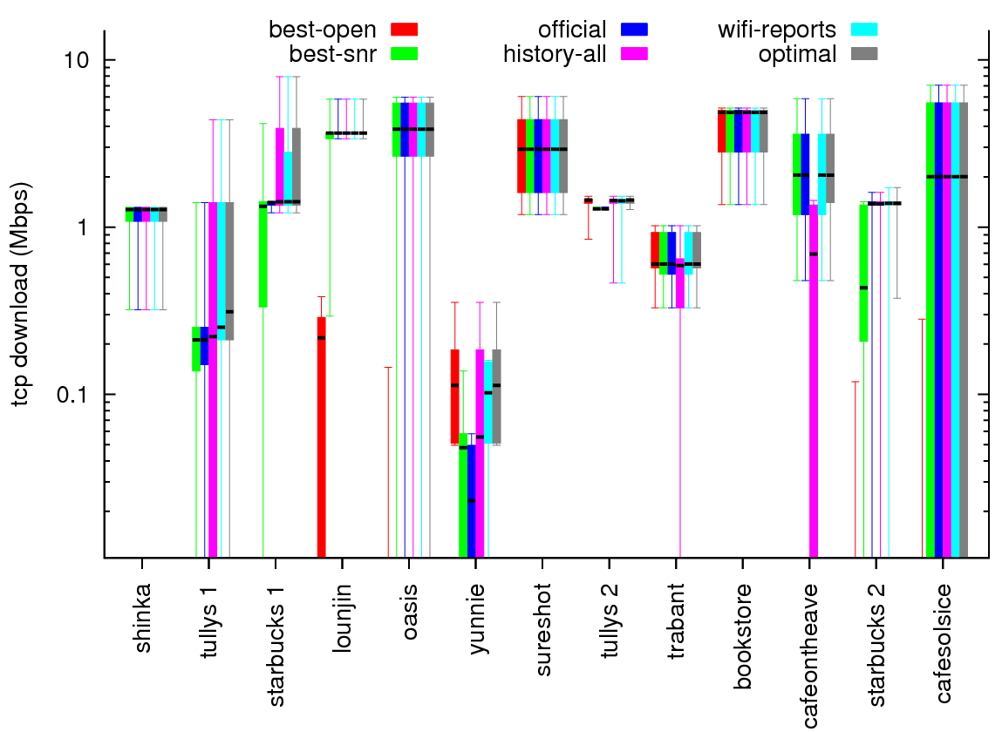
Reports Improve AP Selection

Slide 35
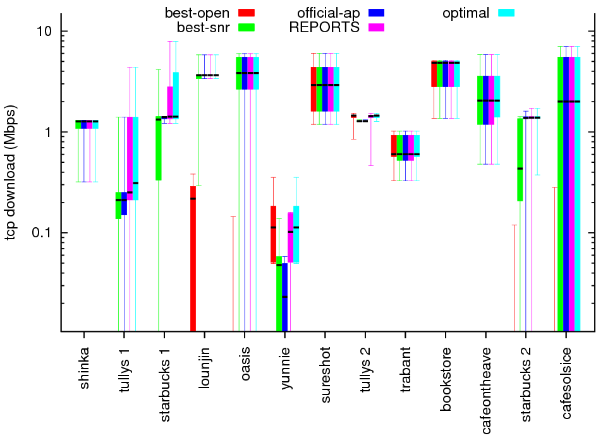
Using Reports Improves Selection

Slide 36
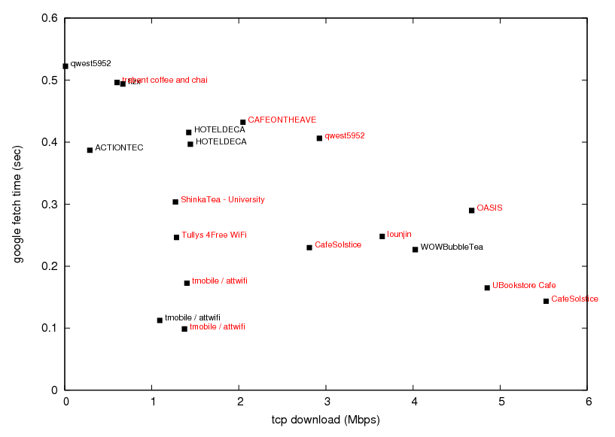
No AP is the Best in All Metrics
Better
Better bandwidth
Mean Google latency (sec)
Better latency
Mean Throughput (Mbps)
Better

Slide 37
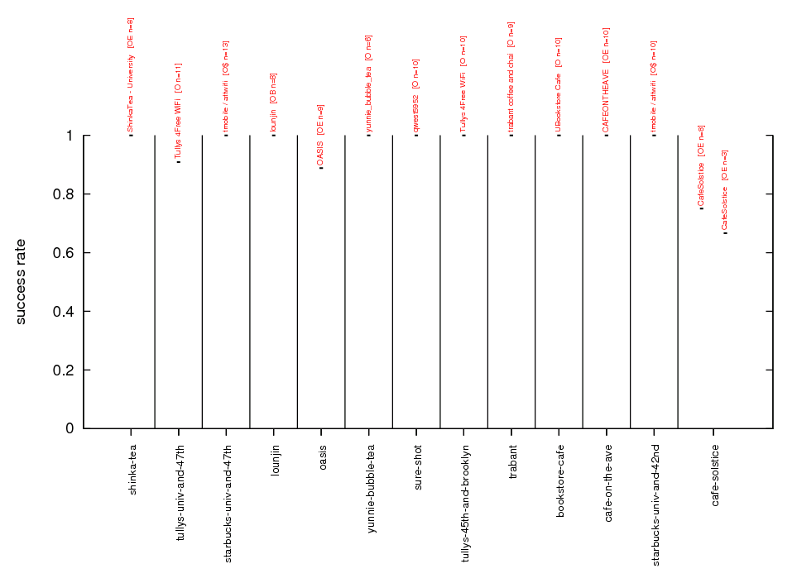
Results: Are there many APs?
Better

Slide 38
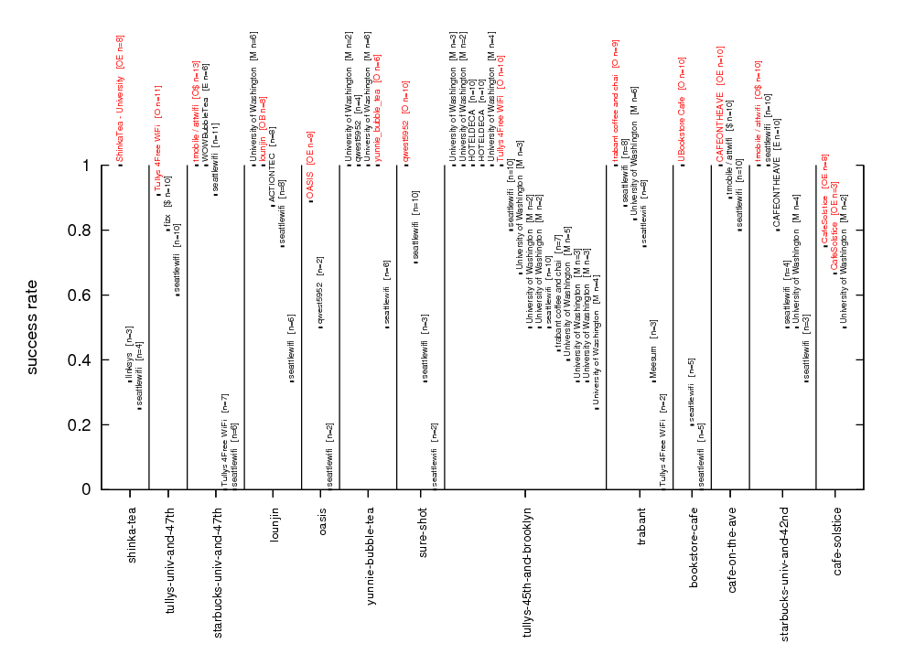
Results: Are there many APs?
Better

Slide 39
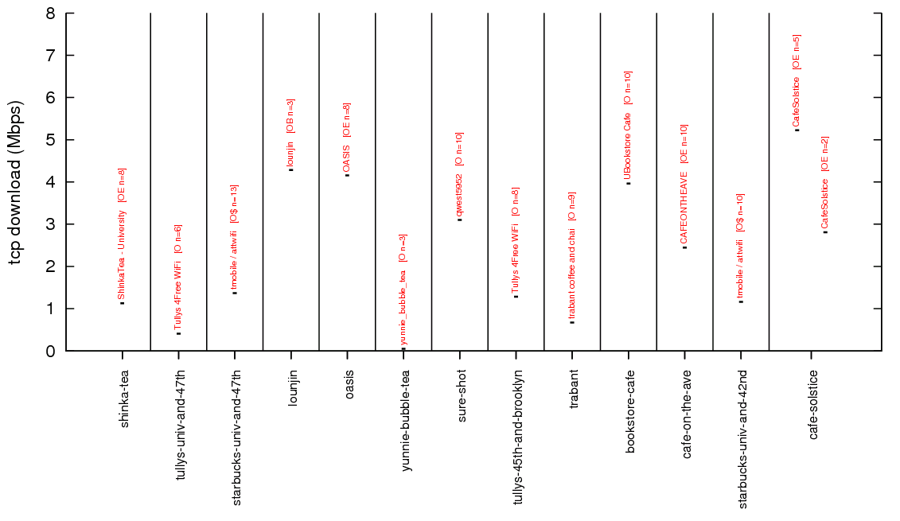
Results: Is there diversity?
Better

Slide 40
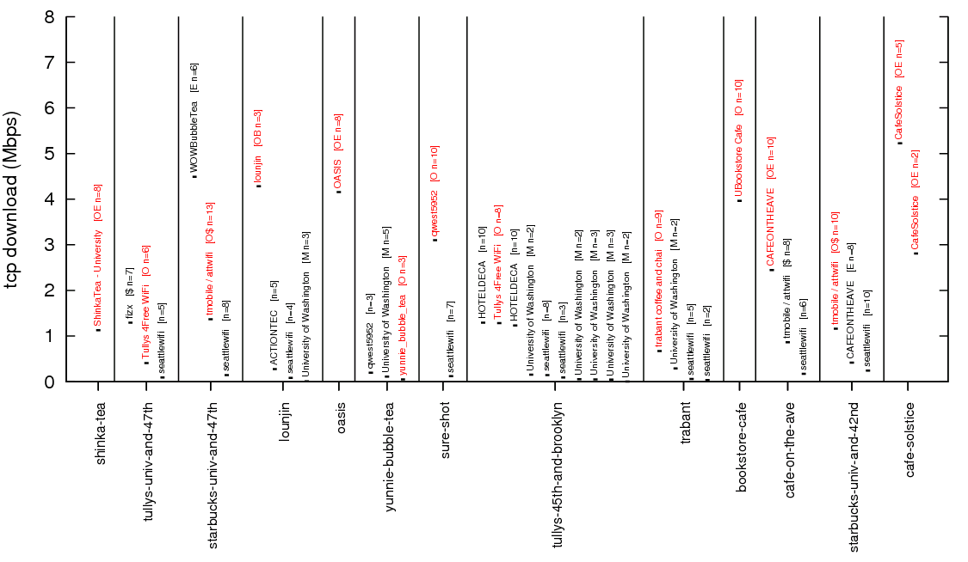
Results: Is there diversity?
Better

Slide 41
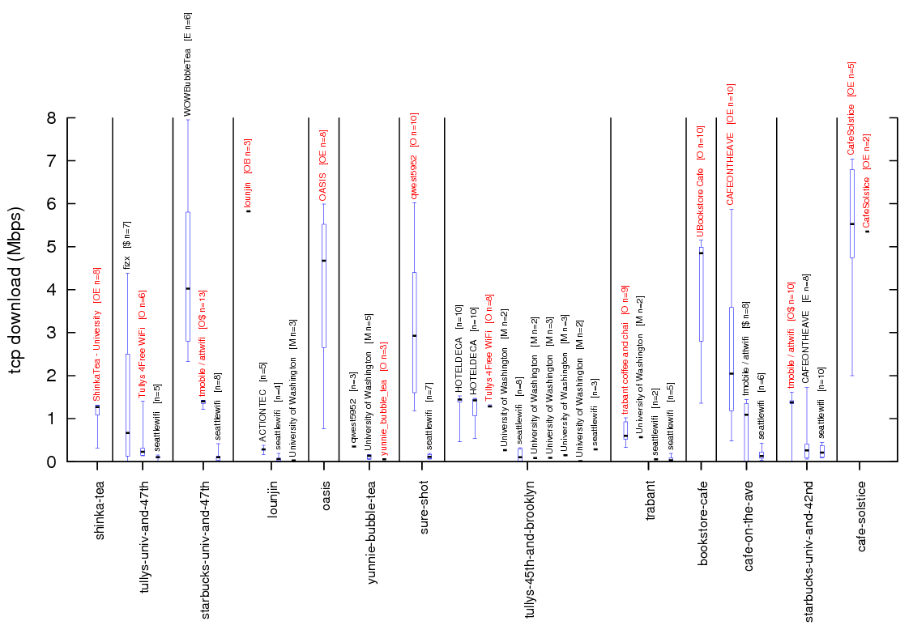
Results: Are measurements predictive?
Better

Slide 42
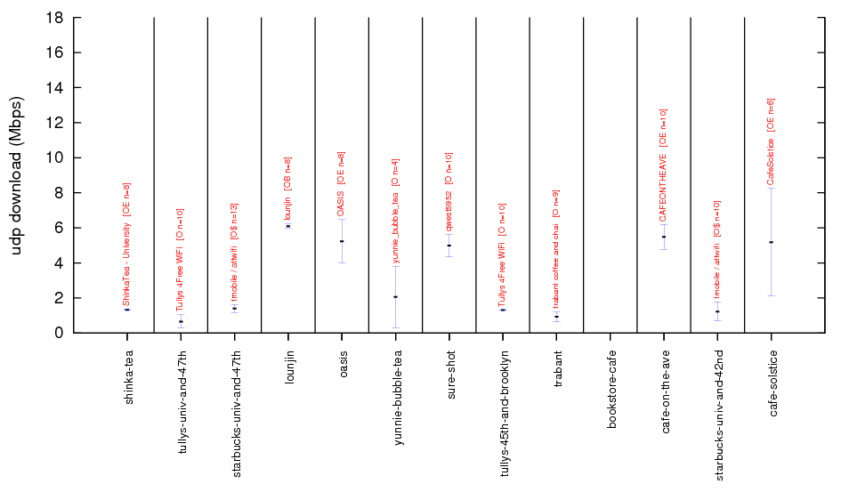
Results: Is there diversity?
Blocked port = no measurement
Better

Slide 43
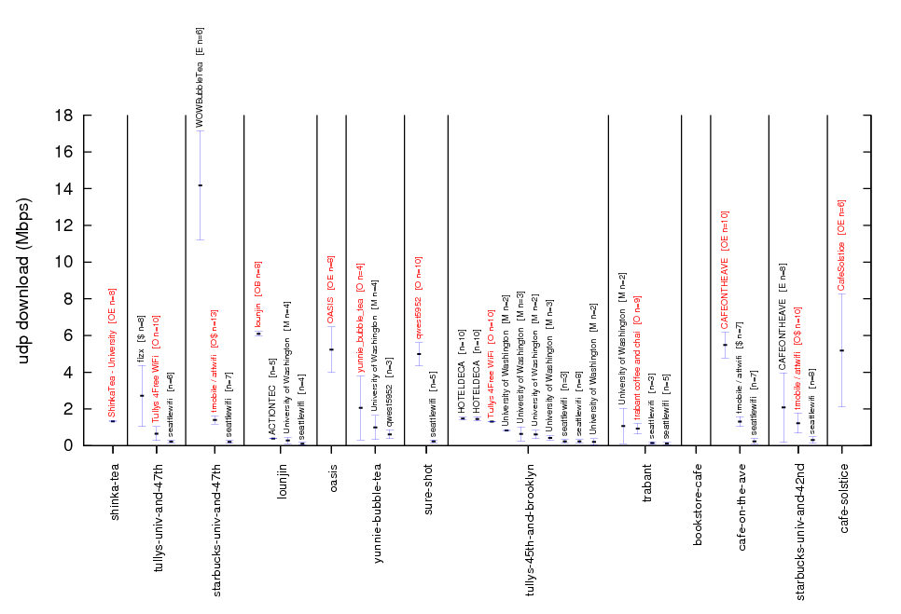
Results: Is there diversity?
Blocked port = no measurement
Better

Slide 44
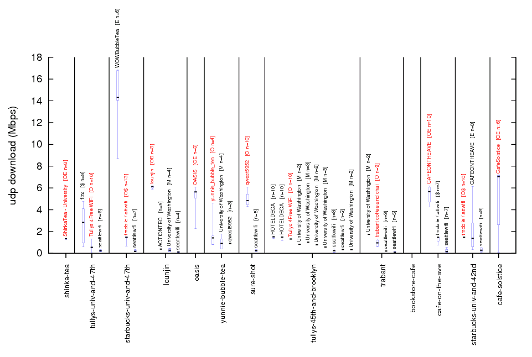
Results: Are measurements predictive?
Blocked port = no measurement
Better

Slide 45
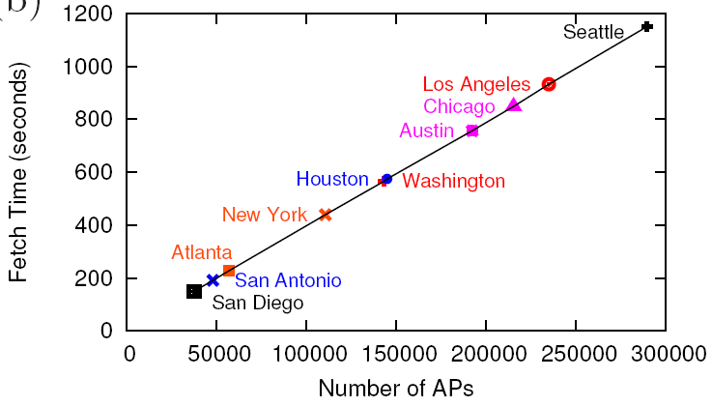
Fetch time for all WiGLE APs
Cost is 2 cents/city/user if we include all APs

Slide 46
=== OLD SLIDES ===

Slide 47

Goal: Use Collaborative Reports
community uploads
measurement reports
Bandwidth: 30 kbps Blocked ports: Email
Reports
Database
Bandwidth: 5 Mbps Blocked ports: None
members download
summary statistics
Notes:
Our goal is to try to remedy this situation by using collaboration. That is, if users that use these APs submit reports about their performance, say, using an automated tool, then future users can download summaries of these reports and make better decisions.
Fix titles.
Design requirements here (but practicle problems)

