Slide 1


Enhancing PIBT via multi-action operations
Egor Yukhnevich¹, Anton Andreychuk²
¹HSE University
²AIRI

Slide 2

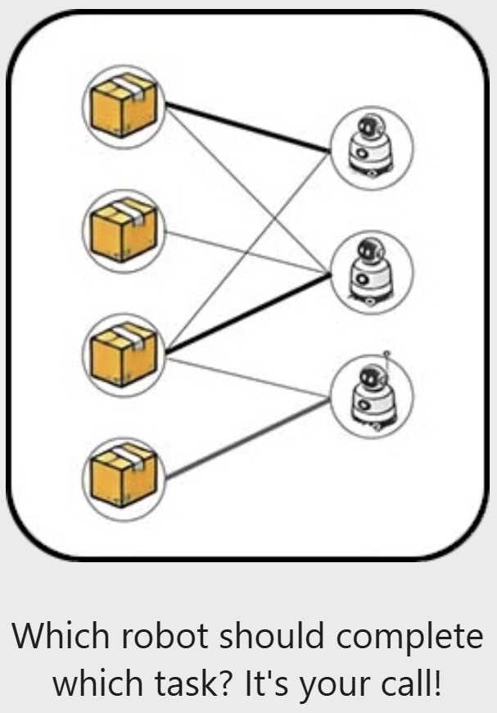
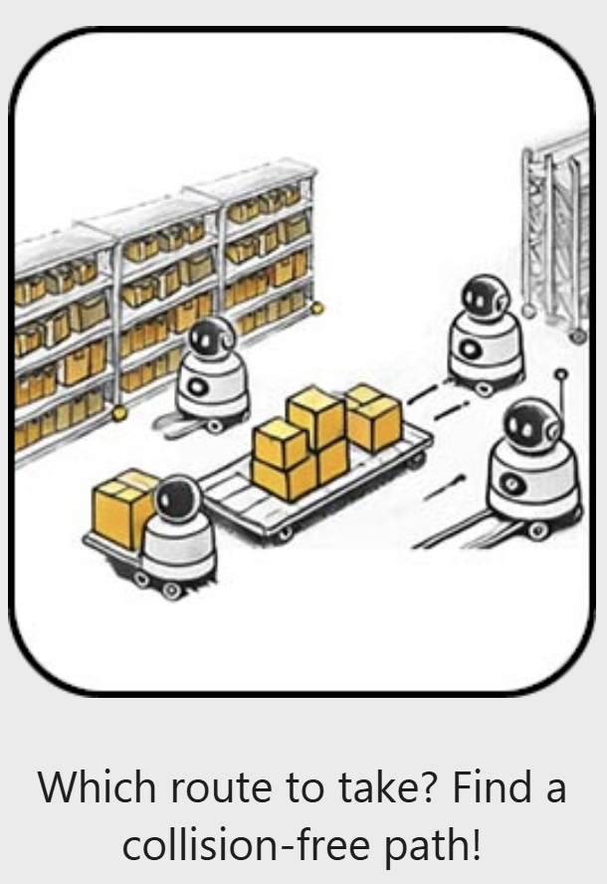
The League of Robot Runners 2024
1. Path Planning Track
2. Task Scheduling Track
3. Combined Track
+Line Honours

Slide 3
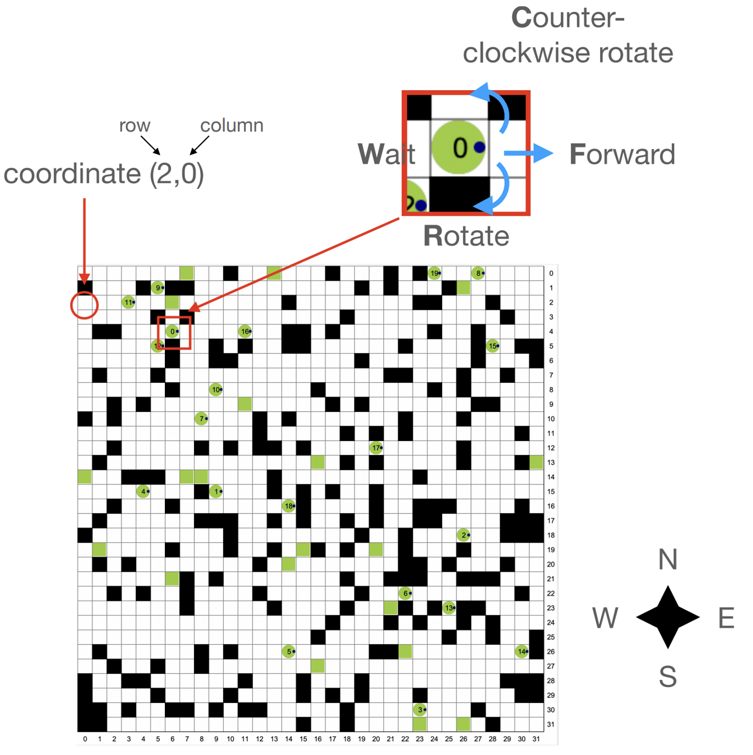
Problem Statement

Slide 4
Problem Statement
Vertex collision
Edge collision

Slide 5
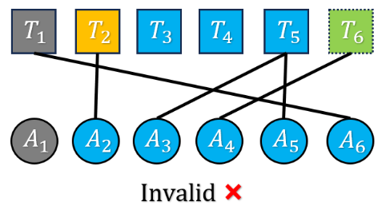
Problem Statement
Vertex collision
Edge collision

Slide 6
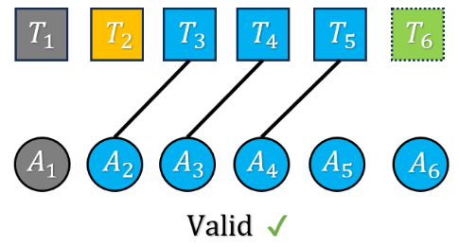
Problem Statement
Vertex collision
Edge collision

Slide 7


Path Planning Solution:
Fast rule-based solver (PIBT-like)
LNS optimizer
Graph Guidance to reduce congestion
Scheduling Solution:
Fast greedy approach

Slide 8
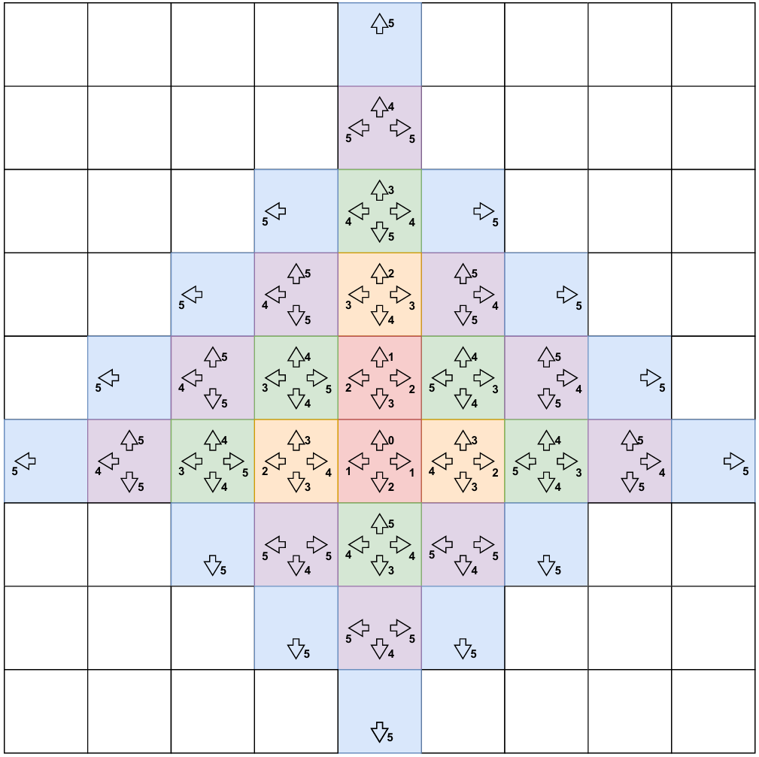
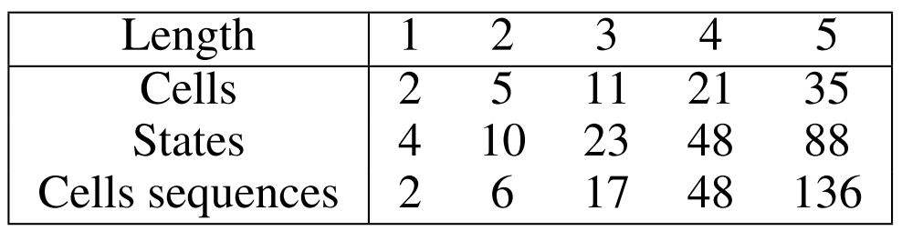
Concept of operations
Operation contains of set of actions – FFF, FFW, etc.*
Rotation action doesn’t change the position of the agent => the actual amount of unique cell sequences is significantly less than 4^{length}
RWF = WRF, CRF=RCF=WWF
Look forward without planning
*R – rotate; F – move forward; W – wait;
C – counter-clockwise rotate;
Notes:
表格中:
Length: action数量
Cells: 给定action数量, agent可能处于cell的数量
States: 给定action数量, agent可能处于State的数量, State包含所处的cell和所指的方向。
Cells sequences: 给定action数量, agent可能经过的cell sequence组合数量

Slide 9
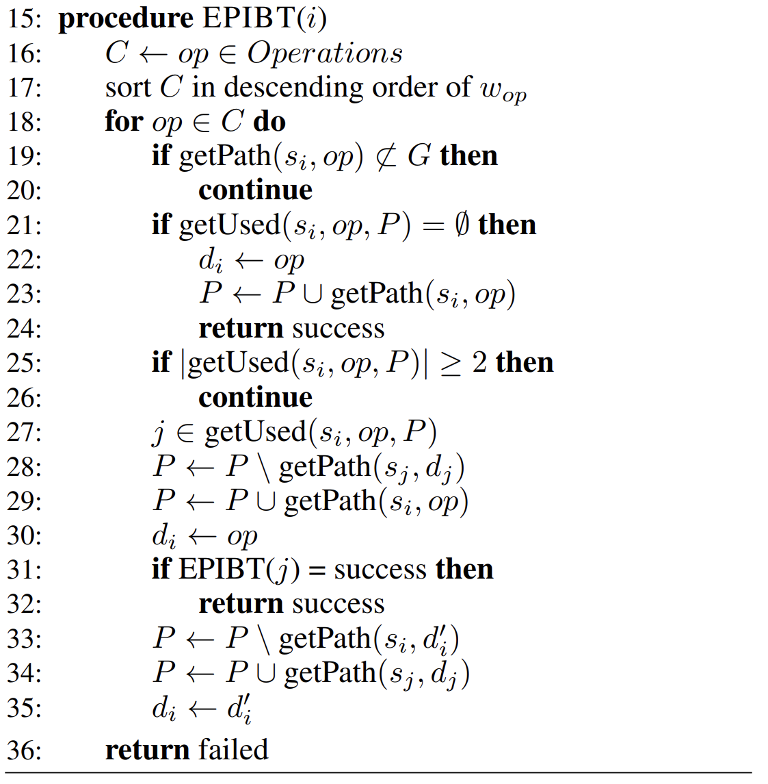
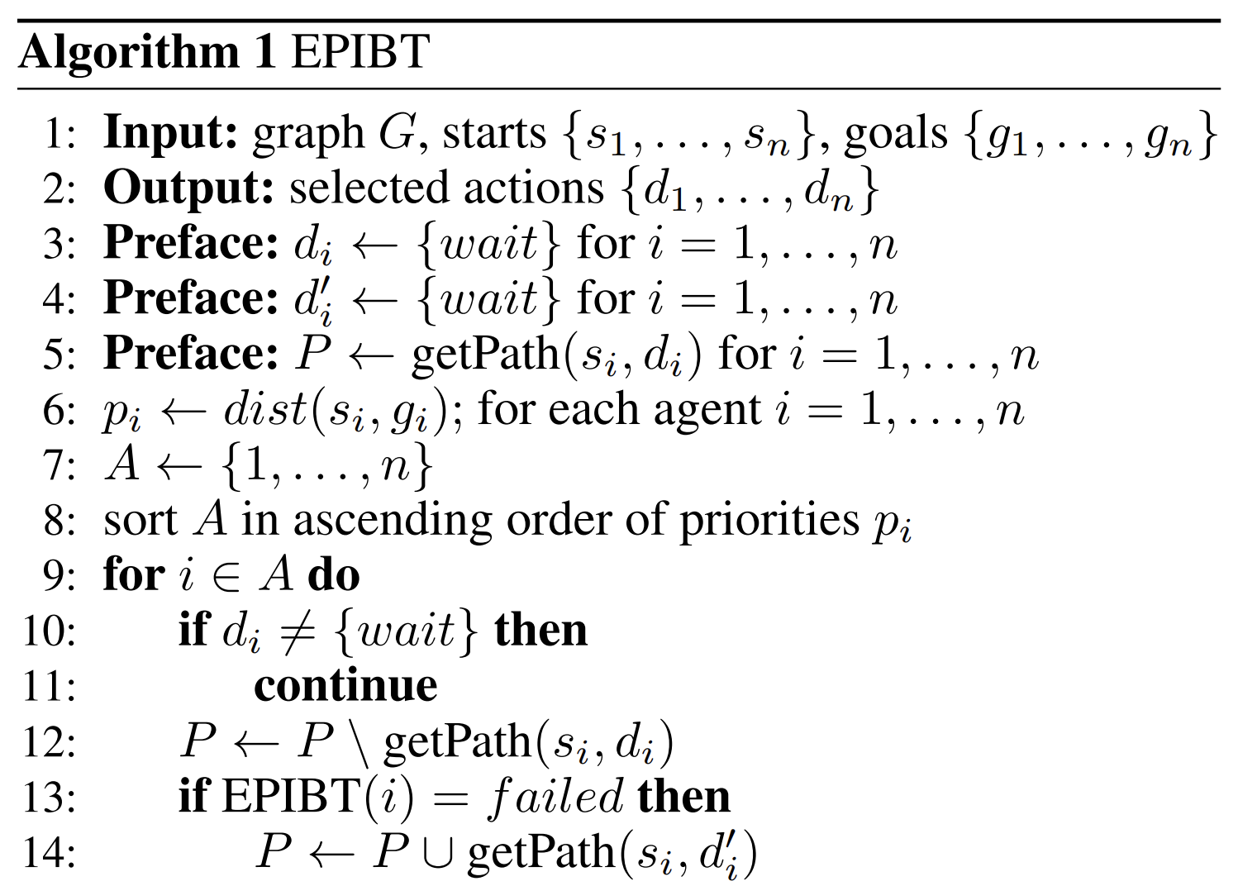

Enhanced PIBT (EPIBT)

Slide 10

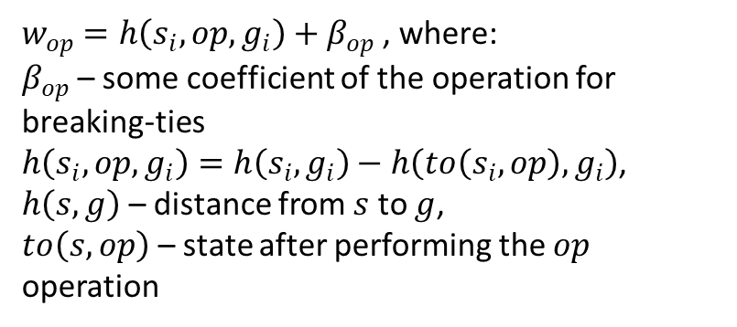
Enhanced PIBT (EPIBT)

Slide 11
Enhanced PIBT (EPIBT)
2. Operations might collide with more than 1 agent – we skip such operations

Slide 12
Enhanced PIBT (EPIBT)
2. Operations might collide with more than 1 agent – we skip such operations
3. Priority is used just for ordering – we allow collisions with any agent

Slide 13
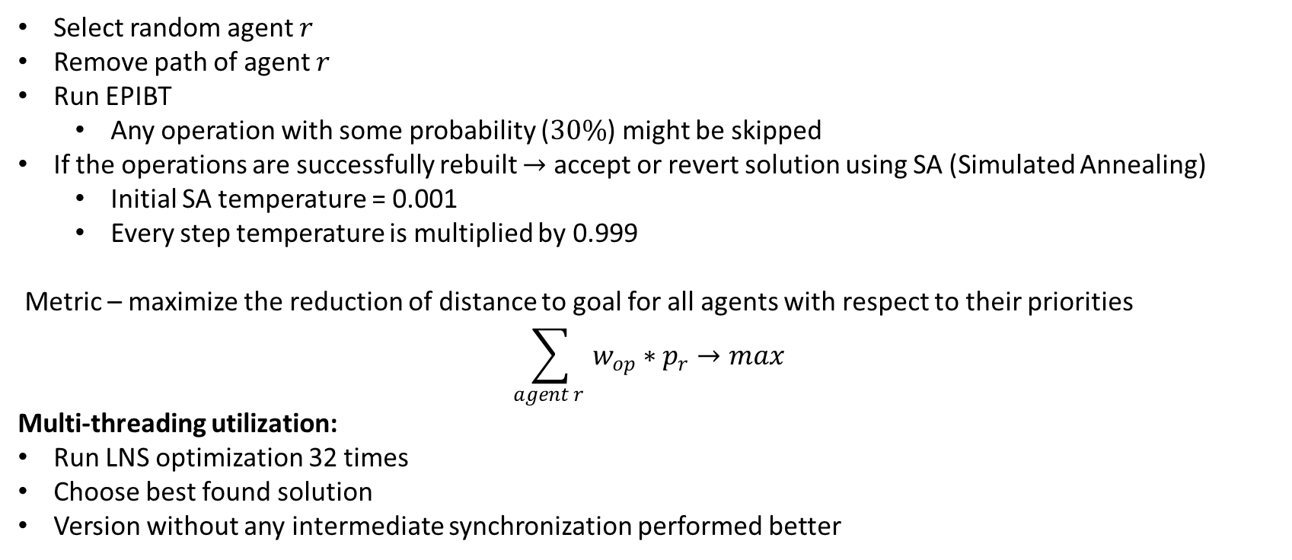
Large Neighborhood Search

Slide 14
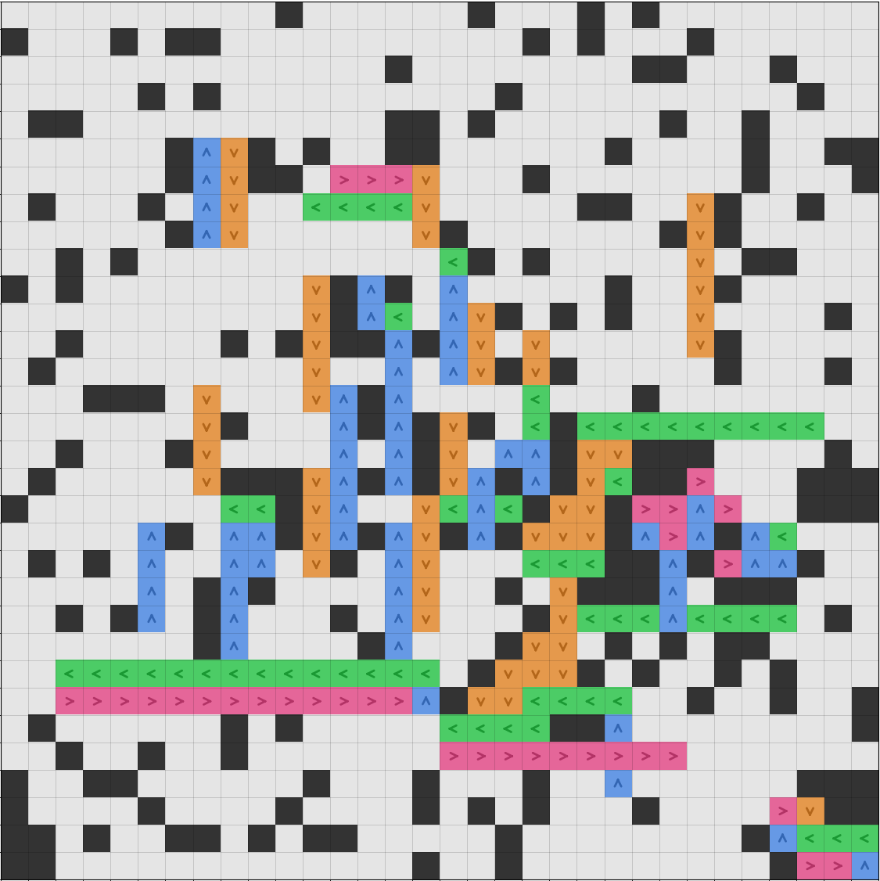


Graph Guidance
None of the existing GG approaches was utilized (Traffic Flow, CMA+ES, etc.)
GG is static, i.e. is not updated during the episode
Handcrafted for map random-32-32-20
Rule-based for the rest maps with even-uneven logic
Penalty for unpreferable actions is 10x cost

Slide 15
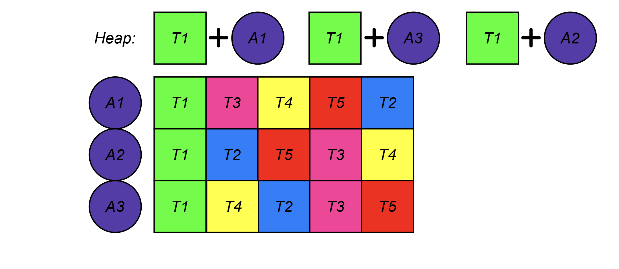
Scheduler
Preliminary:
Compute “cost” of each task – distances between errands
Compute distances between agents and tasks
Sort tasks for each agent based on the “full cost”
Create a heap picking most preferable task for each agent
Step 0

Slide 16
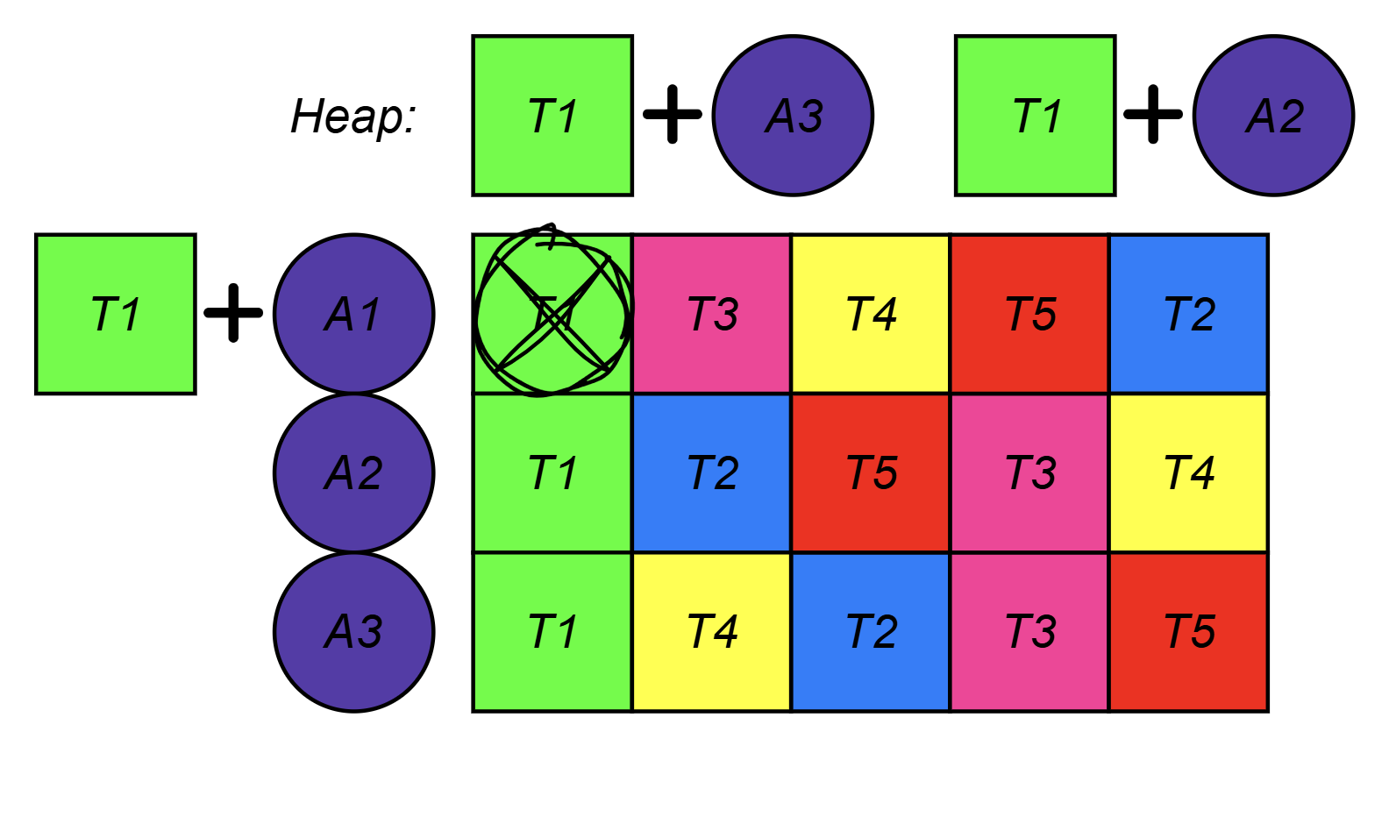
Scheduler
Preliminary:
Compute “cost” of each task – distances between errands
Compute distances between agents and tasks
Sort tasks for each agent based on the “full cost”
Create a heap picking most preferable task for each agent
Main loop:
Pick top agent-task pair
If task is still free – task for this agent is found
Step 1

Slide 17
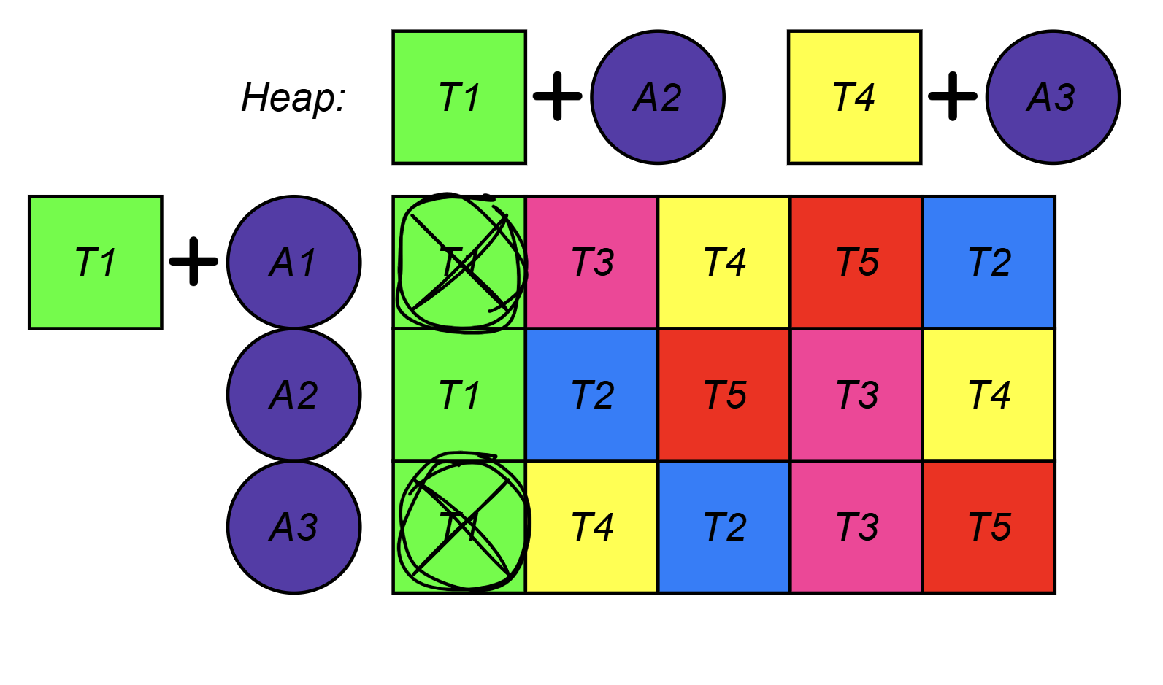
Scheduler
Preliminary:
Compute “cost” of each task – distances between errands
Compute distances between agents and tasks
Sort tasks for each agent based on the “full cost”
Create a heap picking most preferable task for each agent
Main loop:
Pick top agent-task pair
If task is still free – task for this agent is found
Otherwise put next preferable task into heap
Step 2

Slide 18
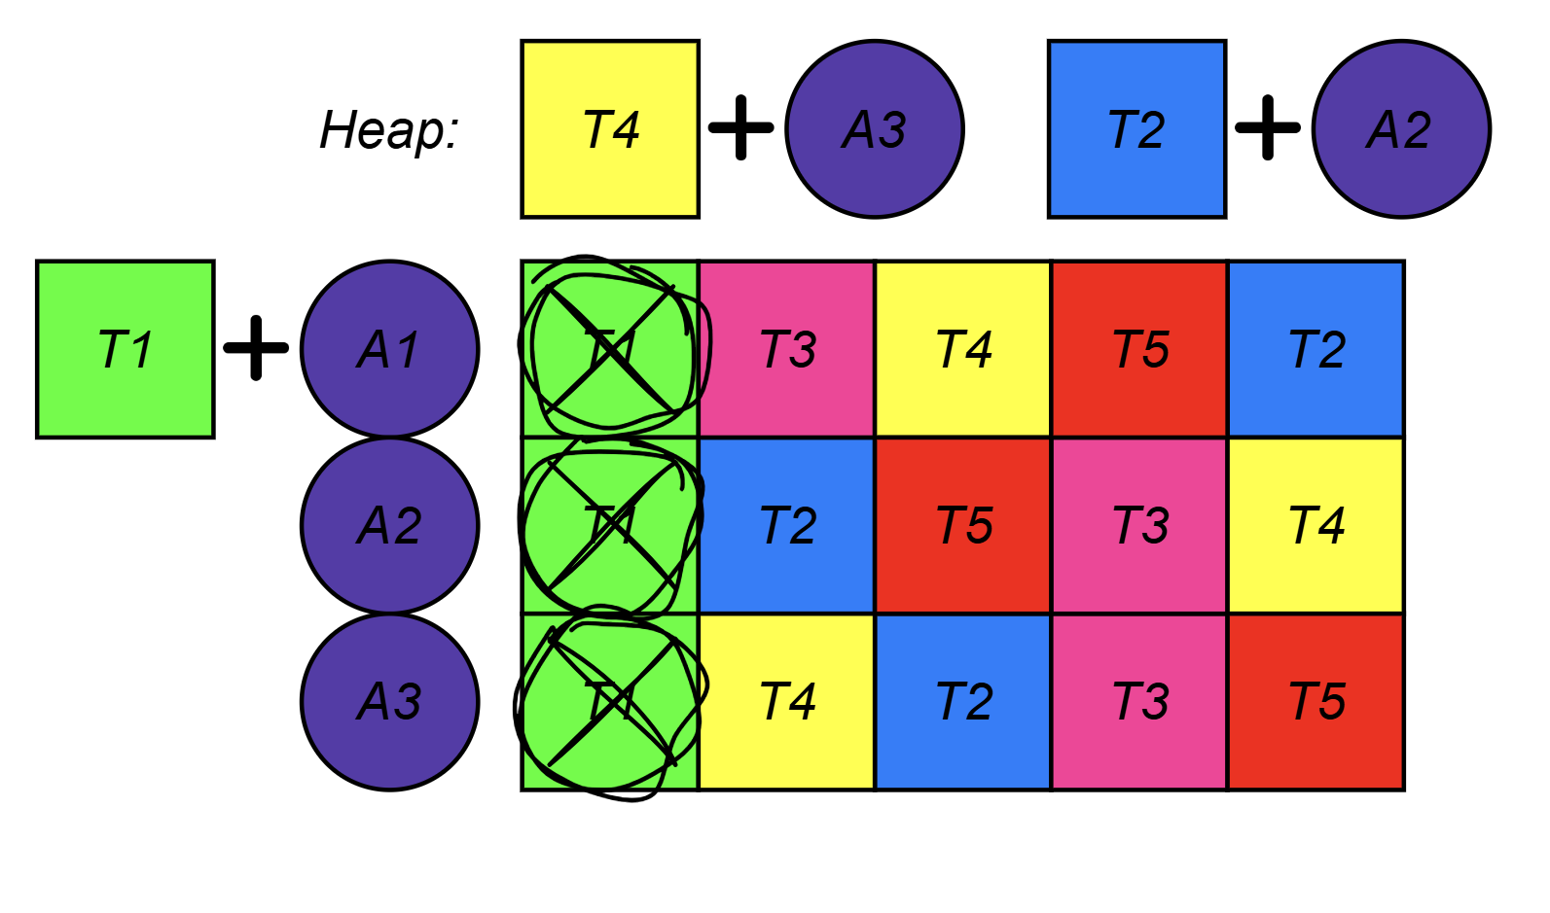
Scheduler
Preliminary:
Compute “cost” of each task – distances between errands
Compute distances between agents and tasks
Sort tasks for each agent based on the “full cost”
Create a heap picking most preferable task for each agent
Main loop:
Pick top agent-task pair
If task is still free – task for this agent is found
Otherwise put next preferable task into heap
Continue until all agents have tasks
Step 3

Slide 19
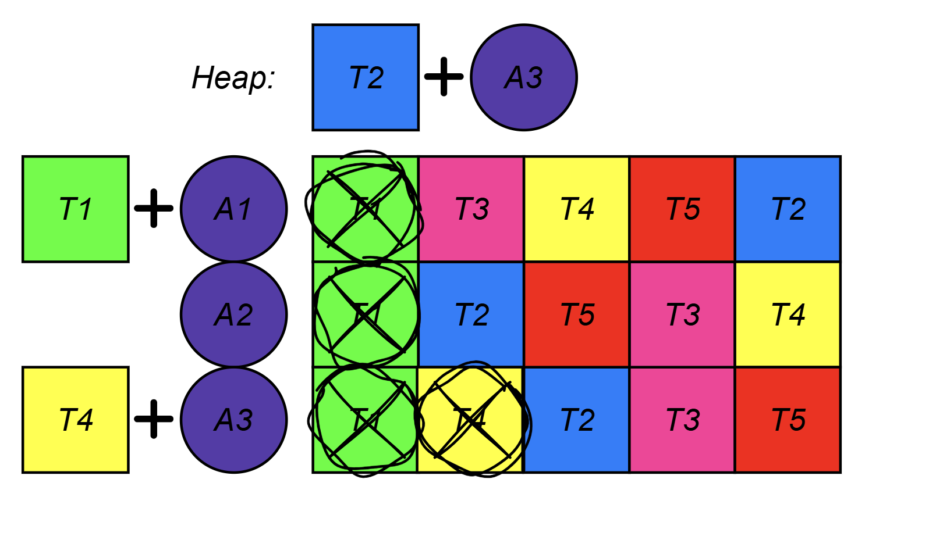
Scheduler
Preliminary:
Compute “cost” of each task – distances between errands
Compute distances between agents and tasks
Sort tasks for each agent based on the “full cost”
Create a heap picking most preferable task for each agent
Main loop:
Pick top agent-task pair
If task is still free – task for this agent is found
Otherwise put next preferable task into heap
Continue until all agents have tasks
Step 4

Slide 20
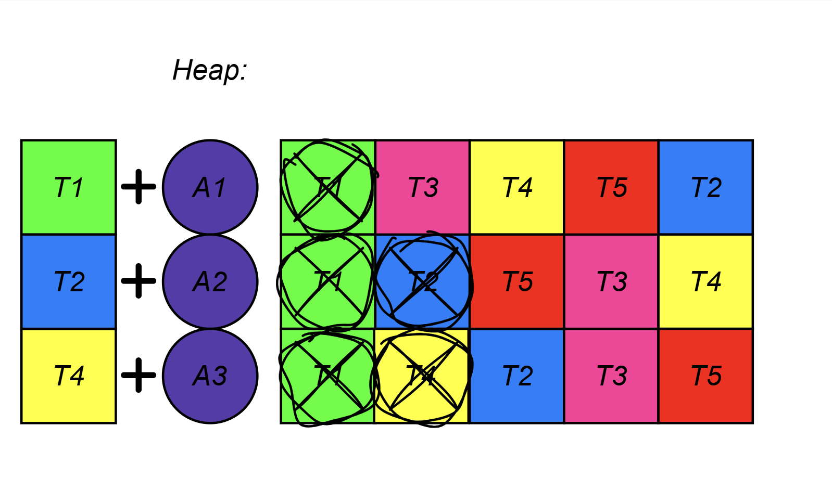
Scheduler
Preliminary:
Compute “cost” of each task – distances between errands
Compute distances between agents and tasks
Sort tasks for each agent based on the “full cost”
Create a heap picking most preferable task for each agent
Main loop:
Pick top agent-task pair
If task is still free – task for this agent is found
Otherwise put next preferable task into heap
Continue until all agents have tasks
Step 5

Slide 21
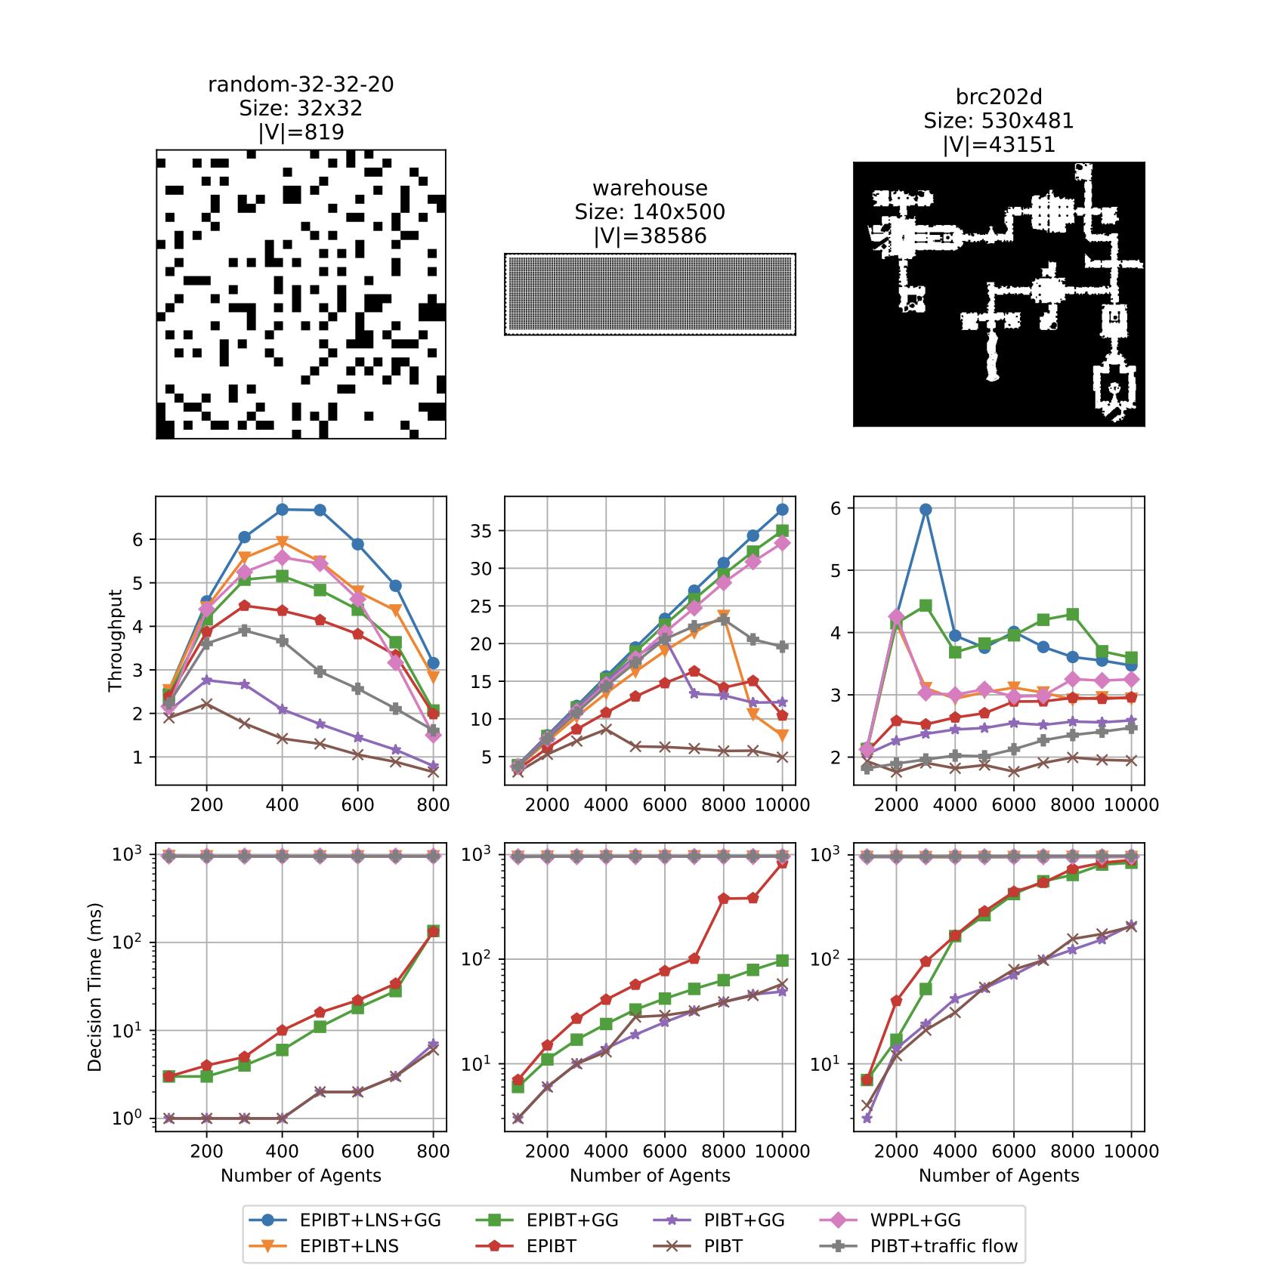
Experimental Evaluation
Algorithms:
PIBT±GG. Our implementation of the basic algorithm.
PIBT+Traffic Flow. Implementation of the basic planner from the LoRR competition.
EPIBT±GG. Baseline method to estimate how EPIBT performs without LNS.
EPIBT+LNS±GG. The final algorithm.
WPPL+GG. The winner of LoRR 2023.
Notes:
看来除了EPIBT外，还多了LNS和GG.

Slide 22
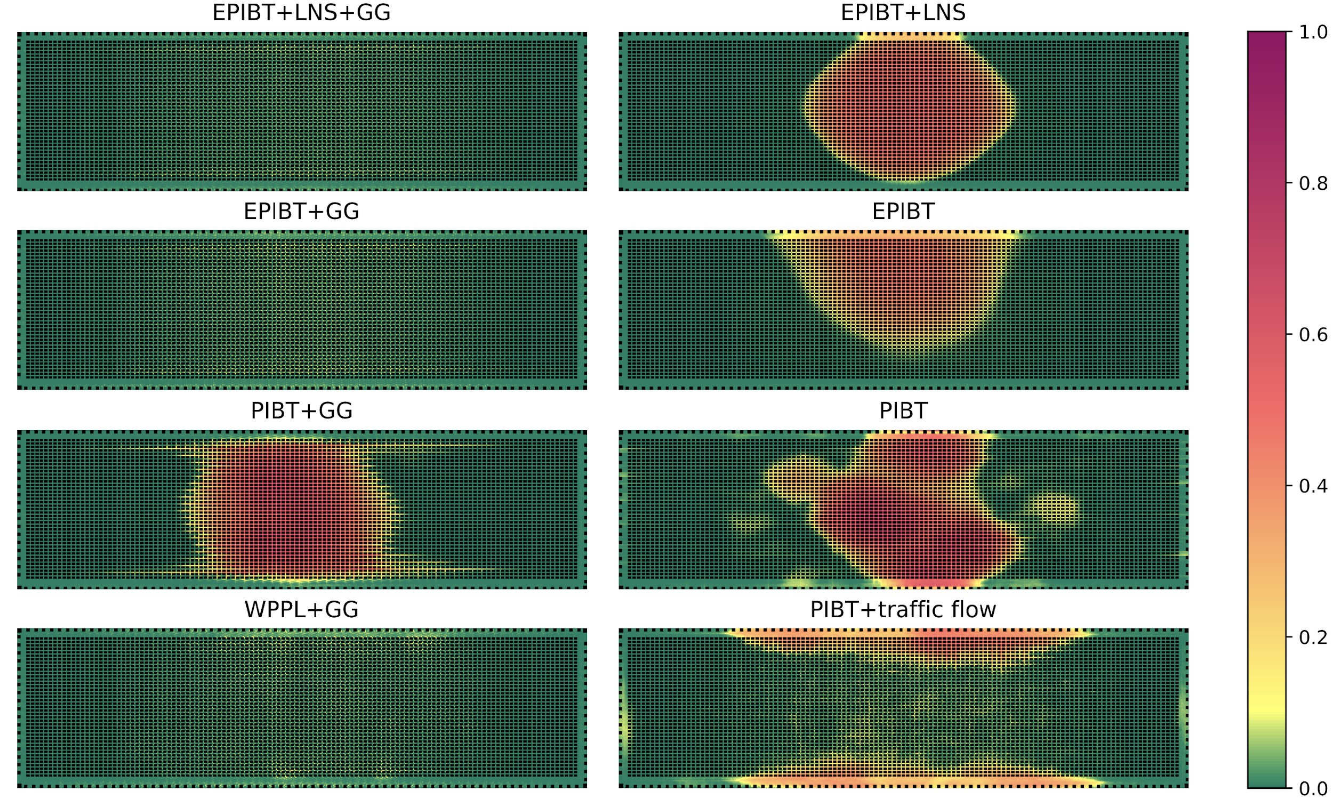
Waiting Heatmaps – Warehouse (10k agents)
Notes:
看来heat map是基于等待画的

Slide 23
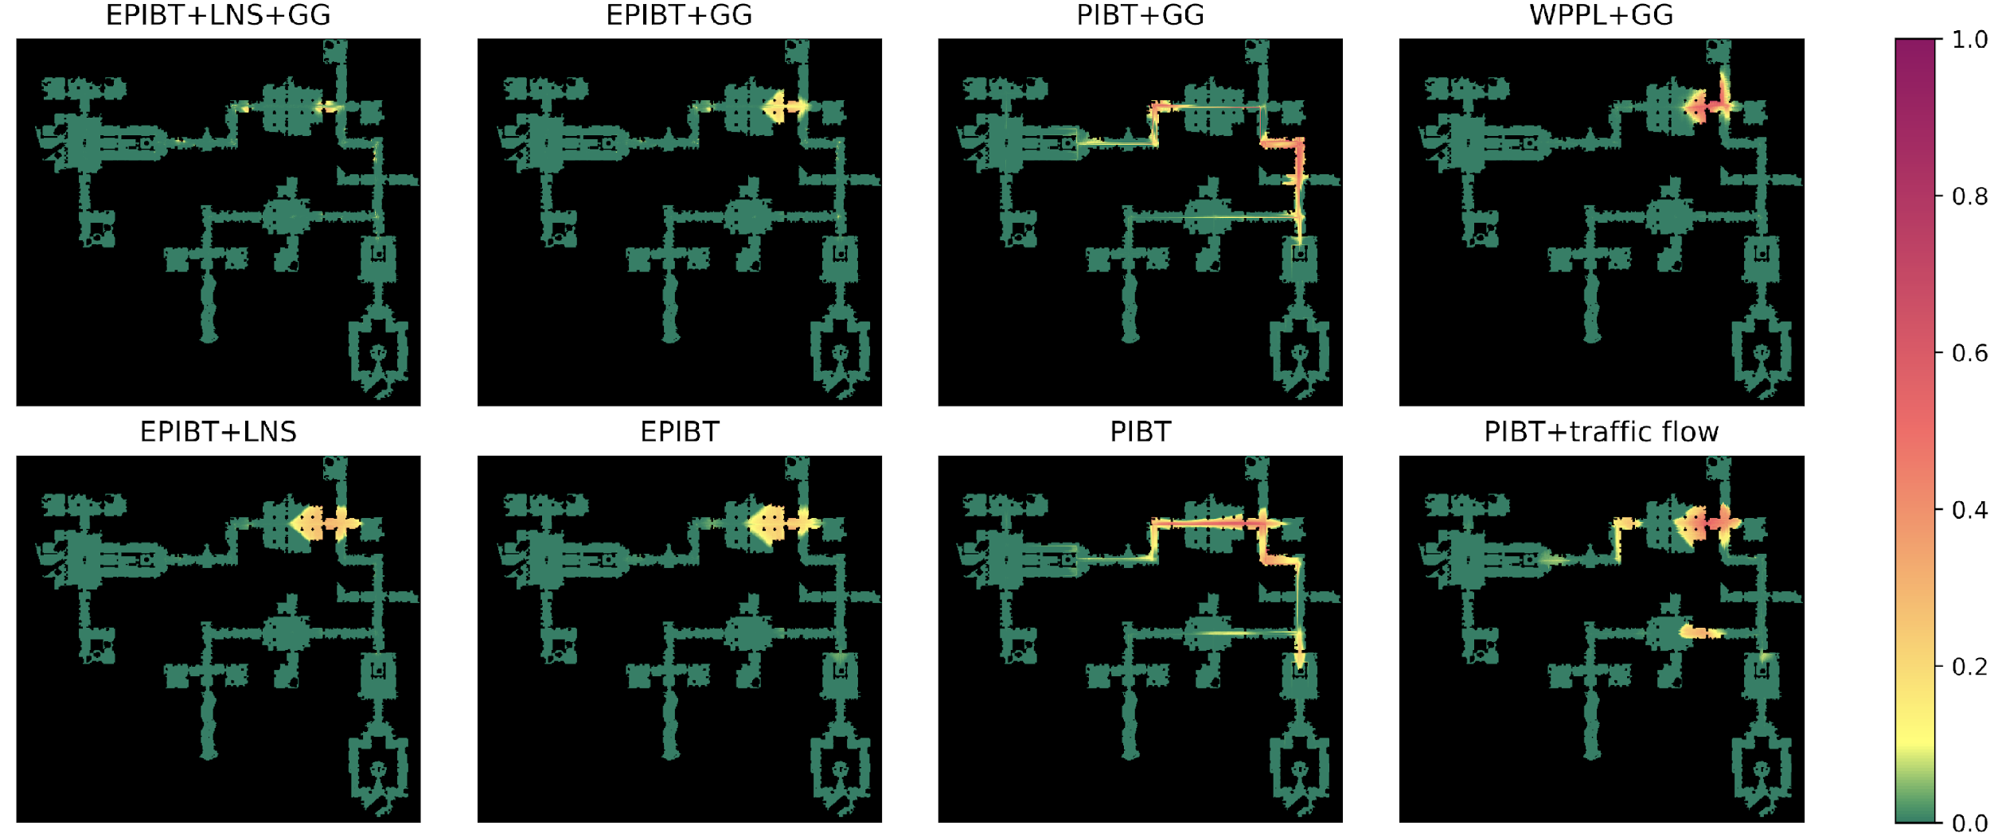
Waiting Heatmaps – brc202d (3k Agents)

Slide 24
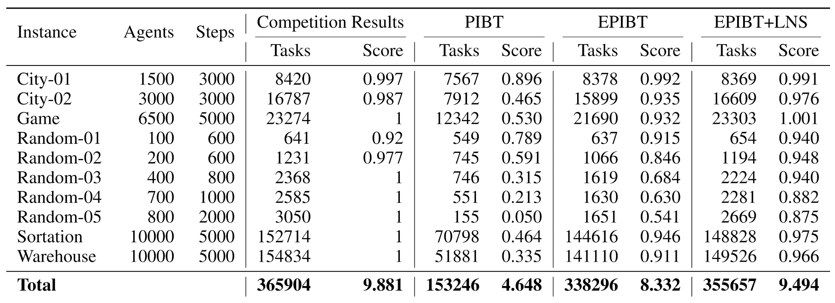
Competition and Some Extra Results

Slide 25
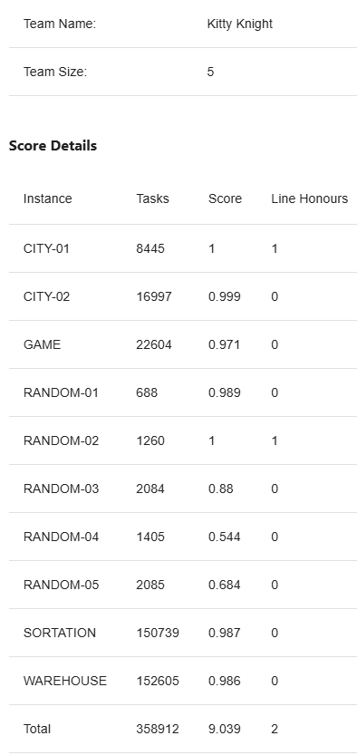
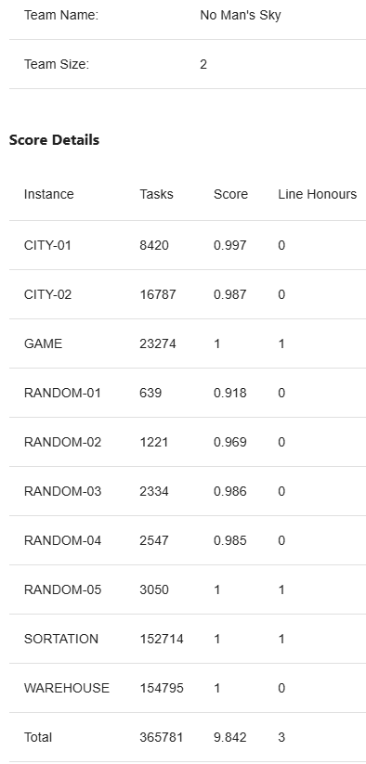
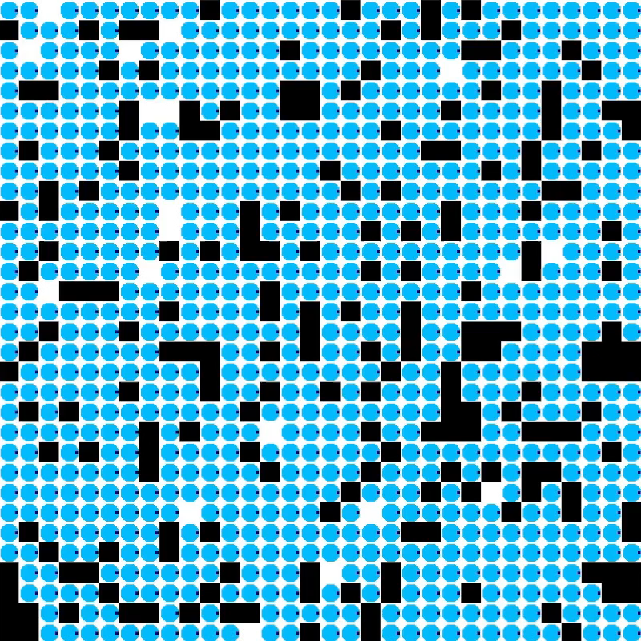
Demo
Competition Results

Slide 26

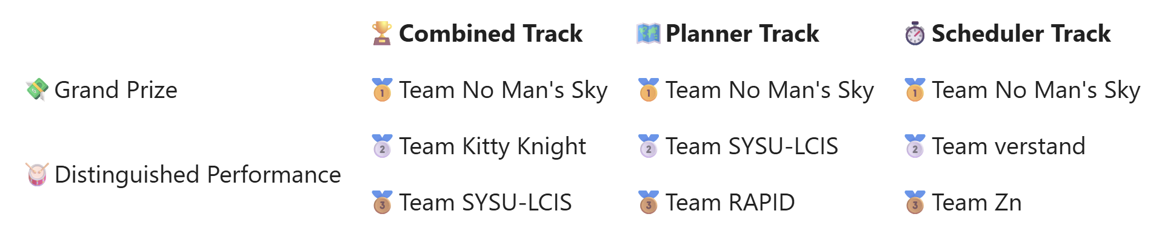

Conclusion
Developing a solver for competition is not the same as doing research:
Focus on particular set of instances results in tweaks, tricks and specific optimizations
You have less control – cannot modify problem statement, choose baselines, benchmark, etc.
Beating existing SOTA approaches is not enough – you need to beat other competitors (that might hide until last day)
Simple ideas that work fast and their efficient implementation might surpass a better approach
There is still a big room for improvement both in terms of the approach and its implementation
github.com/Straple/LORR24
15

