Slide 1
LoRR 2024
https://www.leagueofrobotrunners.org/problem

Slide 2
1 Problem Overview
A team of robots works together in a simplified grid environment. Their job is to run infinite errands, which they accomplish by visiting different locations on the grid. Sometimes errands must be completed in a specific order. A sequence of such errands is called a task.
Objective: complete as many tasks as possible until time runs out.
Notes:
美团外卖

Slide 3
Robot action of each timestep
Valid Action
Move Forward, into an adjacent grid cell
Rotate 90 degree clockwise
Rotate 90 degrees counter-clockwise
Wait at the current location.
Vertex collision
Edge collision

Slide 4
Task Scheduling
An errand is a request for a specific robot to visit a particular target location on the grid. An errand is completed when the assigned robot arrives at the target location.
A task is a request for a specific robot to complete an ordered sequence of errands.
A task is open if one or more errands in the sequence have been completed.
A task is closed and no longer assigned when all the errands in the sequence have been completed.
Each robot has at most one open task.
Tasks can be assigned to any free robot.
Once open, a task cannot be re-assigned.
When a task is completed, more tasks are revealed.

Slide 5
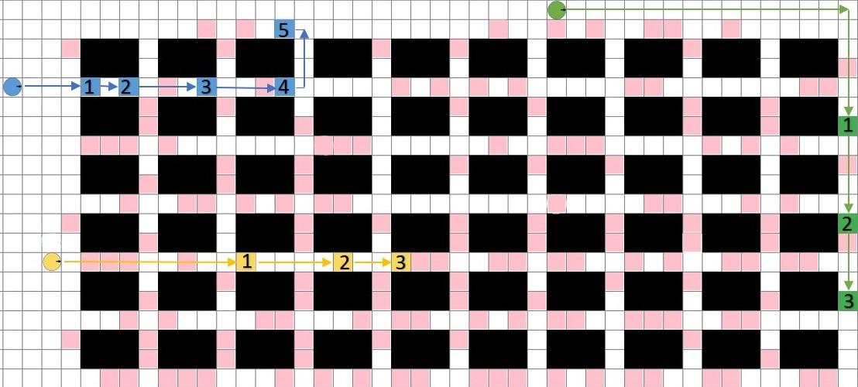
Task Scheduling
Notes:
任务分配、路径规划、大模型等主流方法、

Slide 6
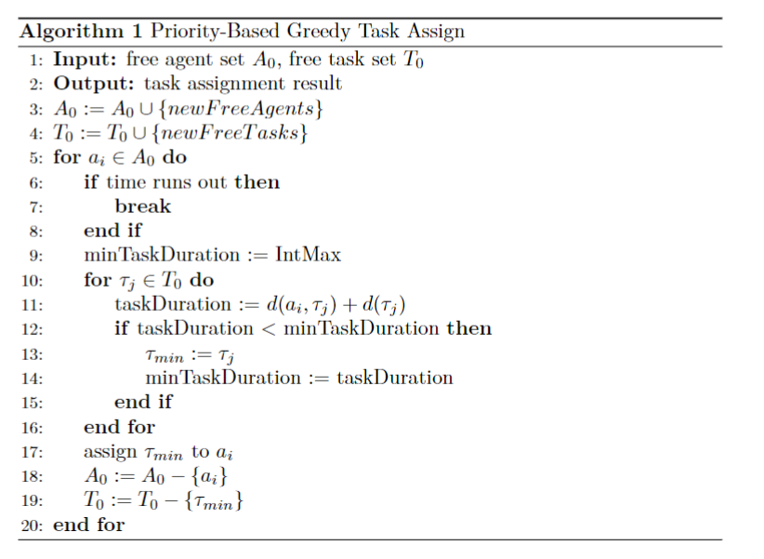
Task Scheduling默认算法
Greedy: 按照agent 1到N的顺序，依次分配完成距离最短的任务。
完成距离：dist(agent, pickup) + dist(pickup, delivery)
Notes:
任务分配、路径规划、大模型等主流方法、

Slide 7
Path Planning
Collision-Free Path: The "collision-free" figure shows a carefully planned situation where robots avoid each other. Both robots finish their tasks without any delays.

Slide 8
Path Planning默认算法: TFO算法
底层算法：Push and Swap中的push
中层算法：Priority inheritance with backtracking (PIBT)
顶层算法：Traffic Flow Optimisation (TFO)
Notes:
看不懂正常。

Slide 9

优先级搜索
皇后（宜修）
华妃（年世兰）
沈贵人（沈眉庄）
莞常在（甄嬛）
安答应（安陵容）
Notes:
《清史稿‧后妃》，卷214，曰：“康熙以后，典制大备。皇后居中宫；皇贵妃一，贵妃二，妃四，嫔六，贵人、常在、答应无定数，分居东、西十二宫”
优先级可以自由制定
优先级可以变更

Slide 10
Tracks
Path Planning Track
Task Scheduling Track
Combined Track
Notes:
组队兴趣。编辑代码。
https://www.leagueofrobotrunners.org/

Slide 11
2 编写代码和本地测试
阅读文档Prepare_Your_Submission.md
官方提供了5个本地测试算例，据说和官网测试算例的数量级一致。
如果需要在windows平台上运行，需要把代码中的DONE变量重命名，并且安装boost库。
Notes:
https://github.com/MAPF-Competition/Start-Kit
https://github.com/MAPF-Competition/Start-Kit/blob/main/Prepare_Your_Submission.md

Slide 12
3 Submission
提交正式代码一个队伍只能用一个github账号。
每天最多5次提交机会，测试一次结果需要7小时，且测试期间无法进行下一次提交。
规划提交时间和顺序。
查看结果。

Slide 13
4 Results
记录结果的格式建议：统一code、markdown、excel中的函数名、注释和排列顺序。

Slide 14
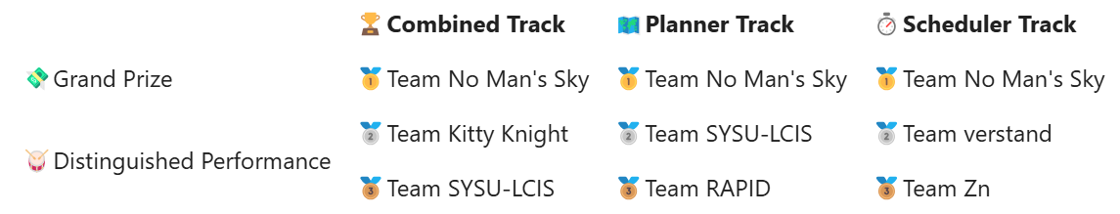
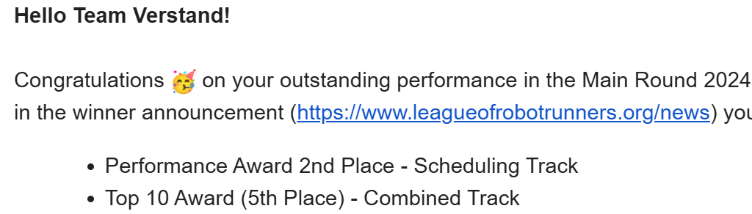
5 Rank

Slide 15
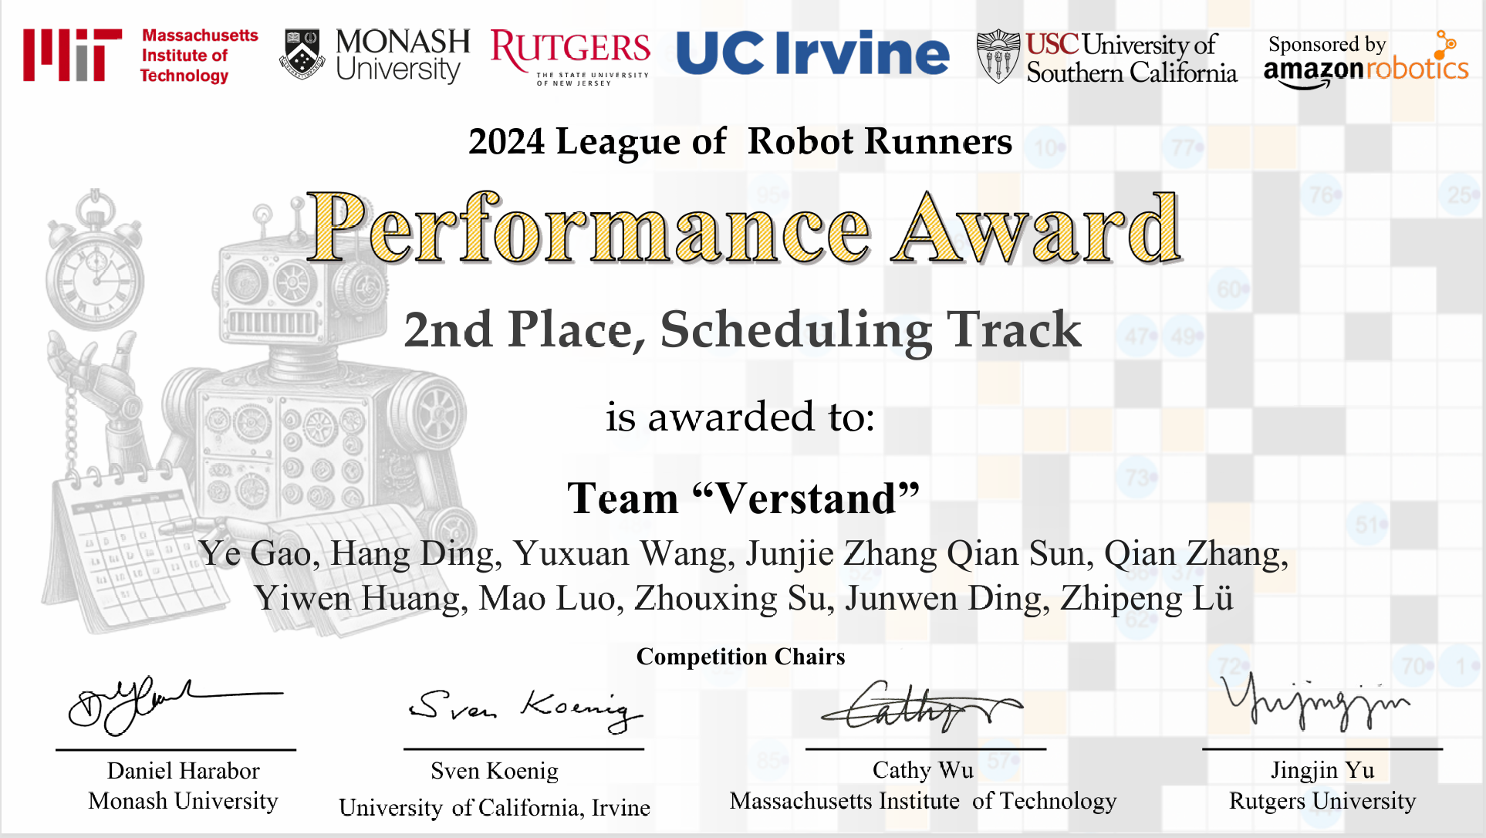

Slide 16
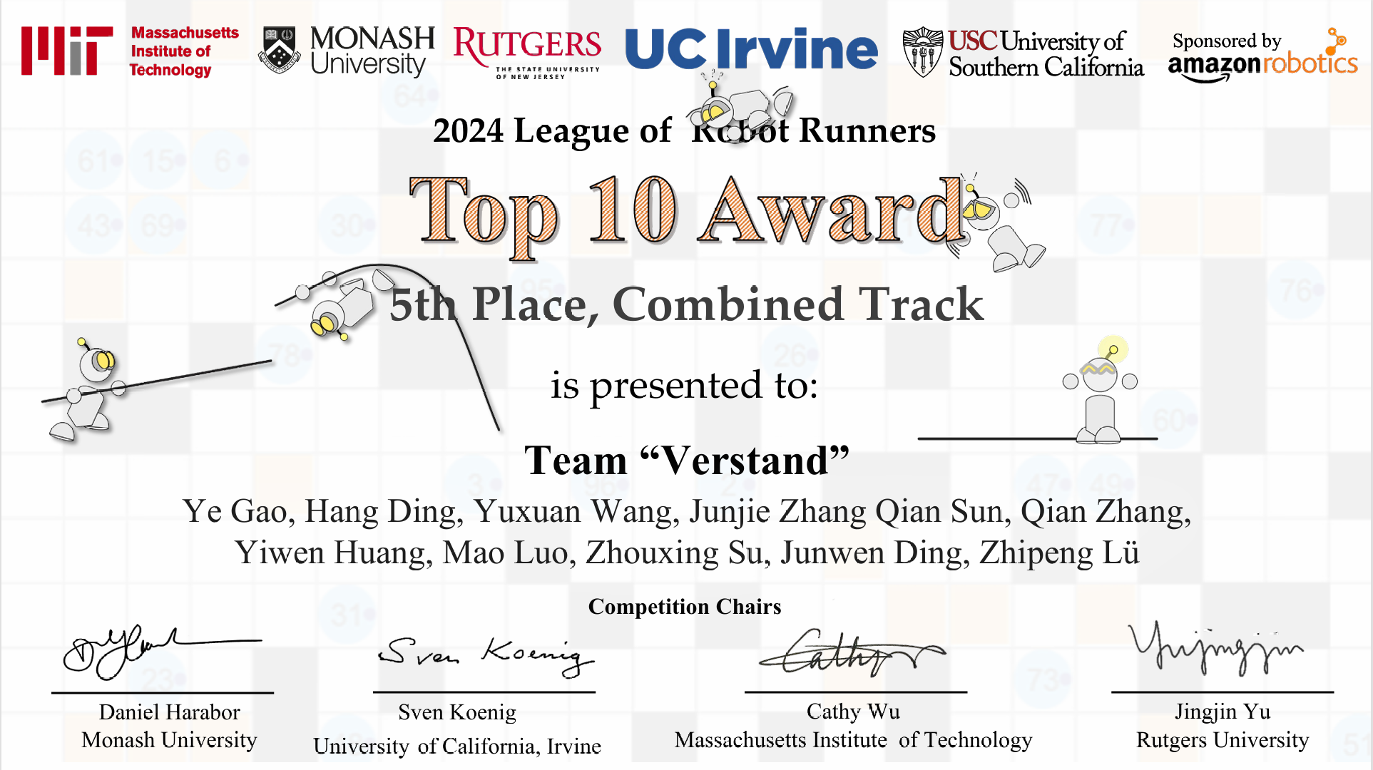

Slide 17
Q&A

