Slide 1
This document contains the specifications for the iot 4 healhcare project :
- Architecture overview
- Specifications for modules to develop
Prerequisites (already done) : Enablement of data flow edge local + Creation of DataGenerator + Creation of Azure environment
Scope of work
1.1/ Enablement of data flow edge to azure in Azure :
- Azure IoT hub up and running → IoT Hub will receive messages from the edge server AND from the azure collector.
- Creation of data structure in Azure SQL server
- Development of Azure Stream Analytics → Azure SQL
1.2/ Enablement of data flow edge to azure in Edge server :
- Development of « edge_to_azure » script on the edge server
2/ Creation of PowerBI dashboards :
- Create connection between PowerBI and the Azure SQL Server
- Put in place dashboard(s) showing the measures : raw values from the mobile phones (healthcare metrics)
- Put in place dashboard(s) showing the analytics results : from Spark processing on the edge server
3/ Enablement of data flow 100% azure :
- Development of hcare_azure_collector in the azure environment (VM running in Azure with public & private keys)
- Make sure that the script can feed the IoT hub like the edge_to_azure script
- Make sure that the data from this dataflow will be shown in the powerBI part

Slide 2




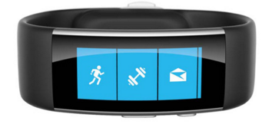

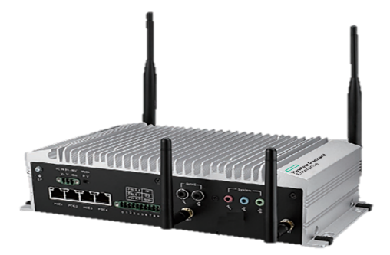
Architecture overview
Legend :
Big Data Open Source
Built in 1st prototype (HPE IT)
Microsoft Azure components
Current developments
Android HPE
Application
data flow
data models
Dashboards
WWW
WW DataViz
WWW
Stream
Analytics
SQL
Server
Power
BI
Raw
Measures
HCare Azure
Collector
IOT HUB
Public IP
Analytics
Results
Data = Raw measures
↑ In the Cloud ↑
↓ At the Edge ↓
Data = Raw measures + Analytics results
Android HPE
Application
Local
Wifi
Local DataViz
Local
Wifi
HCare
Edge
Collector
Edge
To
Azure
Timeseries Viz
Raw
Measures
Majority
Voting
Analytics
Results
Data = Raw measures
Analytic
Module
Analytic
Module
Cassandra DB
Data
Generator
Kafka / Spark Data Bus
Virtual Machine 10.3.35.93 (RHEL 6.8)
Notes:
Step 2 : Edge Ready = Features working WW for demo anytime+anywhere / Integration : Azure level 1
Data collector in Azure (WW)
View of data collected (WW)

Slide 3
Architecture overview – Potential next steps
Spark analytics in Cloud
Spark
modules
Android HPE
Application
data flow
data models
Dashboards
WWW
WW DataViz
WWW
Stream
Analytics
SQL
Server
Power
BI
Raw
Measures
HCare Azure
Collector
IOT HUB
Public IP
Analytics
Results
Data = Raw measures
↑ In the Cloud ↑
Data = Raw measures + Analytics results
Data from Azure to Edge mecanism
↓ At the Edge ↓
Azure
To
Edge
Android HPE
Application
Local
Wifi
Local DataViz
Local
Wifi
HCare
Edge
Collector
Edge
To
Azure
Timeseries Viz
Raw
Measures
Majority
Voting
Analytics
Results
Data = Raw measures
Analytic
Module
Analytic
Module
Cassandra DB
Data
Generator
Kafka / Spark Data Bus
Virtual Machine 10.3.35.93 (RHEL 6.8)
Notes:
Step 2 : Edge Ready = Features working WW for demo anytime+anywhere / Integration : Azure level 1
Data collector in Azure (WW)
View of data collected (WW)

Slide 4
Python script : Edge To Azure
Objective : Send raw measures & analytics results flowing in the local Kafka bus to the IOT Hub in Azure cloud

Slide 5
Specifications for python script
This slides present the context and the specifications for the script in charge of pushing data from LOCAL KAFKA to CLOUD AZURE
An example of python script is also provided (attached to a mail) as a example of
  Config parser usage
  Threading in python
  This example script was aimed to run image analysis in //
Python lib for Kafka to use : http://kafka-python.readthedocs.io/en/master/usage.html ; which is here on github: https://github.com/dpkp/kafka-python

Slide 6

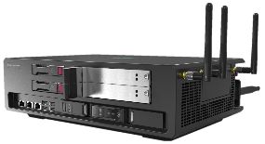
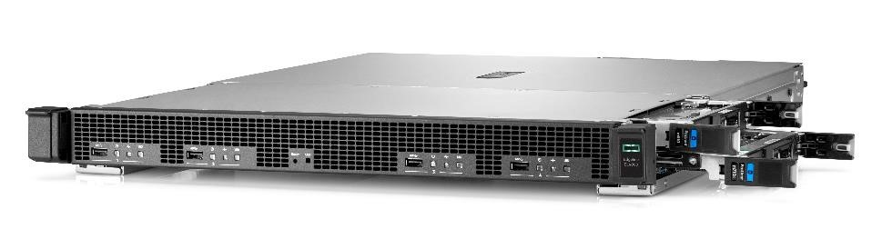
Edge & Azure data Buses : EdgeKafka-to-AzureHub
Microsoft Azure
Purpose of the Edge2azure script :
Send data flowing locally on the Edgeline to Azure cloud (from Kafka bus to Azure IoT hub)
Implement a mechanism of aggregation to be able to regulate the amount of data sent to Azure → 1 message every N seconds. This duration is a « time window » during which data received on kafka have to be aggregated.
Processing
Processing
VIZ
Azure IOT HUB
DB
Cartridge on EL1000
Cartridge on EL1000
Cartridge
Cartridge
Cartridge
Cartridge
APPS
. . .
APPS
edge2azure
APPS
. . .
APPS
edge2azure
APPS
. . .
APPS
. . .
APPS
APPS
edge
2azure
. . .
DATA BUS
DATA BUS
DATA BUS distributed on moonshot servers (EL4000)
Linux
Linux
Linux
Linux
Linux
Linux
« Things »
(sensors)
Edgeline EL1000
« Things »
(sensors)
Edgeline EL1000
Edgeline EL4000

Slide 7
Zoom on the script
Microsoft Azure
Azure IOT HUB
Local applications
Local applications
Local applications
Edge2azure script :
Running on edgeline server
Independant python script
Listening list of topics on the Kafka Bus
Do aggregation on a defined duration
Send aggregated data from Kafka topics to Azure IoIT Hub
Kafka
Topic A
Topic B
Edge2azure
Topic …
python interpretor
Linux
Server(s) at the edge

Slide 8
Python script : guidance proposed
Single file : 1 python file (.py) + 1 config file (.conf)
Running on Python 2.x (like other python script on the edge server)
Principle :
    For each kafka topic listed in the config file, the script creates a listener working inside its own thread.
    We have 1 kafka topic = 1 listener = 1 instance/object of a class = 1 thread of execution
    When a message arrive in the listener, an aggregation function is launched to aggregate the message with the data already received during the timewindow.
    If the duration defined in the config file is reached, the aggregated object is sent to Azure Cloud and resetted OR If the duration is not reached, the listener wait for another message from the kafka topic.
Challenge : each topic has a model of data hence each aggregation model for each topic needs to be implemented in a function
    Example : the function to aggregate with buffering the hearthrate won’t be the same than for the temperature.
The main parts of the script can be :
    main section to create and launch the listeners
    class KafkaTopicListener : each instance will be a thread listening and aggregating a kafka topic
    class AggregationModels : this class will contain the functions of aggregation used by the listener instance
      The purpose is to separate thread execution and aggregation functions → we want to upgrade aggregations easily

Slide 9
Skeleton proposed of the python script - 1 on 3
Import …
# THIS CLASS CONTAINS ALL THE AGGREGATION FUNCTIONS : FOR EACH TOPIC, FOR EACH AGGREGATION METHOD
Class TopicAggregator :
@staticmethod
def gyroscope_buffering (already_aggregated_values, new_value_to_aggregate) :
…. HERE THE CODE TO DO THIS MODEL OF AGGREGATION FOR GYROSCOPE : buffering the values in the time windows
@staticmethod
def gyroscope_keep_last (already_aggregated_values, new_value_to_aggregate) :
…. HERE THE CODE TO DO THIS MODEL OF AGGREGATION FOR GYROSCOPE : keepting only the last value in time
… other variables and model of aggregations ….
Scripts provided as examples :
- test_iot_hub_get_users.py
- test_iot_hub_send_message.py
- img_analysis.py (for multithread, careful : in python 3.5)
- img_analysis.ini
CLASS KAFKA LISTENER : SEE NEXT SLIDE
Main section of the python script
Get the config
Loop For each topic :
- create a KafkaTopicListener instance with the parameters of the topic
- start the instance with instance.start() -> the listener will be executed in a thread in parallel
- sleep for 1 or 2 seconds before looping on next topic to listen
End of the main program : the listeners are executing in the background

Slide 10
Skeleton proposed of the python script - 2 on 3
…
class KafkaTopicListener (threading.Thread) :
def __init__(self, parameters_for_the_topic):
self.topic_name = …
self.topic_duration = …
def aggregate(self, new_message) :
if self.topic_name == ‘gyroscope’ :
if self.topic_model == ‘buffering’ :
  self.my_aggregated_values = TopicAggregator.gyroscope_buffering(self.my_aggregated_values, new_message)
  elif self.topic_model == ‘keep_the_last’ :
self.my_aggregated_values = TopicAggregator.gyroscope_keep_last(self.my_aggregated_values, new_message)
else:
# here the default aggregation will be « keep_last » for the gyroscope
self.my_aggregated_values = TopicAggregator.gyroscope_keep_last(self.my_aggregated_values, new_message)
elif self.topic_name == ‘tempature’ :
…. Aggregation for temperature topic
…..
def run(self)
connection to kafka with python library using the parameters for the topic
# --- Infinite loop on the listening of kafka
while (true)
# --- loop for aggregation
time.perf_counter() → to get the starting time of aggregation
aggregation_duration_not_reached = TRUE
while (aggregation_duration_not_reached) :
    kafka_message = waiting_for_new message
self.aggregate(kafka_message )
time.perf_counter() → message arrived, time spent since start waiting
IF ( time spent > aggregation duration for the topic )
aggregation_duration_not_reached = FALSE
# --- Aggregation reached : sending to azure
SEND THE AGGREGATED VALUES ON AZURE → Adding some fields/values (topic, unique name, see further)
  EMPTY THE BUFFER OR RESET THE AGGREGATED VALUES before looping back on the while
…
Proposed mecanism on how to loop on the new messages from 1 topic in Kafka
- waiting for 1 new message
- collect it
- do aggregation depending on the variable : mean OR addition OR max…
- if aggregation time window is reached :
- flush the aggregated buffer to Azure
- reset the time counting
- reset the aggreation buffer
- back to the loop to wait for next message
MyBuffer = [ ]
For new_message in kafka_queue_obj :
print(new_message)
process(new_message)
time1 = my_
if buffer full
….
if (it is time to flush to Azure)
send buffer to Azure

Slide 11
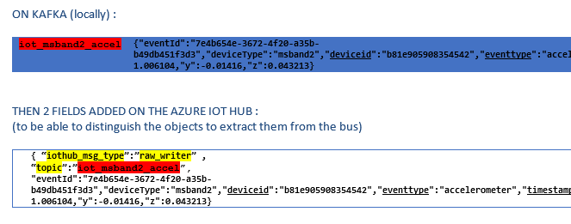
Skeleton proposed of the python script - 3 on 3
TEMPLATE OF CONFIG FILE
Implemented in python with config parser lib
Each Kafka topic to listen has several parameters
-> should be easy to add a new topic
-> the aggregation model can be defined per topic
Template of configuration file of the script
[global_section]
edge_unique_name = ‘vm_93’
Kafka_connection_parameters = …
iot_hub_connection_string=‘…’
iot_hub_device_id=‘…’
[topics_section]
topic_A.name_in_azure = ‘topic_A_name_in_azure’
topic_A.aggregation_model = buffer
topic_A.aggregation_duration_sec = 60
topic_B.name_in_azure = ‘topic_A_name_in_azure’
topic_B.aggregation_model = last_value
topic_B.aggregation_duration_sec = 60
.
….
FIELDS TO ADD WHEN COPYING A MESSAGE
(=JSON OBJECT) FROM KAFKA BUS TO AZURE
It is needed to keep track of :
type of message it will be on the IoT Hub, to identify from which device the message is coming once in Azure
topic on kafka bus from which the message is extracted

Slide 12
PowerBI
Objective : Develop dashboards showing the data pushed in the Azure SQL Server. Two kinds of dashboards : raw measures + analytics results

Slide 13
PowerBI
First step : is to enable the connectivity between the PowerBI environment and the SQL server in Azure
Second step : develop first dashboards to test PowerBI features and possibitilies
More to be detailed later.

Slide 14
Python script : HCare Azure Collector
Objective : Develop a data collector in Azure doing the same function than the Edge collector. Difference : develop in Python (instead of Java) + data sent in IOT Hub instead of Kafka.

Slide 15
Specifications
This script will be hosted in a virtual machine in Azure (already created, Aurelien to provide the access)
This script will be a web server waiting for data on a public IP address from Azure
  Security is important : the web server will be scanned for weaknesses as it will have a public IP on internet
  Don’t use a regular network port (like 80), use the port « 25934 » for example (to minimize the risks)
Python 3.5 can be used in this case (script running alone on a machine)
Use the web framework in Python : http://cherrypy.org
See the example provided : hcare_azure_collector.py :
  Usage of cherrypy with its configuration
  Waiting for json files and writing them on the console

Slide 16
Specifications (suite)
The script should do the same job than the one in java running on the edge (« edge collector »)
Squeleton proposed for the script (see the example provided with cherrypy) :
Initialisation of the webserver
Waiting for the mobile phone to send measures in a json file
  Get the json file
  Check that the mandatory fields are here
  Check that the values are correct
  Create a json object ready to be send to the IoT hub
  Send the json object to the IoT hub
    Format to be coherent with objects sent by the edge_to_azure script
    Use the same python instructions than the edge_to_azure to push data into the IoT hub
Scripts provided as examples :
- hcare_azure_collector.py (example of webserver in python 3.5)
- hcare_azure_collector_dump_weblog20161128T161837378382.txt
(file generated by the script)

