Slide 1
Specifications for python script
This slides present the context and the specifications for the script in charge of pushing data from LOCAL KAFKA to CLOUD AZURE
An example of python script is also provided (attached to a mail) as a example of
Config parser usage
Threading in python
This example script was aimed to run image analysis in //
Python lib for Kafka to use : http://kafka-python.readthedocs.io/en/master/usage.html ; which is here on github: https://github.com/dpkp/kafka-python

Slide 2

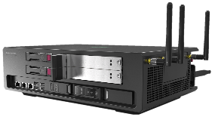
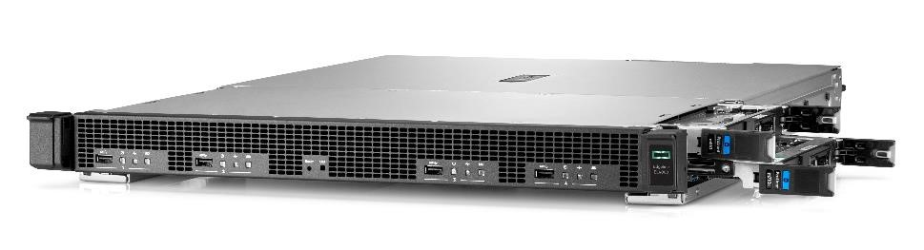
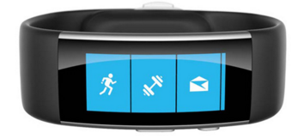
Edge & Azure data Buses : EdgeKafka-to-AzureHub
Microsoft Azure
Purpose of the Edge2azure script :
Send data flowing locally on the Edgeline to Azure cloud (from Kafka bus to Azure IoT hub)
Implement a mechanism of aggregation to be able to regulate the amount of data sent to Azure → 1 message every N seconds. This duration is a « time window » during which data received on kafka have to be aggregated.
Processing
Processing
VIZ
Azure IOT HUB
DB
Cartridge on EL1000
Cartridge on EL1000
Cartridge
Cartridge
Cartridge
Cartridge
APPS
. . .
APPS
edge2azure
APPS
. . .
APPS
edge2azure
APPS
. . .
APPS
. . .
APPS
APPS
edge
2azure
. . .
DATA BUS
DATA BUS
DATA BUS distributed on moonshot servers (EL4000)
Linux
Linux
Linux
Linux
Linux
Linux
« Things »
(sensors)
Edgeline EL1000
« Things »
(sensors)
Edgeline EL1000
Edgeline EL4000

Slide 3
Zoom on the script
Microsoft Azure
Azure IOT HUB
Local applications
Local applications
Local applications
Edge2azure script :
Running on edgeline server
Independant python script
Listening list of topics on the Kafka Bus
Do aggregation on a defined duration
Send aggregated data from Kafka topics to Azure IoIT Hub
Kafka
Topic A
Topic B
Edge2azure
Topic …
python interpretor
Linux
Server(s) at the edge

Slide 4
Python script : guidance
Single file : 1 python file (.py) + 1 config file (.conf)
Running on Python 3.x (not Python 2.x)
Principle :
For each kafka topic listed in the config file, the script creates a listener working inside its own thread.
We have 1 kafka topic = 1 listener = 1 instance/object of a class = 1 thread of execution
When a message arrive in the listener, an aggregation function is launched to aggregate the message with the data already received during the timewindow.
If the duration defined in the config file is reached, the aggregated object is sent to Azure Cloud and resetted OR If the duration is not reached, the listener wait for another message from the kafka topic.
Challenge : each topic has a model of data hence each aggregation model for each topic needs to be implemented in a function
Example : the function to aggregate with buffering the hearthrate won’t be the same than for the temperature.
The main parts of the script can be :
main section to create and launch the listeners
class KafkaTopicListener : each instance will be a thread listening and aggregating a kafka topic
class AggregationModels : this class will contain the functions of aggregation used by the listener instance
The purpose is to separate thread execution and aggregation functions → we want to upgrade aggregations easily

Slide 5
Skeleton proposed of the python script 1 on 3
Import …
# THIS CLASS CONTAINS ALL THE AGGREGATION FUNCTIONS : FOR EACH TOPIC, FOR EACH AGGREGATION METHOD
Class TopicAggregator :
@staticmethod
def gyroscope_buffering (already_aggregated_values, new_value_to_aggregate) :
…. HERE THE CODE TO DO THIS MODEL OF AGGREGATION FOR GYROSCOPE : buffering the values in the time windows
@staticmethod
def gyroscope_keep_last (already_aggregated_values, new_value_to_aggregate) :
…. HERE THE CODE TO DO THIS MODEL OF AGGREGATION FOR GYROSCOPE : keepting only the last value in time
… other variables and model of aggregations ….
CLASS KAFKA LISTENER : SEE NEXT SLIDE
Main section of the python script
Get the config
Loop For each topic :
- create a KafkaTopicListener instance with the parameters of the topic
- start the instance with instance.start() -> the listener will be executed in a thread in parallel
- sleep for 1 or 2 seconds before looping on next topic to listen
End of the main program : the listeners are executing in the background

Slide 6
Skeleton proposed of the python script 2 on 3
…
class KafkaTopicListener (threading.Thread) :
def __init__(self, parameters_for_the_topic):
self.topic_name = …
self.topic_duration = …
def aggregate(self, new_message) :
if self.topic_name == ‘gyroscope’ :
if self.topic_model == ‘buffering’ :
self.my_aggregated_values = TopicAggregator.gyroscope_buffering(self.my_aggregated_values, new_message)
elif self.topic_model == ‘keep_the_last’ :
self.my_aggregated_values = TopicAggregator.gyroscope_keep_last(self.my_aggregated_values, new_message)
else:
# here the default aggregation will be « keep_last » for the gyroscope
self.my_aggregated_values = TopicAggregator.gyroscope_keep_last(self.my_aggregated_values, new_message)
elif self.topic_name == ‘tempature’ :
…. Aggregation for temperature topic
…..
def run(self)
connection to kafka with python library using the parameters for the topic
# --- Infinite loop on the listening of kafka
while (true)
# --- loop for aggregation
time.perf_counter() → to get the starting time of aggregation
aggregation_duration_not_reached = TRUE
while (aggregation_duration_not_reached) :
kafka_message = waiting_for_new message
self.aggregate(kafka_message )
time.perf_counter() → message arrived, time spent since start waiting
IF ( time spent > aggregation duration for the topic )
aggregation_duration_not_reached = FALSE
# --- Aggregation reached : sending to azure
SEND THE AGGREGATED VALUES ON AZURE → Adding some fields/values (topic, unique name, see further)
EMPTY THE BUFFER OR RESET THE AGGREGATED VALUES before looping back on the while
…

Slide 7
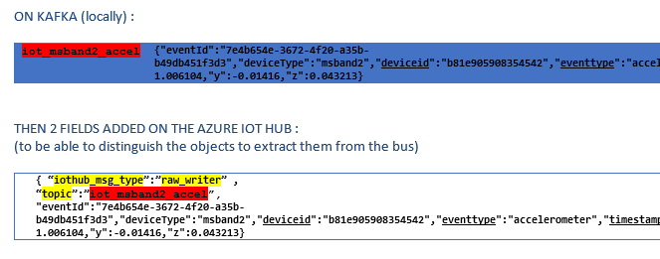
Skeleton proposed of the python script 3 on 3
TEMPLATE OF CONFIG FILE
Implemented in python with config parser lib
Each Kafka topic to listen has several parameters
-> should be easy to add a new topic
-> the aggregation model can be defined per topic
Template of configuration file of the script
[global_section]
edge_unique_name = ‘vm_93’
Kafka_connection_parameters = …
iot_hub_connection_string=‘…’
iot_hub_device_id=‘…’
[topics_section]
topic_A.name_in_azure = ‘topic_A_name_in_azure’
topic_A.aggregation_model = buffer
topic_A.aggregation_duration_sec = 60
topic_B.name_in_azure = ‘topic_A_name_in_azure’
topic_B.aggregation_model = last_value
topic_B.aggregation_duration_sec = 60
.
….
FIELDS TO ADD WHEN COPYING A MESSAGE
(=JSON OBJECT) FROM KAFKA BUS TO AZURE
It is needed to keep track of :
type of message it will be on the IoT Hub, to identify from which device the message is coming once in Azure
topic on kafka bus from which the message is extracted

Slide 8
Aggregation : buffering
HERE ARE THE NOTES FROM VINCENT
It’s about BUFFERING as aggregation rule.
Other kinds of aggregation can be keeping the last_value of the time interval, or keeping the max_value, or providing the average value, etc…
At each processing loop (periodicity is normally defined by spark.batch_duration parameter)
Fill in the buffer for each sensor. If buffer reaches the limit then remove the oldest entries (in the order they entered the buffer) to keep the last arrived, and continue filling it.
Push each buffer to the IoT Azure bus
Compute the traffic frequency and log it to logger
Nb message sent / spark.batch_duration
Cleanup the buffer for the next loop

