Slide 1

EMPLOYEES BURNOUT ANALYSIS AND PREDICTION
CAPSTONE PROJECT
Presented By:
Name: Suman Kumar Gochhayat
College Name: Balasore College of Engineering & Technology
Department : Computer Science & engineering
Internship domain : Artificial Intelligence
Email id : ssgochhayat2018@gmail.com

Slide 2
PROJECT OVERVIEW
Employee burnout is a significant issue affecting both individual well-being and organizational performance. Key contributors include excessive workloads, limited autonomy, insufficient support, and poor work-life balance. Burnout manifests as emotional exhaustion, depersonalization, and diminished personal accomplishment, leading to higher absenteeism, turnover, and reduced job satisfaction. Strategies to combat burnout include fostering a supportive culture, flexible work practices, and wellness programs, promoting healthier and more productive work environments.

Slide 3
OUTLINE
Problem Statement
System Development Approach
Algorithm & Deployment
Result
Conclusion
Future Scope
References

Slide 4
Problem Statement
This project examines employee burnout through data-driven insights and predictive modeling to uncover its root causes, warning signs, and risk factors within the organization. Utilizing these findings, targeted interventions are designed to promote a healthier work culture, boost employee engagement, and reduce burnout, driving overall organizational success and sustainable growth.

Slide 5
System Approach
System requirements
Google Colab - It provides a cloud-based Jupyter notebook interface pre-configured with popular libraries and tools.
Google Drive - Convenient for smaller datasets and collaboration.
Hardware Acceleration - Use hardware accelerators like GPUs or TPUs, which Google Colab provides with varying availability.
Library required to build the model
Pandas – It is a Python library for data manipulation, analysis, and structured data handling.
Matplotlib - A Python library for creating static, interactive, visual plots.
Sklearn - It simplifies machine learning with tools for modeling and evaluation.
Seaborn - It simplifies data visualization with beautiful, statistical graphs in Python.

Slide 6
Algorithm & Deployment
Understand the Problem - Predict the "Burn Rate" of employees based on factors like designation, resource allocation, and mental fatigue.
Import Libraries - Import necessary libraries: pandas, numpy, matplotlib, seaborn, sklearn.
Load Dataset - Load the dataset into a pandas DataFrame.
Data Preprocessing - Handle missing values (e.g., using fillna () or dropna ()).Encode categorical variables using Label Encoder or get_dummies ().Normalize numerical features with Standard Scaler().
Exploratory Data Analysis (EDA) - Visualize feature relationships with scatter plots and heatmaps. Check distributions and outliers with histograms.
Feature Selection - Select relevant features based on correlation or domain knowledge.
Split Dataset - Split data into training and testing sets (e.g., 80% train, 20% test) using train_test_split ().
Model Training - Train a model (e.g., Linear Regression, Random Forest).

Slide 7
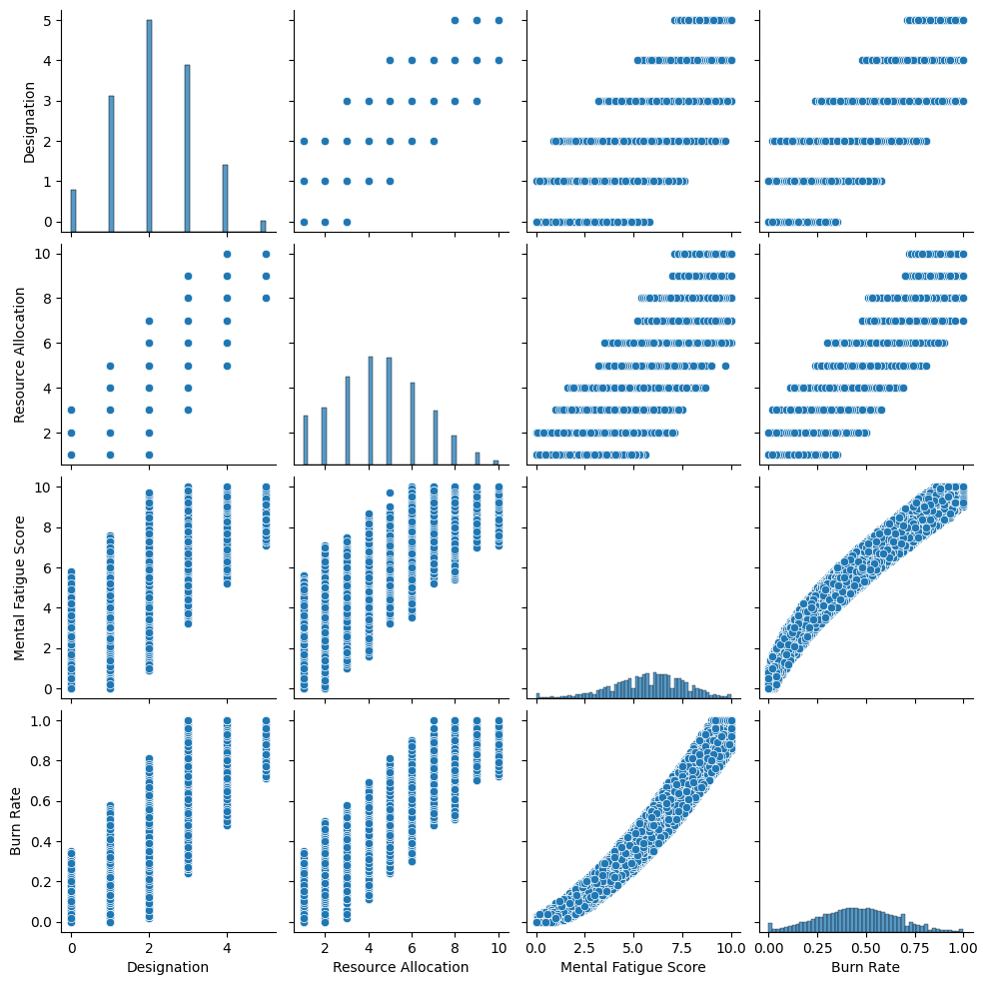
Result

Slide 8
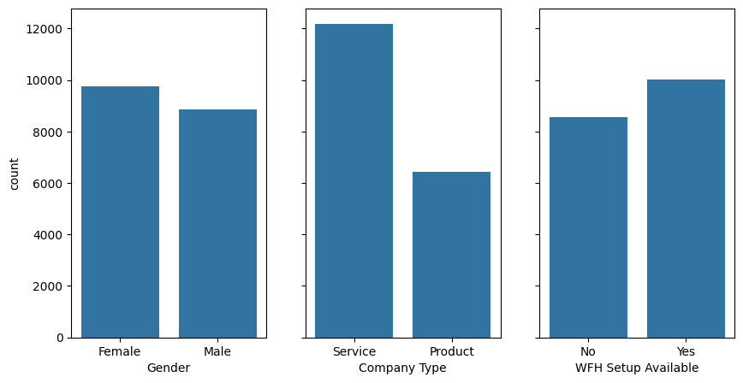
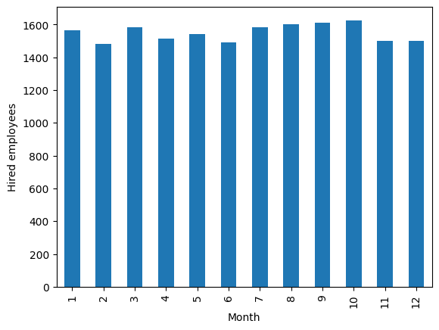
Result

Slide 9
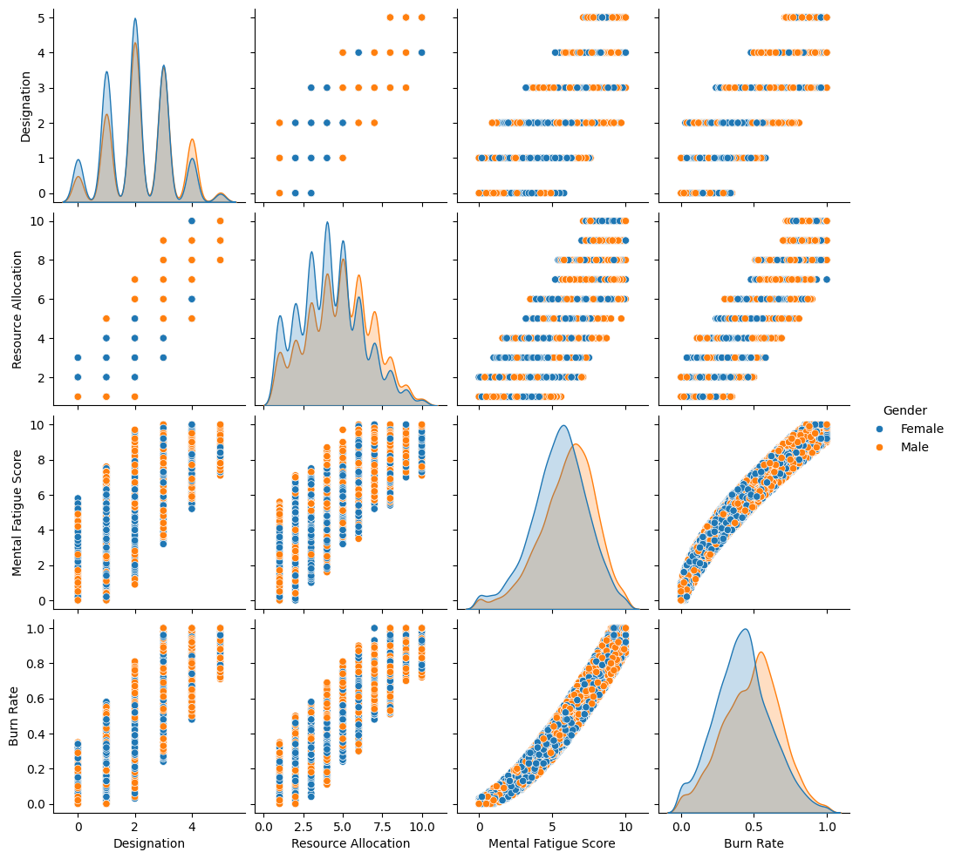
Result

Slide 10
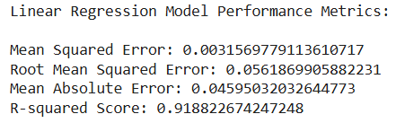
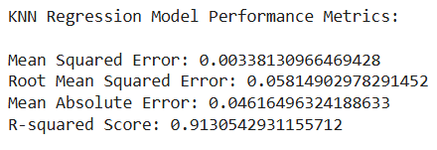
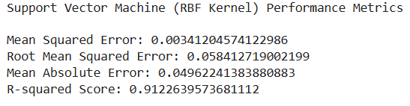
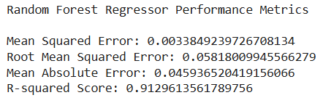
Result

Slide 11
Conclusion
Burnout analysis reveals key risk factors within our organization, highlighting the urgent need for proactive intervention. By implementing preventive measures such as workload management, employee recognition, and stress management programs, we can create a healthier and more productive work environment. Regular monitoring and reassessment will ensure the effectiveness of our burnout prevention strategies and allow us to adapt to evolving needs.

Slide 12
Future scope
Real-time monitoring - Track burnout risk in real-time using live data.
HR tech integration - Seamlessly connect burnout tools with HR systems.
Empower employees - Give employees tools to manage their own burnout risk.
Transform workplace culture - Create a culture that prioritizes employee well-being.
Focus on prevention - Shift towards proactive well-being initiatives.
Global adaptation - Adapting solutions to different cultures and work settings.
Ethical data use - Ensuring responsible and fair use of employee data.

Slide 13
References
Artificial Intelligence Fundamentals from IBM SkillsBuild.
https://www.geeksforgeeks.org/k-nearest-neighbours/
https://www.researchgate.net/publication/370831958_The_link_between_burnout_and_job_performance_a_meta-analysis
https://www.tandfonline.com/doi/abs/10.1080/1359432X.2023.2209320
https://ieeexplore.ieee.org/document/9587830

Slide 14
THANK YOU

