Slide 1
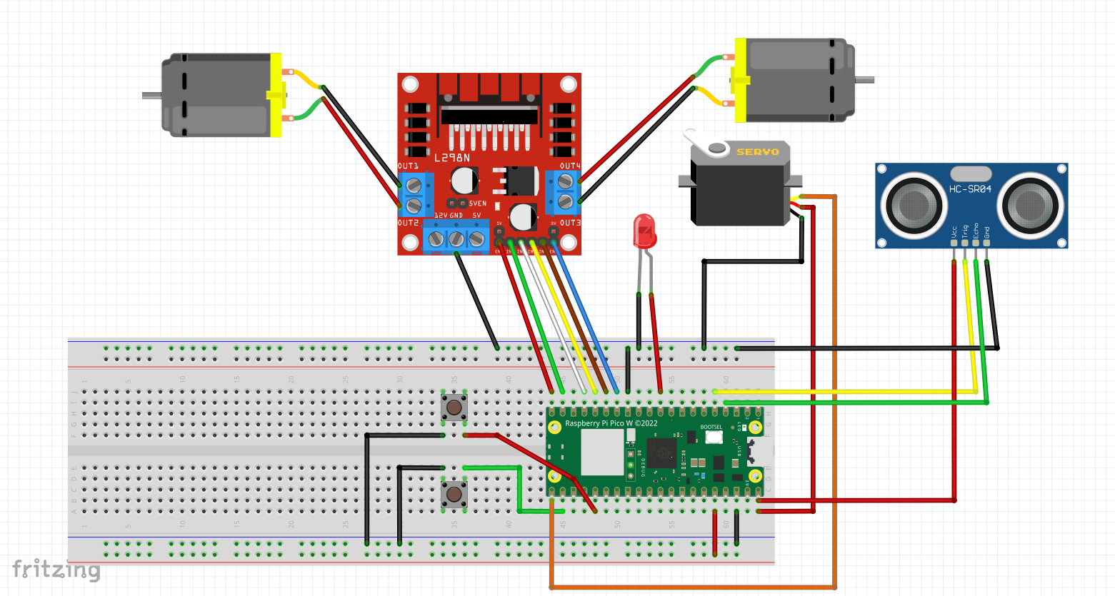
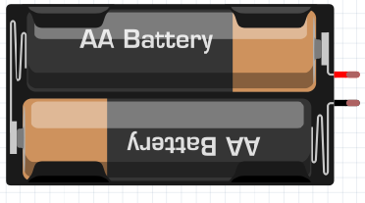
OBSTACLE AVOIDING
ROBOTIC CAR
15 14 13 12 11 10

Slide 2
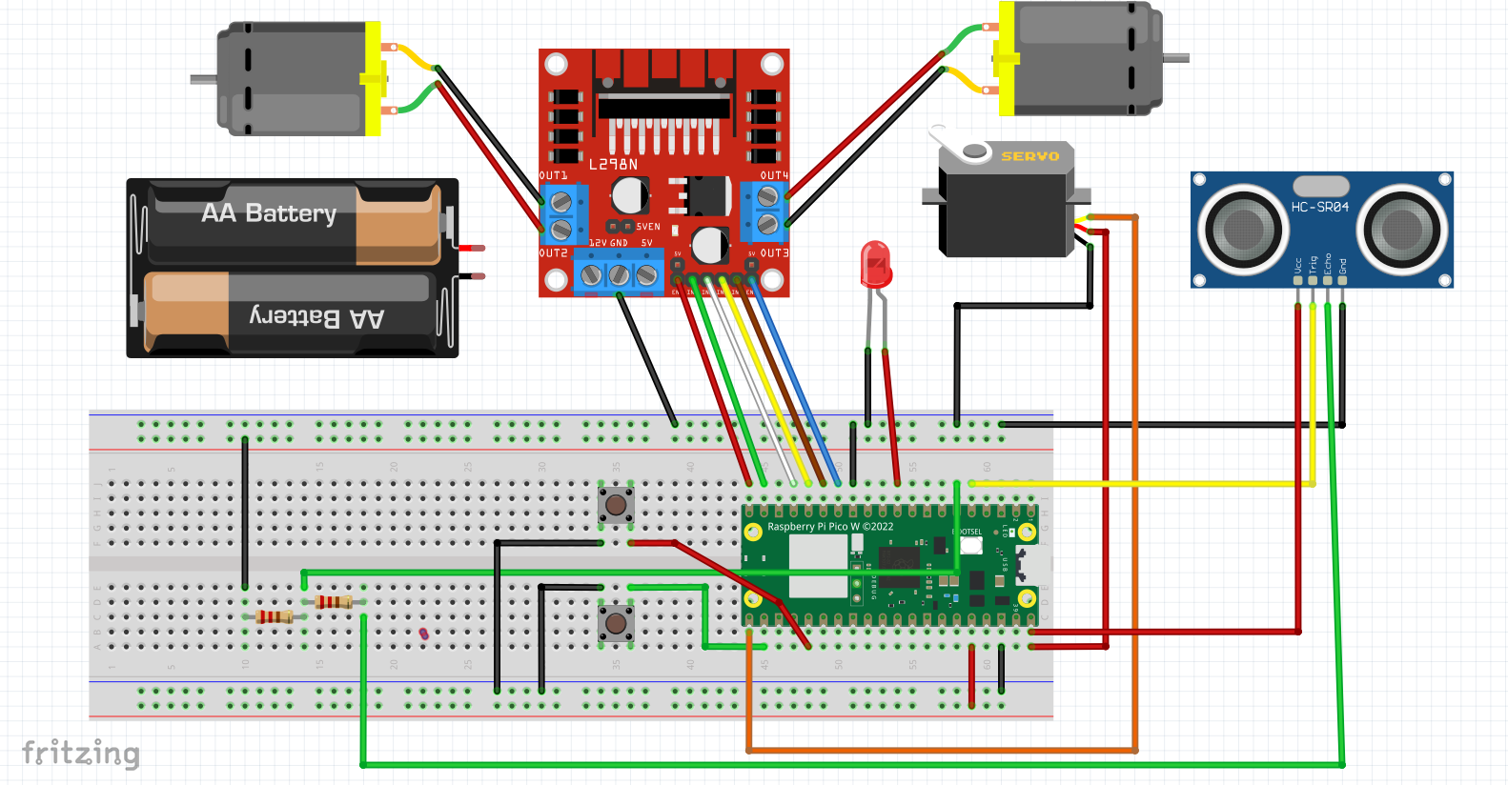
OBSTACLE AVOIDING
ROBOTIC CAR
15 14 13 12 11 10
VOLTAGE
DIVIDER
2.2K
1K

Slide 3
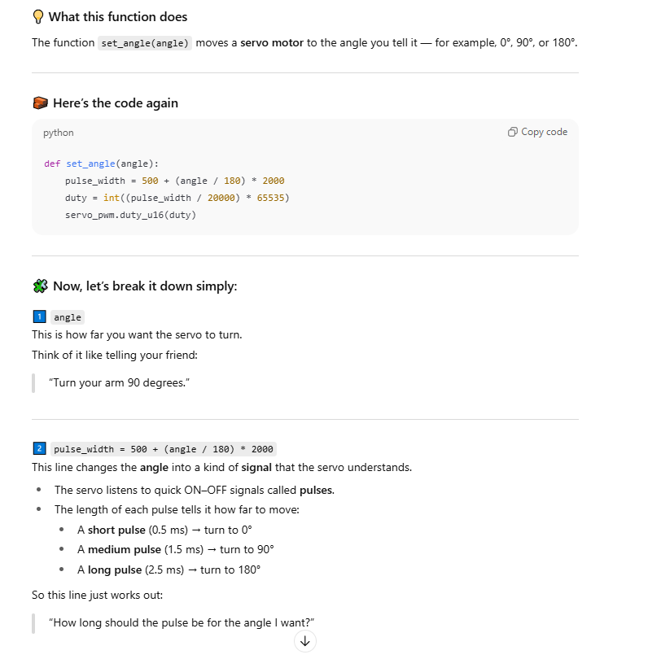
Servo Motor

Slide 4
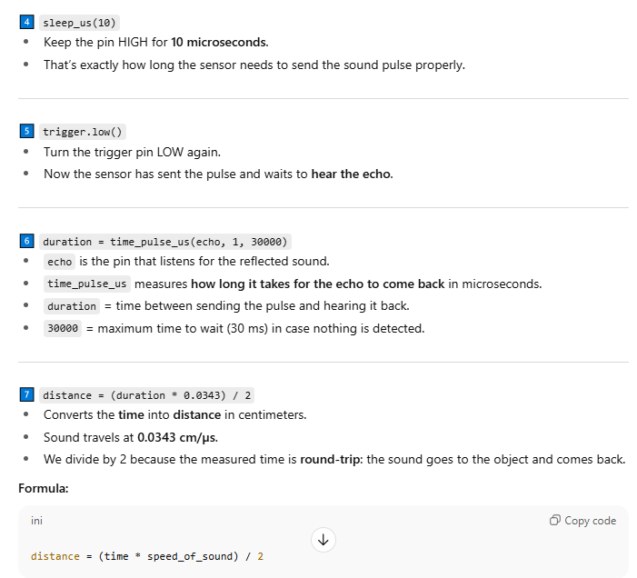
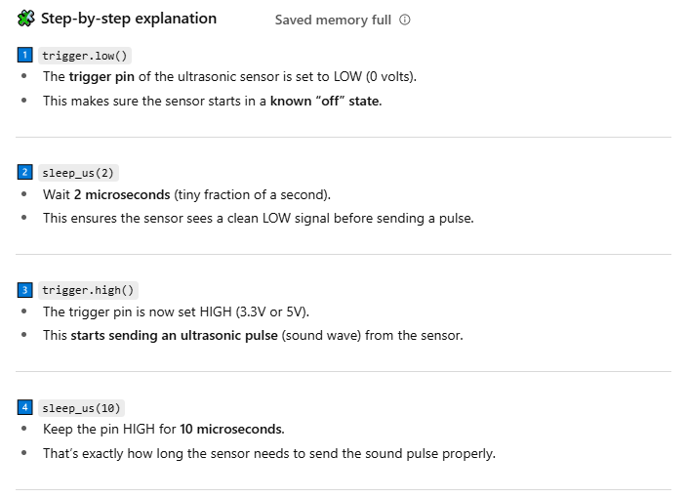
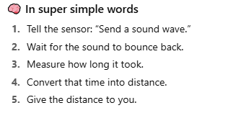
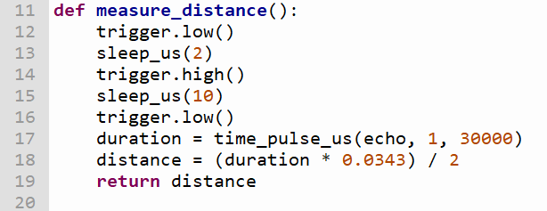
How the HCSR04 works

Slide 5
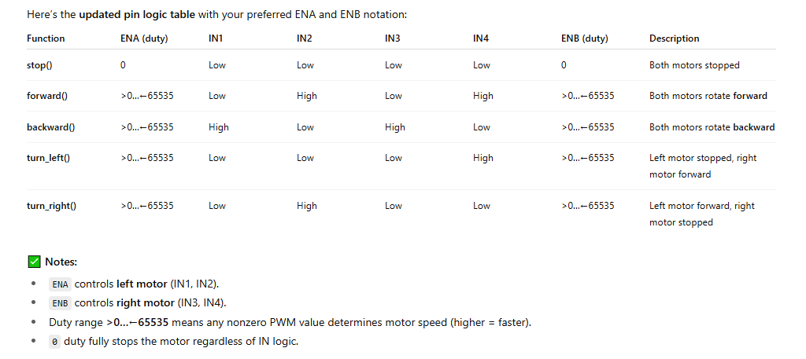
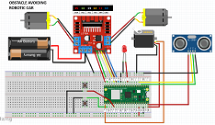
CONTROLLING THE L298N MOTOR DRIVER
PIN LOGIC TABLE USED IN SAMPLE CODE
15 14 13 12 11 10

Slide 6
FORWARD
duty
low
high
low
high
duty
ENA
IN1
IN2
IN3
IN4
ENB
15 14 13 12 11 10

Slide 7
BACKWARD
duty
high
low
high
low
duty
ENA
IN1
IN2
IN3
IN4
ENB
15 14 13 12 11 10

Slide 8
TURN LEFT
duty
low
low
low
high
duty
ENA
IN1
IN2
IN3
IN4
ENB
15 14 13 12 11 10

Slide 9
TURN RIGHT
duty
low
high
low
low
duty
ENA
IN1
IN2
IN3
IN4
ENB
15 14 13 12 11 10

