Slide 1


Slide 2
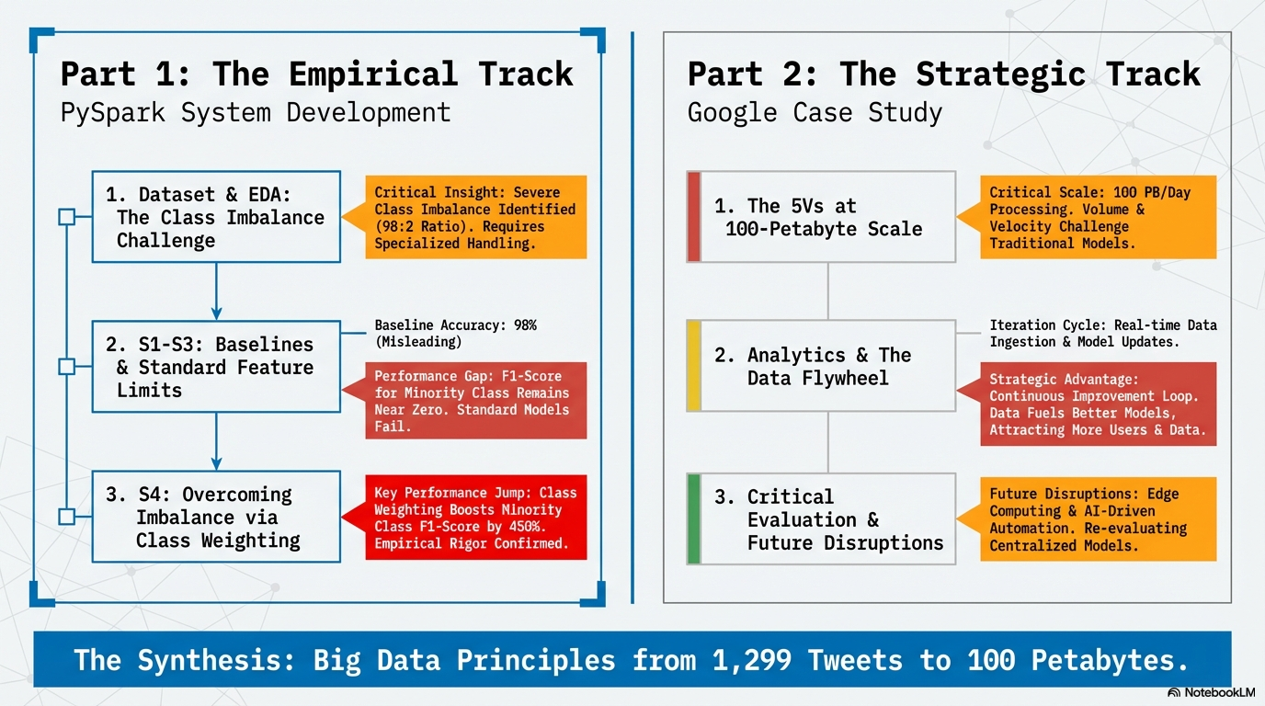

Slide 3
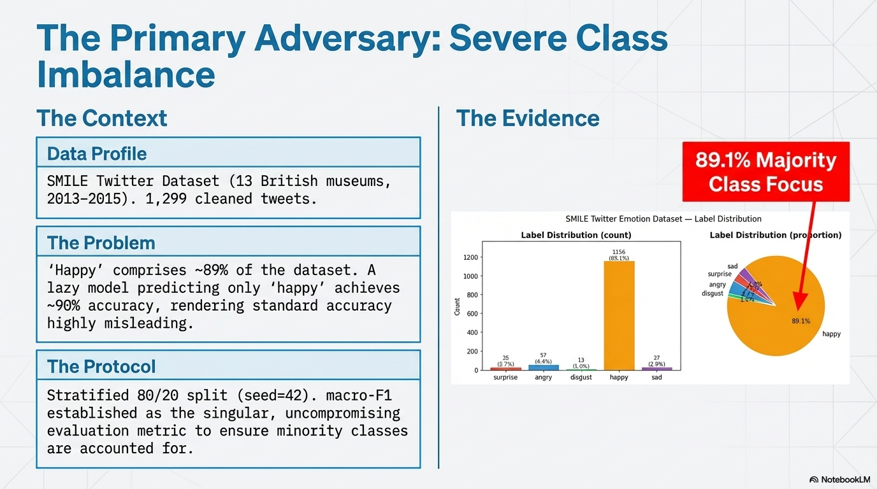

Slide 4
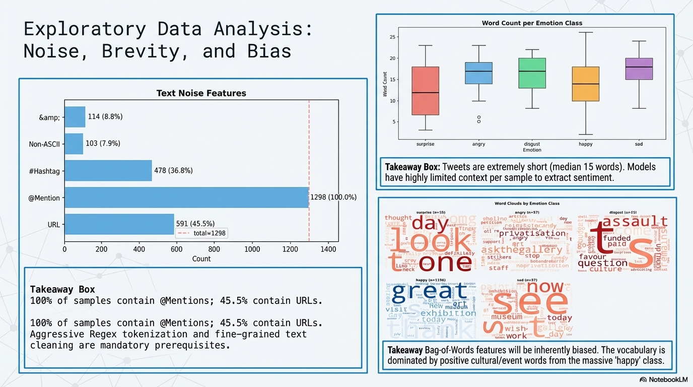

Slide 5
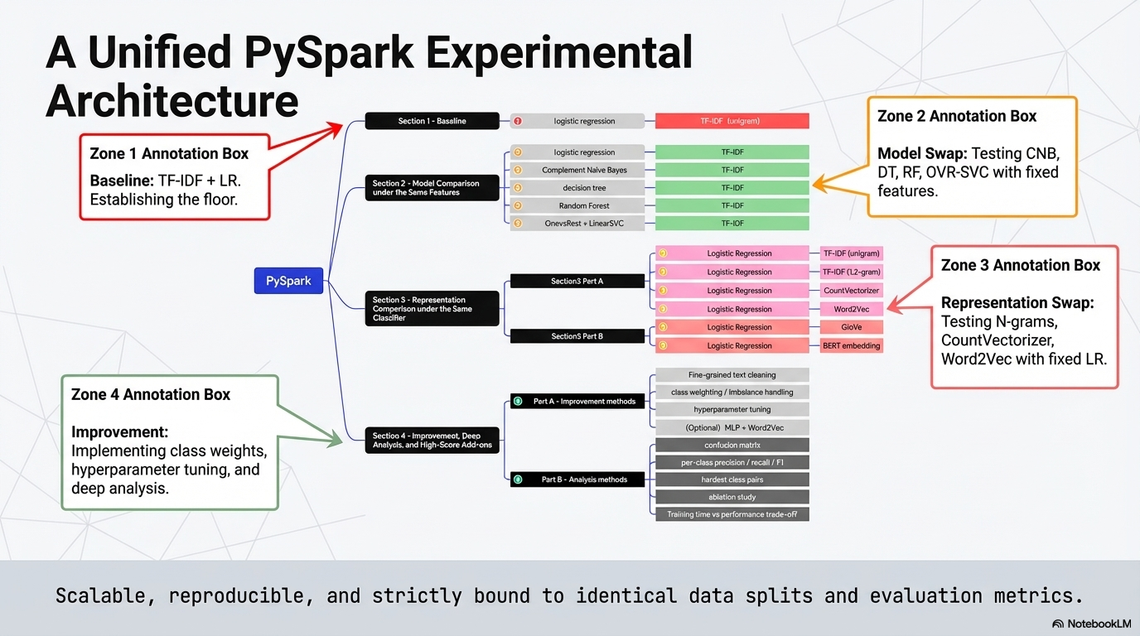

Slide 6
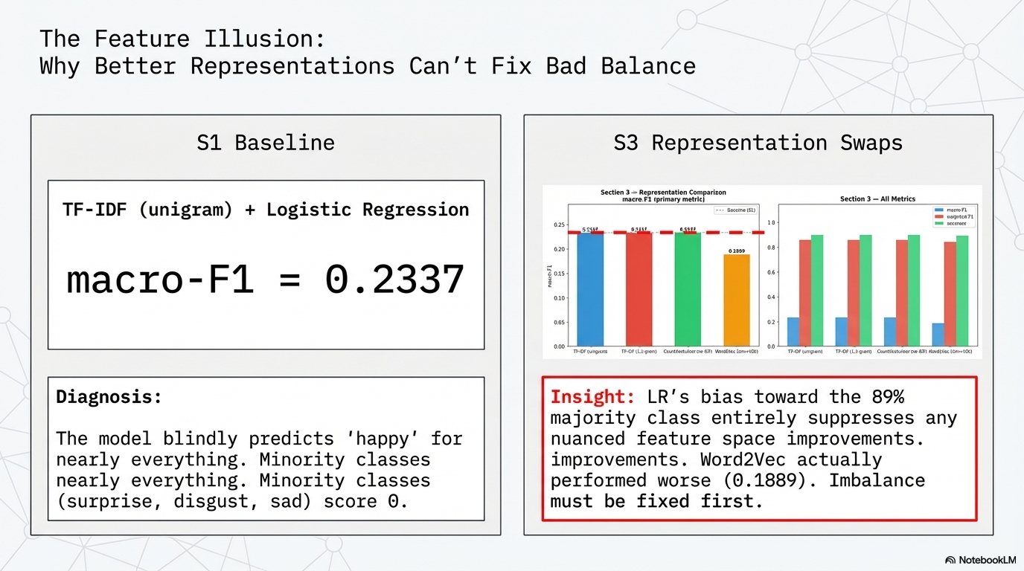
Notes:
“这一页我们想回答一个问题：baseline 表现差，是不是因为 TF-IDF 太简单？
为此，我们固定分类器，比较了多种表示方式，包括 n-grams、CountVectorizer 和 Word2Vec。结果发现 macro-F1 并没有明显改善，Word2Vec 甚至更差。
这说明当前任务的首要瓶颈不是特征表示，而是类别不平衡。模型已经被 89% 的 majority class 强烈主导，因此在处理 imbalance 之前，单纯升级表示方式并不能带来实质改善。”
"On this page, we want to answer a question: is the poor baseline performance due to TF-IDF being too simple?
To investigate, we fixed the classifier and compared several representation methods, including n-grams, CountVectorizer, and Word2Vec. The results showed no significant improvement in macro-F1—Word2Vec even performed worse.
This suggests that the main bottleneck in the current task isn't feature representation, but rather class imbalance. The model is heavily dominated by the 89% majority class, so upgrading representations alone won't help much until we address the imbalance first."

Slide 7
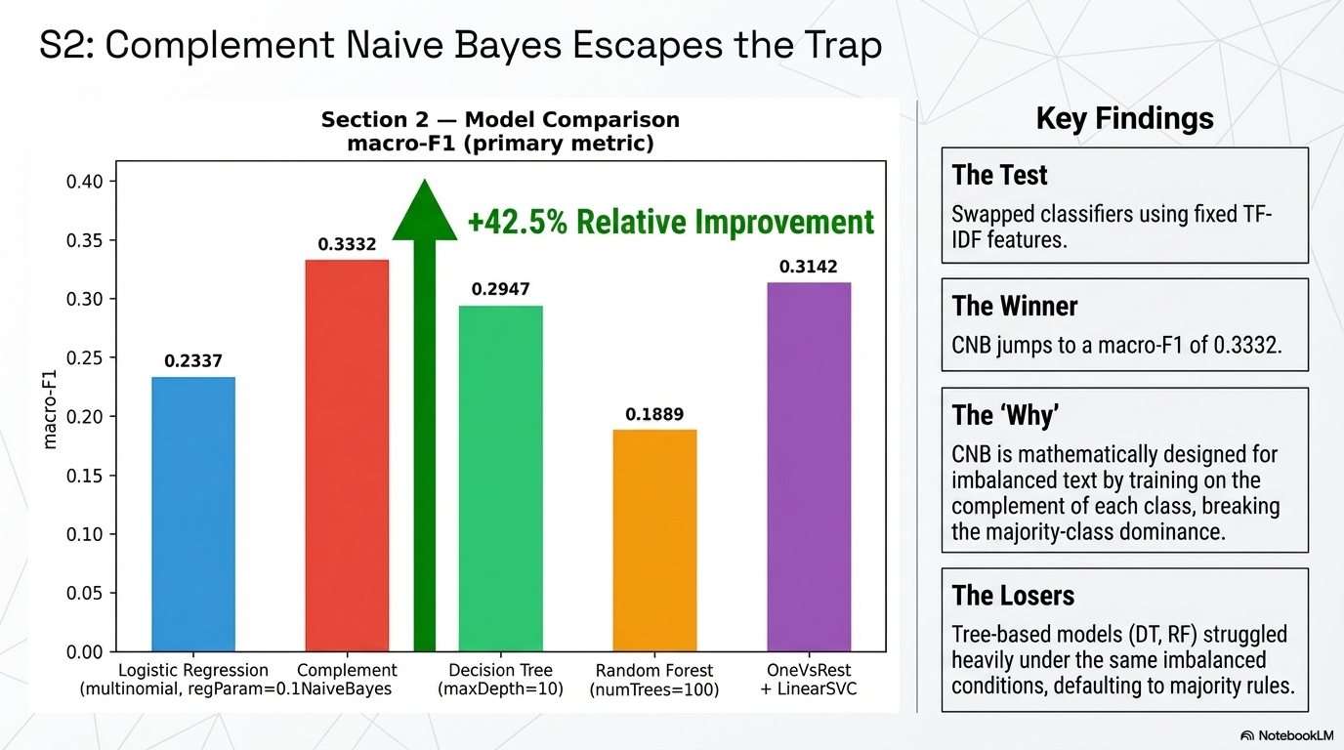

Slide 8
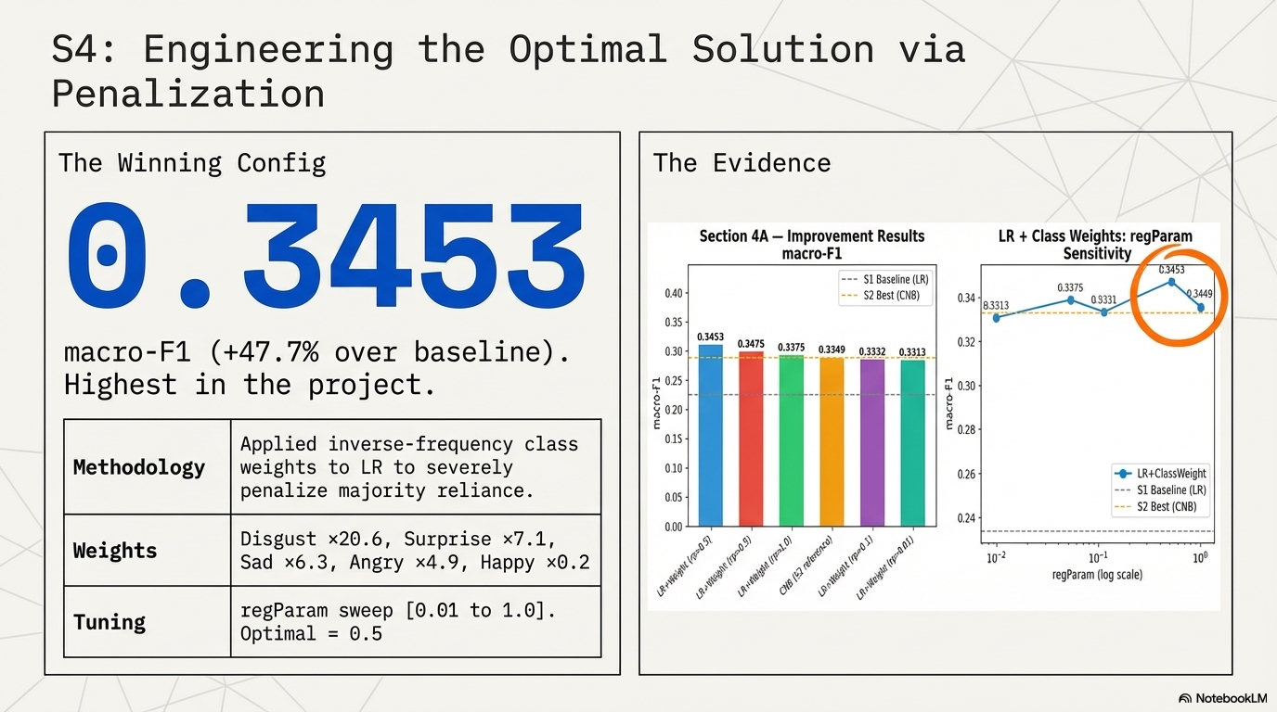
Notes:
“Originally, our best Section 4 result came from weighted Logistic Regression, reaching a macro-F1 of 0.3453. This confirmed that class weighting was a meaningful solution to the imbalance problem. However, after completing the remaining experiments, our ablation study revealed a stronger final configuration: light cleaning only + TF-IDF + class weight + LR, which raised macro-F1 further to 0.4465. So the final lesson is that imbalance handling mattered, but preprocessing strategy mattered just as much.”

Slide 9
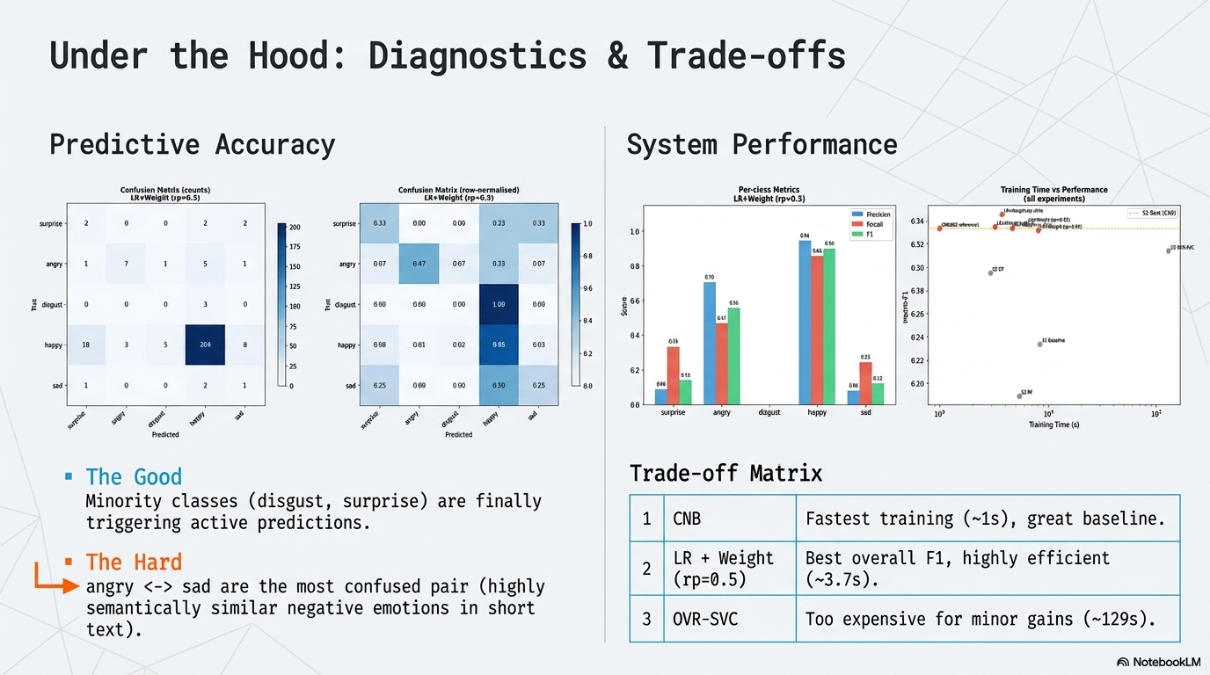

Slide 10
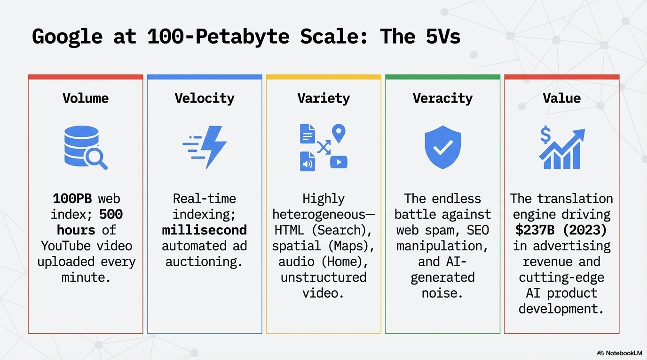

Slide 11
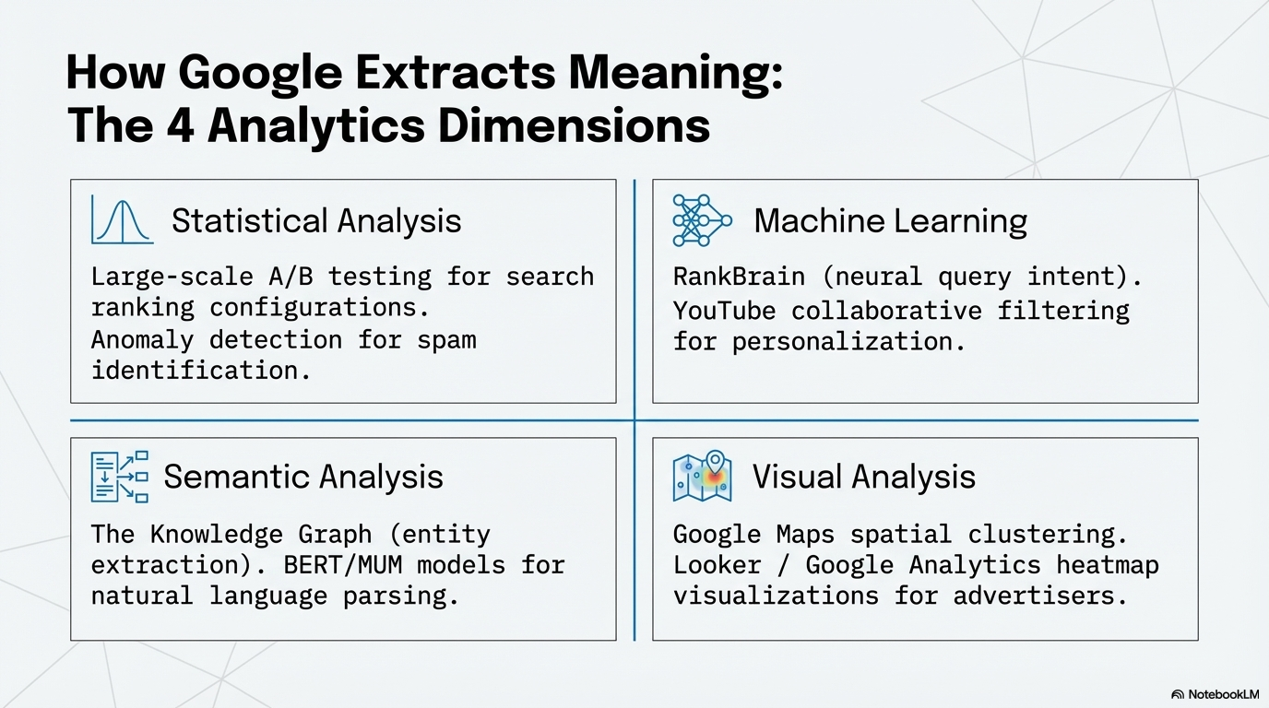

Slide 12
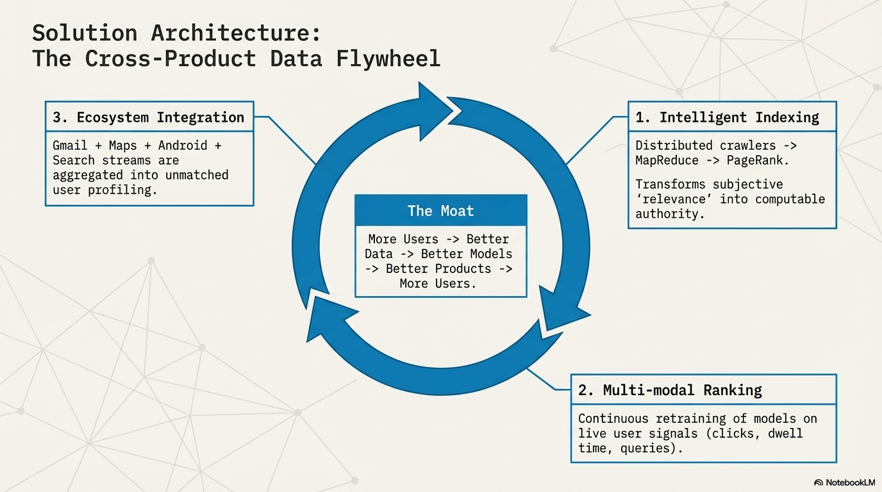

Slide 13
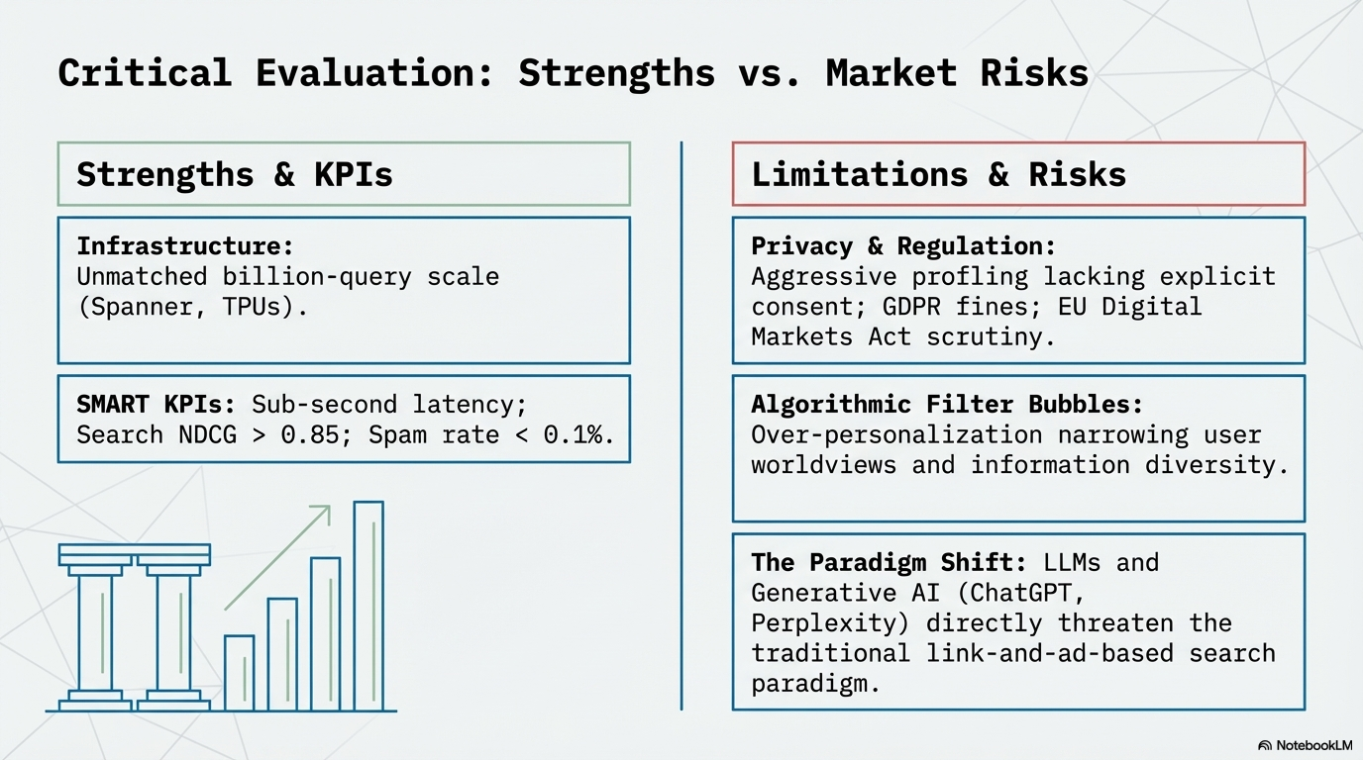

Slide 14
