Slide 1
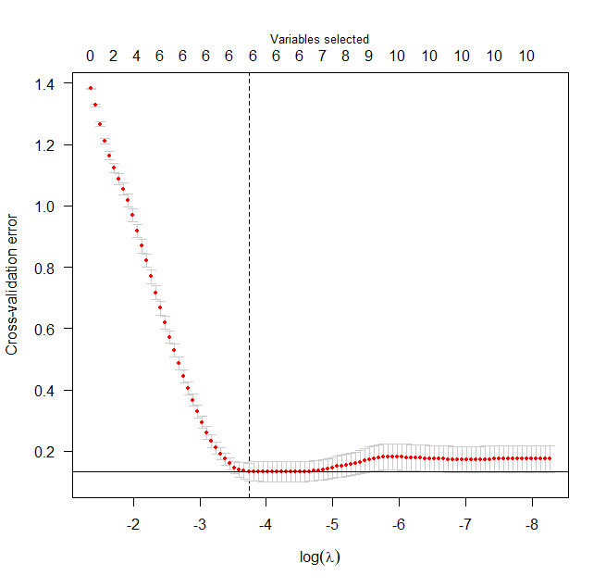
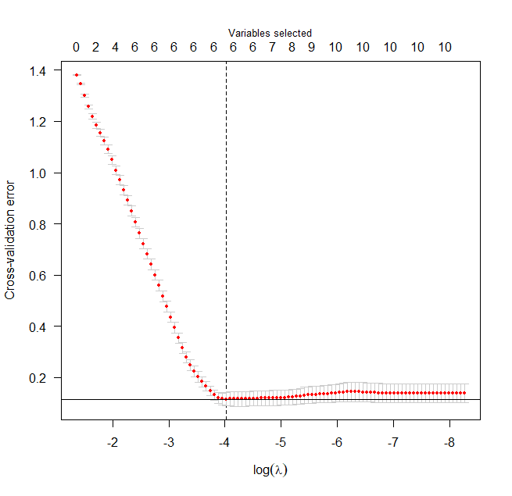
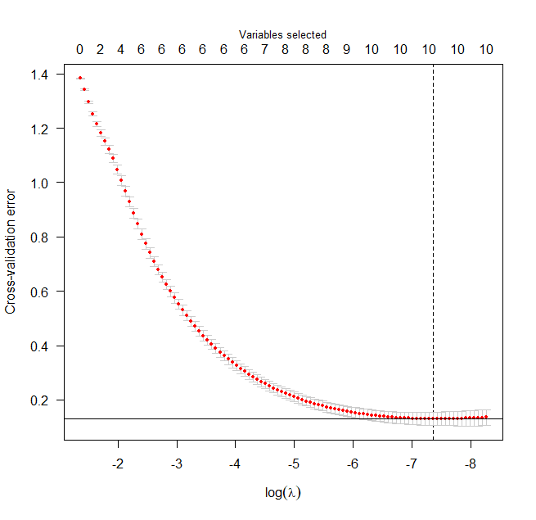

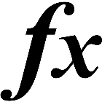




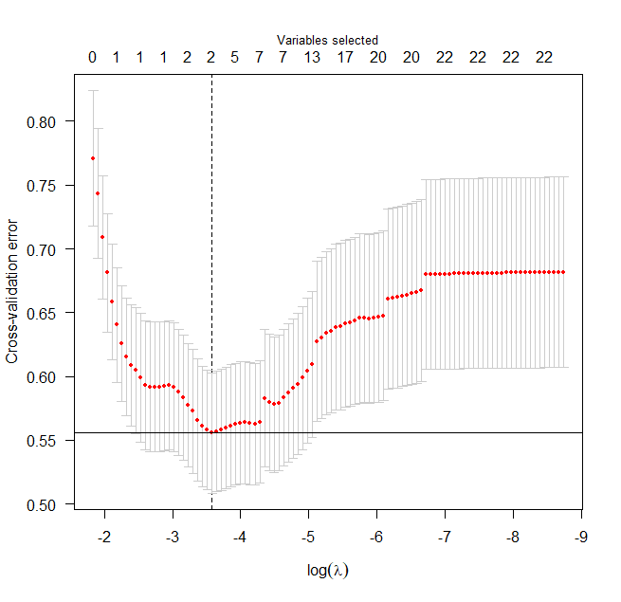
Department of Statistics
Honors Poster Presentation
December 5, 2018
SeokHwan Song, Dr. Zhengyuan Zhu
Comparison of the Performances of Several Penalty Functions
Background
There are a number of variables, and the values of the variables affect the results of analyzing. Some of variables are not influential and disturb the result. The variables selections are very important in analyzing data, and there are very diverse kinds of method to select variables. The penalty function in the logistic regression is one of the great existing methodologies. Error = Estimated Value – True Value Penalty Functions
Results
Compare Performances of Penalty Functions in Several Methods In order to compare performances of the functions, Cross-Validation Error, Standard Error, and variables selected are analyzed. Each method was conducted 500 times and the results’ averages are used. Original Variables
V1 | V2 | V3 | V4 | V5 | V6 | V7 | V8 | V9 | V10
2.5 | 5 | 0 | 0 | 3 | 0 | 0 | 4 | 6 | 7
 | MCP | SCAD | lasso
Cross-Validation Error | 0.1701592 | 0.171405 | 0.1758395
Standard Error | 7.090142 | 10.90302 | 12.88414
Variable Selected | 6 | 6 | 10
Penalty
Objectives
This project finds out the most efficient penalty function through several analyses. The performances of three penalty functions are compared (Lasso, Smoothly Clipped Absolute Deviations (SCAD) and Minimax Concave Penalty (MCP)) - The penalty functions have different penalties Apply a data-set from a survey into the penalty function and analyze it
Tool and Methods
Simulation
Comparing
Data-set
V1 | V2 | V3 | V4 | V5
2.59 | 5.07 | 0.00 | 0.00 | 3.10
V6 | V7 | V8 | V9 | V10
0.00 | 0.00 | 4.04 | 6.36 | 7.19
V1 | V2 | V3 | V4 | V5
2.95 | 5.77 | 0.00 | 0.00 | 3.51
V6 | V7 | V8 | V9 | V10
0.00 | 0.00 | 4.67 | 7.22 | 8.19
V1 | V2 | V3 | V4 | V5
2.22 | 4.45 | 0.26 | 0.14 | 2.62
V6 | V7 | V8 | V9 | V10
0.12 | 0.17 | 3.46 | 5.42 | 6.12
Simulate a data set using R software.
(10 coefficients, and 500 data)
Squared Error, Cross-Validation Error, and Variable selected are used.
Apply the data-set from a survey, “Swine Producers: Influenza A Virus in US Swine”.
Further Work
A survey is used, and the data from the survey is applied to MCP, the most efficient function. The survey is “Swine Producers: Influenza A Virus in US Swine, conducted by Veterinary Diagnostic Laboratory in Iowa State University.”
Conclusions
MCP performs the most efficiently among the three penalty functions. MCP has lowest Cross-Validation Error Standard Error. MCP selected variables correctly and the actual values are close to the true value. With the data-set from the survey, MCP performs well with the reliable results. Reference Fan, Jianqing, and Runze Li. “Variable Selection via Nonconcave Penalized Likelihood and Its Oracle Properties.” Journal of the American Statistical Association, vol. 96, no. 456, 2001, pp. 1348–1360., doi:10.1198/016214501753382273. Zhang, Cun-Hui. “Nearly Unbiased Variable Selection under Minimax Concave Penalty.” The Annals of Statistics, vol. 38, no. 2, 2010, pp. 894–942., doi:10.1214/09-aos729.
Cross-Validation Error | 0.5556148
Variable Selected | 2
Q72 and Q73 are only selected from 23 variables.
Penalty Functions
Conclusion
Apply the simulated data into the penalty functions (lasso, SCAD, MCP).
MCP is selected as the best performing penalty function
Acknowledgements
Citation : https://www.presentationgo.com/presentation/chain-process-diagram-for-powerpoint/
http://chittagongit.com/icon/data-set-icon-19.html

