Slide 1
Exploratory Machine Learning
Encoding Method: One Hot
Validation: Train-Test Split (90%, 10%)
ML Algorithms:
LASSO
Ridge
CART
RF
XGB

Slide 2
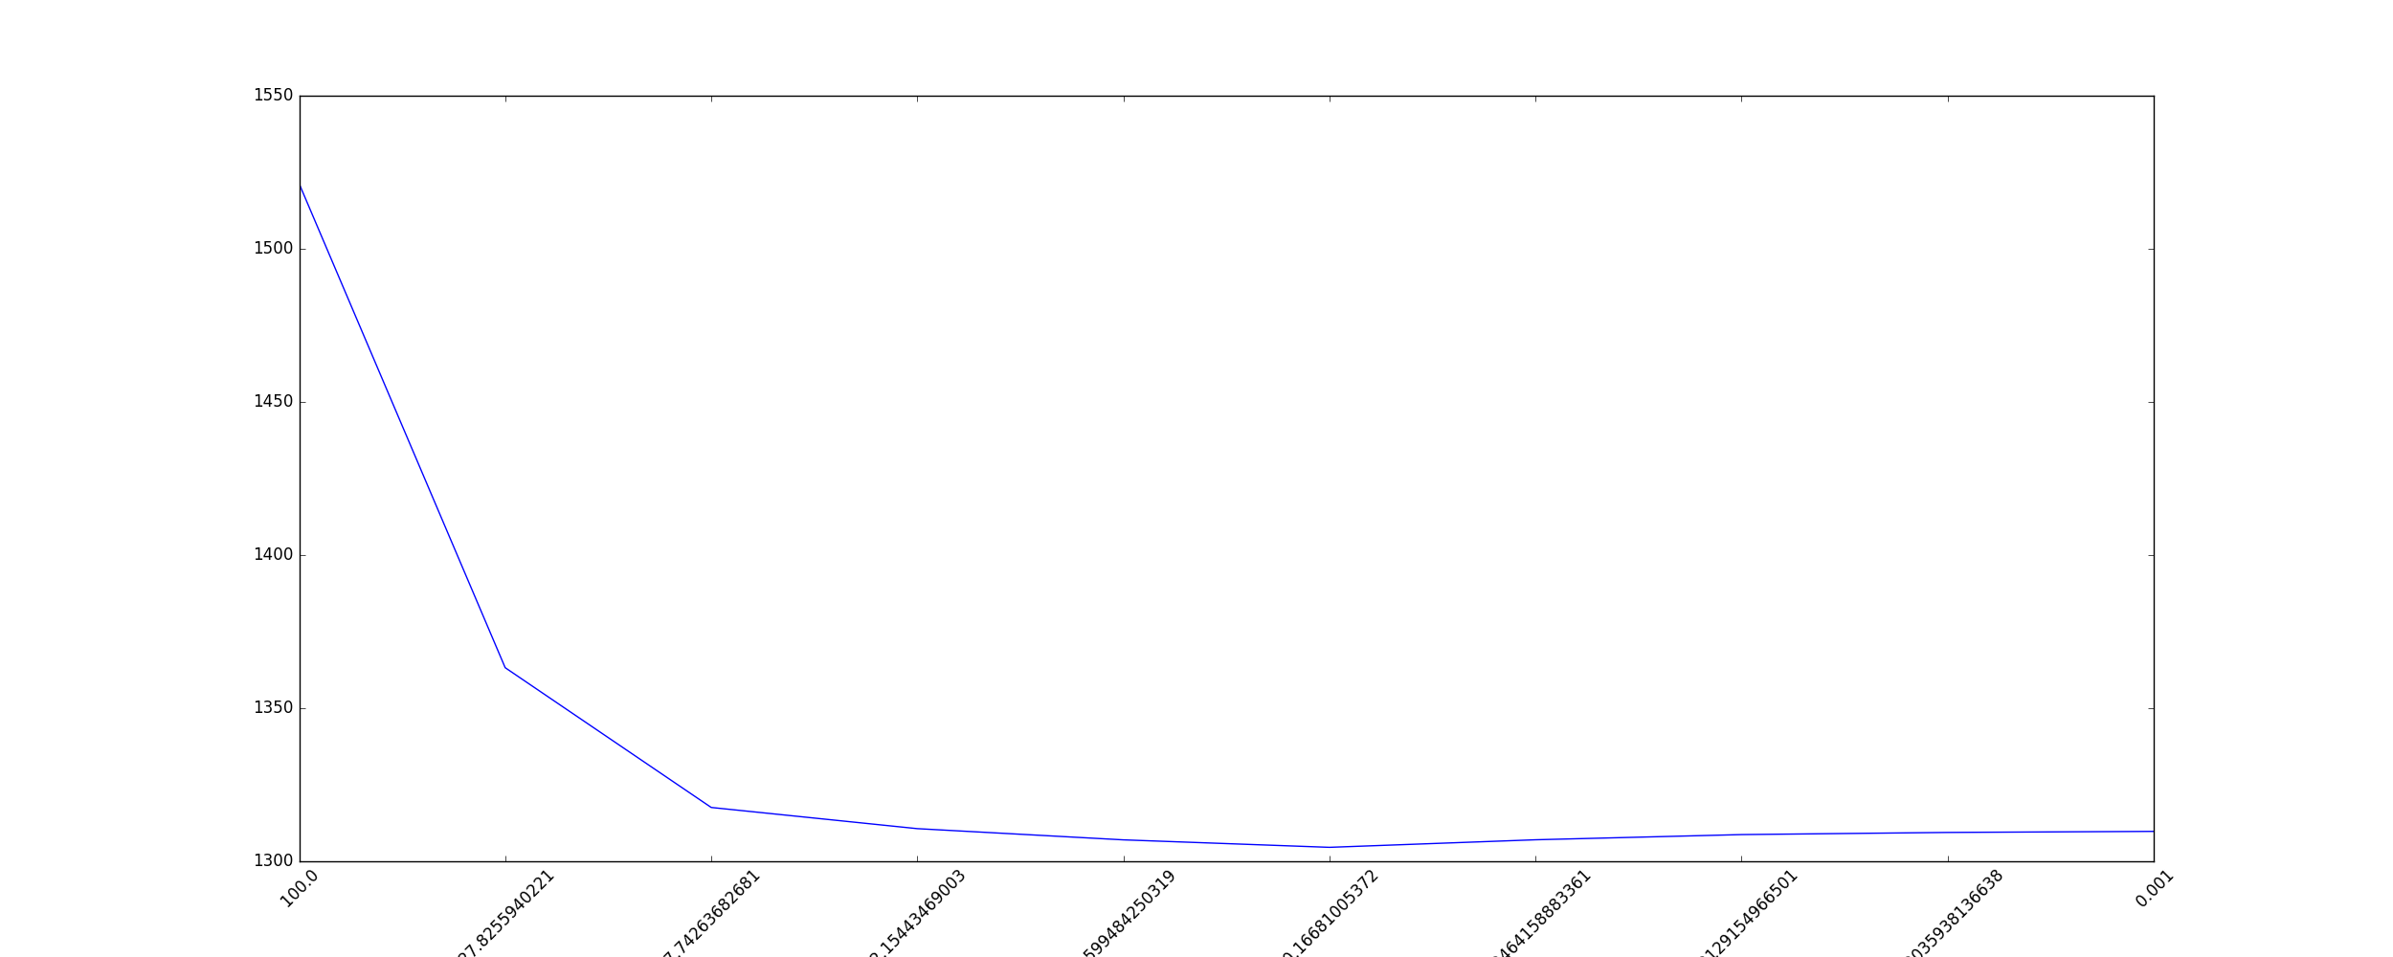
LASSO
Best lambda: 0.16681005372
Mean Absolute Error: 1304.56199159

Slide 3
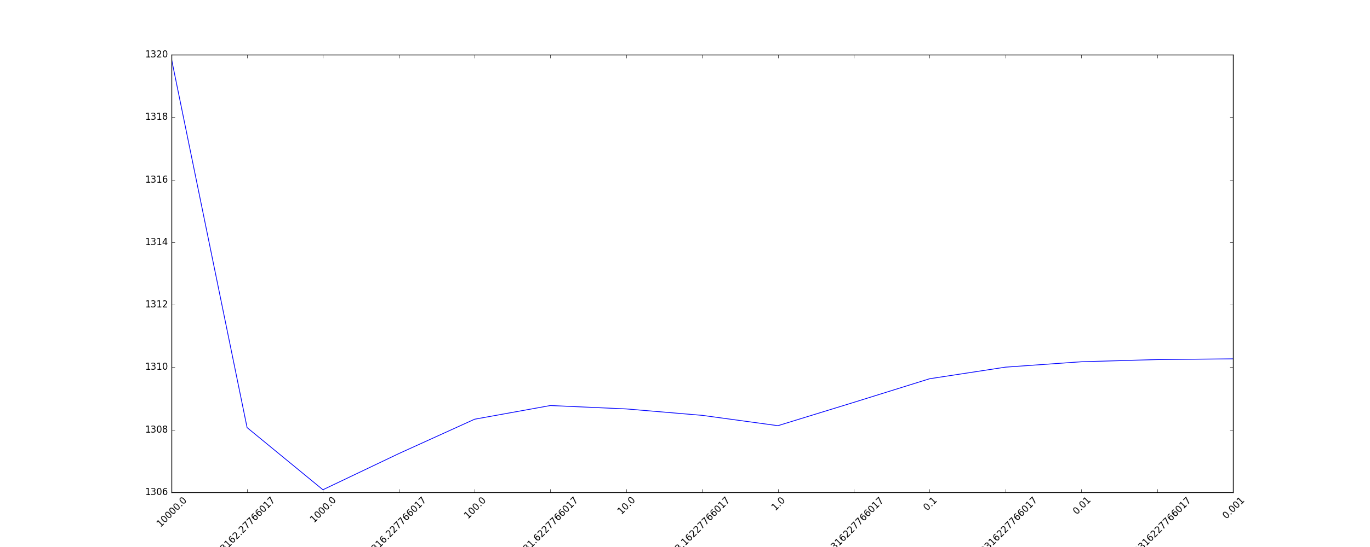
Ridge
Best lambda: 1000.0
Mean Absolute Error: 1306.081294

Slide 4
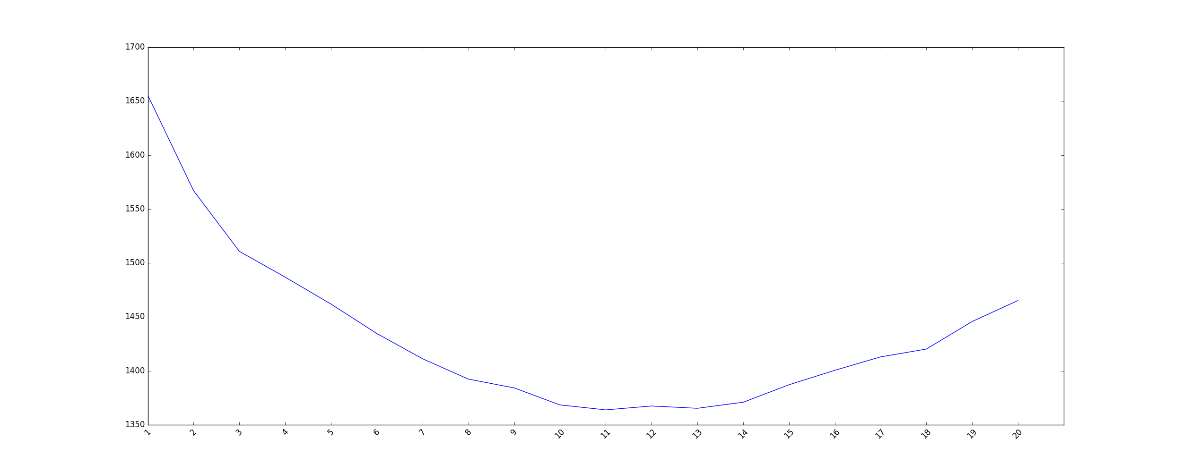
CART
Best Tree Depth: 11
Mean Absolute Error: 1363.85839567

Slide 5
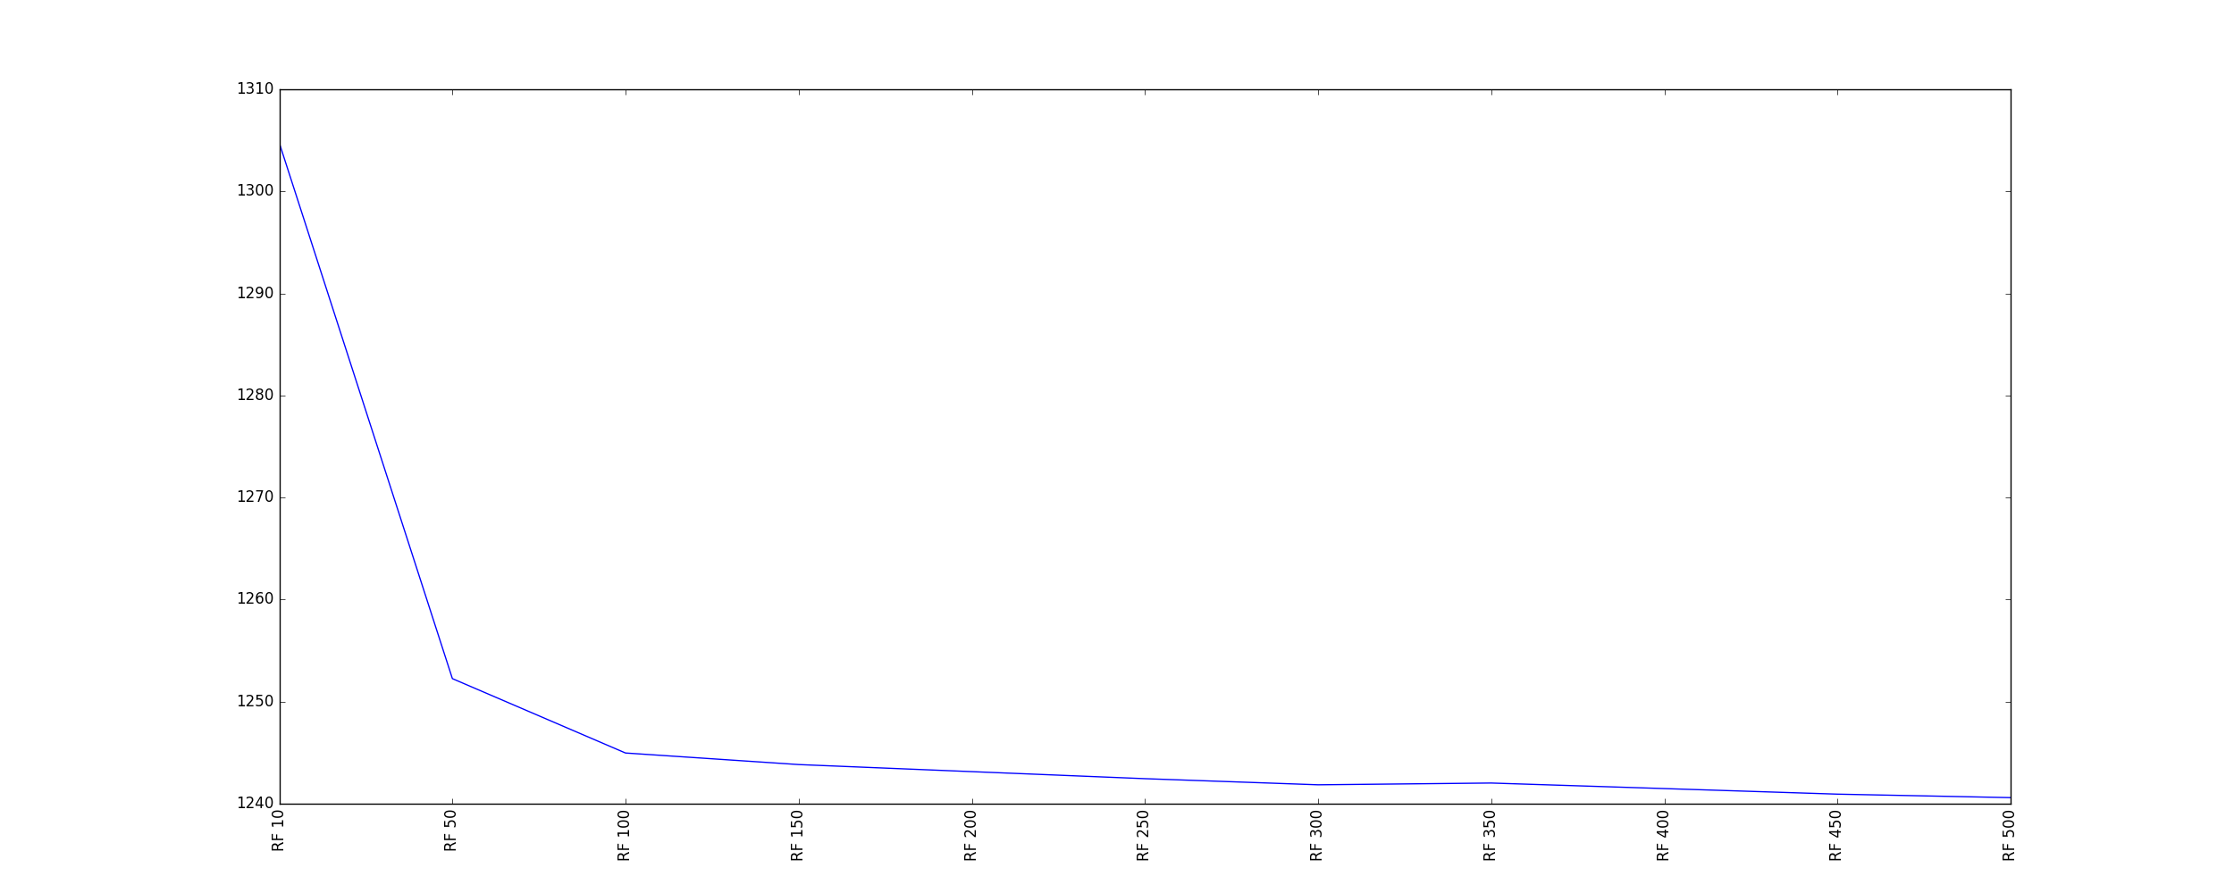
Random Forest
Number of Trees: 500
Mean Absolute Error: Approaching 1240

Slide 6
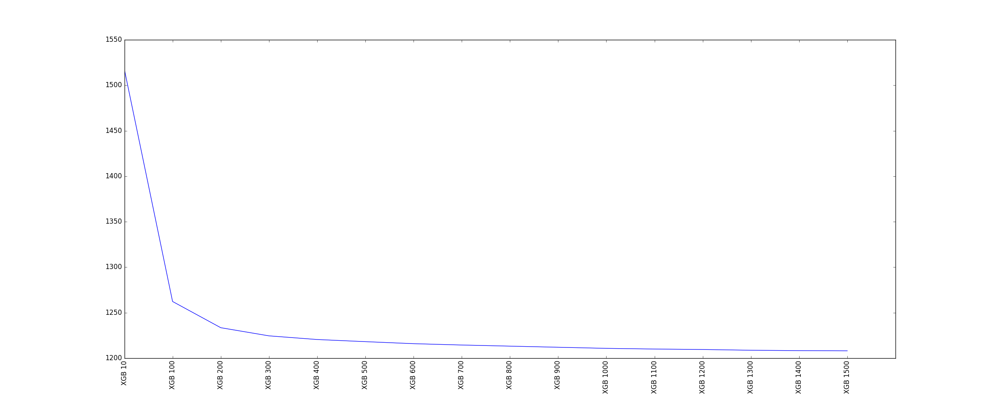
Xgboost
Number of boosted models: 1500
Mean Absolute Error: Approaching 1200

