Slide 1
Oncology Research Platform Summer Practicum
Lauren Crabtree
Andrea McCarter
Siddharth Shah
Sarah Bartlett

Slide 2
Agenda
Project Objectives
Current State and Limitations
Our Focus
Data Selection
Exploratory Analysis
Survival Analysis
Logistic Regression & Decision Tree
Dashboard Examples
Impact

Slide 3
Project Objectives
Evaluate current state architecture for cancer research systems and analyze gaps
Develop functional requirements for a cancer research platform
Perform sample analysis
Provide sample visualizations
Recommend a dashboard implementation

Slide 4
Current State
Multiple data sources, data formats and EHR systems
Data sources
Public data - genomic data, imaging data, survival and epidemiology data
Private data - EHR systems such as Epic and Cerner, clinical data
Research data - PubMed, Medline Plus
Existing platforms - CancerLinQ by ASCO and IBM Watson
Standard APIs – FHIR and HumanAPI

Slide 5
Limitations
No centralized research system
Interoperability between systems
Disparate data sources
Lack of visualizations and analytics

Slide 6
Our Focus
Breast cancer patient data
Sample analysis
How accurately can survival be predicted?
What are the key factors affecting differences in survival rates?
Dashboard - Use sample analysis to inform design

Slide 7
Analysis

Slide 8
Data Selection
Selected breast cancer patient data
Utilized SEER data due to availability of a variety of variables
Narrowed patient selection to analyze HER2 biomarker
HER2+ : Tumor mutation with HER2 protein; promotes tumor cell growth
HR+: Tumor receives signals from hormones; promotes tumor cell growth

Slide 9
Exploratory Analysis
Evaluated survival over time
Evaluated survival by demographic factors
Analyzed outcomes by subtype
Compared variables

Slide 10
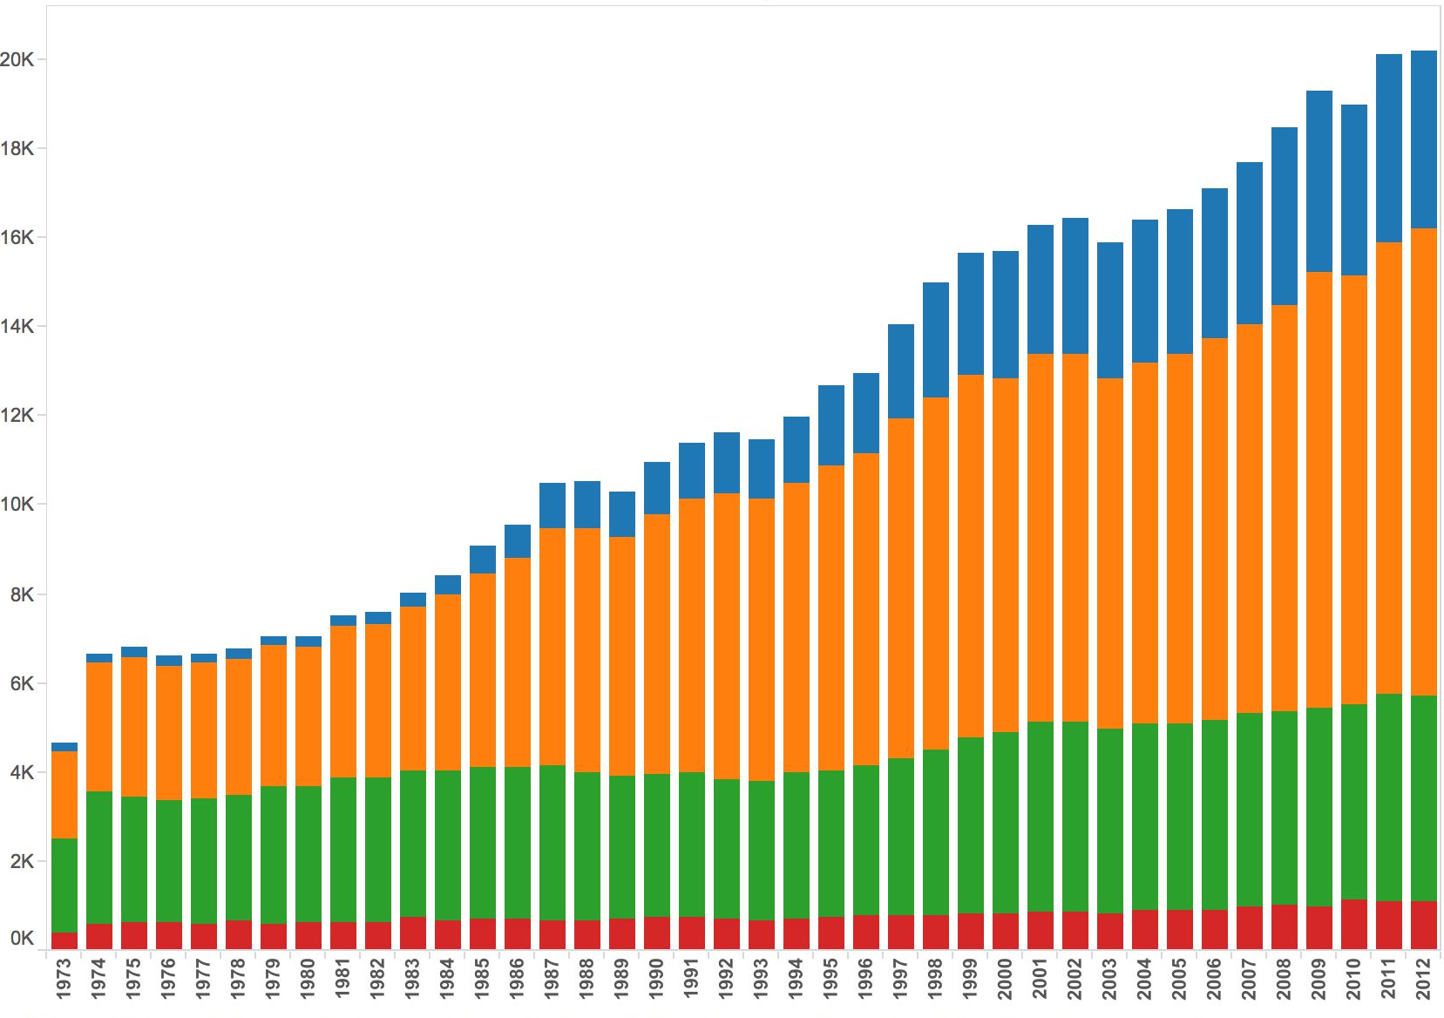
Exploratory Analysis
Yearly Total Records by Stage 1973-2012
Stage 0
Number of Patients
Stage 1
Stage 2
Stage 4
Year

Slide 11
Survival Analysis

Slide 12
Survival Analysis

Slide 13
Predictive Models
Predicting survival for stage 4 patients (diagnosed in 2010)
Survival is a binary variable (0 = patient alive or died of other cause, 1 = patient died of cancer)
58% survived, 42% died
Logistic Regression
Decision Tree
Can be used to inform researchers and patients probability of survival

Slide 14
Logistic Regression Results
Statistically significant predictors of survival
Tumor-related variables
Subtype
Grade
Size
Demographic variables
Race
Age at diagnosis
Predictive power
AUC (area under the curve) – 0.73

Slide 15
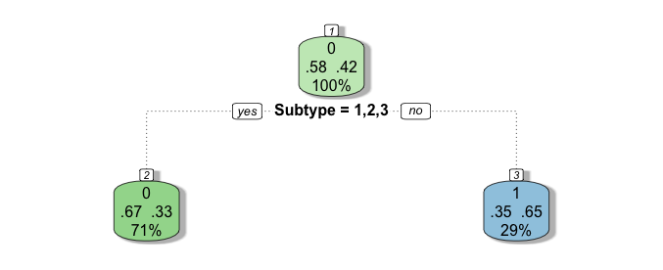
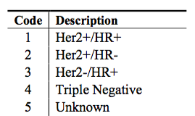
Decision Tree Results
Tumor subtypes:
Is tumor subtype 1,2 or 3?
If yes, 67% probability of survival
If no (subtype = 4 or 5), 35% probability of survival
Predictive power
Misclassification rate of tree - 33%

Slide 16
Dashboard Examples

Slide 17
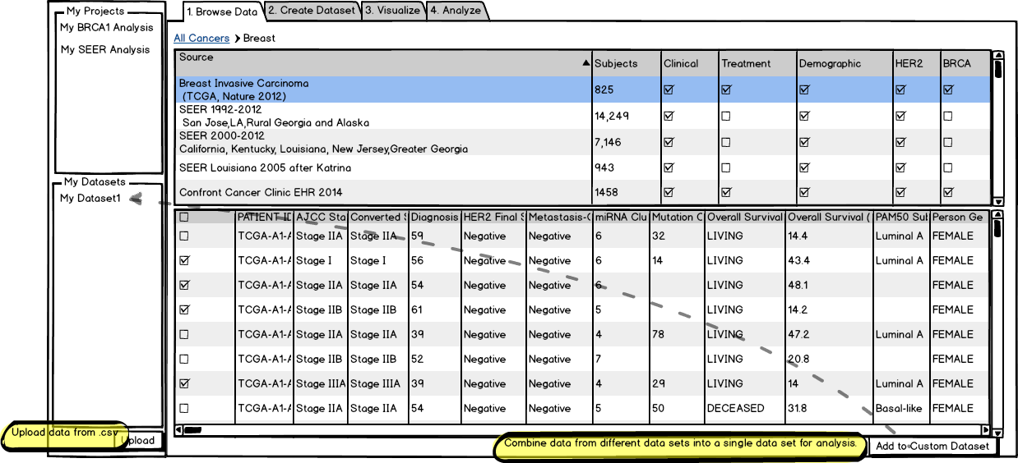
Browse Data
Notes:
Proposed solution is a 4-tabbed dashboard encompassing the 3 general areas of:
data browsing & data set creation
visualization
analysis
Data Browse:
view publicly available data sets as well as FHIR enabled EHR systems
see information about those data sets including:
number of subjects
what types of research relevant data are included
browse the raw data
select subjects from one or more data sets and save to a custom data set

Slide 18
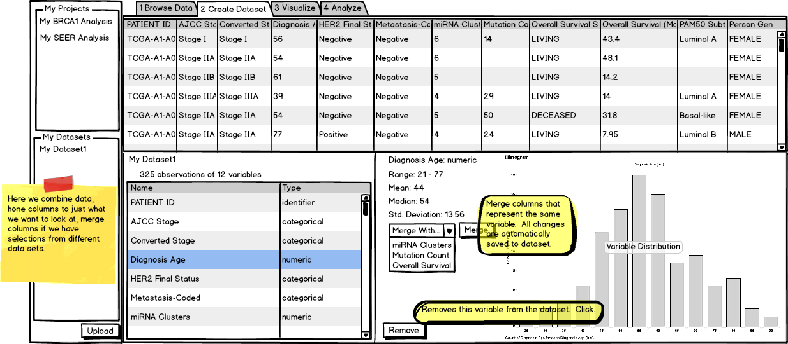
Create Data Set
Notes:
Create Dataset:
combine, merge variables
view basic information about each: ex. numeric
mean, median, std. deviation
histogram for distribution

Slide 19
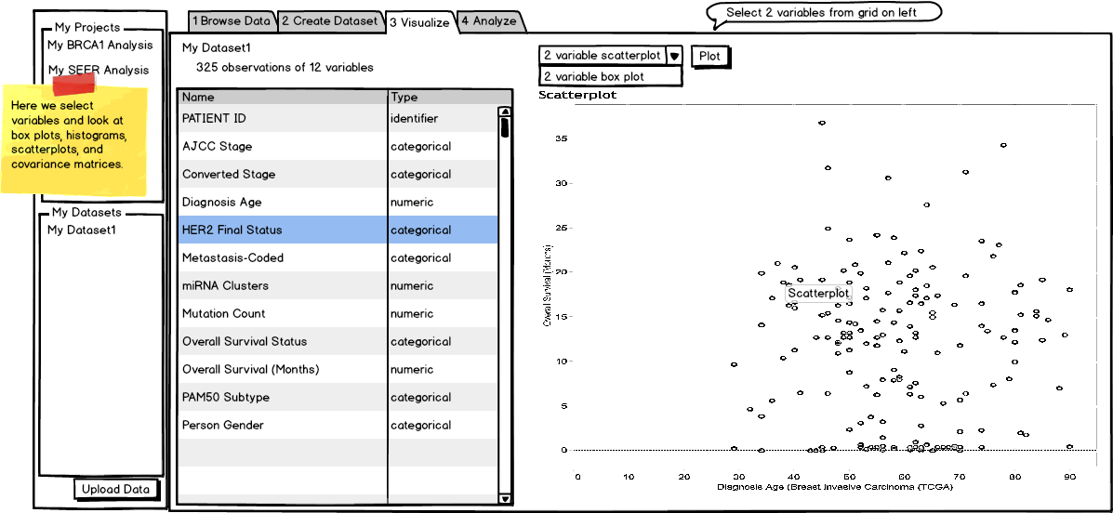
Visualize
Notes:
Visualize
at this time recommending two variable visualizations, can be expanded later
examples of 2-variable scatterplots and box plots

Slide 20
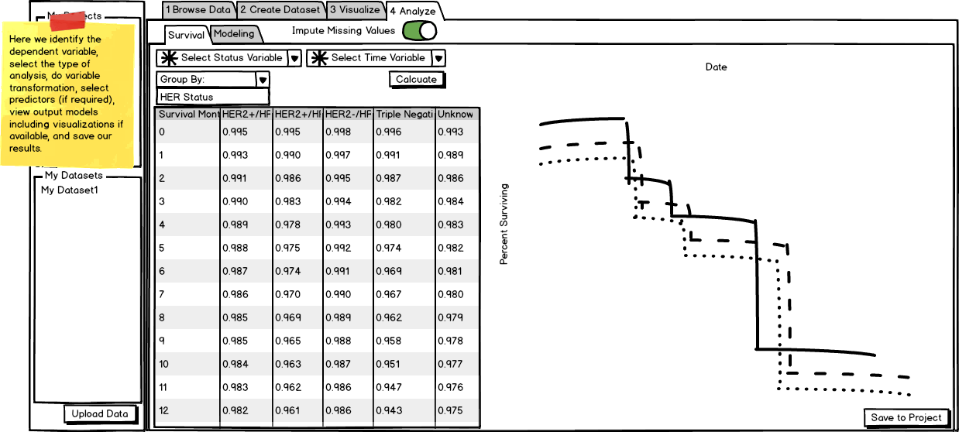
Analyze
Notes:
Analyze
two general methods of analysis
Kaplan Meier survival analysis
Predictive modeling
predictive modeling
logistic regression
decision trees
ordinary regression
multiple imputation
Save analysis to projects at any time

Slide 21
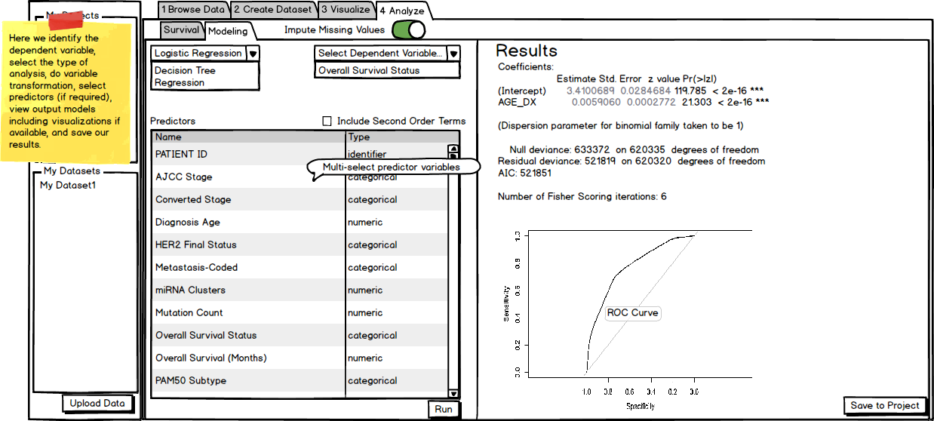
Analyze

Slide 22
Impact
Why is this beneficial?
Creation of personalized data set from various sources
Allows researcher to track performance of one provider against overall trends
Visualizations give researchers a fast overview of their data and analysis that may be a good fit for the dataset

