Slide 1
Using R Language
Data Analysis
and Visualisation
Hotel Bookings Analysis

Slide 2
Introduction
This analysis explores a dataset of hotel bookings, providing insights into booking channels, customer profiles, stay lengths, and financial metrics like the Average Daily Rate (ADR) and total revenue. The goal is to uncover ways to improve operations, enhance guest experiences, and boost revenue.
Key findings include how booking channels impact revenue, the relationship between lead time and cancellations, and how special requests affect rates. We also examine revenue trends across the year, guest behavior based on stay length, and repeat guest preferences. Additionally, the data reveals how a guest's country of origin influences booking patterns, offering a deeper understanding of hotel operations.

Slide 3
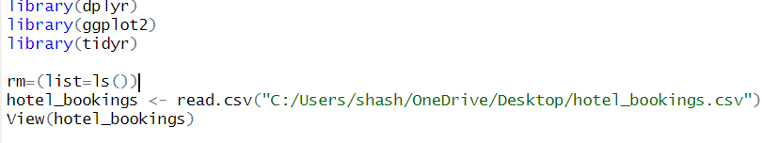
Importing Libraries & Reading data file
Library Loading
Environment Clearing
Data Import
Data Inspection

Slide 4
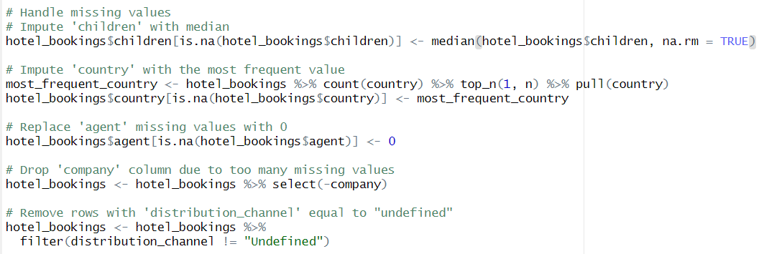
Data Preprocessing & Handling Missing Values
Imputation:
Fills missing values in children and country columns.
Replacement:
Replaces missing values in agent column with 0.
Removal:
Removes company column and rows with "undefined“ in distribution channel column

Slide 5
What Are The Business Questions To Increase Profits?
01.
02.
03.
04.
Which distribution channel generates the highest revenue?
What is the relationship between lead time and cancellations?
What is the Revenue by guest type?
What are the top 10 countries by number of bookings?

Slide 6
What Are The Business Questions To Increase Profits?
05.
06.
07.
08.
How does Length of stay impact ADR?
What is the Room type preference for repeat guests?
How do special requests impact ADR?
What is the Revenue by month ?

Slide 7
Which distribution channel generates the highest revenue?
01.
Let’s learn more on this question by code and a chart

Slide 8
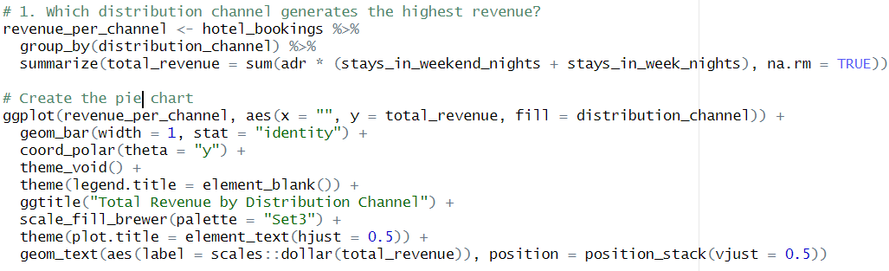
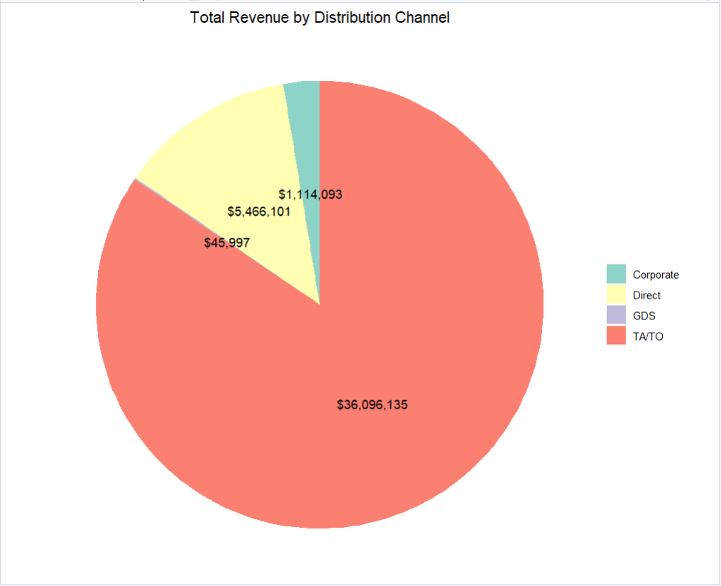
Distribution Channel Vs. Highest Revenue
CHART EXPLAINATION:
TA/TO (Travel Agent/Tour Operator) is the most profitable channel, accounting for approximately 83.3% of the total revenue.
Direct bookings contribute 12.5% to the total revenue.
GDS (Global Distribution System) and Corporate channels generate relatively smaller portions of the revenue, with 1.1% and 0.1% respectively
CODE EXPLAINATION:
It calculates revenue for each distribution channel and creates a pie chart to visualize the distribution. It also customizes the chart's appearance.

Slide 9
ACTIONS SHOULD BE DONE:
Strengthen TA/TO partnerships: Focus on building and maintaining strong relationships with travel agents and tour operators to attract more bookings through this channel.
Optimize direct booking channel: Implement strategies to encourage guests to book directly, such as offering exclusive deals or loyalty programs.
Explore corporate market: Identify potential corporate clients and tailor offerings to attract more business from this segment.
Diversify distribution channels: Consider expanding into other distribution channels, such as online travel agencies (OTAs) or metasearch engines, to reach a wider audience.

Slide 10
What is the relationship between lead time and cancellations?
02.
Let’s learn more on this question by code and a chart

Slide 11
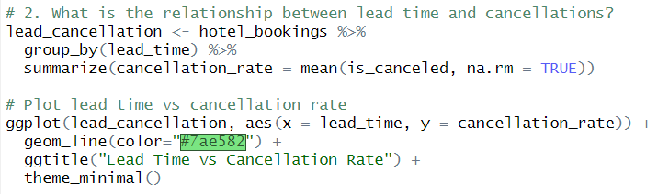
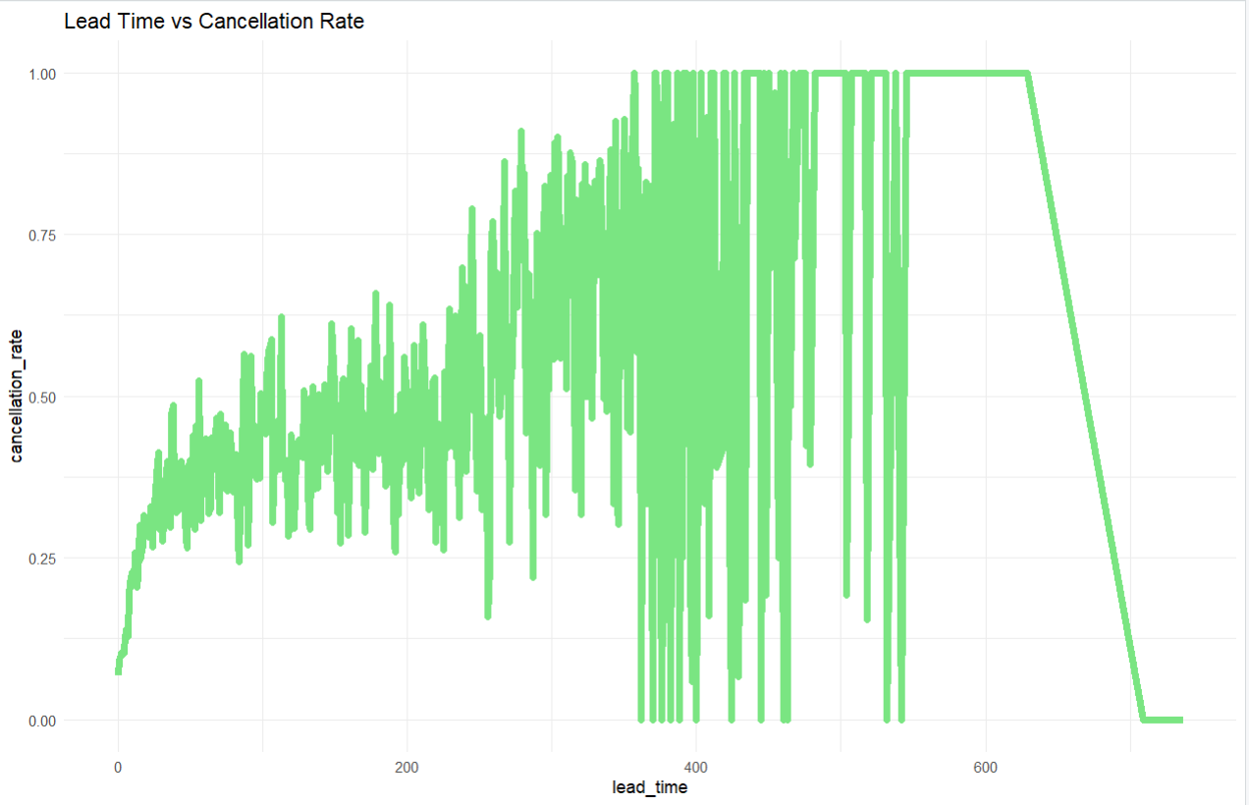
Lead Time Vs. Cancellations
CHART EXPLAINATION:
Initial increase: Cancellation rates generally increase as lead time grows, especially in the range of 0 to 200 days.
Plateau: Between 200 and 600 days, the cancellation rate plateaus, remaining relatively high.
Sharp decline: After 600 days, cancellation rates drop significantly
CODE EXPLAINATION:
It analyzes the relationship between lead time and cancellation rate by calculating the average cancellation rate for each lead time and visualizing it in a line chart.

Slide 12
ACTIONS SHOULD BE DONE:
This suggests that bookings made closer to the arrival date are more likely to be canceled, while those made well in advance are more stable. However, there's a potential for cancellations to increase again as the arrival date approaches.

Slide 13
What is the Revenue by guest type?
03.
Let’s learn more on this question by code and a chart

Slide 14
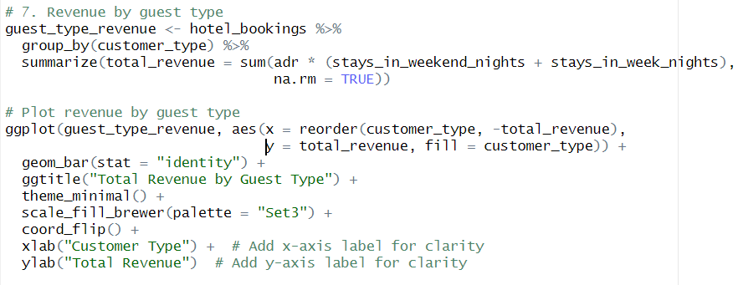
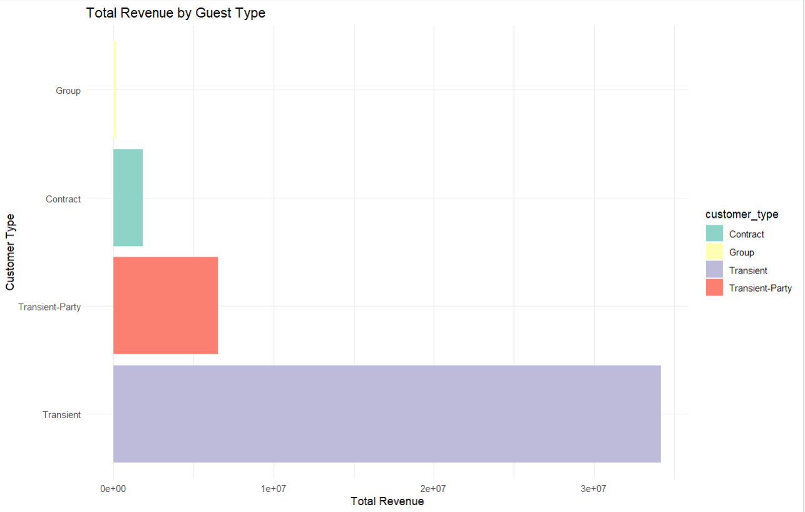
Revenue By Guest Type
CHART EXPLAINATION:
Transient guests generate the most revenue, followed by Transient Party guests.
Contract guests generate a moderate amount of revenue.
Group guests generate the least revenue
CODE EXPLAINATION:
It analyzes the total revenue generated by different guest types. It calculates the total revenue for each type, then creates a bar chart to visualize the results.

Slide 15
ACTIONS SHOULD BE DONE:
This suggests that individual travelers and small groups contribute significantly to the hotel's revenue, while larger groups may not be as profitable.

Slide 16
What are the top 10 countries by number of bookings?
04.
Let’s learn more on this question by code and a chart

Slide 17
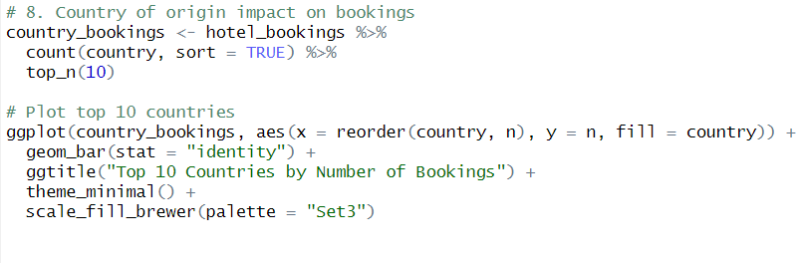
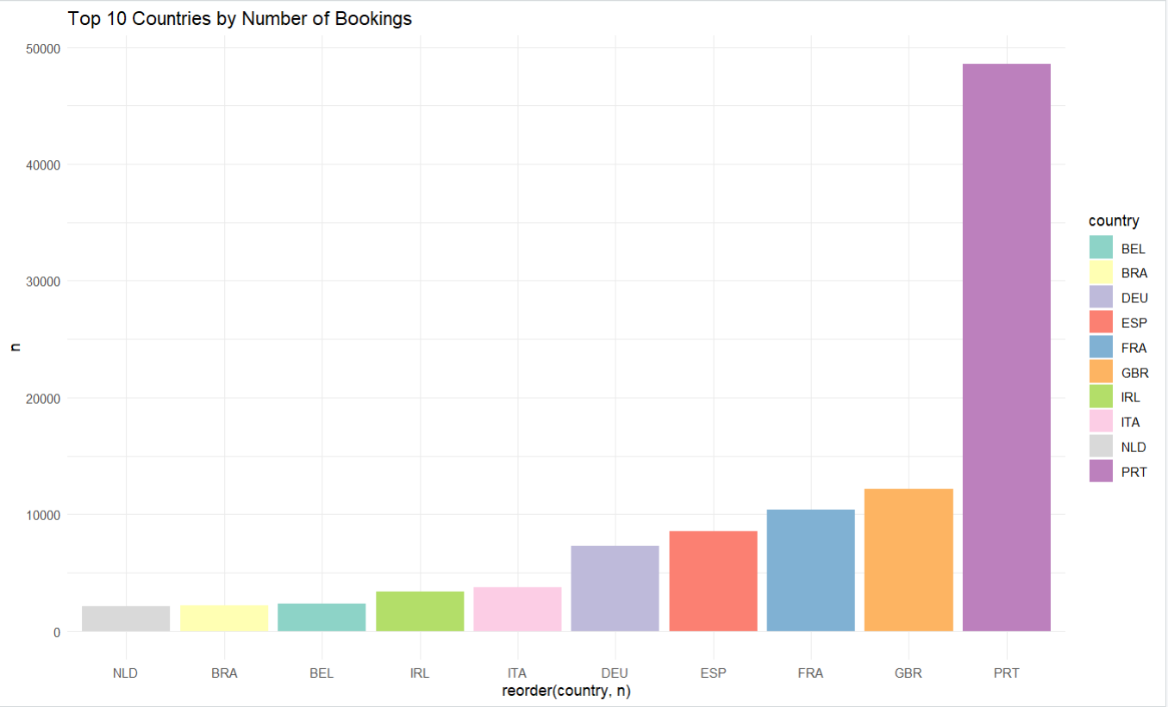
Top 10 Countries By no. Bookings
CHART EXPLAINATION:
PRT (Portugal) has the highest number of bookings.
GBR (Great Britain) and FRA (France) also have a significant number of bookings.
NLD (Netherlands), ITA (Italy), DEU (Germany), and ESP (Spain) have moderate numbers of bookings.
BEL (Belgium), IRL (Ireland), BRA (Brazil), and NLD (Netherlands) have relatively low numbers of bookings.
CODE EXPLAINATION:
It analyzes the number of bookings made by guests from different countries. It counts the occurrences of each country in the dataset, selects the top 10 most frequent countries, and then creates a bar chart to visualize the results.

Slide 18
ACTIONS SHOULD BE DONE:
This suggests that guests from Portugal, Great Britain, and France are more likely to book at this hotel, while guests from other countries may be less frequent.

Slide 19
How does Length of stay impact ADR?
05.
Let’s learn more on this question by code and a chart
Let’s learn more on this question by code and a chart

Slide 20
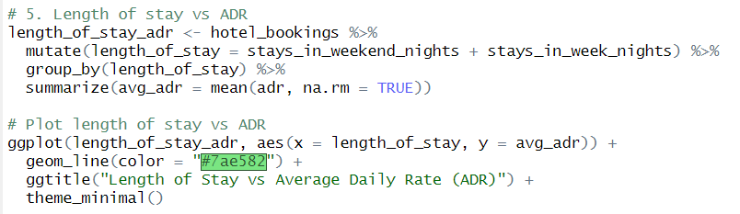
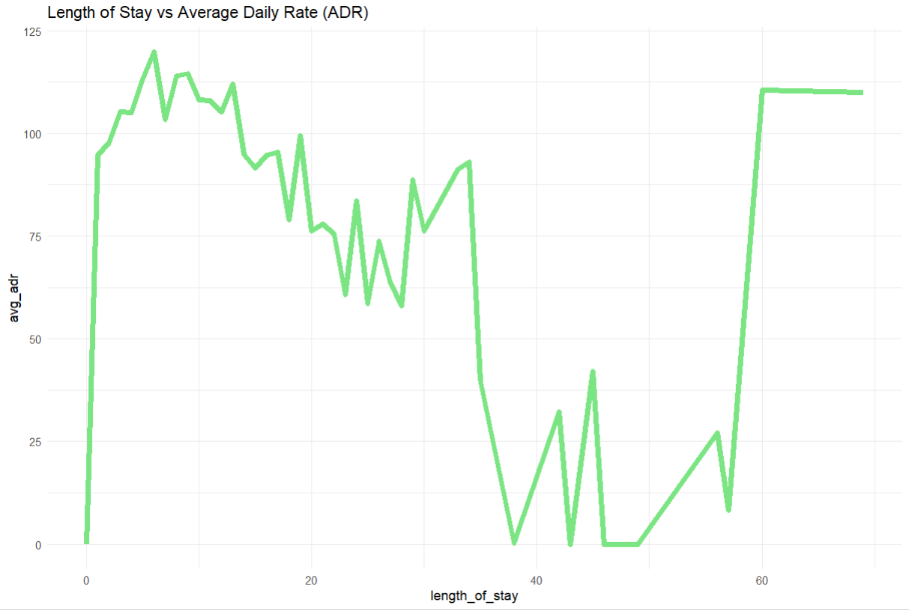
Length Of Stay Vs. ADR
CHART EXPLAINATION:
Initial increase: The ADR generally increases as the length of stay increases, especially for stays up to about 20 days.
Fluctuations: After 20 days, the ADR becomes more volatile, with some fluctuations and a slight downward trend.
Overall upward trend: Despite some fluctuations, there's a general upward trend in ADR as the length of stay increases.
CODE EXPLAINATION:
It analyzes the relationship between the length of stay and the average daily rate (ADR) in a hotel booking dataset. It calculates the average ADR for each length of stay and visualizes the results in a line chart.

Slide 21
ACTIONS SHOULD BE DONE:
This suggests that guests who stay longer tend to pay higher rates on average. However, there may be some exceptions or discounts for longer stays, leading to fluctuations in the ADR.

Slide 22
06.
What is the Room type preference for repeat guests?
Let’s learn more on this question by code and a chart

Slide 23
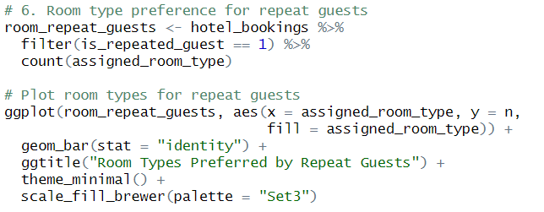
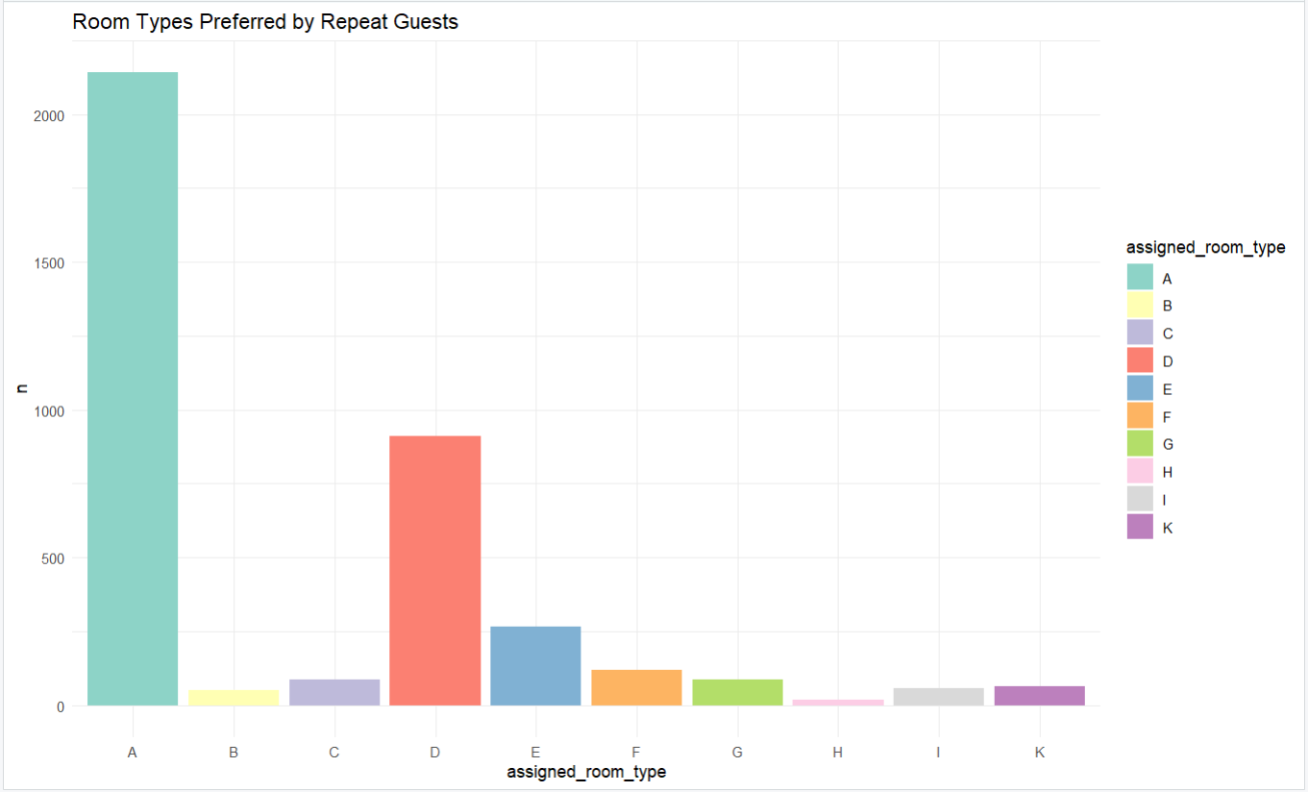
Room type Vs. Repeat Guests
CHART EXPLAINATION:
Room type A is the most preferred by repeat guests.
Room type D is also popular among repeat guests.
Room types B, C, E, F, G, H, I, and K have significantly lower numbers of repeat guests.
CODE EXPLAINATION:
It analyzes the room type preferences of repeat guests in a hotel booking dataset. It filters the data for repeat guests, counts the occurrences of each assigned room type, and then creates a bar chart to visualize the results

Slide 24
ACTIONS SHOULD BE DONE:
This suggests that repeat guests have a strong preference for certain room types, likely due to factors such as size, amenities, or location.

Slide 25
07.
How do special requests impact ADR?
Let’s learn more on this question by code and a chart

Slide 26
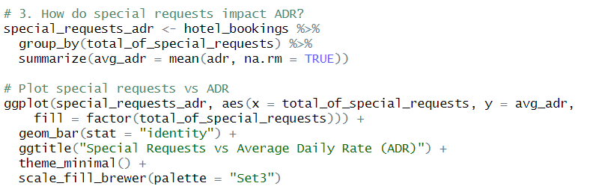
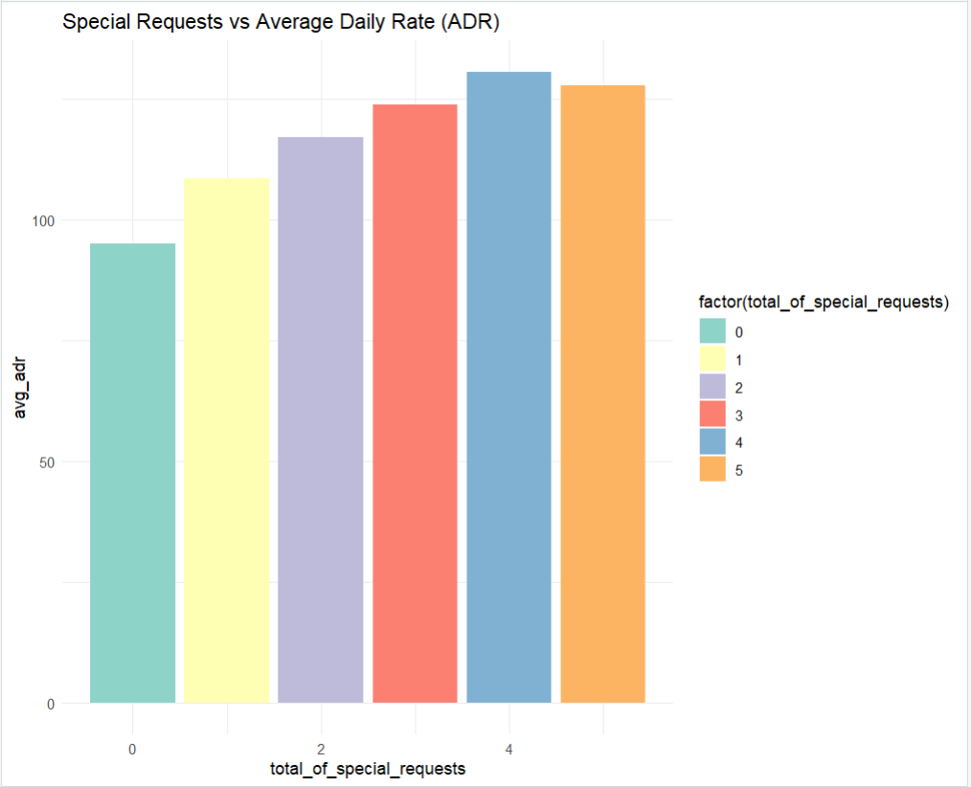
Special Requests Vs. ADR
CHART EXPLAINATION:
As the number of special requests increases, the average daily rate also tends to increase. This suggests that guests who make more special requests are willing to pay higher rates for their accommodations.
The relationship is not perfectly linear. There may be some fluctuations in the ADR as the number of special requests increases, indicating that other factors besides special requests may also influence the pricing.
CODE EXPLAINATION:
It analyzes the relationship between the number of special requests and the average daily rate (ADR) in a hotel booking dataset. It calculates the average ADR for each number of special requests and visualizes the results in a bar chart.

Slide 27
ACTIONS SHOULD BE DONE:
Overall, the chart indicates a positive correlation between special requests and ADR, suggesting that hotels can potentially increase revenue by offering personalized services and amenities to their guests.

Slide 28
08.
What is the Revenue by Month?
Let’s learn more on this question by code and a chart

Slide 29
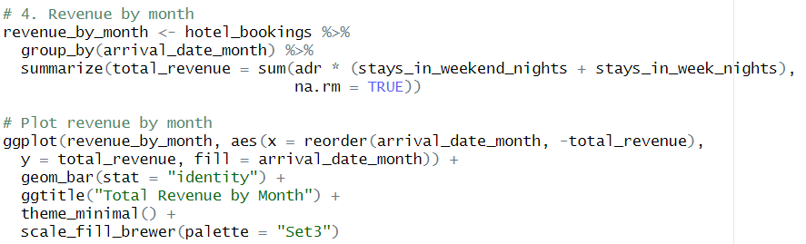
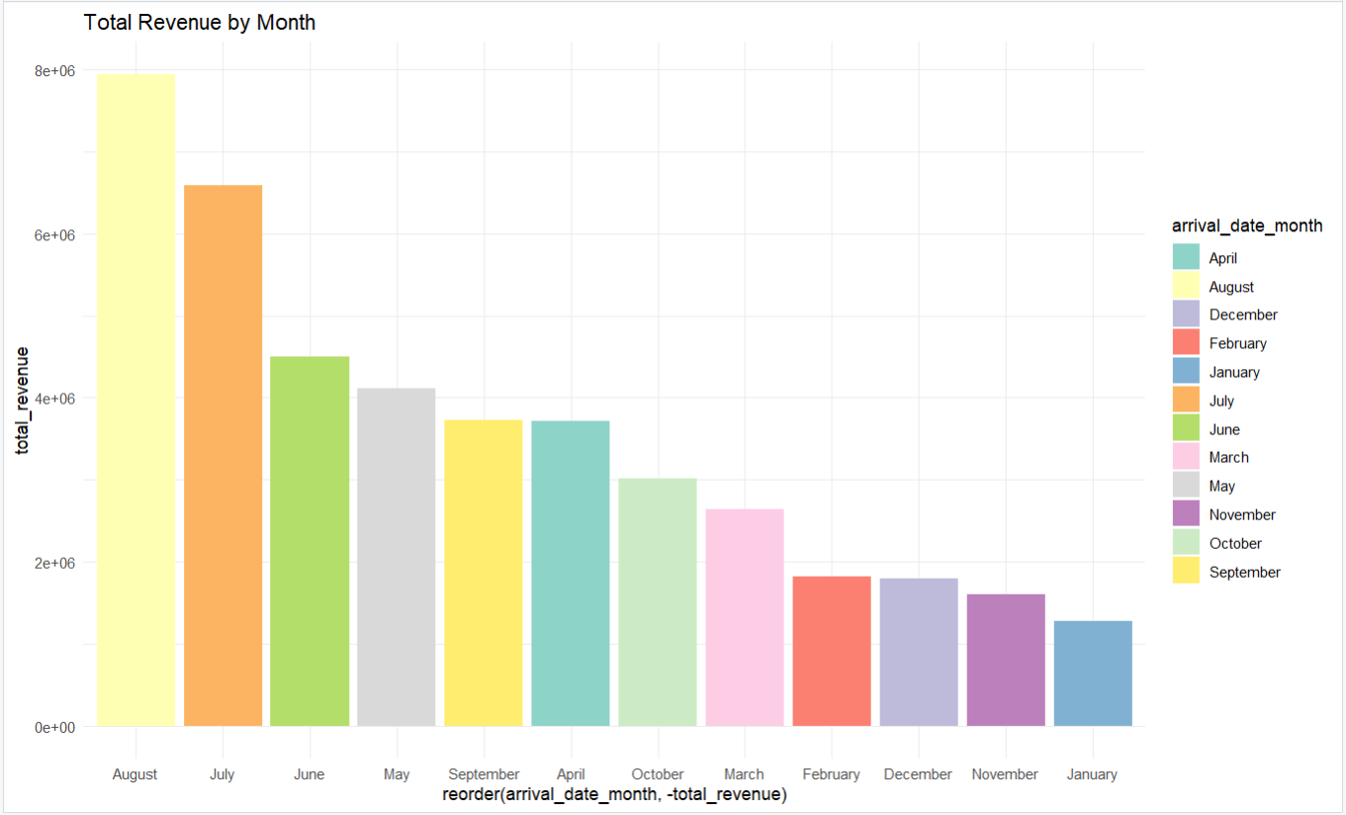
Revenue By Month
CHART EXPLAINATION:
August is the month with the highest total revenue.
July, June, and May also have relatively high levels of revenue.
March, February, December, November, and January have the lowest levels of revenue.
CODE EXPLAINATION:
It analyzes the total revenue generated by each month in a hotel booking dataset. It calculates the total revenue for each month, then creates a bar chart to visualize the results.

Slide 30
ACTIONS SHOULD BE DONE:
This suggests that the hotel experiences peak revenue during the summer months (June to August) and early fall (September), while the winter months (December to February) and spring months (March to May) are less profitable.

Slide 31
Thanks!
Do you have any questions?
shashraf214@gmail.com
Please keep this slide for attribution

