Slide 1
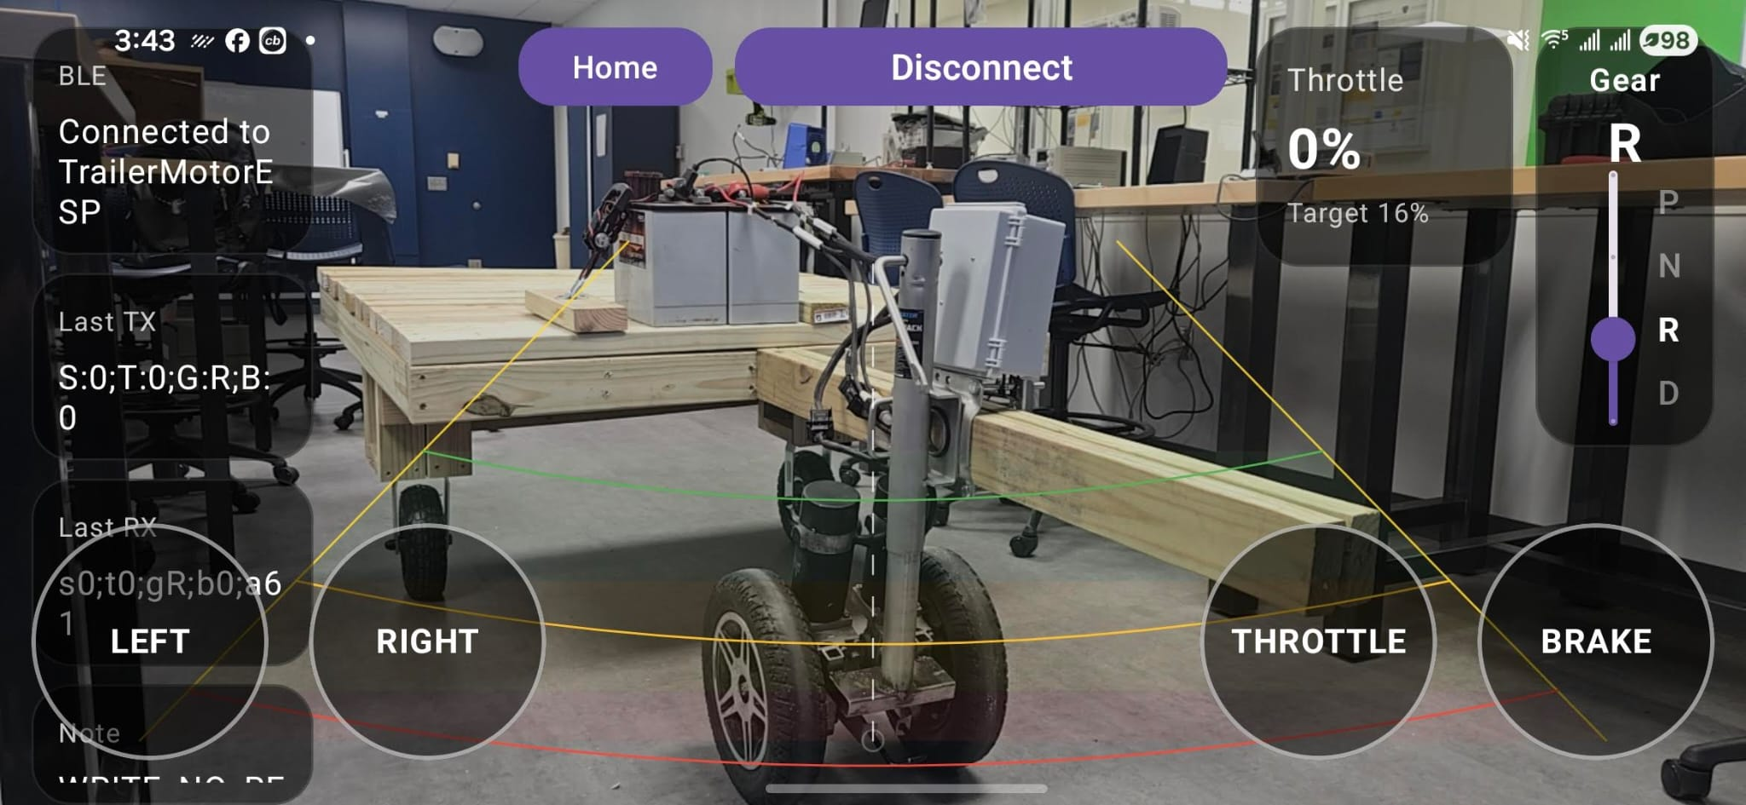
Control Interface & System Flow
Software
Design
Three-component
system working
in concert
Android App
Kotlin / Jetpack Compose
Live control screen — phone camera background, BLE connected to TrailerMotorESP
BLE Motor ESP32
Android App
Kotlin / Compose
BLE
Motor ESP32
BLE Control
PWM/DIR
Dual Motors
Tank-drive
Real-time motor control
WiFi Camera ESP32
WiFi
MJPEG
Android App
WebView stream
Camera ESP32
WiFi Hotspot AP
ESP32-CAM
192.168.4.1:81
Live reverse video feed

Slide 2
Control Logic & Hardware Safety
Software
Safety &
Logic
Heartbeat & Watchdog
Throttle Ramp (App-Side)
App sends command packet every 200ms
ESP32 watchdog: safe-stop if silent >500ms
Emergency stop on BLE disconnect
Covers app freeze, out-of-range, crash
Press → ramps 8% up to target over N seconds
Release → ramps back down to 0% smoothly
Brake → instant reset to 0, ramp cleared
Ramp lives in app; ESP32 just executes
200ms
Heartbeat
Interval
BLE Packet Format
ESP32 Hardware Interlocks
500ms
Format: S:<dir>;T:<throttle>;G:<gear>;B:<brake>
Steering: –100=Left, 0=Straight, +100=Right
Throttle: 0–100%, Gear: P/N/R/D
Strict validation — bad packets rejected
Single applyState() — only relay control point
D↔R swap blocked while throttle active
Mutex protects shared state (BLE + main tasks)
Park/Neutral clears throttle & steering instantly
Watchdog
Timeout
8%→N%
Throttle
Ramp Start

