Slide 1
filters
SecurityContextHolder
AuthenticationManager
DelegatingFilterProxy
FilterChainProxy
SecurityFilterChain
JwtAuthenticationFilter
ProviderManager
AuthenticationProvider
filters
AbstractUserDetailsAuthenticationProvider
DaoAuthenticationProvider
UserDetailsService
DB

Slide 2
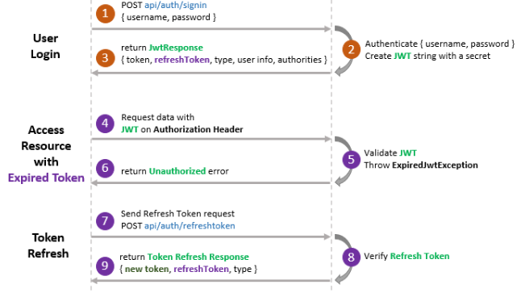
Refresh Token
Client
Server

Slide 3
PROPAGATION.REQUIRES_NEW
Executed in
Transaction T1
Begin Transaction T1
EmployeeServiceImpl
@Transactional(propagation = Propagation.REQUIRES_NEW)
public Employee addEmployee() {
}
End Transaction T1
Executed in
Transaction T1
Executed in
Transaction T2
Begin Transaction T1
Begin Transaction T2
OrganizationServiceImpl
@Transactional(propagation = Propagation.REQUIRED)
public void joinOrganization() {
}
EmployeeServiceImpl
@Transactional(propagation = Propagation.REQUIRES_NEW)
public Employee addEmployee() {
}
End Transaction T1
End Transaction T2

