Slide 1

Medisyn lab case study (Barclays)
Shivam Sharma
(shivam94000@gmail.com)

Slide 2
PROBLEM Statement
Unlocking insights from customer feedback
Context
Medisyn Labs has launched a diverse range of medicines targeting:
Common ailments: cold, flu, allergies, pain relief
Products sold via online platforms, where customers:
Leave reviews and ratings
Mention the illness/condition they used the medicine for
What is needed?
Build intelligent system to
classify customer reviews as positive or negative
Predict the effectiveness rating of a medicine based on review content and usage context
Build a model to classify customer reviews as positive or negative
Recommend medicines based on user symptoms and historical reviews
Current Challenge
It is suspected that,
Customer feedback contains untapped insights which could enhance:
Product formulation
Marketing strategies
Customer support service

Slide 3
DATA
Let’s see what data we have for investigation
2 .tsv files
Train set - 75%
Test set – 25%
Variables Included (in exact order):
Customer Identifier – Unique reviewer ID
Medicine Name – Product being reviewed
Rating – 10-star overall satisfaction score
Effectiveness – 5-step categorical rating
Side Effects – 5-step categorical rating
Condition/Illness – Reason for taking the medicine
Review: Benefits – Text describing perceived benefits
Review: Side Effects – Text describing experienced side effects
Review: Overall – General feedback and experience
Sample Data

Slide 4
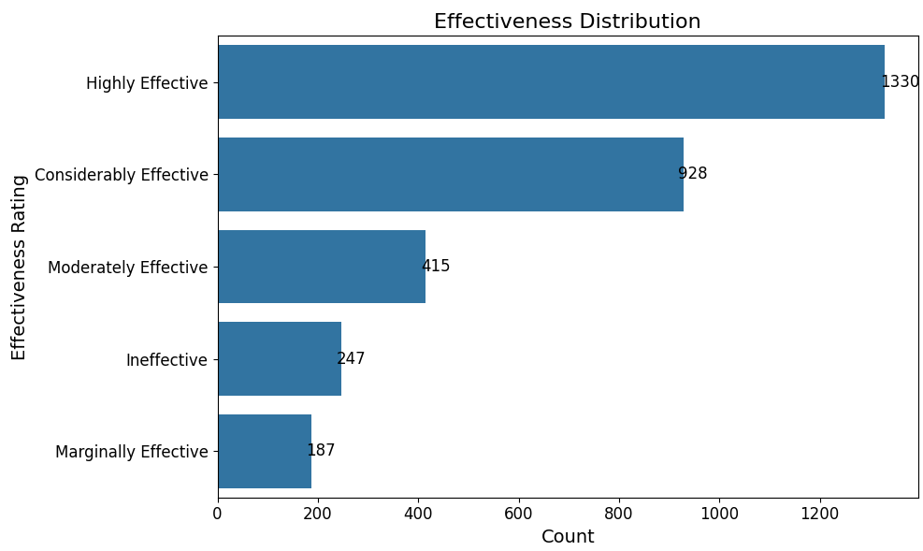
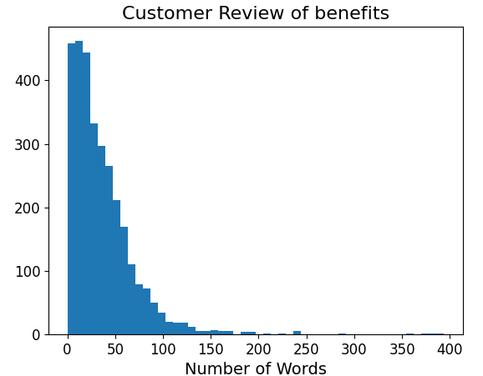
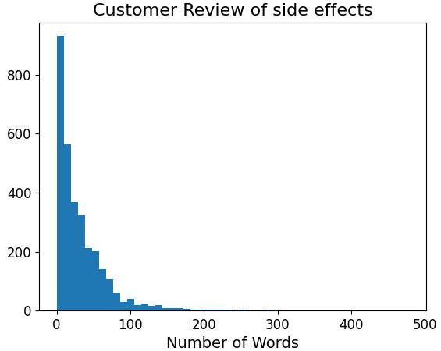
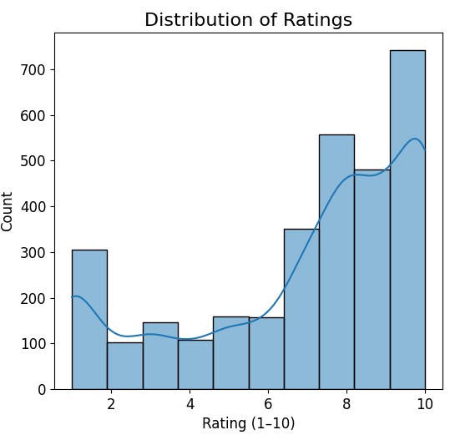
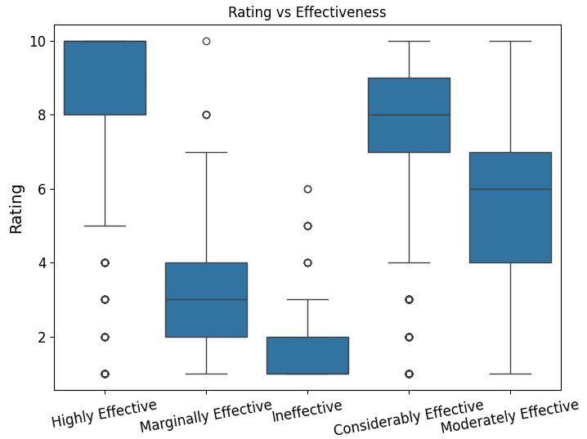
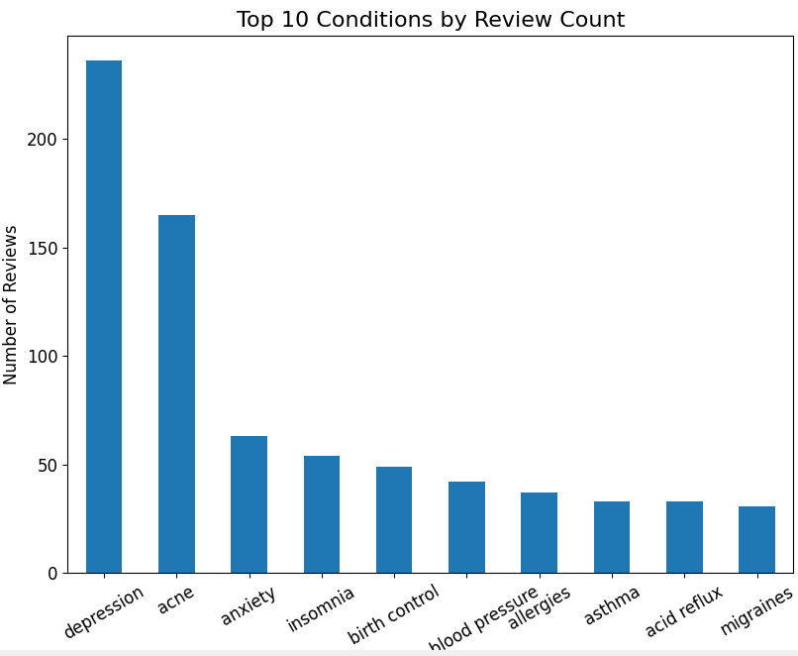
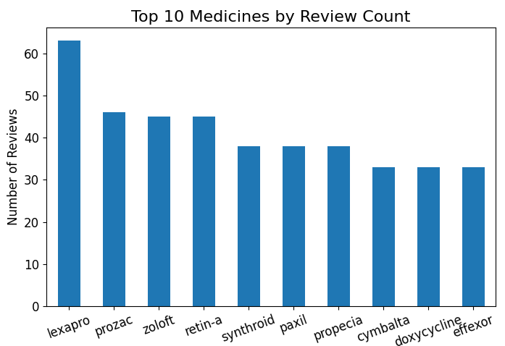
Total rows in train set → 3107
Total rows in test set → 1036
DATA INSIGHT
Investigating the data …

Slide 5
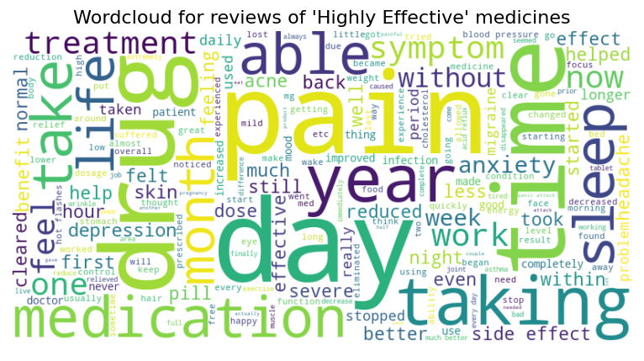
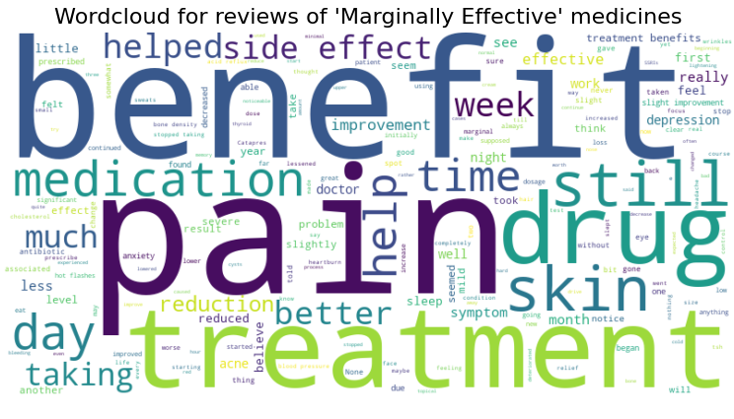
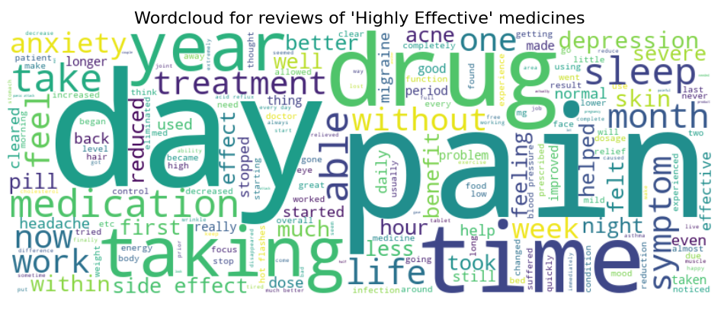
Total rows in train set → 3107
Total rows in test set → 1036
DATA INSIGHT
Investigating the data …

Slide 6
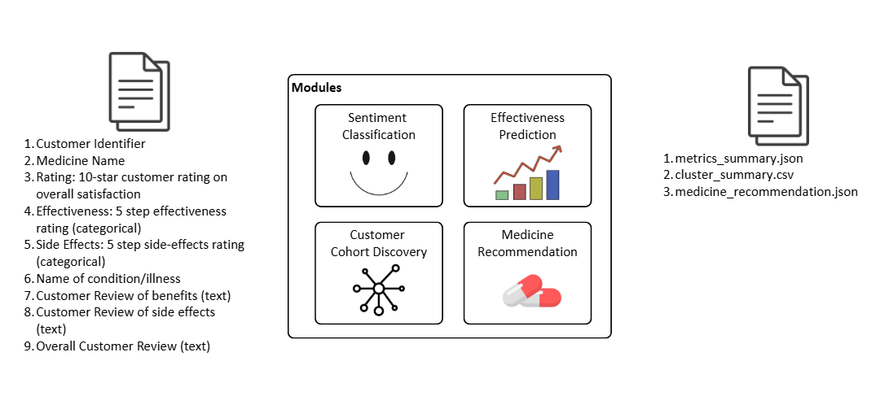
High Level Solution Modules

Slide 7
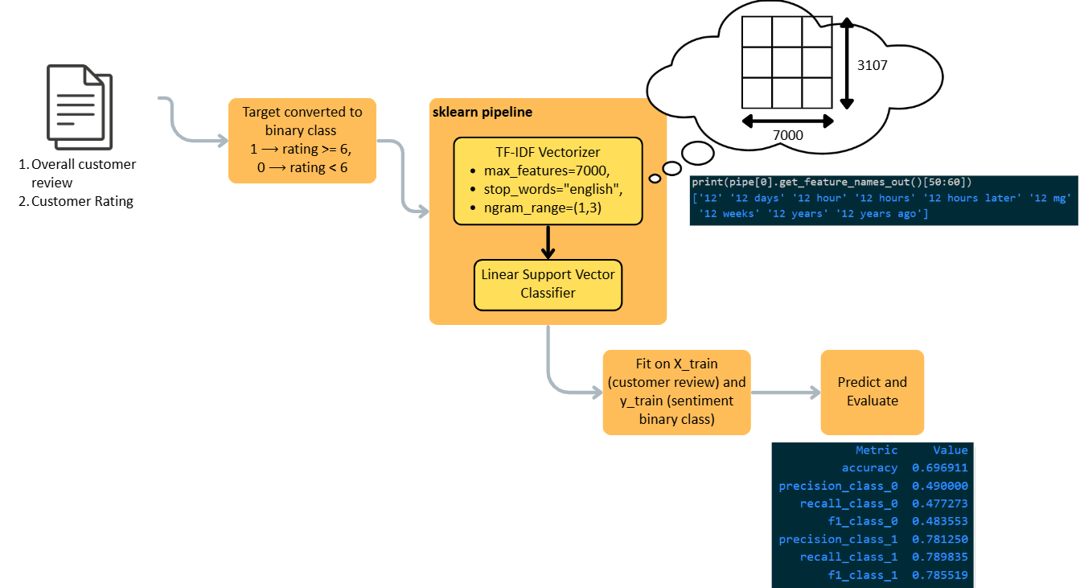
Sentiment Classification
Metrics
accuracy - 69.69%
F1 score – 78.55%
Why Linear SVC
Fast & Efficient: Works well with large datasets and high-dimensional features (like TF-IDF vectors).
Robust: Doesn’t get distracted by outliers.
Explainable
Value
Captures emotional tone of patients
Adds another layer of interpretability to reviews
Supports better understanding of medicine perception

Slide 8
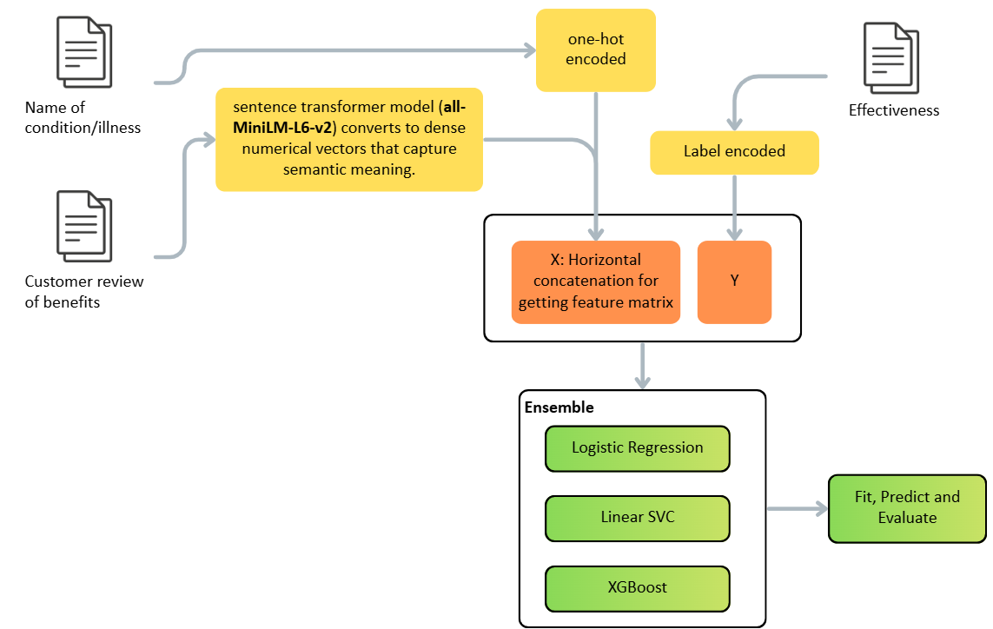
Effectiveness Classification
Methodology
Encode reviews using Sentence Transformers
One-hot encode condition
Classifiers: Logistic Regression, SVM, XGBoost
Output
5-step effectiveness rating
Value:
Helps identify promising medicines from patient experiences
Provides structured insight into textual reviews

Slide 9
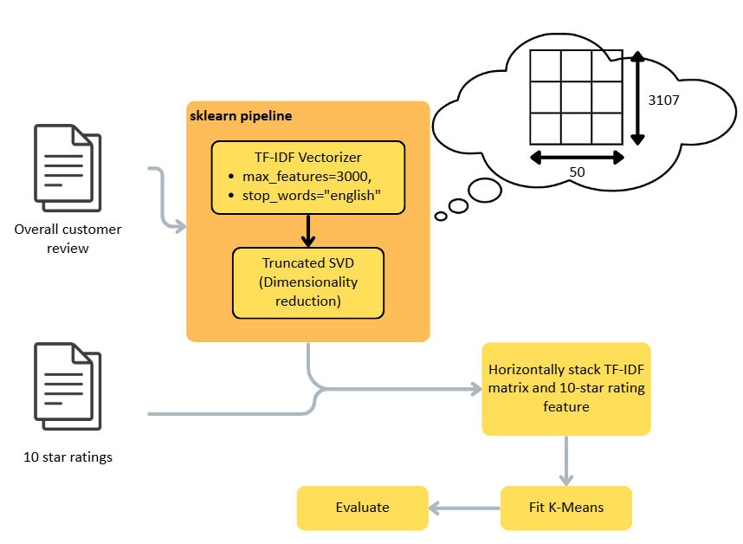
Customer Cohort
Methodology
Text features: TF-IDF + Truncated SVD
Combine with rating score
K-Means clustering
Output
Cohorts of customers grouped by similar reviews & satisfaction
Value
Supports segmentation for better healthcare strategies
Metric
Silhouette score - 52.55%
Interpretation – Score of ~52% means that clusters are quite distinct — much better than typical text + ratings clustering where 0.1 to 0.3 is common

Slide 10
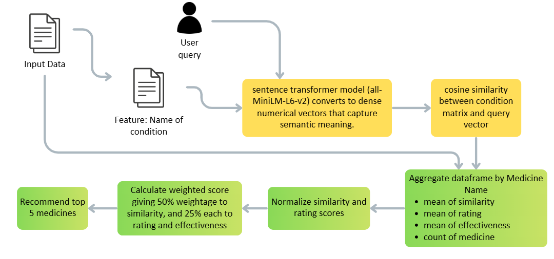
MEDICINE RECOMMENDATION SYSTEM
Value
Guides patients towards medicines with strong peer support
Provides transparent reasoning behind each suggestion
Strategy to evaluate system output
Offline evaluation
Precision@K – of the top-k recommended medicines, how many are actually relevant
Recall@K – of all relevant medicines, how many did the system retrieve in top-k
Online evaluation
CTR – click through rate
Conversion / adoption rate

