Slide 1
User Roles
Admin
Internal Employee
Individual Customer
Customer From Client Company

Slide 2
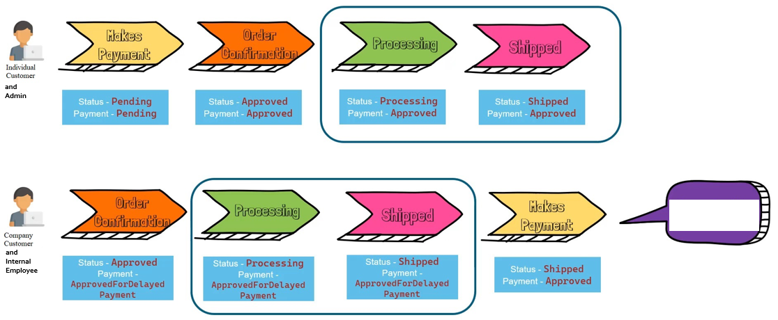
Order Status Management
and
Admin
Customers have 30 days to make payment after order is shipped
and
Internal Employee

Slide 3


Architecture
React SPA
Reviews module – Customer recommendations/feedback
View
axios
DiveInColors
Main Application
View
(Razor Pages)
CRUD
operations
ASP.Net Core Web Application
UnitOf Work
Entity Framework
Repository Pattern
DbContext
ASP.Net Web API
Model
Controller
(Business Logic)
REST API
Swagger
Microsoft.AspNetCore.Mvc.Cors
Model
Controller
(Business Logic)
Entity Framework
DbContext

