Slide 1
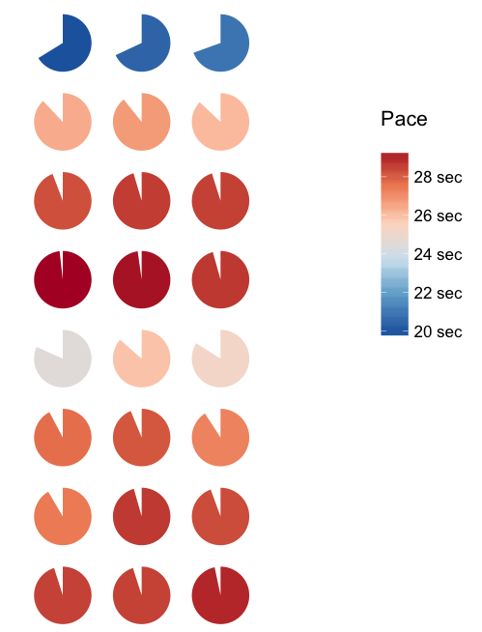

Slide 2
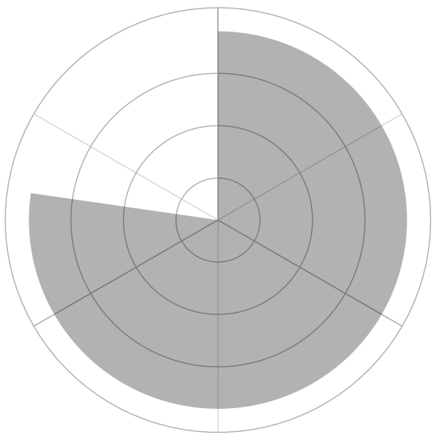
OUTS
1
2
3
BASE STATE
30 / 0 sec
20 sec
10 sec

