Slide 1
What’s In Your Pipeline?
Up’s and Down’s of Container Image Scanners
Shay Berkovich
Security Research Group @ BlackBerry

Slide 2
Scope
Container Image Scanning will solve:
Find known 3rd-party vulnerabilities in your product
Container Image Scanning will NOT solve:
Detect undiscovered vulnerabilities
Protect against malicious containers
Protect against backdoors
Solve container runtime security problems

Slide 3
Importance of Image Scanning
Traditional VM vs container image – where the source came from?
Traditional VMs are less likely to be downloaded from internet
Companies usually maintain a set of approved VMs licensed by OS vendor if needed
Unless you are building the base image by yourself, attacker has degree of access to your base images
Many super-popular images shared widely
Vulnerability in the image is carried wherever the image goes (including customer environment)
Notes:
VMs traditionally getting more attention from IT department. There are new attempts of maintaining a “golden set of container base images” like Distroless
Vulnerability propagation
Downloading images from DockerHub if your organizational policy does not prohibit this. Multistage builds also help.
Glenn’s note on last point: “I think the key is the exact list of packages installed and the configuration of those packages, which is based on the central repository but might be different. With a container sitting in a central repository, the configuration/list of packages is obvious.
”

Slide 4
Importance of Image Scanning
"RootFS": {
"Type": "layers",
"Layers": [
"sha256:488d…",
"sha256:b4a2…",
"sha256:2243…"
]
},
Wide container adoption
Driver 1: image reusability
Driver 2: easy to deploy
Docker Hub, Quay, Google GCR
FROM debian:latest
COPY …
USER …
nginx_latest.tar
docker pull debian
docker run –it debian bash
Notes:
Continuing on vulnerability propagation – 2 drivers behind it:
Image reusability
Easiness to deploy
Later driver is orchestration

Slide 5
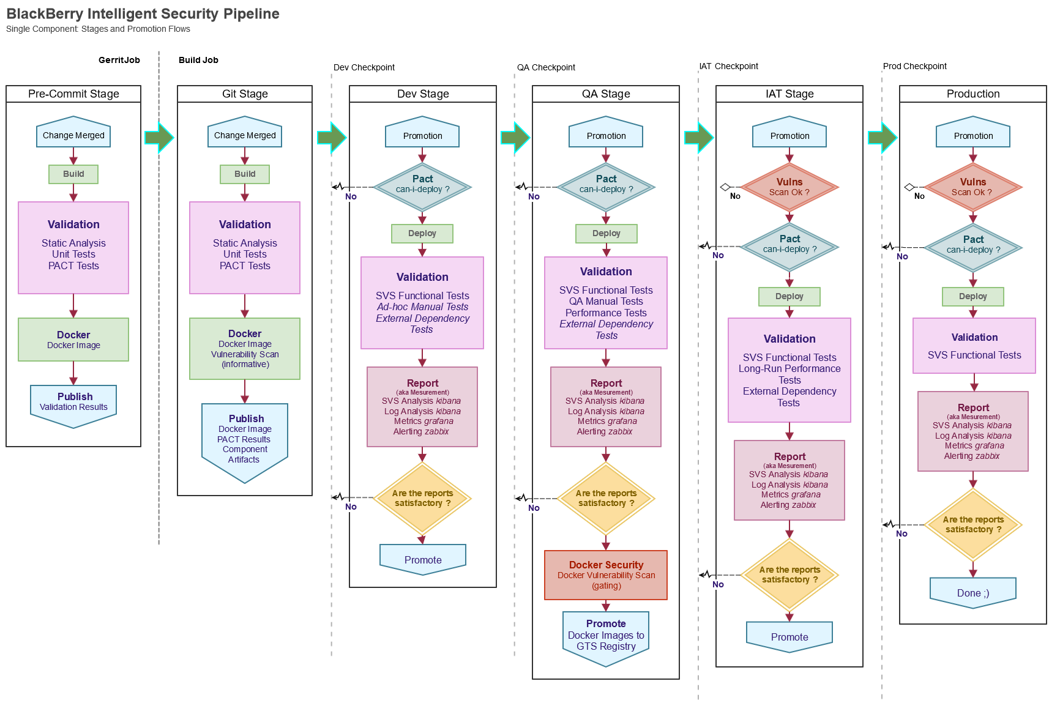
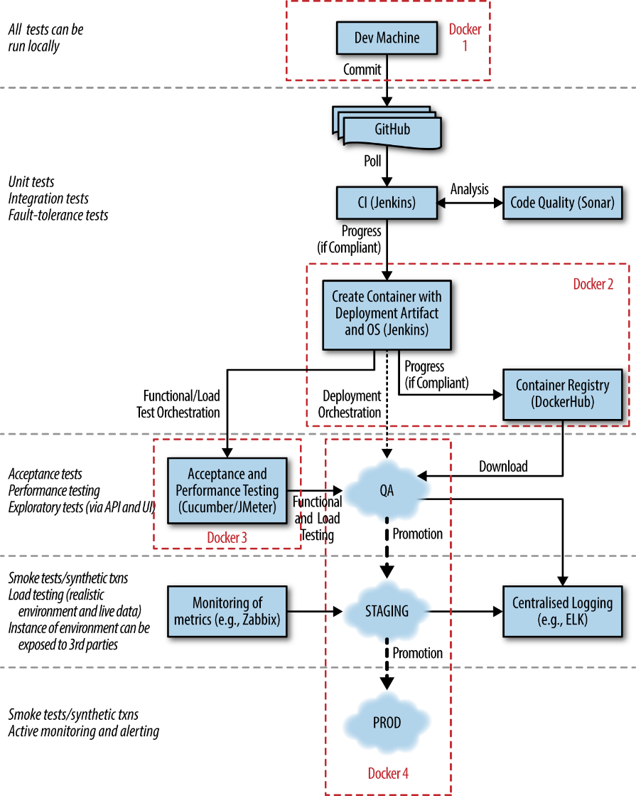
Modern Container CI/CD Pipeline
Notes:
Modern pipeline is quite messy as you can see on the example of typical Java pipeline
Now add Docker and Kubernetes deployments and you have yourself a headache
But we are focusing today on Container Image Scanning stage that can happen at multiple stages (see arrows)

Slide 6
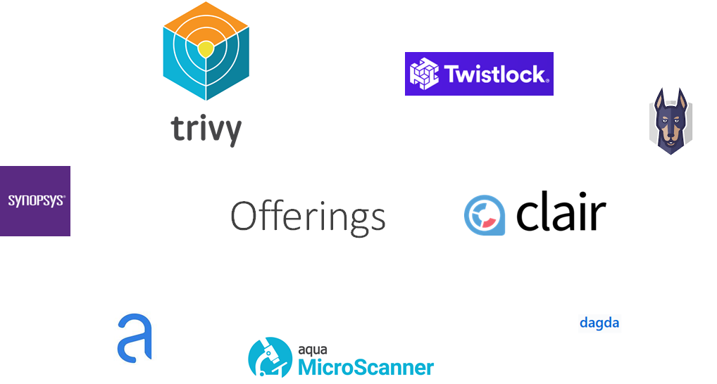

Slide 7
Component detection (libraries, packages, software)
Vulnerability matching
Reporting

Slide 8
Gap 1 – Components detection

Slide 9
Component detection (libraries, packages, software)
Vulnerability matching
Reporting

Slide 10
Most scanners, that we’ve surveyed, employ the same component detection technique that relies on package manager:
For Debian/Ubuntu
For CentOS/RHEL
For Alpine
What about source-built packages?
What about slim/runtime Docker images striping package manager off?
The trend of image slimming is expected to continue (Distroless, Dockerslim, multi-stage builds etc.).
dpkg-query –admindir
rpm --dbpath
cat /apk/db/installed
Notes:
And we see that this trend of image slimming continuing.
Studies have shown the correlation between image size / bloating and number of vulnerabilities in the image.

Slide 11
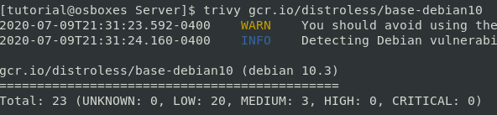
A word on Distroless…
Why do scanners work on Distroless??
You are relying on Google developers to tell you what’s in your image.
ls –la /var/lib/dpkg/status.d/
Notes:
Distroless is by definition is a set of runtime images promoted by Google

Slide 12
Future
Binary analysis
Container-aware package managers (i.e. Distroless)
Runtime querying
docker exec –it debian:10.2 dpkg-query –W
Notes:
If vendors cant do binary analysis with package version detection (admittedly hard) the direction will go towards container-aware package managers.
Runtime querying is also possible – think about security solution running as pod in a cluster and performing continuous scanning, but not only for runtime security.

Slide 13
Gap 2: Unsupported images

Slide 14
Component detection (libraries, packages, software)
Vulnerability matching
Reporting

Slide 15
What about Fedora?
Only one out of 6 surveyed scanners supported Fedora
Unsupported image versions within the repository:
Trivy supports Ubuntu 18.04 but not 18.10
Clair supports Ubuntu 18.04 and 20.04 but not 18.10 and 19.10
Microscanner supports Ubuntu 18.04 and 20.04 but not 18.10 and 19.10
CentOS
Huge numbers of vulnerabilities. Is it actionable at all?

Slide 16
From our experience:
{ "scan_started":{ "seconds":1593444618, "nanos":356881360
}, "scan_duration":10, "digest":"92a440546181ef055c62aa6c91787e665361bb74cfc30850f0ab15325bb97e96", "os":"fedora", "version":"29", "image_assurance_results":{ "checks_performed":[ { "policy_id":1, "policy_name":"Default", "control":"max_severity", "maximum_severity_allowed":"high"
}]}, "vulnerability_summary":{ "total":0, "high":0, "medium":0, "low":0, "negligible":0, "sensitive":0, "malware":0
}, "scan_options":{
}, "partial_results":true, "initiating_user":"token", "data_date":1543020471, "changed_result":false, "function_metadata":{
}}}
no vulns ≠ no vulns
Notes:
Only in rare circumstances we sow 0 vulns that means 0 vulns, for example alpine vanilla images and even then other scanners probably will find something.
To the second point: unfortunately, scanners are very not clear on the reasons for 0 vulns. Often no indication whatsoever that image is unsupported or feeds are not ready. Scanners try to do their best regardless, but by doing that they are shooting themselves in the foot.

Slide 17
Future
Binary analysis
Robust feed parsing and feed standardization
Distro standardization (i.e. RedHat UBI)

Slide 18
Gap 3: Vulnerabilities are not easy

Slide 19
Component detection (libraries, packages, software)
Vulnerability matching
Reporting

Slide 20
 | Trivy | Anchore | Microscanner | Clair
Debian:10.2 | 65 | 41 | 15 | 60
None of these sets of vulns is a superset of another
None of these sets encompasses ALL image vulns
Each set contains at least one FP
Notes:
Given this numbers how do we even approach scanner comparison? Definitely need to dig deeper ino the single vulns. But – how do we determine whether the vulnerability is TP / FP?
There was no way around it – we rolled our sleeves and started to manually judge vulnerabilities to attribute them to one of the groups.

Slide 21
Fedora:29
CentOS:7.7.1908
Debian:10.2
Ubuntu:18.10
Alpine:3:9:4
Benchmark
Feeds
Manual judging
Notes:
This was our initial view. However, as we went we had to drop CentOS and Fedora for the following reasons:
- Only 1 out of 6 scanners supports Fedora
- Overall we found over 600 distinct vulns on CentOS, which renders manual judgement impossible

Slide 22
CentOS:7.7.1908
Fedora:29
Debian:10.2
Ubuntu:18.10
Alpine:3:9:4
Benchmark
91 manually-judged Debian vulns
71 manually-judged Ubuntu vulns
10 manually-judged Alpine vulns

Slide 23
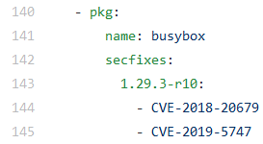
Applicability Classes
TP –simple cases where vulnerability is clearly applicable
Recently-found
Triaged as unimportant
FP – vulnerability is clearly not applicable
Backport Patches
Non-functional packages
Kernel vulns
But what if there is something in the middle?
CVE-2018-20679
CVE-2020-10751 in libselinux.so.1
Notes:
Clarify Applicability classes term. Reasoning behind is that “Types” term is overloaded by different vulnerability types – scoring, severity, priority, CWE, impact etc. What we really measure here is the rate of vulnerability applicability/truthfullness

Slide 24
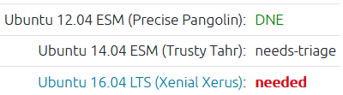
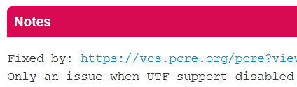
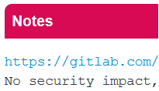

Applicability Classes
I = Inconclusive
Untriaged
Environmental – build arguments, usage pattern etc.
Invalidated by comments
Future unclear
CVE-2020-13776 (updated on June 24)
CVE-2019-20838
CVE-2018-1000654
CVE-2019-13050
Notes:
I != FP . They can be TPs under certain conditions but the conditions are out of scanner control.
I:
Environmental – depending how the library is compiled
Future unclear – f.e. conceptual weakness
MM:
NVD lists CVE-2018-12886 as affecting version 4.1 through version 8. It is unclear whether 8.8 would be within this range. In our testing, 50% of scanners reported the issue.
CVE-2020-10029 on Ubuntu - NVD shows that glibc is fixed in 2.32 whereas Ubuntu tracker shows its fixed in 2.30 - clear version mismatch. NVD probably parses "Target Milestone" field in bugzilla, whereas Ubuntu tracker looks at comments/commits
D: in this case chances that the vuln will be fixed upstream are slim

Slide 25
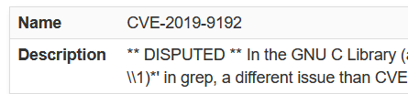
Applicability Classes
MM = different feeds disagree on fixed or affected package versions
D = disputed by maintainers
CVE-2019-5188
CVE-2016-10228
CVE-2019-9192
Notes:
I != FP . They can be TPs under certain conditions but the conditions are out of scanner control.
I:
Environmental – depending how the library is compiled
Future unclear – f.e. conceptual weakness
MM:
NVD lists CVE-2018-12886 as affecting version 4.1 through version 8. It is unclear whether 8.8 would be within this range. In our testing, 50% of scanners reported the issue.
CVE-2020-10029 on Ubuntu - NVD shows that glibc is fixed in 2.32 whereas Ubuntu tracker shows its fixed in 2.30 - clear version mismatch. NVD probably parses "Target Milestone" field in bugzilla, whereas Ubuntu tracker looks at comments/commits
D: in this case chances that the vuln will be fixed upstream are slim

Slide 26
The truth is …
Many times, even when having all the information, scanners don’t know whether vulnerability is applicable or not
The decision of what to do with I / MM / D is environmental

Slide 27
Two benchmark modes:
Paranoid: treat every problematic vuln as TP
Relaxed: treat every problematic vuln as FP
I / MM / D
TP
I / MM / D
FP
Notes:
We recognize that different companies have different security policies and different security teams. Some (like some government orgs) would prefer to manually analyze every potential vulnerability as it was TP. For other companies with more constraint resources, Relaxed mode would be more appropriate. But the bottomline – scanner performance will differ depending on this choice: paranoid or relaxed. And so before comparing/choosing scanners future customers must take into account their internal situation.

Slide 28
Quality metrics:
Precision = TP / (TP+FP)
Recall = TP / (TP+FN)
F-measure = 2 * Precision * Recall / (Recall + Precision)

Slide 29
UBCIS – Ultimate Benchmark for Container Image Scanners
 |  | Trivy |  |  | Anchore |  |  | Clair |  |  | Microscanner
 |  | Precision | Recall | F-measure | Precision | Recall | F-measure | Precision | Recall | F-measure | Precision | Recall | F-measure
Debian:10.2 | Relaxed | 0.69 | 0.98 | 0.81 | 0.67 | 0.59 | 0.62 | 0.68 | 0.89 | 0.77 | 0.4 | 0.13 | 0.2
 | Paranoid | 1.00 | 0.74 | 0.85 | 1.00 | 0.47 | 0.64 | 1.00 | 0.68 | 0.81 | 1.0 | 0.17 | 0.29
Debian:10.3 | Relaxed | 0.69 | 0.98 | 0.81 | 0.66 | 0.57 | 0.61 | 0.68 | 0.89 | 0.77 | 0.43 | 0.14 | 0.21
 | Paranoid | 1.00 | 0.73 | 0.84 | 1.00 | 0.45 | 0.61 | 1.00 | 0.67 | 0.80 | 1.0 | 0.16 | 0.28
Debian:10.4 | Relaxed | 0.68 | 0.98 | 0.8 | 0.63 | 0.54 | 0.58 | 0.67 | 0.89 | 0.76 | 0.38 | 0.12 | 0.19
 | Paranoid | 1.0 | 0.72 | 0.84 | 1.00 | 0.43 | 0.60 | 1.00 | 0.66 | 0.79 | 1.0 | 0.16 | 0.28
Alpine:3.9.4 | Relaxed | 1.00 | 1.00 | 1.00 | 1.00 | 1.00 | 1.00 | 1.00 | 0. 17 | 0.29 | 1.00 | 0. 17 | 0.29
 | Paranoid | 1.00 | 1.00 | 1.00 | 1.00 | 1.00 | 1.00 | 1.00 | 0. 17 | 0.29 | 1.00 | 0. 17 | 0.29
Alpine:3.10.4 | Relaxed | 1.00 | 0.5 | 0.67 | 1.00 | 0.5 | 0.67 | 0 | 0 | 0 | 0 | 0 | 0
 | Paranoid | 1.00 | 0.5 | 0.67 | 1.00 | 0.5 | 0.67 | 0 | 0 | 0 | 0 | 0 | 0
Alpine:3.11.5 | Relaxed | 1.00 | 1.00 | 1.00 | 1.00 | 1.00 | 1.00 | 0 | 0 | 0 | 0 | 0 | 0
 | Paranoid | 1.00 | 1.00 | 1.00 | 1.00 | 1.00 | 1.00 | 0 | 0 | 0 | 0 | 0 | 0
Ubuntu:18.10 | Relaxed | NA | NA | NA | 0.57 | 0.44 | 0.50 | NA | NA | NA | NA | NA | NA
 | Paranoid | NA | NA | NA | 0.86 | 0.45 | 0.59 | NA | NA | NA | NA | NA | NA
Ubuntu:19.10 | Relaxed | 0.67 | 0.1 | 0.19 | 0.64 | 1.00 | 0.78 | NA | NA | NA | NA | NA | NA
 | Paranoid | 1.0 | 0.1 | 0.2 | 0.96 | 1.00 | 0.98 | NA | NA | NA | NA | NA | NA
*as of 21/09/2020

Slide 30
Practical Recommendations

Slide 31
Before Choosing Scanner
Assess risk tolerance
Can you afford to miss vulnerabilities (relaxed mode), or must treat all vulnerabilities as potentially critical (paranoid mode)?
Scanners with a better paranoid mode score will generally raise more alerts, requiring more resources.

Slide 32
Before Choosing Scanner
Look at the deployment environment
What base image are you using?
Is the image supported by the scanner?

Slide 33
Before Choosing Scanner
Based on risk (#1) and base image (#2), use the benchmark results (Table 2) to select the appropriate scanner.

Slide 34
Before Choosing Scanner
From our experience, no image had zero vulnerabilities. A lack of vulnerabilities points to configuration problems or an unsupported image.

Slide 35
Before Choosing Scanner
Combining multiple scanners in a CI/CD pipeline is a good idea. Decide how to merge the results.

Slide 36
After Choosing Scanner
Keep watching the benchmark for changes.

Slide 37





A word on registry-embedded scanning
Relying on container registry scanning?
Amazon ECR
Harbor starting v1.10
Sysdig
Azure Container Registry
Google Container Registry
*as of June 2020
Notes:
Are you relying on registry scans? Now, as you know various pitfalls I encourage you to check what scanner your registry employs. Potentially, if the registry cannot integrate different scanners you might think about switching registry or deploying inline scanner at different stage.
And finally, Google uses its own Container Analysis tool that we haven’t evaluated.

Slide 38
Future Research
Vulnerability volumes
Do all of them have patches?
How do we fix those that don’t?
Should we allow High’s in production?
Dealing with “Negligible / Unimportant” vulnerabilities
Are they really as “Negligible” as scanner thinks?
Notes:
The way I see future research in this area develops – there are two major issues
Some scanners already offer automatic fixes but that’s not enough
The harder it is to judge the vulnerability the more chances it will end up on Negligible list. Scanner use this technique to pass on the judging responsibility to the user.

Slide 39
Material
UBCIS paper (USENIX CSET 2020)
https://www.usenix.org/publications/proceedings
Open Source
https://github.com/blackberry/ubcis

Slide 40
Thank you for listening
@sshaybbc

