Slide 1
UBCIS
Ultimate Benchmark for Container Image Scanning
Preliminary work paper / Short
Shay Berkovich
Jeffrey Kam
Glenn Wurster
Security Research Group @ BlackBerry

Slide 2
Importance of Image Scanning
Traditional VM vs container image – where the source came from?
Unless you are building the base image by yourself, attacker has degree of access to your base images
Vulnerability propagation: reusability and deployability
FROM debian:latest
COPY …
USER …
docker pull debian
docker run –it debian bash
Notes:
VMs traditionally getting more attention from IT department. There are new attempts of maintaining a “golden set of container base images” like Distroless
Vulnerability propagation
Downloading images from DockerHub if your organizational policy does not prohibit this. Multistage builds also help.
Glenn’s note on last point: “I think the key is the exact list of packages installed and the configuration of those packages, which is based on the central repository but might be different. With a container sitting in a central repository, the configuration/list of packages is obvious.
”

Slide 3
Scope
Container Image Scanning will solve:
Find known 3rd-party vulnerabilities in your product
Container Image Scanning will NOT solve:
Detect undiscovered vulnerabilities
Protect against malicious containers
Protect against backdoors
Solve container runtime security problems

Slide 4
Scanner Results on debian:10.2
None of these sets is a superset of all others
None of these sets encompasses ALL image vulnerabilities
Each set contains at least one FP
 | Trivy | Anchore | Microscanner | Clair
Debian:10.2 | 64 | 37 | 8 | 60
Notes:
Given this numbers how do we even approach scanner comparison? Definitely need to dig deeper ino the single vulns. But – how do we determine whether the vulnerability is TP / FP?
There was no way around it – we rolled our sleeves and started to manually judge vulnerabilities to attribute them to one of the groups.

Slide 5
Component detection (libraries, packages, software)
Vulnerability matching
Reporting
Notes:
Sources of inconsistencies:
- PHASE1: Most scanners query the package manager, while few perform binary analysis. The two approaches might cause different versions to be detected.
PHASE2: While common vulnerabilities can be found in a single vulnerability feed such as National Vulnerability Database (NVD), most scanners employ a set of vulnerability feeds (including some commercial) to use as many sources of potential vulnerabilities as possible. The list of feeds, along with the feed prioritization, differs greatly from scanner to scanner.
PHASE2: Some scanners authors curate vulnerability feeds, leading to a lag in time between the vulnerability being known and being reported by a specific scanner.
PHASE3:Ambiguity - It is sometimes unclear whether a vulnerability exists in an open source component, or if it is present in the component as deployed in the container. Scanners authors can weight vulnerability feed information differently when deciding whether to report a vulnerability in a container.

Slide 6
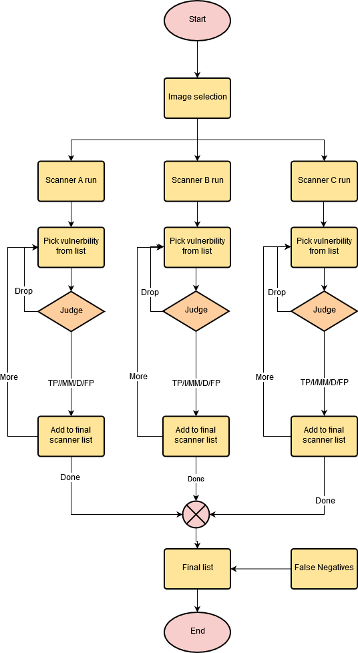
Fedora:29
CentOS:7.7.1908
Debian:10.2
Ubuntu:18.10
Alpine:3:9:4
Benchmark
Feeds
Feeds
Manual judging
Manual judging
Notes:
This was our initial view. However, as we went we had to drop CentOS and Fedora for the following reasons:
- Only 1 our of 6 scanners supports Fedora
- Overall we found over 600 distinct vulns on CentOS, which renders manual judgement impossible

Slide 7

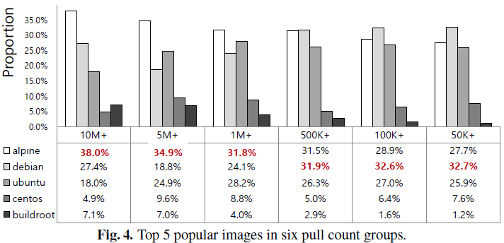
Stability
Popularity
Relevance
Not very old – should not contain 100s of vulns
Not under active maintenance
Benchmark will still change as new vulnerabilities are discovered for existing package versions
“A Study of Security Vulnerabilities on Docker Hub”,
Proceedings of the Seventh ACM on Conference on Data and Application Security and Privacy, 2017

Slide 8
CentOS:7.7.1908
Fedora:29
Debian:10.2
Ubuntu:18.10
Alpine:3:9:4
Benchmark
98 manually-judged Debian vulns
72 manually-judged Ubuntu vulns
10 manually-judged Alpine vulns
662 CentOS vulns
211 Fedora vulns

Slide 9
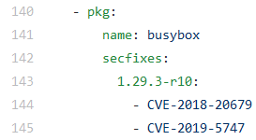
Applicability Classes
TP –simple cases where vulnerability is clearly applicable
Recently-found
Triaged as unimportant
FP – vulnerability is clearly not applicable
Backport Patches
Non-functional packages
Kernel vulns
Architecture mismatch
But what if there is something in the middle?
CVE-2018-20679
Libc-utils, libselinux.so.1
CVE-2020-10751
Notes:
Clarify Applicability classes term. Reasoning behind is that “Types” term is overloaded by different vulnerability types – scoring, severity, priority, CWE, impact etc. What we really measure here is the rate of vulnerability applicability/truthfullness

Slide 10
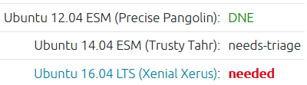
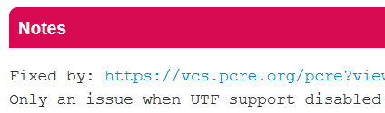
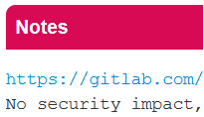

Applicability Classes
I = Inconclusive
Untriaged
Environmental – build arguments, usage pattern etc.
Invalidated by comments
Future unclear
CVE-2020-13776 (updated on June 24)
CVE-2019-20838
CVE-2018-1000654
CVE-2019-13050
Notes:
I != FP . They can be TPs under certain conditions but the conditions are out of scanner control.
I:
Environmental – depending how the library is compiled
Future unclear – f.e. conceptual weakness
MM:
NVD lists CVE-2018-12886 as affecting version 4.1 through version 8. It is unclear whether 8.8 would be within this range. In our testing, 50% of scanners reported the issue.
CVE-2020-10029 on Ubuntu - NVD shows that glibc is fixed in 2.32 whereas Ubuntu tracker shows its fixed in 2.30 - clear version mismatch. NVD probably parses "Target Milestone" field in bugzilla, whereas Ubuntu tracker looks at comments/commits
D: in this case chances that the vuln will be fixed upstream are slim

Slide 11

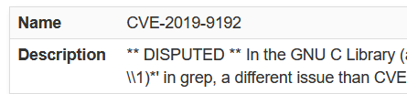
Applicability Classes
MM = different feeds disagree on fixed or affected package versions
D = disputed by maintainers
CVE-2018-12886
CVE-2020-10029
CVE-2019-9192
Notes:
I != FP . They can be TPs under certain conditions but the conditions are out of scanner control.
I:
Environmental – depending how the library is compiled
Future unclear – f.e. conceptual weakness
MM:
NVD lists CVE-2018-12886 as affecting version 4.1 through version 8. It is unclear whether 8.8 would be within this range. In our testing, 50% of scanners reported the issue.
CVE-2020-10029 on Ubuntu - NVD shows that glibc is fixed in 2.32 whereas Ubuntu tracker shows its fixed in 2.30 - clear version mismatch. NVD probably parses "Target Milestone" field in bugzilla, whereas Ubuntu tracker looks at comments/commits
D: in this case chances that the vuln will be fixed upstream are slim

Slide 12
The truth is …
Many times, even when having all the vulnerability reports, scanners don’t know whether vulnerability is applicable or not
The decision of what to do with I / MM / D is environmental

Slide 13
Quality metrics:
Precision = TP / (TP+FP)
Recall = TP / (TP+FN)
F-measure = 2 * Precision * Recall / (Recall + Precision)

Slide 14
UBCIS – Ultimate Benchmark for Container Image Scanners
 |  | Trivy |  |  | Anchore |  |  | Clair
 |  | Precision | Recall | F-measure | Precision | Recall | F-measure | Precision | Recall | F-measure
Debian-10.2 | Relaxed | 0.78 | 0.98 | 0.87 | 0.69 | 0.51 | 0.59 | 0.71 | 0.86 | 0.78
 | Paranoid | 1.00 | 0.69 | 0.82 | 1.00 | 0.41 | 0.58 | 0.96 | 0.64 | 0.77
Alpine-3.9.4 | Relaxed | 1.00 | 1.00 | 1.00 | 1.00 | 1.00 | 1.00 | 1.00 | 0.20 | 0.33
 | Paranoid | 1.00 | 1.00 | 1.00 | 1.00 | 1.00 | 1.00 | 1.00 | 0.20 | 0.33
Ubuntu-18.10 | Relaxed | NA | 0.00 | NA | 0.46 | 0.73 | 0.56 | 0.48 | 0.67 | 0.56
 | Paranoid | NA | 0.00 | NA | 0.92 | 0.42 | 0.57 | 0.90 | 0.36 | 0.51
*as of 30/06/2020
Relaxed: I / MM / D => FP
Paranoid: I / MM / D => TP

Slide 15
Practical Recommendations

Slide 16
Before Choosing Scanner
Assess risk tolerance
Can you afford to miss vulnerabilities (relaxed mode), or must treat all vulnerabilities as potentially critical (paranoid mode)?
Scanners with a better paranoid mode score will generally raise more alerts, requiring more resources.

Slide 17
Before Choosing Scanner
Look at the deployment environment
What base image are you using?
Is the image supported by the scanner?

Slide 18
Before Choosing Scanner
Based on risk (#1) and base image (#2), use the benchmark results (Table 2) to select the appropriate scanner.

Slide 19
Before Choosing Scanner
From our experience, no image had zero vulnerabilities. A lack of vulnerabilities points to configuration problems or an unsupported image.

Slide 20
Before Choosing Scanner
Combining multiple scanners in a CI/CD pipeline is a good idea. Decide how to merge the results.

Slide 21
After Choosing Scanner
Keep watching the benchmark for changes.

Slide 22





A word on registry-embedded scanning
Relying on container registry scanning?
Amazon ECR
Harbor starting v1.10
Sysdig
Azure Container Registry
Google Container Registry
Notes:
Are you relying on registry scans? Now, as you know various pitfalls I encourage you to check what scanner your registry employs. Potentially, if the registry cannot integrate different scanners you might think about switching registry or deploying inline scanner at different stage.
And finally, Google uses its own Container Analysis tool that we haven’t evaluated.

Slide 23
Open Source
https://github.com/blackberry/UBCIS
Two modes:
Superscan
Scorer

Slide 24

Thank you for listening
@sshaybbc
sshayb

