Slide 1
AquaSol
Reducing Municipal Fresh Water OPEX
a.k.a. Non-Revenue Water Management with District Metering Areas
Smart City & IoT
- Steven Shearer, Brian Fu, Jacky Lee, Robert Yuen
tmForum {open}:hack - Vancouver July 11 & 12, 2016

Slide 2
Reducing Municipal Fresh Water OPEX
Municipalities purchase fresh water and distribute it to residents. (Especially older) water distribution lines are susceptible to slow leaks – which is a gross waste of public funds.
Recognized as a global issue by the UN, World Bank, & many Water Associations world-wide with some cities’ estimates averaging 30% wastage.

Slide 3
Solution Approach
Measure, Analyze, Repair, Repeat
focus here is 1st 2 steps
Solution Architecture
Municipal OpenData water usage per Property
New IoT water meters at mid-points
tmForum Trouble Ticket API
Reporting portal

Slide 4
Expected Benefits
Reduction in cost of fresh water purchased by municipality.
Avoidance of expensive damage caused later by burst water main.
Greater capability to withstand drought.
Revenue increase from fraud detection.

Slide 5
Proposed Process, subsequent to {open}:hack
Get Property & Water Meter Detail
Get Property Water Usage History
Get Municipal Water Supply History
Get Municipal Water Segment Distribution History
Calc Water Supply, Usage, & Leakage per Segment
Review Water Leakage Findings
Get Water Network Hierarchy
Tested with data provided
by City of Surrey.
Open Data validated
Simulated with 1st 4 digits of Postal Code
Available, but custom extract provided
Simulated
Simulated with 1st 4 digits of Postal Code
Calculated
Sample report generated

Slide 6
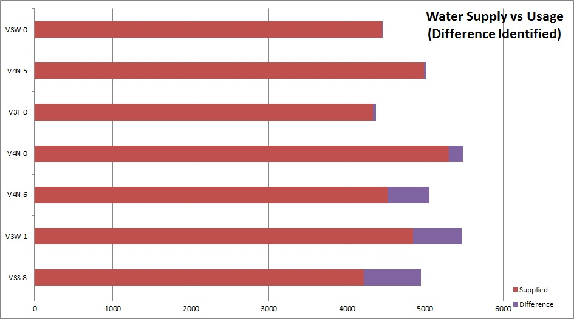
Sample Report 1

Slide 7
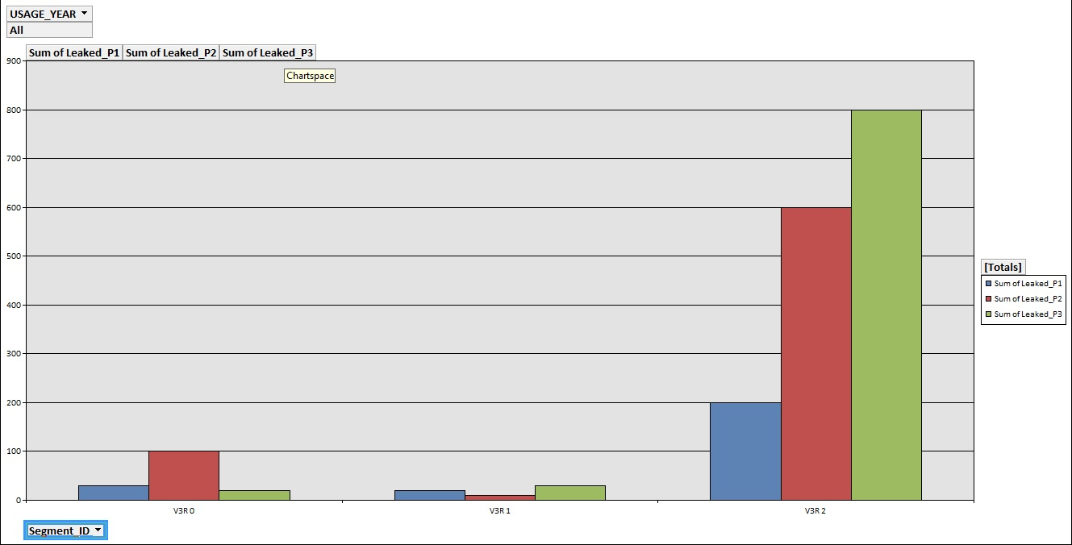
Sample Report 2

Slide 8
Business Challenges
According to World Bank, Dec 2006, many public water utilities suffer from:
Weak governance, financial framework, staffing skills
Political & economic constraints
Deteriorating infrastructure
Recommendation:
- Performance-based public-private partnerships (PPP)

Slide 9
Business Challenges
According to Asian Development Bank, 2010, underestimation of:
technical difficulties,
complexity of NRW management,
potential benefits of action.
Recommendation:
- Performance-based public-private partnerships (PPP)

