Slide 1
AquaSol
Reducing Municipal Fresh Water OPEX
Smart City & IoT
Steven Shearer, Brian Fu, Jacky Lee, Robert Yuen
tmForum {open}:hack - Vancouver July 11 & 12, 2016

Slide 2
Reducing Municipal Fresh Water OPEX
Municipalities purchase fresh water and distribute it to residents. (Especially older) water distribution lines are susceptible to slow leaks – which is a gross waste of public funds.
Recommended sales/implementation approach is to start on North American east coast, and/or Europe.

Slide 3
Solution Architecture
Municipal OpenData water usage per Property
New IoT water meters at mid-points
tmForum Trouble Ticket API
Reporting portal

Slide 4
Expected Benefits
Reduction in cost of fresh water purchased by municipality.
Avoidance of expensive damage caused later by burst water main.
Greater capability to withstand drought.
Revenue increase from fraud detection.

Slide 5
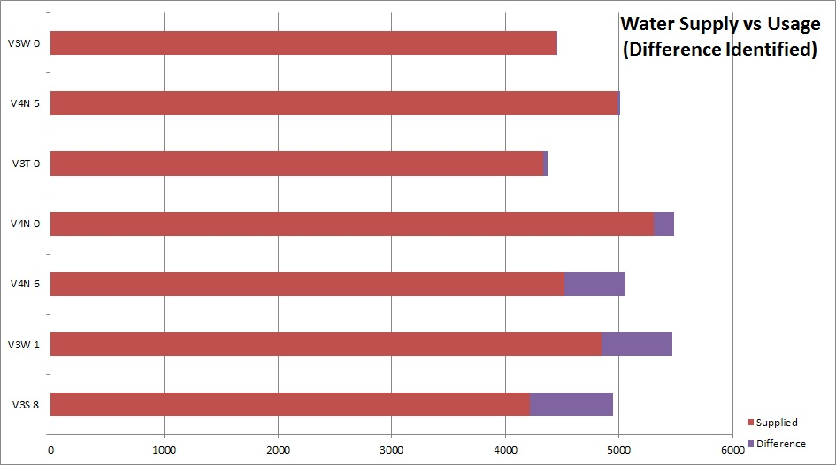
Sample Report

