Slide 1
CS 445 / 645
Introduction to Computer Graphics
Lecture 12
Camera Models

Slide 2

Paul Debevec
Top Gun Speaker
Wednesday, October 9th at 3:30 – OLS 011
http://www.debevec.org
MIT Technolgy Review’s “100 Young Innovators”

Slide 3
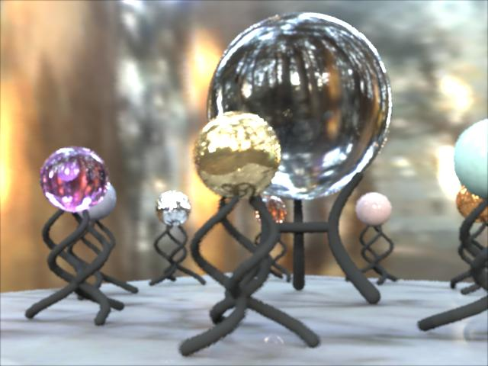
Rendering with Natural Light

Slide 4
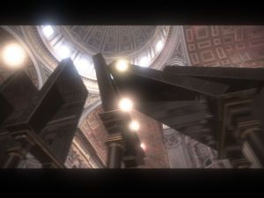
Fiat Lux

Slide 5
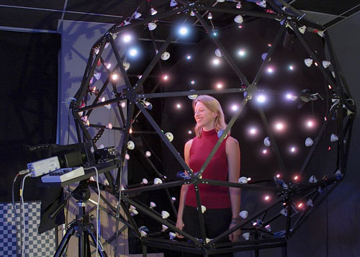
Light Stage

Slide 6
Moving the Camera or the World?
Two equivalent operations
  Initial OpenGL camera position is at origin, looking along -Z
  Now create a unit square parallel to camera at z = -10
  If we put a z-translation matrix of 3 on stack, what happens?
    Camera moves to z = -3
      Note OpenGL models viewing in left-hand coordinates
    Camera stays put, but square moves to -7
  Image at camera is the same with both

Slide 7
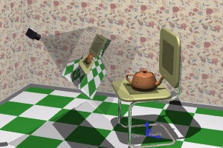
A 3D Scene
Notice the presence of
the camera, the
projection plane, and
the world
coordinate axes
Viewing transformations define how to acquire the image on the projection plane

Slide 8
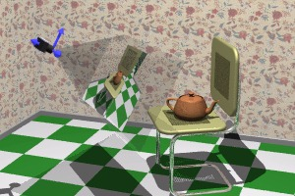
Viewing Transformations
Goal: To create a camera-centered view
Camera is at origin
Camera is looking along negative z-axis
Camera’s ‘up’ is aligned with y-axis (what does this mean?)

Slide 9

2 Basic Steps
Step 1: Align the world’s coordinate frame with camera’s by rotation

Slide 10

2 Basic Steps
Step 2: Translate to align world and camera origins

Slide 11
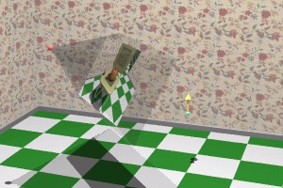
Creating Camera Coordinate Space
Specify a point where the camera is located in world space, the eye point (View Reference Point = VRP)
Specify a point in world space that we wish to become the center of view, the lookat point
Specify a vector in world
space that we wish to
point up in camera
image, the up vector (VUP)
Intuitive camera
movement

Slide 12
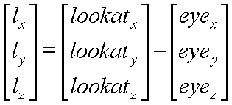

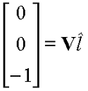
Constructing Viewing Transformation, V
Create a vector from eye-point to lookat-point
Normalize the vector
Desired rotation matrix should map this vector
to [0, 0, -1]^{T} Why?

Slide 13

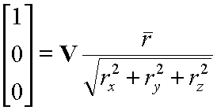
Constructing Viewing Transformation, V
Construct another important vector from the cross product of the lookat-vector and the vup-vector
This vector, when normalized, should align with [1, 0, 0]^{T} Why?

Slide 14

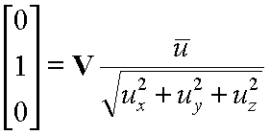
Constructing Viewing Transformation, V
One more vector to define…
This vector, when normalized, should align with [0, 1, 0]^{T}
Now let’s compose the results

Slide 15
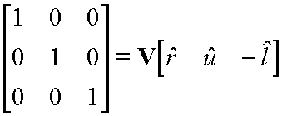
Composing Matrices to Form V
We know the three world axis vectors (x, y, z)
We know the three camera axis vectors (u, v, n)
Viewing transformation, V, must convert from world to camera coordinate systems

Slide 16
Composing Matrices to Form V
Remember
  Each camera axis vector is unit length.
  Each camera axis vector is perpendicular to others
Camera matrix is orthogonal and normalized
  Orthonormal
Therefore, M⁻¹ = M^{T}

Slide 17
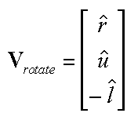
Composing Matrices to Form V
Therefore, rotation component of viewing transformation is just transpose of computed vectors

Slide 18
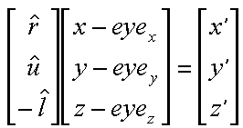
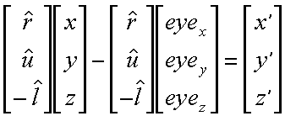
Composing Matrices to Form V
Translation component too
Multiply it through

Slide 19
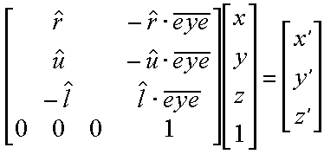
Final Viewing Transformation, V
To transform vertices, use this matrix:
And you get this:

Slide 20
Canonical View Volume
A standardized viewing volume representation
Parallel (Orthogonal) Perspective
x or y = +/- z
x or y
x or y
Back
Plane
Back
Plane
1
Front
Plane
Front
Plane
-1
-z
-z
-1

Slide 21
Why do we care?
Canonical View Volume Permits Standardization
  Clipping
    Easier to determine if an arbitrary point is enclosed in volume
    Consider clipping to six arbitrary planes of a viewing volume versus canonical view volume
  Rendering
    Projection and rasterization algorithms can be reused

Slide 22
Projection Normalization
One additional step of standardization
  Convert perspective view volume to orthogonal view volume to further standardize camera representation
    Convert all projections into orthogonal projections by distorting points in three space (actually four space because we include homogeneous coord w)
      Distort objects using transformation matrix

Slide 23
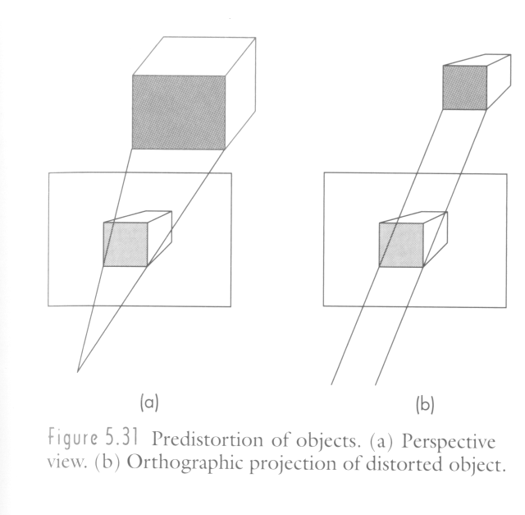
Projection Normalization
Building a transformation matrix
  How do we build a matrix that
    Warps any view volume to canonical orthographic view volume
    Permits rendering with orthographic camera
All scenes rendered with orthographic camera

Slide 24

Projection Normalization - Ortho
Normalizing Orthographic Cameras
  Not all orthographic cameras define viewing volumes of right size and location (canonical view volume)
  Transformation must map:

Slide 25
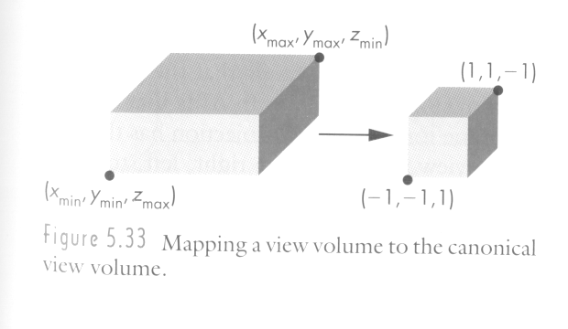
Projection Normalization - Ortho
Two steps
  Translate center to (0, 0, 0)
    Move x by –(x_{max} + x_{min}) / 2
  Scale volume to cube with sides = 2
    Scale x by 2/(x_{max} – x_{min})
  Compose these transformation matrices
    Resulting matrix maps orthogonal volume to canonical

Slide 26
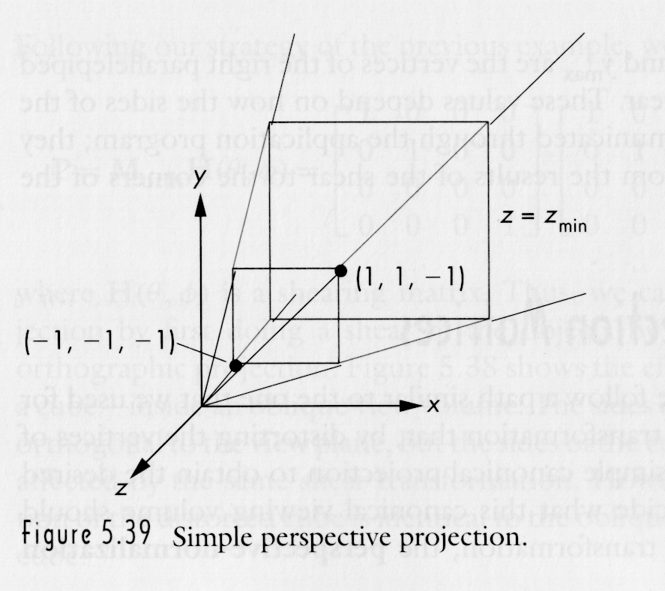

Projection Normalization - Persp
Perspective Normalization is Trickier

Slide 27
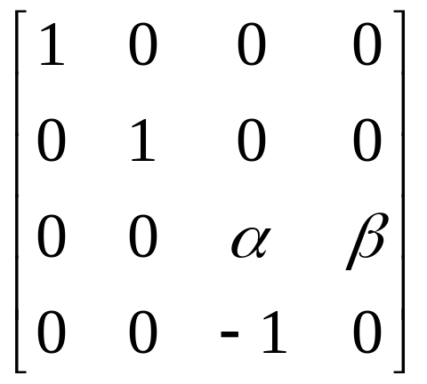

Perspective Normalization
Consider N=
After multiplying:
  p’ = Np

Slide 28

Perspective Normalization
After dividing by w’, p’ -> p’’

Slide 29
Perspective Normalization
  If x = z
    x’’ = -1
  If x = -z
    x’’ = 1
Quick Check

Slide 30



Perspective Normalization
What about z?
  if z = z_{max}
  if z = z_{min}
  Solve for α and β such that zmin -> -1 and zmax ->1
  Resulting z’’ is nonlinear, but preserves ordering of points
    If z₁ < z₂ … z’’₁ < z’’₂

Slide 31
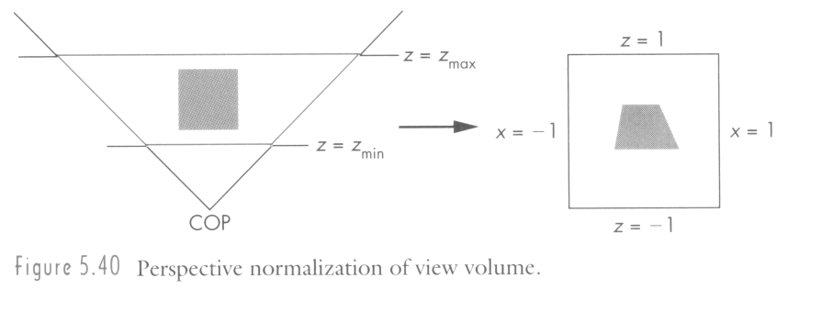
Perspective Normalization
We did it. Using matrix, N
  Perspective viewing frustum transformed to cube
  Orthographic rendering of cube produces same image as perspective rendering of original frustum

Slide 32
Color
Next topic: Color
  To understand how to make realistic images, we need a basic understanding of the physics and physiology of vision. Here we step away from the code and math for a bit to talk about basic principles.

Slide 33
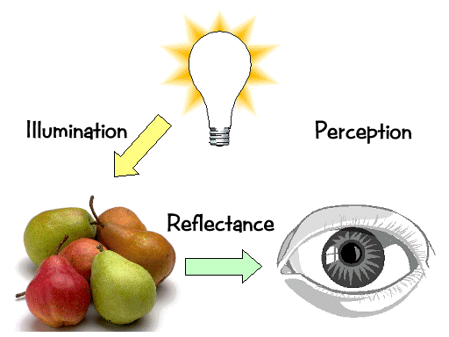
Basics Of Color
Elements of color:

Slide 34
Basics of Color
Physics:
  Illumination
    Electromagnetic spectra
  Reflection
    Material properties
    Surface geometry and microgeometry (i.e., polished versus matte versus brushed)
Perception
  Physiology and neurophysiology
  Perceptual psychology

Slide 35
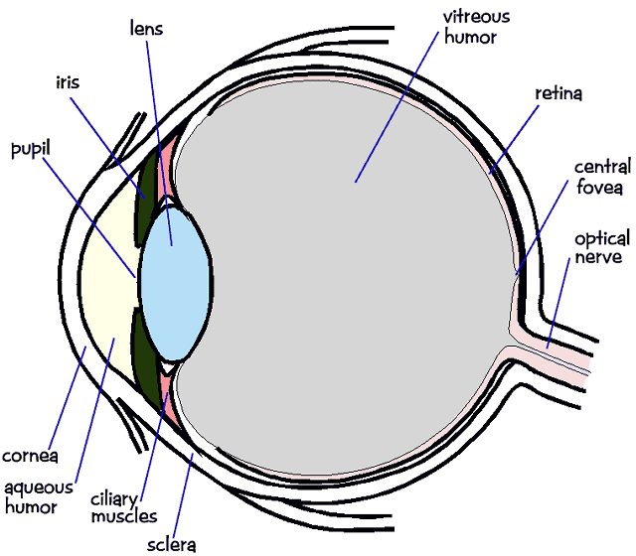
Physiology of Vision
The eye:
The retina
  Rods
  Cones
    Color!

Slide 36
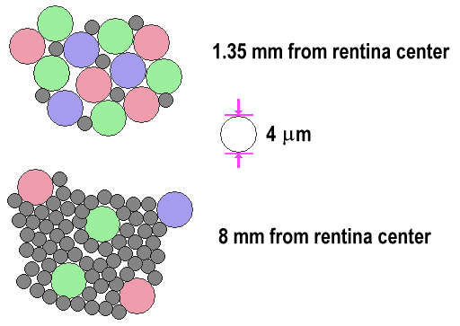
Physiology of Vision
The center of the retina is a densely packed region called the fovea.
  Cones much denser here than the periphery

Slide 37
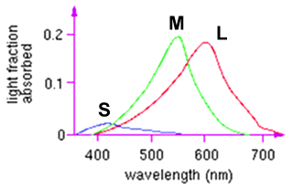
Physiology of Vision: Cones
Three types of cones:
  L or R, most sensitive to red light (610 nm)
  M or G, most sensitive to green light (560 nm)
  S or B, most sensitive to blue light (430 nm)
  Color blindness results from missing cone type(s)

Slide 38
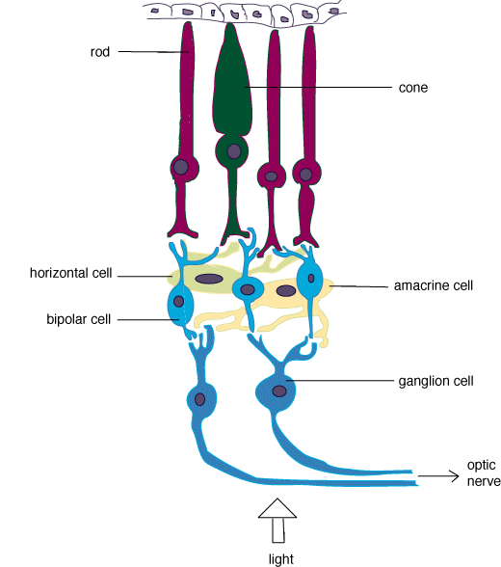
Physiology of Vision: The Retina
Strangely, rods and cones are at the back of the retina, behind a mostly-transparent neural structure that
collects their response.
http://www.trueorigin.org/retina.asp

Slide 39
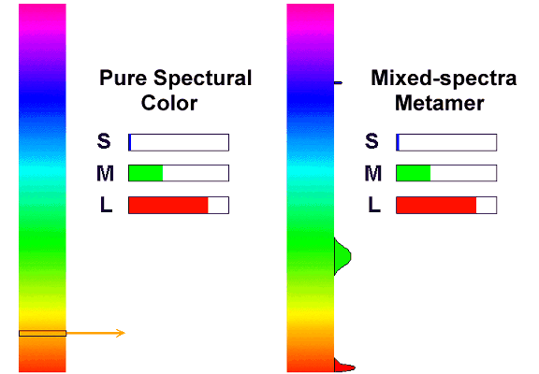
Perception: Metamers
A given perceptual sensation of color derives from the stimulus of all three cone types
Identical perceptions of color can thus be caused by very different spectra

Slide 40
Perception: Other Gotchas
Color perception is also difficult because:
  It varies from person to person
  It is affected by adaptation (stare at a light bulb… don’t)
  It is affected by surrounding color:

Slide 41
Perception: Relative Intensity
We are not good at judging absolute intensity
Let’s illuminate pixels with white light on scale of 0 - 1.0
Intensity difference of neighboring colored rectangles with intensities:
      0.10 -> 0.11 (10% change)
      0.50 -> 0.55 (10% change)
will look the same
We perceive relative intensities, not absolute

Slide 42
Representing Intensities
Remaining in the world of black and white…
Use photometer to obtain min and max brightness of monitor
This is the dynamic range
Intensity ranges from min, I₀, to max, 1.0
How do we represent 256 shades of gray?

Slide 43
Representing Intensities
Equal distribution between min and max fails
  relative change near max is much smaller than near I₀
  Ex: ¼, ½, ¾, 1
Preserve % change
  Ex: 1/8, ¼, ½, 1
  I_{n} = I₀ * r^{n}I₀, n > 0
I₀=I₀
I₁ = rI₀
I₂ = rI₁ = r²I₀
…
I₂₅₅=rI₂₅₄=r²⁵⁵I₀

Slide 44
Dynamic Ranges
Dynamic Range Max # of
Display (max / min illum) Perceived
Intensities (r=1.01)
CRT: 50-200 400-530
Photo (print) 100 465
Photo (slide) 1000 700
B/W printout 100 465
Color printout 50 400
Newspaper 10 234

Slide 45
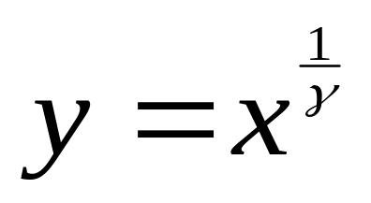
Gamma Correction
But most display devices are inherently nonlinear: Intensity = k(voltage)^{γ}
  i.e., brightness * voltage != (2*brightness) * (voltage/2)
  γ is between 2.2 and 2.5 on most monitors
Common solution: gamma correction
  Post-transformation on intensities to map them to linear range on display device:
  Can have separate γ for R, G, B

Slide 46
Gamma Correction
Some monitors perform the gamma correction in hardware (SGI’s)
Others do not (most PCs)
Tough to generate images that look good on both platforms (i.e. images from web pages)

