Slide 1

Santosh Shedbalkar

Slide 2

Goal: To obtain the numerical approximations to solutions of Initial Value Problems
Initial Value Problem: y′(x) = f(x, y(x)), y(x0) = y0
At sequence points x1, x2, … this method computes to y1 ≈ y(x1), y2 ≈ y(x2), …
There are many approximation methods that can be used to compute the values y1, y2, …

Slide 3
Methods:
  Euler Method
  Mid Point Method
  Trapezoidal Method
  Heun’s Method
  Runge-Kutta Methods
  Nystrom Methods
The difference between these methods is, up to what degree they approximate the values

Slide 4
While deriving these formulae the aim of the mathematicians has been to obtain methods which approximate y1≈y(x0+h) so that the error in this first and typical step can be bounded by a multiple of h^{p+1}, where, h is the step and the integer p, known as the order, takes on increasingly high values.

Slide 5

A method with s stages can be represented by a tableau, often called the "Butcher tableau“ given by,
0 | 0 | 0 | 0 | … | 0
c₂ | a₂₁ | 0 | 0 | … | 0
c₃ | a₃₁ | a₃₂ | 0 | … | 0
… | … | … | … | … | …
c_{s} | c_{s1} | c_{s2} | c_{s3} | … | 0
 | b₁ | b₂ | b₃ | … | b_{s}

Slide 6
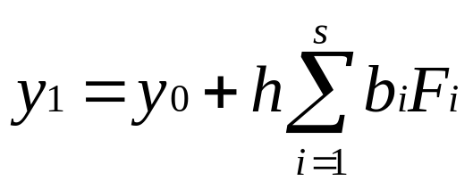
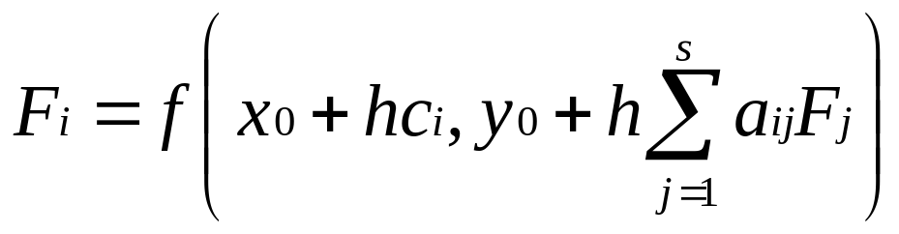
The output approximation is equal to,
Where F_{i}, the stage equations is given by,

Slide 7
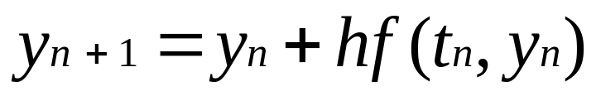
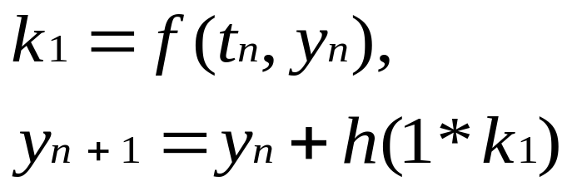
Euler’s Method:
Butcher Tableau for Euler’s method:
Using the Tableau:
0 | 0
0 | 1

Slide 8
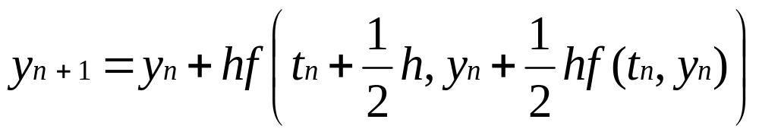
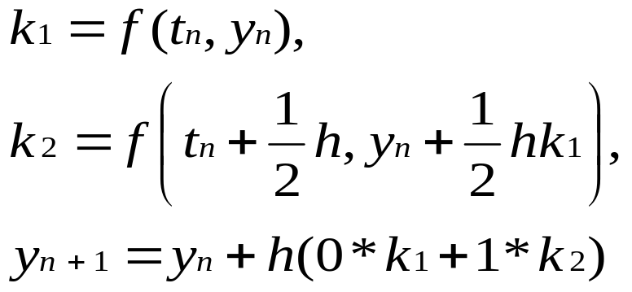
Midpoint Method:
Butcher Tableau:
Using the Tableau:
0 | 0 | 0
1/2 | 1/2 | 0
 | 0 | 1

Slide 9
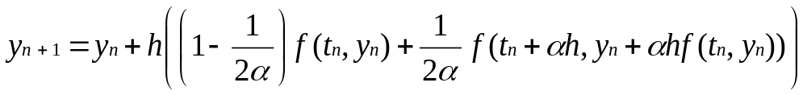
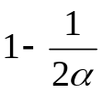

Second order Runge-Kutta methods with 2 stages:
Butcher Tableau:
When α = ½, it gives the Midpoint method and when α = 1, it gives the Heun’s method
0 | 0 | 0
α | α | 0

Slide 10
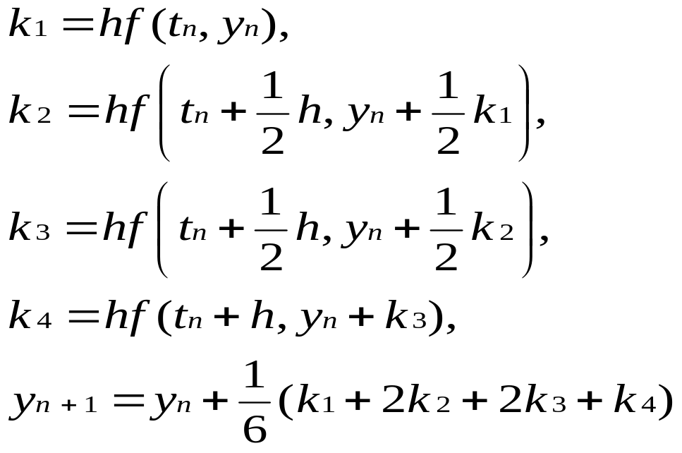
RK4 method:
Butcher Tableau:
0 | 0 | 0 | 0 | 0
½ | ½ | 0 | 0 | 0
½ | 0 | ½ | 0 | 0
1 | 0 | 0 | 1 | 0
 | 1/6 | 1/3 | 1/3 | 1/6

Slide 11
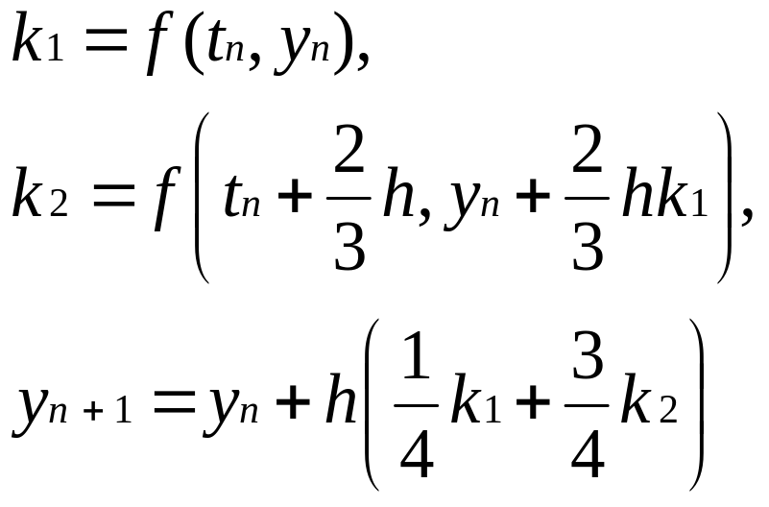

Usage:
Solve:
The tableau above yields the following equations:
0 | 0 | 0
2/3 | 2/3 | 0
 | 1/4 | 3/4

Slide 12
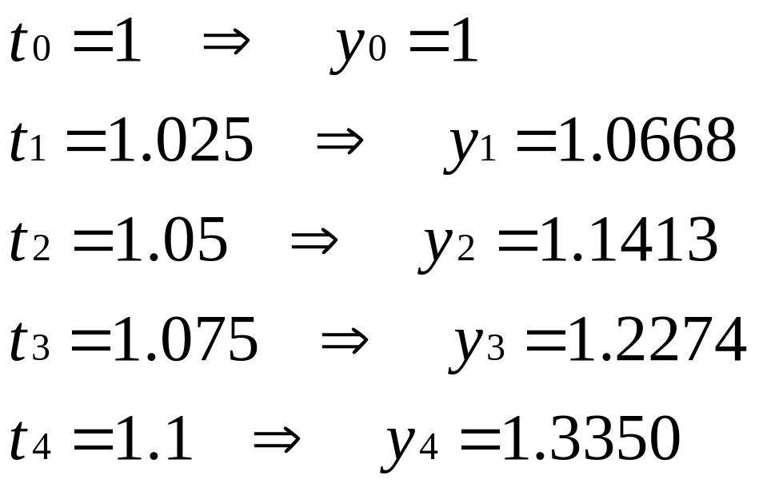

Slide 13
Thank you

