Slide 1
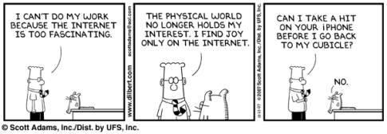
CS260- Networking; it’s not that difficult
Computer Networks I,
Interprocess Communication
Jeff Tucker
jjeff@digipen.edu

Slide 2
Who’s this guy??
Formerly at Microsoft on the Network Class Library Team (System.Net)
Bachelor of Science from University of Washington in CSS
Email: jjeff@digipen.edu
Commonly referred to as “Jeff Jeff”
I love programming!!

Slide 3
Course Goals
Solid understanding of the TCP/IP stack
Able to write networked software using Winsock
Solid understanding of security principles for networking
Solid understanding of Network architecture, models, and protocols
Understanding of some of the unique challenges presented by networked games

Slide 4
Syllabus

Slide 5
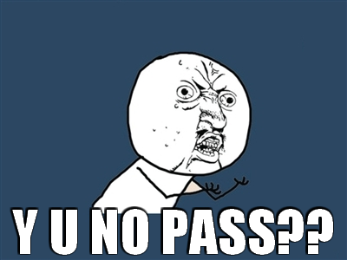
How to fail CS260
Don’t turn in an assignment. Better yet, don’t turn in any of the assignments
Don’t show up to class
Wait until the last minute to join a group for group projects
Don’t study for the exams
Don’t attend exam review sessions

Slide 6
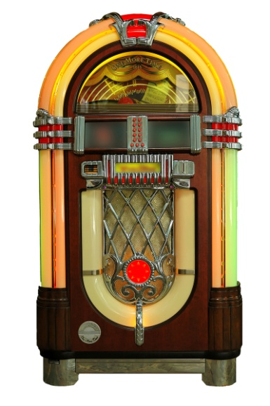







Why do we care about networks?

Slide 7
Why do we really care about networks?
The internet has become a huge part of the business world
  Internet ads- $21.1 billion
  Internet commerce- $131 billion
  60% of business has an online presence
Social Networking
  MySpace- $580 million in 2008, $15 billion today
  Facebook- $3.75 billion in 2008, $15 billion today
  Twitter- $4.1 billion (total profit to date: $0)

Slide 8
Why do we care?
68% of households play games
59% play with other gamers in person regularly
41% will purchase at least one game this year
62% of most frequent game players say they play online games
42% play games on wireless devices (iPhone or PDA)
Source: Entertainment Software Association survey

Slide 9
Internet User Demographics
Total Internet Usage | %
Total | 71%
Men | 71%
Women | 70%
Usage by Age | %
18-29 | 87%
30-49 | 83%
50-64 | 65%
65+ | 32%

Slide 10
Demographics (cont)
Net Usage by Age | %
18-29 | 87%
30-49 | 83%
50-64 | 65%
65+ | 32%
Game usage by age | %
<18 | 25%
18-49 | 49%
50+ | 26%

Slide 11

Online gaming growth

Slide 12
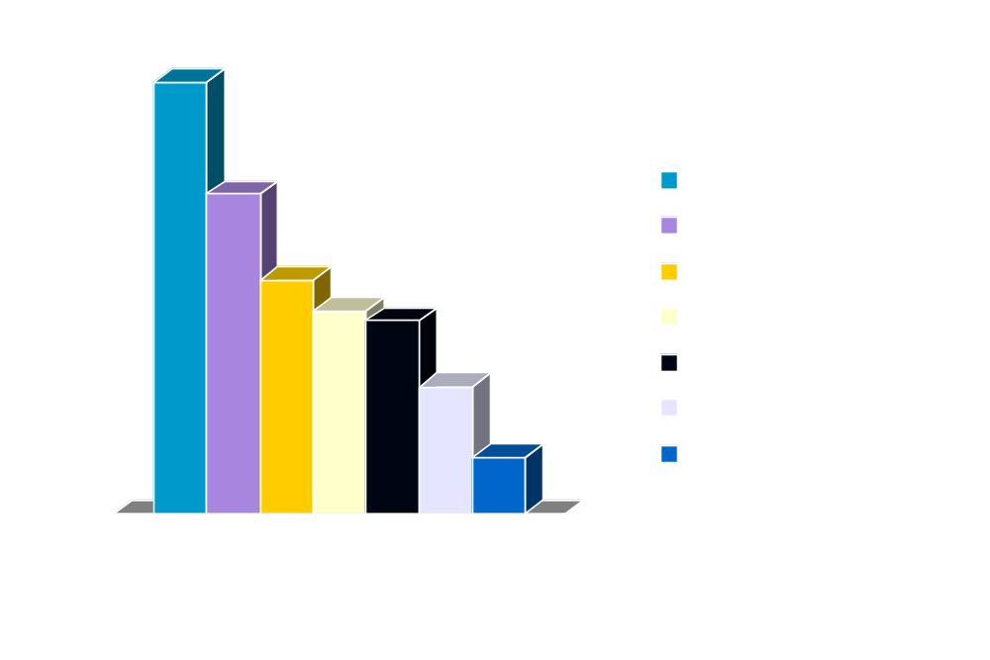
Game Console Sales

Slide 13
More statistics
62% of Xbox 360 owners play online
Wii owners jumped from 18% to 29% this year
Xbox360 and PS3 owners download more content than owners of other systems

Slide 14
Top Games Sold- 2009
Rank | Title
1 | Call of Duty: Modern Warfare 2 (xbox 360)
2 | Wii Fit
3 | Wii sports resort
4 | Mario Kart Wii
5 | Wii Play
6 | Halo 3: ODST
7 | Pokemon Platinum
8 | Call of Duty: Modern Warfare 2 (PS3)
9 | Madden NFL 10
10 | New Super Mario Bros Wii

Slide 15
Top Games Sold- 2009
Rank | Title
1 | Call of Duty: Modern Warfare 2 (xbox 360)
2 | Wii Fit
3 | Wii sports resort
4 | Mario Kart Wii
5 | Wii Play
6 | Halo 3: ODST
7 | Pokemon Platinum
8 | Call of Duty: Modern Warfare 2 (PS3)
9 | Madden NFL 10
10 | New Super Mario Bros Wii

Slide 16
Top Xbox 360 games (as of 2009)
1 | Halo 3
2 | Modern Warfare 2
3 | Gears of War
4 | Gears of War 2
5 | Grand Theft Auto IV
6 | Call of Duty 4: Modern Warfare
7 | Fable II
8 | Call of Duty: World at War
9 | Halo: Reach
10 | Halo 3: ODST

Slide 17
What is a network?
Computer network
  Many different machines with different functions
  Connected to each other via some medium
  Able to exchange information
Distributed System
  Independent machines working together to provide a single service
  Connected to each other via some medium
  Typically appears as a single machine

Slide 18
Network Types
LAN - Local Area Network
MAN – Metropolitan Area Network
WAN – Wide Area Network
Internet – many connected networks of all kinds

Slide 19
Network Software
Layered architecture
N layers, each of which have:
  Services
  Interface
  Protocol

Slide 20
Communication between layers
Layer N of one computer can communicate with layer N of another (but not really. . .)
A Layer provides services to the layer above and consumes services from the layer below via an interface
Data unit is the “Packet”
Encapsulation is used to move data between layers

Slide 21
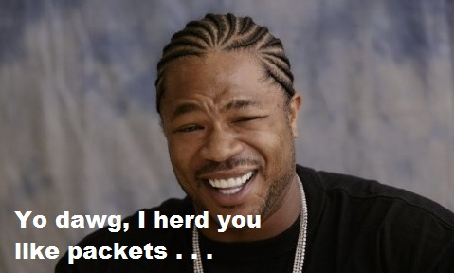
Encapsulation
Each layer take the full packet of the upper layer as data
That layer adds or removes a header (sometimes a footer)
That layer passes the packet to the next layer
Layers know nothing about the protocol in use by other layers*
* usually

Slide 22
Layer design issues
Addressing
Error Control
Flow Control
Arbitrary message size
Multiplexing/Demultiplexing
Routing

Slide 23
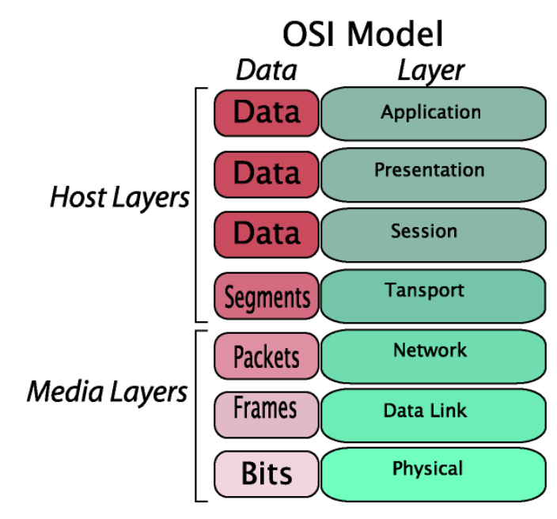

Slide 24
OSI Model – helpful phrase
Please - Physical
Do – Data Link
Not - Network
Throw - Transport
Sausage - Session
Pizzas - Presentation
Away - Application

Slide 25
OSI Models - Strengths
Clear distinction between protocol, interface, and service
Fits well with OO programming (SRP)
Very general- not biased towards a particular protocol

Slide 26

OSI model problems
Bad Timing
Bad Technology
Bad Implementation
Bad Politics

Slide 27
TCP/IP
TCP/IP widely in use today
Four layers
  Application
  Transport
  Internet
  Host-to-network (many other names)
Doesn’t really fit the OSI model

Slide 28
Service Types
Connection oriented (Example: TCP)
  Reliable Message Stream
  Reliable Byte Stream
  Unreliable Byte Stream
Connectionless (Example: UDP)
  Datagram
  Acknowledged Datagram
  Request-Reply

Slide 29
Why TCP/IP?
Protocol | Win NT | Win2k | WinXP | Sever 2k3 | Vista | Win7
TCP/IP | Y | Y | Y | Y | Y | Y
DLC | Y | Y | N | N | N | N
NetBEUI | Y | Y | N | N | N | N
IPX | Y | Y | Y | N | N | N
TP4 | Y | N | N | N | N | N
IPv6 | N | N | Y | Y | Y | Y

Slide 30
And then there was the Internet
ARPANET
Facilitated improved communication between research agencies
The notion that the internet was invented to survive a nuclear war appears to be an urban legend. This was based on some early research that RAND did on communication failures in war.

Slide 31
ARPA (now DARPA)
Created by President Eisenhower in Feb of 1958 in response to the Soviet launch of Sputnik
Its mission is to create new technology for the DoD

Slide 32
The Idea
A packet switched network instead of a message switched network

Slide 33
The People
Paul Baran- originally proposed packet switched networks in 1960. AT&T killed the idea
J.C.R. Licklider- many of the ideas of our modern network while working for BBN in 1962. He was at ARPA until 1963
Bob Taylor- continued communications work at ARPA, eventually brought in Larry Roberts from MIT
Larry Roberts- original architect of ARPANET
Donald Davies- researcher at NPL, built first actual packet switching network

Slide 34
ARPANET
ARPANET went online on October 29th, 1969
  UCLA, UCSB, SRI, University of Utah
  First message was from SRI to UCLA
By 1972, ARPANET had 37 hosts
NSFNET created by the National Science Founadation for universities without government contracts.
ARPANET and NSFNET merged in mid 1980’s
MILNET split off in 1983- NIPR, SIPR, JWICS

Slide 35
So what about TCP?
4 hosts- OK
More than 4 hosts – problem
All hosts using whatever protocols and technology they feel like – bigger problem

Slide 36
The solution: TCP
Created in 1973 to allow communication between different networks with a standard protocol
RFC 675 drafted in 1974 to define TCP
In 1977, John Postel, one of the inventors of TCP, published IEN2, which stated that the TCP protocol was doing too much
In 1978, the IP protocol was split out of TCP as a network layer, leaving TCP as strictly host to host
In 1980, first formal TCP protocol was created (IPv4)

Slide 37
Berkely Sockets
In order to encourage people to use TCP, Berkely created Sockets and included the software as part of Unix
TCP was easy to use, which lead to more people connecting and more hosts

Slide 38
Lots of Hosts!
More hosts- names were easier than addresses
InterNIC- organization run by SRI, managed host names by distrubuting a file called HOSTS.TXT
Lots of hosts + lots of new hosts = cumbersome HOSTS.TXT
DNS was the solution.
  Implemented by Paul Mockapetris with John Postel

Slide 39
Lots of addresses!
IANA- Internet Assigned Numbers Authority
Responsible for managing IP addresses, port numbers, domain names, and protocol parameters
Run by ARPA
In 1988, ICANN was created as a merger of IANA and InterNIC

Slide 40
Internet Standards
Internet Engineering Task Force- IETF
  Created in 1986 to oversee standards for the internet
  Most notable for maintaining TCP/IP
  Publisher of RFC’s
  Completely open –
    Anyone can attend to IETF meetings
    Anyone can contribute to internet standards

Slide 41
What about WWW?
Four main applications-
  Email, News, Remote Login (Telnet), File Transfer
WWW- new application by Tim Berners-Lee (CERN)
  Coupled with Mosaic (written by Marc Andreessen)
  Allowed people to easily share information in text, image, sound, and video
  Could link to other WWW resources

Slide 42
TCP in conclusion
Universally accepted standard for communication on the internet
  No dependence on underlying connection
  Designed for routing
  Integrated addressing system
  Scales well- has been very successful scaling without changing the protocol
  Open standards
  Everyone uses it!

