Slide 1
Introducing:
The TCP/IP Protocol Stack

Slide 2
What is an RFC and why do I care?
RFC = Request For Comment
  Proposes a standard
  Anyone can contribute
  Every standard on the internet has one!
  Often, this is the only specification you’ll get

Slide 3
Let’s look at an RFC!

Slide 4
The Transport Layer of TCP/IP
Connection oriented and connectionless
Allows more reliability than layers below

Slide 5
Connections and ports
The IP protocol controls IP addresses
  IPv4 and IPv6
  Used to route packets between hosts
The port-
  Useful for multiplexing and demultiplexing on a single IP address

Slide 6
But what port?
Some ports are standardized by the IANA
Assigning port number: RFC 3692
Port types:
  Well-known: 0 - 1023
  Registered: 1024 – 49151
  Dynamic: 49152 - 65535

Slide 7
Well-known ports
Well-known ports that you should know well*
  21 – FTP
  22 – SSH
  23 – TELNET
  25 – SMTP
  53 – DNS
  80 – HTTP
  110 – POP3
* This will be on the test. You will have a list of ports, you will write the service that runs on those ports. Memorize this and you will get full credit for that question.

Slide 8
Interesting Idea: The process server
One service listens on one well-known port
Connections come in to that port
Connections query service on that port about locations of other services
  Connection is transferred to other port OR
  New connection is made on that port

Slide 9
Sockets
A socket is one end of a connection
  It is bound to a port and address (interface)
  Socket Types:
    Datagram sockets- sit there and listen for datagrams
    Stream sockets- establish a connection (two of these are a socket pair)
    Raw sockets- allow you to access just the IP protocol OR even write directly to the network layer

Slide 10
Socket service primitives
SOCKET
BIND
LISTEN
ACCEPT
CONNECT
SEND
RECEIVE
CLOSE

Slide 11
TCP and UDP
TCP is
  Connection based
  Guarantees packet delivery
  Guarantees packet order
UDP is
  Connectionless
  Sends data however
  Guarantees nothing

Slide 12
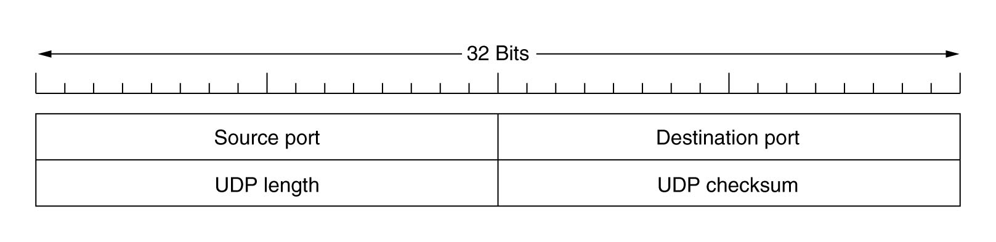
UDP header
UDP- RFC 793
Very simple

Slide 13
Establishing a UDP connection
You don’t, it’s connectionless! Remember? I just said that.
Sender
  Creates a UDP datagram giving it the port it is destined for
  Sends it out
Receiver
  Listens on a port
  Processes UDP packets as they come in

Slide 14
Why UDP? Why not just IP?
UDP adds a port
  Useful for multiplexing and demultiplexing
  That’s really all. Not very complicated
UDP adds minimal error checking
  Checksum, computed the same way as TCP

Slide 15
TCP
Addressing
Connection establishment
Connection termination
Flow control and buffering
Multiplexing and Demultiplexing
Crash recovery

Slide 16
In a perfect world. . .
Host A sends connect request
Host B acknowledges
Both hosts send and receive data
When a host is done, it gracefully closes the session
No errors exist, everything is perfect

Slide 17
In the real world. . .
Packets get lost
Packets get corrupted
Duplicate packets exist
Different segments of networks have different bandwidth

Slide 18
General TCP model
Every packet has a way to identify it uniquely and show in what order it is meant to be consumed
Every packet is acknowledged
A dropped packet can be re-sent
If a packet arrives out of order, it’s still ok
If a packet never arrives at all or is never acknowledged, it can be dealt with

Slide 19
Robustness principle
Be conservative in what you do
Be liberal in what you accept from others

Slide 20
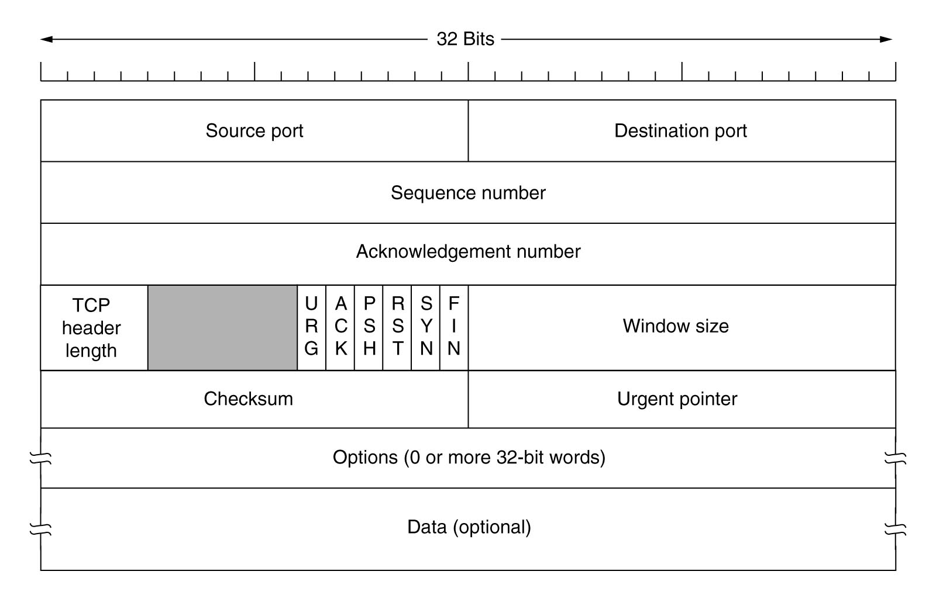
TCP Packet header

Slide 21
Connection Establishment
Biggest problem: delayed duplicates
If a connection is established twice, bad things can happen

Slide 22
Solutions?
Throw-away transport addresses
  Makes a process-server impossible
Use a sequence number for each connection and don’t repeat
  You would need a LOT of memory to store used sequence numbers.
  Host crashes could lose that history resulting in duplicates
Find a way to get rid of delayed duplicates
  Good idea!

Slide 23
Eliminating Delayed Duplicates
Goal- you must guarantee that a packet and its acknowledgement will be dead
Solution 1: restrict subnets to eliminate duplicates – this is impossible
Solution 2: kill packets after a certain number of hops
Solution 3: some sort of time stamp that expires a packet after a certain amount of time

Slide 24
Time-based solution
Each host has a clock
Initialize a sequence number using the lo-order bits of the clock so that each session starts with a different value
Sequence must be large enough to guarantee that a packet will be dead when wrap-around occurs

Slide 25
Many problems with time
Host crashes- Doesn’t know where it was when it crashed! Solutions:
  Wait for it! (not practical)
  Make sure that sequence numbers won’t overlap by some time T which is the maximum segment lifetime (MSL)

Slide 26
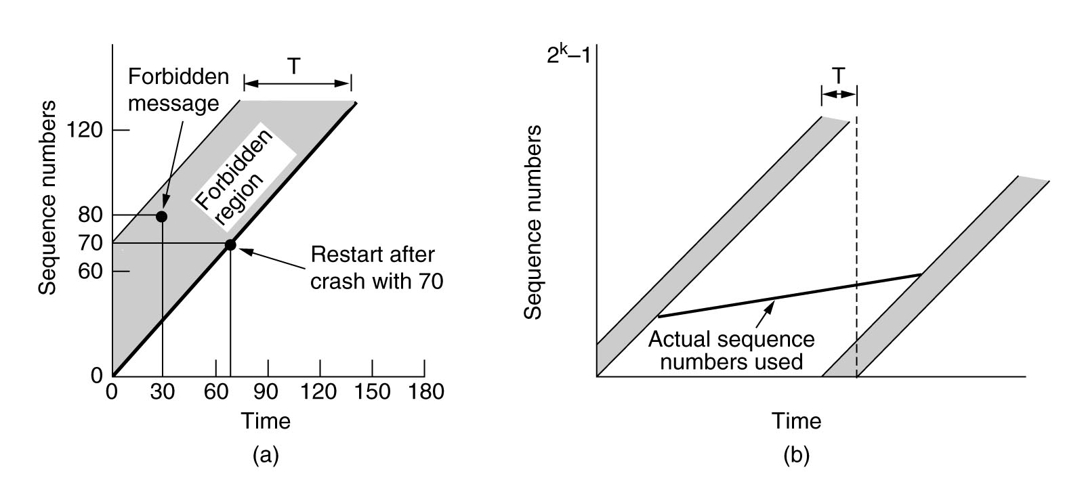
Clock –too slow or too fast?
Send data faster than the clock ticks-sequence number rises too fast
Send data slower, sequence number eventually collides from the other direction

Slide 27
Clocks
Must check T value before sending. If it is within “danger zone” (or on the highway to it):
  Either delay the packet
  Or re-sync the packet

Slide 28
More problems with sequence numbers
Wrap-around can occur within MSL. TCP MSL is 120 seconds.
Wrap-around is not possible as long as this is satisfied:
2^31 / B < MSL
MSL may be shorter

Slide 29
Wrap-around times:
Network | B*8 bits/sec | B bytes/sec | TWrap secs
ARPANET | 56kbps | 7KB | ~3.6 days
DS1 | 1.5Mbps | 190KB | ~3 hours
Ethernet | 10Mbps | 1.25MB | ~30 minutes
DS3 | 45Mbps | 5.6MB | 380
FDDI | 100Mbps | 12.5MB | 170
Gigabit | 1Gbps | 125MB | 17

Slide 30
So how do we connect?
Must establish sequence number on both sides
Must ensure that if connection packets are dropped, no error occurs
Must ensure that duplicate packets are handled

Slide 31
Three-way handshake
TCP uses a three-way handshake to connect.
  Host A sends SYN packet with initial sequence number
  Host B sends SYN,ACK with its initial sequence number and an acknowledgement of A’s sequence number
  Host A sends ACK to acknowledge B’s sequence number
If it gets totally screwed, RST can be used any time to re-sync the sequence numbers

Slide 32
TCP sequence numbers
TCP assigns a sequence number to EVERY octet it sends. Octet is a fancy word for byte.
Acknowledgement is accomplished by sending the sequence number of the NEXT expected byte
The header must state how many octets will be in a packet (segment)
Typically there is a maximum segment size (MSS)

Slide 33
Ending a session
Just close it!!!!1!!!1!!1!one!!111!!!!!
Actually much more difficult than it sounds
Two ways:
  Asymetric – one side just hangs up. May result in data loss
  Symmetric – both sides release their end of the connection (treat like two one-way connections)

Slide 34
The two-army problem
Host A sends FIN
Host B sends ACK
Did ACK get through? We don’t know!
Do we re-send FIN?
  How many times? Do we wait? Do we give up? What if ACK was sent but dropped? What if FIN never got there? This can go on forever.
Solution? More timers!

Slide 35
Timer the first
When a FIN is sent, we send an ACK and our own FIN and start a timer.
If the other side doesn’t ACK, drop the connection when the timer goes off

Slide 36
Timer the second
When we send a FIN, start a timer
If no response when the timer runs out, we re-send and re-start the timer
We do this N times. N should be a reasonable number.
“Just keep doing it” is not an acceptable solution

Slide 37
Timer the third
Every time we send a packet, a timer is started
If we don’t hear from the other side when the timer runs out, drop the connection
Periodically send keep-alive to keep connection open

Slide 38
How does TCP end a connection?
Either party sends a FIN, indicating that it has no more data to send
Other party ACKs the FIN
If no ACK is received in 2 * MSL, drop
Eventually the other side will figure out you dropped

Slide 39
Flow control
Buffering is used for flow-control
Sliding window-
  A host will indicate how much data they are willing to receive
  That number changes as time goes on
  A host will not send more data than the other host is willing to receive
  A host will not allow packets to exist that are more than the other host has stated it will receive and haven’t been ACKed

Slide 40
Buffer problems
Big buffer, small data
Small buffer, big data
Big and Small buffers- hard to manage
Dynamic buffers- also hard to manage
Buffers WILL be a problem for you

Slide 41
Buffers for sending
You must store what has already been sent
Buffer on sender or receiver?
  For big transfers, buffer on the receiver so that the client can send at the maximum rate
  For small transfers, buffer on the sender.
  Many strategies for this

Slide 42
Subnets make things more interesting
Subnets may not have a lot of capacity
There may be plenty of buffer space available
If you send more than the subnet can transport:
  Many packets outstanding
  Timeouts may happen
  Retransmits may happen

Slide 43
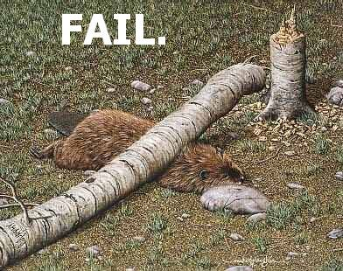
Flow Control
If you’re sending a small amount of data at a time:
  Imagine one byte. You need a 20 byte header for it.
  You need a 20 byte ACK for it.
  That’s 40 bytes to send a single byte.

Slide 44
Nagle’s algorithm
Wait to acknowledge for a while. Maybe you’ll get some more data to send?
Nagle’s algorithm-
  Send one byte
  Wait for it to be acknowledged
  Send the data that accumulated while you waited
  Buffer again until all the data you just send is ACKed
  Fill a window if you can
  Fill a segment if you can

Slide 45
Nagle’s algorithm. . .
Will annoy you at some point
Won’t work if data is really meant to be streamed
  Will show as random bursts
Can be disabled via SetSockOpt()

Slide 46
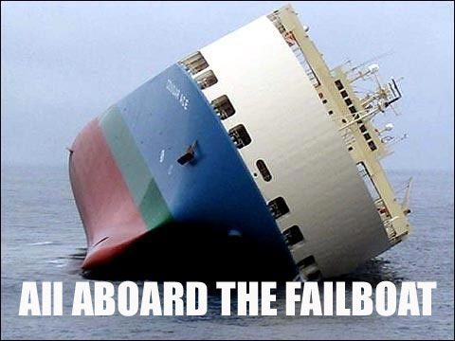
What about the receiver?
Receiver processes one byte at a time
Window will fill, receiver will open up one byte in the window with a 20byte header
“Silly window syndrome”

Slide 47
Clark’s algorithm
Don’t send an updated window size until either:
  You can handle the original amount of data you advertised OR
  The buffer is half-empty
Clark’s algorithm and Nagle’s algorithm can be used together (and often are)

Slide 48
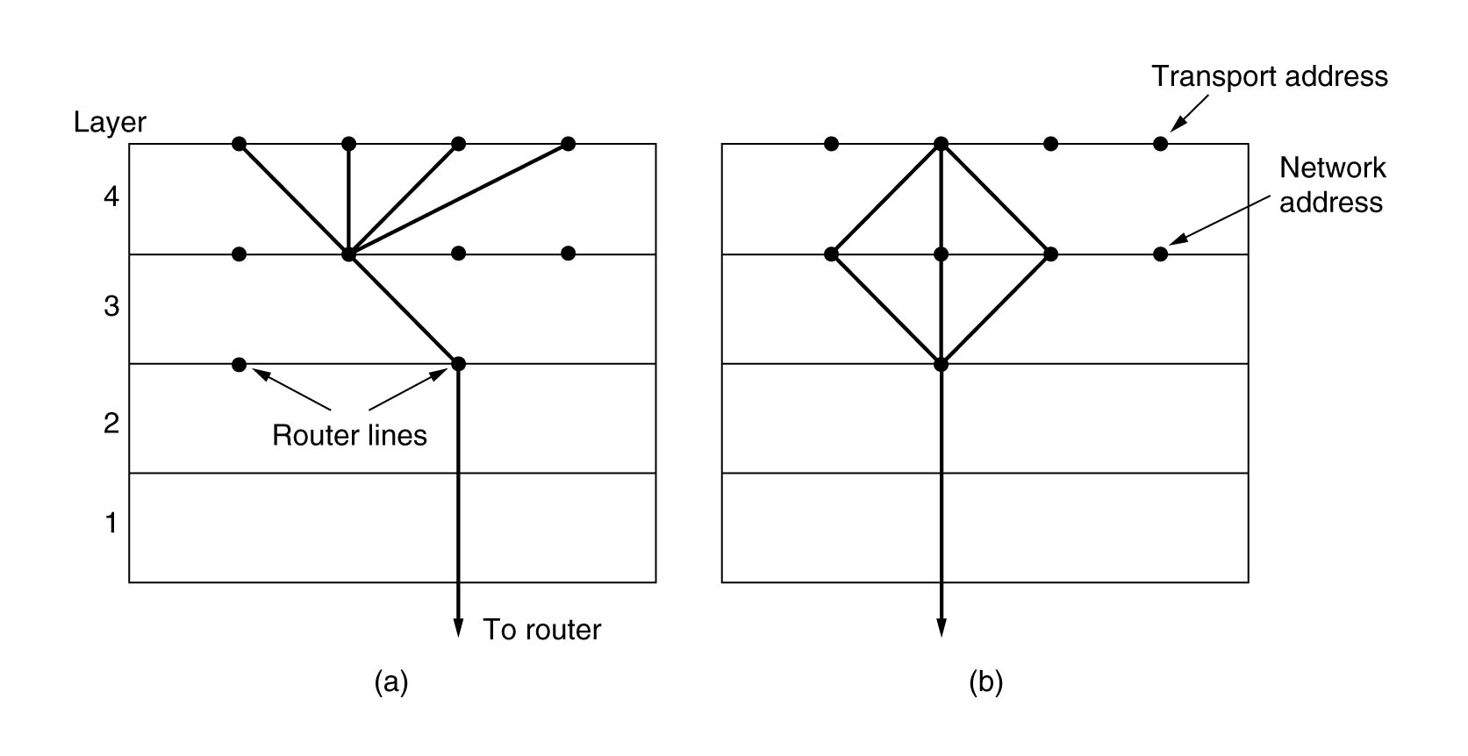
Multiplexing

Slide 49
Crash recovery
You have to do two things:
  Write the data to the application layer
  Send the ACK
So which order?
  ACK first- no write so packet was sent and acknowledged but the application never got it
  Write first- may never send the ACK so you get a duplicate packet without knowing it’s a duplicate
“Perfect Protocol” is not possible

Slide 50
Congestion
RFC 2581- TCP congestion
Two problems-
  network capacity
  receiver capacity
Two windows
  Receiver window
  Congestion window
Send the lesser of the two windows

Slide 51
Slow Start
Initialize a Congestion Window and set it to the maximum segement size (MSS)
Send that much data and start a timer
If the segment is ACKed before the timer goes off, double the congestion window size
Repeat until
  You hit the client window size OR
  The timer goes off before the ACK, in which case scale back to most recent successful window

Slide 52
Internet Congestion
Add another parameter called Threshold, initially 64k
When a timeout occurs:
  Cut threshold in half
  Slow start but don’t increase past threshold
  Increase linearly above Threshold
  Repeat each timeout

Slide 53
TCP Timers (more)
Retransmission timer
Persistence timer
Keep-alive timer
TIMED_WAIT timer

Slide 54
RTT- round trip time
RTT is maintained by each connection
Best estimate of current round trip time of a packet
Changes dynamically by comparing actual measured round trip time to RTT value
Smoothed using this formula:
RTT = αRTT + (1- α)M
α = some smoothing factor (7/8)

Slide 55
Retransmission
Even with good RTT value, still not trivial
TCP uses βRTT but how do you choose β ?
β = 2 is not a good choice but was used originally
Jacobson’s solution was to use the standard deviation
Standard deviation was hard to compute so mean deviation was used instead (can be computed with + - and shifts)

Slide 56
Jacobson’s algorithm
Adds another variable, D
D is | M – RTT |
D is smoothed via;
  D = αD + (1 – α) |RTT – M|
  α might not be the same as the RTT smoothing value
Timeout is usually set to RTT + 4 * D
4 is arbitrary but
  <1% that a packet is outside of 4 standard deviations
  4 can be done in a shift

Slide 57
Timeouts and RTT
Did you get an ACK?
Is your ACK for the original packet or the retransmitted one?
If you guess wrong, M becomes huge!

Slide 58
Karn’s algorithm
If you retransmit, you double the timeout for each failure
Repeat until a packet gets through without a retransmit
Ignore M until packets start going through again

Slide 59
Persistence timer
Prevents a deadlock:
  Receiver sends a window of 0 (meaning buffer full, please wait)
  Sender sits there
  Receiver sends a new ACK with a window of >0 but packet is dropped.
When persistence timer goes off, sender sends a probe to get a new ACK

Slide 60
Keep-alive timer
Sometimes a connection will go for a long time with no data sent. What happened?
  Maybe one host dropped silently
  Keep-alive sends a single packet to see if the other host is still there
  Every time a data packet is sent, Keep-alive timer restarts
  Very common with web servers (default in HTTP 1.1)

Slide 61
TIMED_WAIT
After a FIN is sent and acknowledged
Twice the MSL
Ensures that no packets are outstanding

Slide 62
Fast retransmission
If a packet is out of order, send a duplicate ACK
This informs the client that an out or order packet was received
Should immediately send another ACK when a new segment fills or partially fills the gap

Slide 63
Fast retransmit cont.
When three duplicate ACKs are received:
  This means that there is a lost packet at the sequence number ACKed
  TCP should retransmit what appears to be the missing segment WITHOUT waiting for the RTT timer

Slide 64
Error control
The checksum field is the 16 bit one's complement of the one's complement sum of all 16 bit words in the header and text.
A 96-bit pseudo header is added
Checksum bit is set to 0’s
If not WORD aligned, padd with 0’s
To verify, the one’s complement sum of the whole thing should be 1
Unlike two’s complement, one’s complement is not affected by endianness

Slide 65
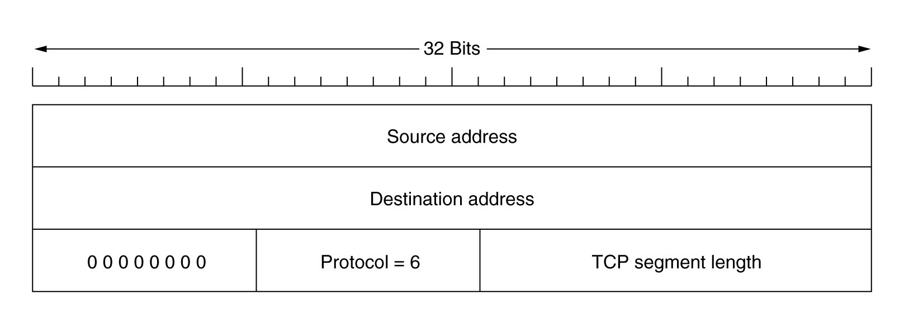
IP Pseudoheader

Slide 66
PSH
The PUSH flag means that the receiver is kindly requested to send everything in its buffer to the application layer
The receiver SHOULD send all of its buffered data to the application layer when it sees this flag
Will it?? Maybe. . .

Slide 67
URG
Urgent header, means that the segment contains urgent data and the urgent pointer is significant
Points to the sequence number AFTER the urgent data (offset to non-urgent data)
There are no interrupts in TCP so this is the next best thing

Slide 68
Options
TCP header has options that can mean extra capabilities
Option values are defined by the IANA
Options MUST be word-aligned
Options may have a kind and a length (length is optional)
Option length counts the option-kind length as well as the option-data octets
0 means end of option list

Slide 69
NOP option
Means No Operation
Useful to allow other options to be word-aligned

Slide 70
Maximum Segment Size
Option Kind and Length are set
Contains one 16-bit int that has the maximum segment size that will be sent by this host
May only be sent with the initial SYN
If this option is not used, any segment size is permitted

Slide 71
SACK
Selective Acknowledgement (RFC 2018)
Problem- we only know if the left side of the window has been ACKed.
We don’t know if anything else got through
Only one packet gets a retransmit with each round trip
SACK fixes this

Slide 72
SACK Options
Option SACK permitted
  Sent with SYN, means that host will accept SACK options

Slide 73
SACK options cont
Option SACK Acknowledged
  Bytes immediately after contain the left and right edges of a window that HAS been received.
  It can show multiple gaps
  It does NOT invalidate or change the ACK sequence number
  When more packets are received, host will advance the ACK number normally, indicating what packets were received
  Sender can re-send only those missing packets
  Expected to be used with Timestamp option

Slide 74
Timestamp (RFC 1323)
Sets a timestamp on a segment
Has two fields, timestamp and echo-reply
Echo-reply is only valid on ACK and shows the timestamp of the segment it is ACKing

Slide 75
Window scaling (RFC 1323)
Sometimes, int16 isn’t a big enough window
WAN connections with a high RTT are problematic if buffers are too small
Scaling option holds the scale factor of the window size logarithmically. Scale may only be a power of 2 (stores the shift count)
Only valid if sent in SYN initially
Both sides must use

Slide 76
PAWS
Protect Against Wrapped Sequence (numbers)
Uses a 32 bit time stamp similar to the Timestamp option (RTTM) that must be monotone non-decreasing time
Segment can be discarded if the timestamp is older than a more recently received timestamp
Time stamp must not increase too quickly (we talked about this)

Slide 77
TCP Pros and Cons
TCP pros
  Guaranteed delivery that is confirmed
  Missing or out-of-order packets are handled
  Session can be re-synchronized if errors occur
  Guarantees that all data is sent before shutdown
Cons
  Session management complex
  Retransmissions can be expensive
  Headers are large

Slide 78
UDP pros and cons
UDP pros
  No acknowledgment- data streams much faster
  Less overhead in sending packets
  Management is less complex
  Much simpler implementation
UDP cons
  No way to know if it was delivered
  No way to detect errors
  No way to get missing data
  No way to determine if another host has more data or is even still there

Slide 79
For games, what do we care about?
Real-time nature often favors UDP. If TCP loses data, by the time it gets retransmitted it may be too late
TCP may block other data until missing data is re-sent. Blocked data is bad
ACK is expensive
TCP has larger headers
No security on anything we talked about
UDP has much less management overhead

Slide 80
Games- two things that are death
Network Address Translation
Proxy servers
You will learn to hate these someday (if you don’t already)

