Slide 1
The Data-Link Layer (and stuff)

Slide 2
How does it actually get there?
How does one machine communicate directly with another machine?
What is the Media Access Control Sublayer?
Two modes of communication
  point to point
  broadcast

Slide 3
Data Link Layer Functions
Encapsulates packets into frames
Marking the start and end of frames
  Character count- not so good
  Flag bytes- specific stream indicates the start/end of frame. What if flag is in data? What about non 8-bit chars?
  Bit stuffing- like flag bytes except using individual bits

Slide 4
Error detection (and correction)
Include additional information to either:
  Know that there was an error
  Correct the error
Error correction- Hamming
Error detection- Cyclic Redundancy Check (CRC), also know as polynomial codes

Slide 5
Hamming-
Hamming distance- how many bits are different between two strings of bits (call this d)
Every possible string of bits which is permitted can be called a code.
To detect d errors you need d+1 bits in a single code
To correct d errors, you need 2d+1 bits in a single code
Extra parity bits- either even or odd
  For even parity, if an odd number of bits are set, add a 1
  If an even number of bits are set, add a 0
Powers of 2 are check bits in networking

Slide 6
Correcting burst errors
Burst errors are harder to correct since we can only correct a single bit (usually).
There is a way to cheat
  Create a matrix of each byte to send
  Send a column, not a row
  When reassembled, usually only 1 bit is off per byte

Slide 7
Error Detection- CRC
It’s just a fancy way of using parity bits
Uses a generator polynomial where coefficients are all either 1 or 0, must be agreed on in advance- G(x)
View the bits of the message as the coefficients of another polynomial M(x). Append r bits to M(x) where r is the degree of G(x)
Divide G(x) into x^{r} M(x) using modulo 2 division
Subtract the remainder (r bits or fewer) from x^{r} M(x) and append this as the parity

Slide 8
CRC continued
To detect errors with CRC
The received frame (T(x)) is corrupted by some errors (E(x))
We divide the frame (T(x) + E(x)) by G(x). Since T(x) / G(x) should be 0 due to the parity being added, if it isn’t 0 (due to E(x)) then there was an error.

Slide 9
Questions about CRC?
This slide intentionally left blank

Slide 10
PPP- Point to Point Protocol
RFC 1661
Commonly used on the internet
Three main features-
  Framing that delineates the start and end of a frame unambiguously
  Link control protocol- creates/controls a link between endpoints
  Network control protocol-negotiates network protocol options independent from the protocols used

Slide 11
Channels
How do we divide a single channel up for many users? Divide channel by N?
Frequency division- divide frequency by N to get individual channels, assign one per host
Time division- divide total bandwidth by N to get a time slot
Either of these is fine if traffic is likely to be constant between hosts

Slide 12
Dynamic Channels
Traffic tends to occur in bursts
If a host isn’t using a channel, the channel just sits there wasting bandwidth
Station model
Single Channel Assumption- there is one “wire”
Collision Assumption
Time- continuous or slotted
Carrier sense (or not)

Slide 13
Collision Detection
CSMA- Carrier Sense Multiple Access
  Propagation delay- what if the signal hasn’t gotten there yet?
  1-persistent CSMA- if channel is idle, send it!
  Nonpersistent CSMA- if channel is not idle, don’t keep checking, wait a while
  P-persistent- wait for idle. If idle, only transmit in this slot with a certain probability p

Slide 14
CSMA/CD
the CD stands for Collision Detection
If a collision is detected, stop immediately!
Collision detection is an analog process
  You must listen to what you’re sending
  Noise bursts indicate collisions
  CSMA/CD is half-duplex- it can’t send and receive at the same time

Slide 15
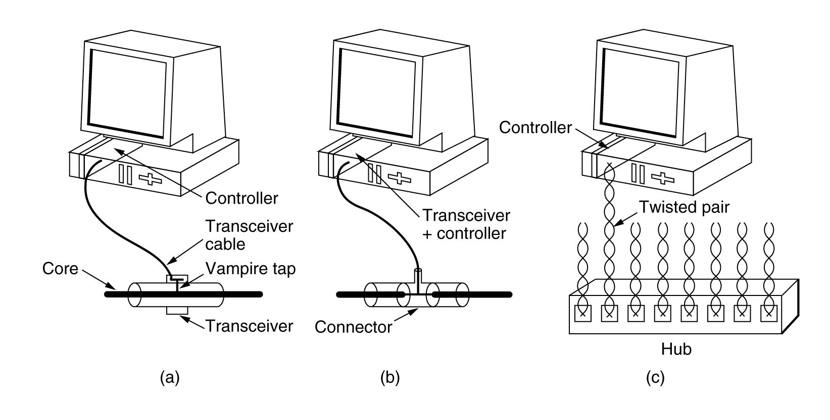
Ethernet- 802.3
Most common protocol at this layer
Also of note:
  Token ring and Token bus- avoids collisions
10Base5, 10Base2, 10base-T

Slide 16
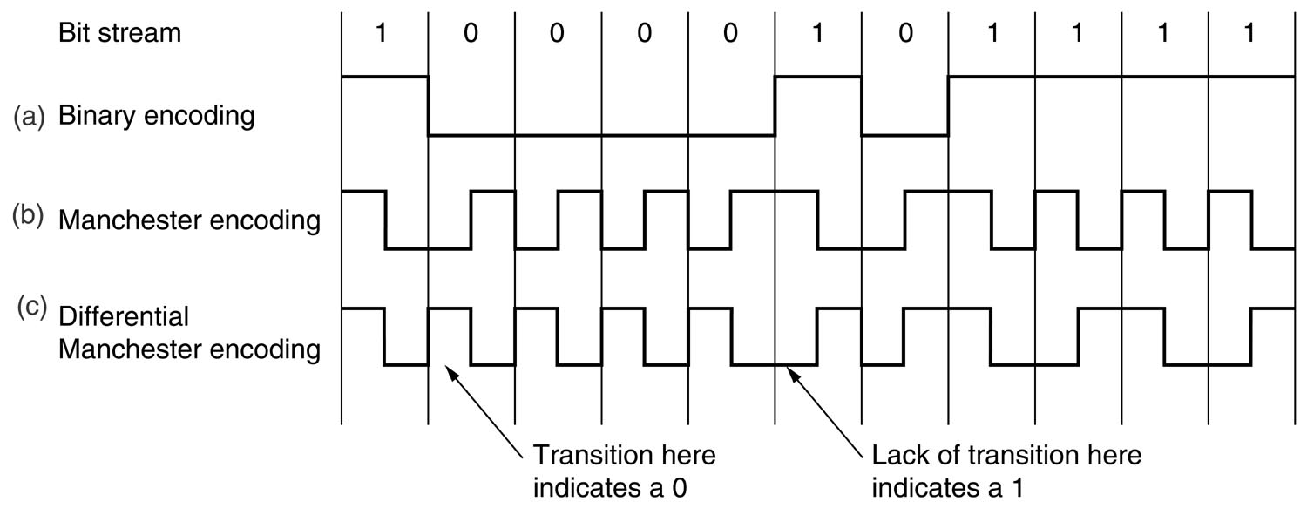
Signal transmission
0 volts = 0 and 5 volts = 1
Problem- how to tell if 0 volts over time means idle or lots of zeros? What about sampling?
Manchester encoding and differential Manchester encoding

Slide 17
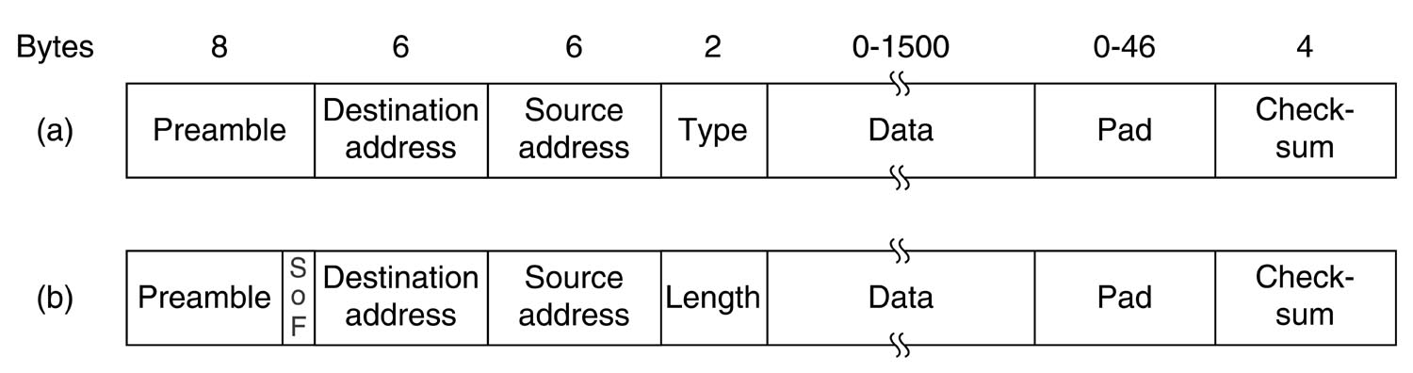
Ethernet Protocol
MAC address – 48bit hardware address
Type- there are a few types of Ethernet frames
Data- limited to 1500 bytes
Must be at least 46 bytes of data
  this must change with cable length and speed
Checksum is a CRC

Slide 18
Ethernet Collisions
Binary exponential backoff algorithm
  After a collision, divide time into discrete slots equal to the length of the worst round trip propagation time
  First collision, wait either 0 or 1 slots
  Second collision, wait 0, 1, 2, or 3 slots
  Third collision, wait for a random slot in the range of 2^3-1. Keep doing this.
  After 16 collisions, give up

Slide 19
Fast Ethernet
1992- IEEE decided that they needed a faster network
New standards proposed with lots of new features
In the end they just decided to take the existing 802.3 Ethernet and make it go faster. This was 802.3u (mostly just called Fast Ethernet)

Slide 20
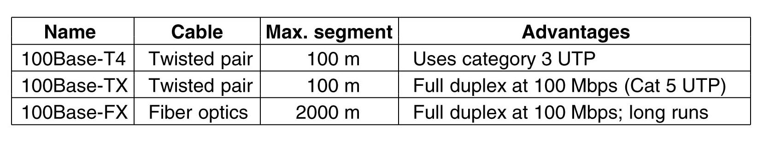
Fast Ethernet
Added some new wire types
Had to drop 10Base-2 and 10Base-5 cabling due to reduced bit time of 10ns
And then again in 1998, Gigabit Ethernet, which was Fast Ethernet only faster!

Slide 21
802.2- Logical Link Control
Another protocol on top of Ethernet but below IP
LLC provides:
  Unreliable datagram
  Acknowledged datagram
  Connection-oriented service

Slide 22
Ethernet summary
It’s fast
It’s cheap
It’s simple
It’s easy to maintain
It’s reliable
It’s easy to make faster
It supports TCP/IP

