Slide 1
Network Game Programming
Understanding networking and making good choices

Slide 2
Game Types
Client-server
Peer to peer
Things to consider:
  Lag
  Total number of players
  Bandwidth of clients/server
  Players with slow connections
  Cheating

Slide 3
What are we even trying to do?
N players
Player 1:
  Moves
  Triggers an event (jump, shoot, etc)
All other players:
  See exactly what player 1 did
  Can interact in real time

Slide 4

Networks are not real time!
Games are real time
Networks are not real time
Networks are often very slow
Problem?

Slide 5
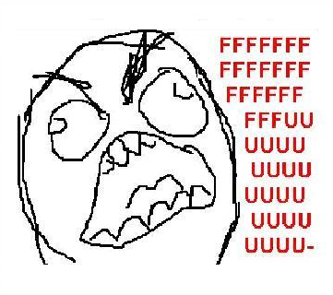
Meet your enemy: Network Latency
Lag makes things not happen in real time
Can we fake it?
Can we get rid of it?

Slide 6
Proposal 1: ignore it
Ignore lag, pretend it doesn’t exist
Does every game care about lag (no)?
  Chess?
  Plants vs. Zombies?
  Poker?
How much lag is ok? Can you just ignore it?
  Jumping to avoid an obstacle
  Giving a unit an order that it is to carry out in 10 seconds

Slide 7
Proposal 2: Design around it
Every unit you control takes some time to “acknowledge” your orders
Units move whenever they feel like it
Collisions may not be very important
Some amount of lag is tolerable
Other ideas?

Slide 8
Proposal 3: Compensate for it
I know where I’m moving
I can predict where you’re going (maybe)
I can know with certainty where certain objects will be
Can I possibly make accurate predictions based on this?
  Yes
  (Actually, it depends)

Slide 9
Proposal 4: Hide it
Trigger something before its animation is through playing?
Change something’s speed?
Play things back after they already happened?

Slide 10
Behavior Types
Deterministic Behavior (motion)
Non-Deterministic Behavior (events)

Slide 11
Deterministic Behavior
The behavior of an object at any given time is known
Deterministic behavior might:
  Follow the laws of physics
  Have a fixed set of behaviors
  Use a pseudo-random sequence to determine actions
Seed all clients random-number generators with the same value to eliminate the need for updates

Slide 12
Non-Deterministic Behavior
Impossible to know what is going to happen next with any degree of certainty
  User input or decisions
  AI decisions

Slide 13
Compensating for network lag
Every event already happened
Need to either:
  Predict what is about to happen (and be right)
  React to what has already happened before it has actually happened i.e. Sleep(-1)
  When you are wrong, compensate somehow

Slide 14
Lockstep
Send the intent to do something before you do it
Clients operate in “turns”
  A turn length can be dynamic
  Could calculate based on the slowest client
A message executes on the turn it was meant for
A message must be sent and received prior to the turn it was meant for

Slide 15
Design around lockstep- delay commands
When a command is given, don’t execute it right away
But send it immediately.
All hosts know how long the delay is between command receipt and execution
By the time you need to execute the command, all hosts will have the message
Hosts know how old a message is
Not very useful for real-time action games

Slide 16
Prediction: The Easy Way
Don’t predict at all
Get a new position from the server or other clients
Teleport there
It’s easy
If you have any lag, you’ll teleport randomly and game may not be very playable

Slide 17
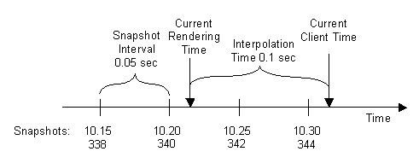
Prediction: frame-behind
Send regular updates of entity positions
Don’t render immediately, wait some delay
Interpolate between positions
Missing snapshots ok since we’re interpolating
Approach used in the Source Engine (Half-Life 2)

Slide 18
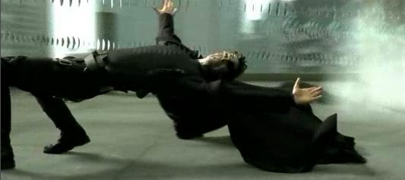
Frame behind on the server
Clients see entities where they used to be
Clients aim where entity used to be
No one hits

Slide 19
But the server knows!
The server knows that all clients are 100ms behind and are interpolating
Server “rewinds” all players back:
  100ms to compensate for client side prediction
  + Packet RTT (how late was the message)
  Do hit detection at this point
  Tell the client what happened

Slide 20
Prediction- Dead reckoning
Movement in one direction is likely to stay the same over time
When movement changes, we probably won’t be too far off
Compensate for incorrect position smoothly
Velocity may be a good way to predict
Acceleration may be better but errors may make things worse
Can use movement history to approximate current velocity and acceleration

Slide 21
Compensating for when you’re off
Teleport there! All games do this to some extent. Sometimes you have no choice
Interpolate between your actual location and the “correct” location to compensate smoothly
Use splines- often the best way to choose the smoothest path

Slide 22
Splines (part 1)
You need four points:
  Coordinate 1- starting position
  Coordinate 2- position after 1 second given current velocity (coordinate 1 + starting velocity)
  Coordinate 3- position after 1 second using reversed ending velocity (coordinate 4 – end velocity)
  Coordinate 4- end position (usually new packet that just arrived)

Slide 23

Splines (part 2)
x = At³+ Bt²+ Ct + D
y = Et³+ Ft²+ Gt + H
t = time (0 to 1)
A = x₃ – 3x₂ +3x₁ – x₀
B = 3x₂ – 6x₁ + 3x₀
C = 3x₁ – 3x₀
D = x₀
E = y₃ – 3y₂ +3y₁ – y₀
F = 3y₂ – 6y₁ + 3y₀
G = 3y₁ – 3y₀
H = y₀

Slide 24
Splines- (part “what was all that?”)
First, get the current position and velocity. Calculate the future position using the current velocity
Decide how many steps you’re going to move on this spline before calculating a new one (that’s t)
Calculate the final position after t intervals based on the packet you just got
Use final position and subtract velocity * t
Could also use acceleration with velocity to improve smoothness

Slide 25
YOU MUST KNOW DELAY!
You must at all times have a good approximation of how late each message is.
Each client may have a different delay
If the server knows the delay of all the clients, it can compensate
This may change over time

Slide 26
Area of interest filtering
I don’t care about the player behind the building
I can’t see the player about to sneak up on me anyway
I can’t see things across the map
Looking through a rifle scope gives a very small field of vision
If I can’t see it, I don’t care about it
Can implement as a range, a cone of perception, or both

Slide 27
Local perception filters
Things close up
  Must see as close to real-time as possible
  Must see in enough detail
Things far away- I may not notice them so much
  Can use less detail
  Can use less information to update
  Can even be out of date (but should still be real-time)
  Bullet time- I can speed things up as they get closer

Slide 28
We need a protocol
TCP gives us all kinds of nice stuff so some people use it
  EVE Online, WoW
UDP gives us pretty much nothing
  HALO, Half-Life, pretty much all FPS games
How can we make UDP useful

Slide 29
Useful things to do
Create/Destroy a connection
Send some data reliably
Send other data unreliably
Measure lag
Correct/detect errors
Terminate a connection
How does TCP do these things?
  (We can certainly implement the same things over UDP)

Slide 30
What to send? General guidelines
Keep data as small as possible
Cram as much data into packets as possible
Stay below your MSL!!! (you need to know what type of network the game should target for this)
Don’t send the same message twice. (If nothing has changed, there’s no need to mention it)
Compression is possible but the algorithm is often costly

Slide 31
Messages != Packets
A message just shows something happening in the game
  Could be an event or a position change
A packet consists of messages
Packets have their own header

Slide 32
Messages could have:
ID of object the message represents.
The action on that object. May not necessarily represent movement e.g. game start, player death, object creation, etc.
Position- you need this in some form
Velocity- you can send this for more accuracy or you can approximate from past positions
Acceleration- can send or approximate as with velocity
Pitch/yaw/roll- quaternions are useful

Slide 33
Ways to make messages smaller
Use fewer bytes/bits!
  Use enums for all actions and pack into a single byte
  Keep object IDs small (do you need INT_MAX objects? If not, do you need an int?)
  Send deltas only (need to sync periodically though)
Aggregate messages for same objects
Best way to make a message smaller: don’t send it!
  Only send messages that a client cares about

Slide 34
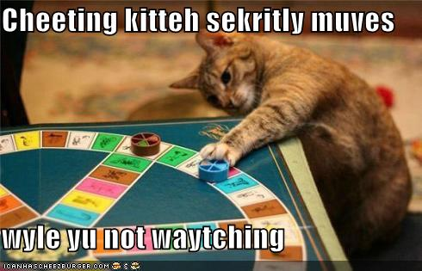
Cheating
Aim bots
Wall hacks
Replay attacks
Etc.

Slide 35
How to prevent cheating
Packet tampering- adding additional messages to a packet. Use a checksum to prevent. Can salt your checksum
Look-ahead cheating- lockstep (peer-to-peer)
  Must communicate the intent to do something
  Must do what was communicated
Cracking- people may mess with your game’s internals. Write good code to prevent

Slide 36
Non-software cheating
Collusion- players collaborate such that they have more information than they otherwise would have (imagine sharing your hand in poker with other players)
  Only a person with all of the game information can detect this. Can also detect by monitoring behavior over time but not possible in real-time
Offending other players- not just foul language or naughty name-calling. Must be able to police players in game.

