Slide 1
Wires and Signals

Slide 2
Bandwidth
Henry Nyquist’s theorem
  Signal of bandwidth H reconstructed with 2H samples/second
  Maximum Data rate = 2H Log₂ V bits/second
  V = number of discrete levels
Claude Shannon
  Noise exists on a transmission medium
  Signal to noise ratio: The ratio of signal power to noise power (in decibels)
  H Log₂ (1 + S/N) bits/second

Slide 3
Magnetic media
Tapes, disk drives, etc.
Highest bandwidth for least cost
Delay is usually high

Slide 4
Twisted Pair
Two insulated copper wires
  Wires can act like an antenna
  Twists cancel out waves
Groups of twisted pair are shielded
Can run several miles
Low cost, adequate performance

Slide 5

Types of twisted pair
Unshielded twisted pair (UTP)
  Category 3
  Category 5
  Category 6
Shielded twisted pair
  Obsolete everywhere except at IBM

Slide 6
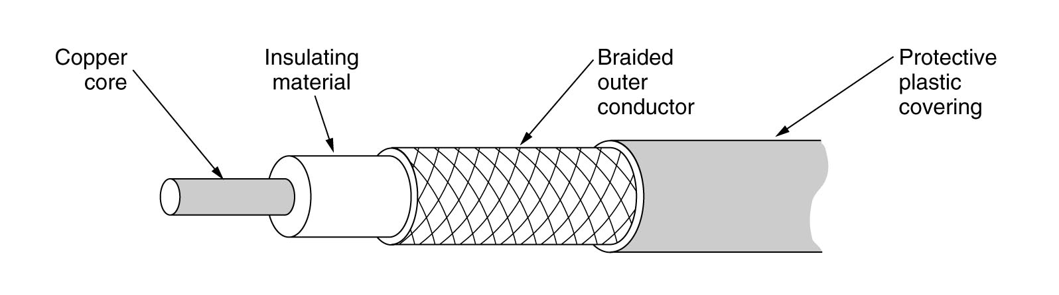
Coaxial cable
Two kinds
  50 ohm – used for all-digital transmissions
  75 ohm – used for analog transmissions
Good resistance to noise, high bandwidth

Slide 7
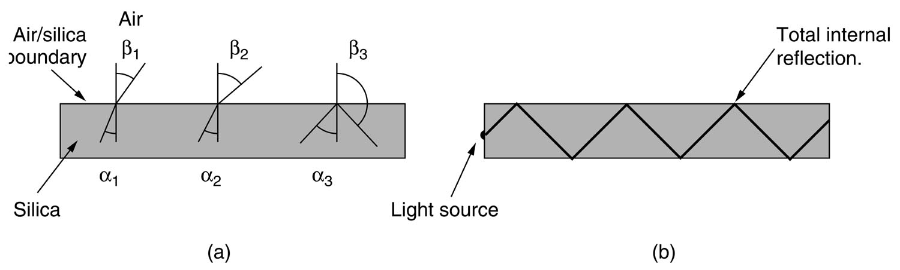
Fiber Optics
Far greater increase in bandwidth than CPU power
Current speed limited by switching
Three components
  Light source
  Transmission medium
  Detector
Reflection
  Light passing between media is refracted
  Angle of incidence above a certain value reflects the light back into the media

Slide 8
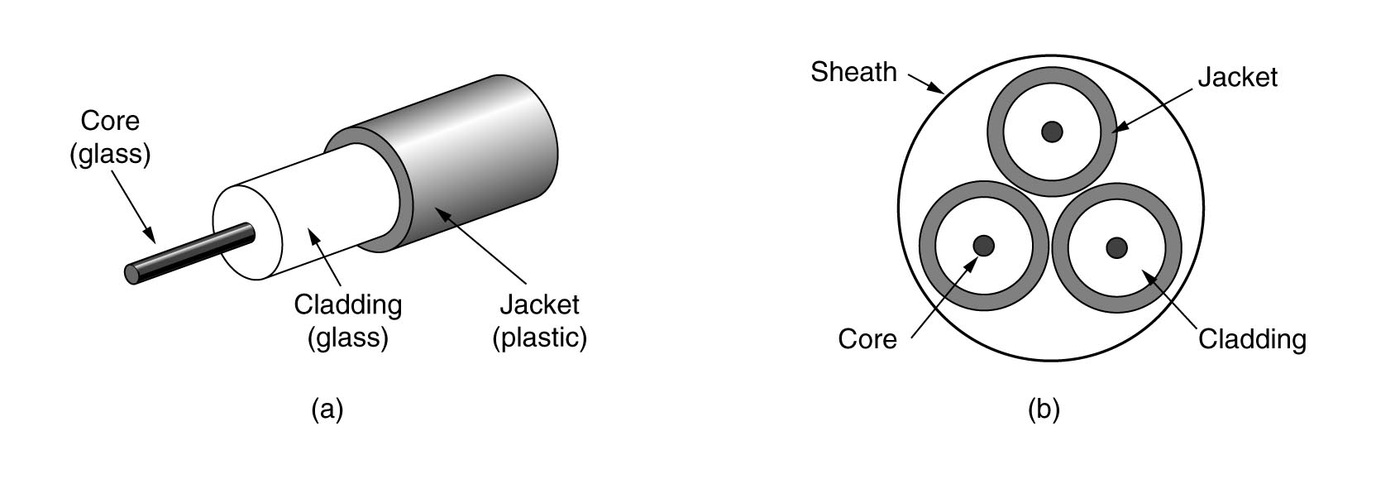
Fiber Cables
Fiber connections
  Terminated with connectors (10-20% loss of light)
  Spliced (10% loss of light)
  Fused (can be as good as a single piece of fiber)
Light sources
  LED
  Lasers

Slide 9
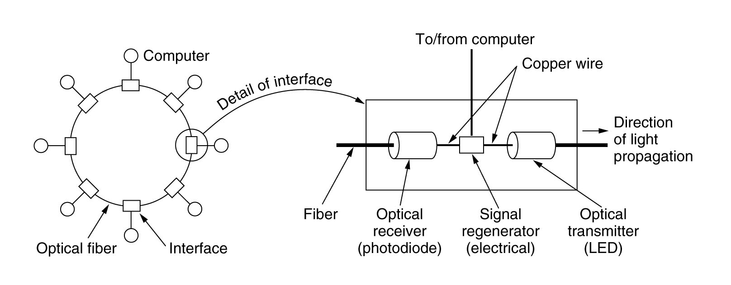
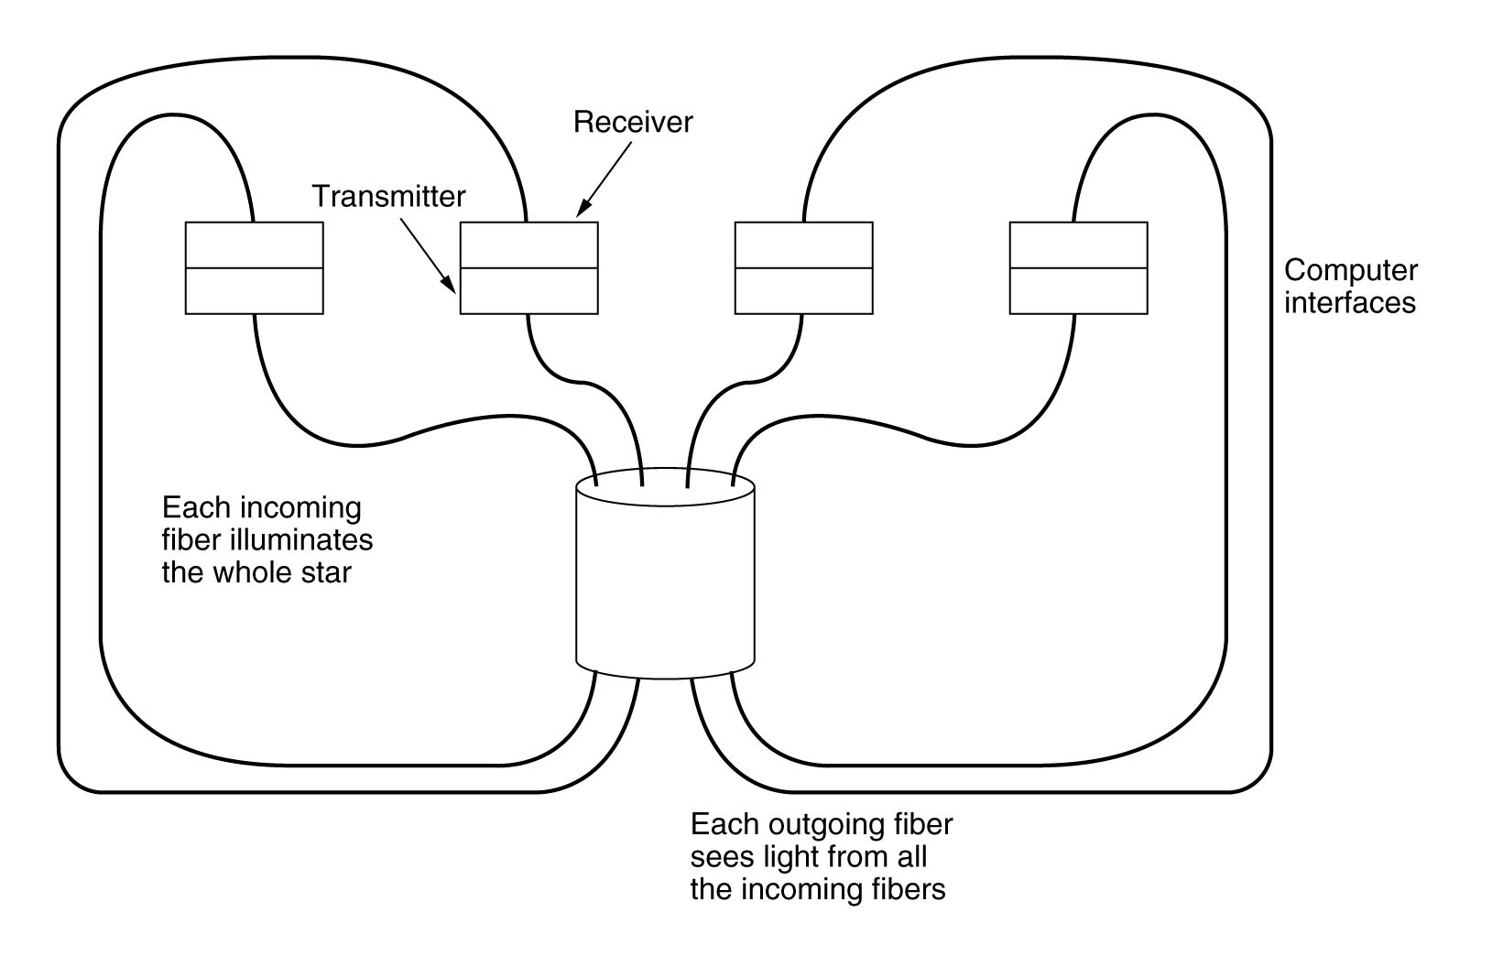
Fiber LANs

Slide 10
Comparison of Fiber and Copper
Fiber
  Higher bandwidth
  Fewer repeaters
  Not affected by power surges
  Thin and lightweight
  Difficult to tap – more security
Copper
  More familiar technology, less skill needed
  Can be bent
  Cheaper
  Can transmit in both directions

Slide 11
Wireless
Moving electrons create waves
Oscillations per second is the frequency (measured in Hz).
Distance between two consecutive maxima/minima is the wavelength

Slide 12
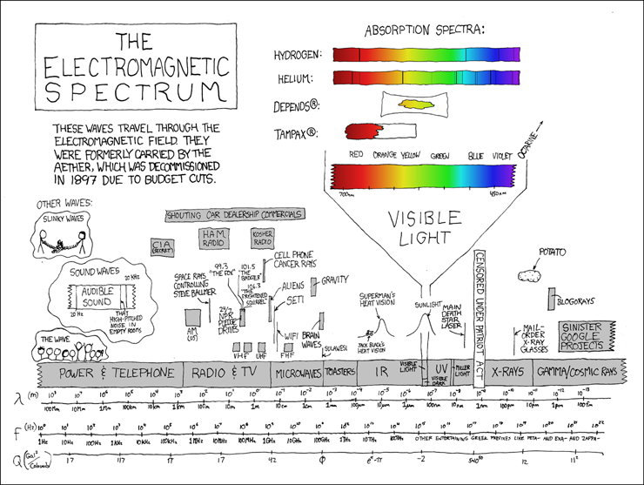

Slide 13
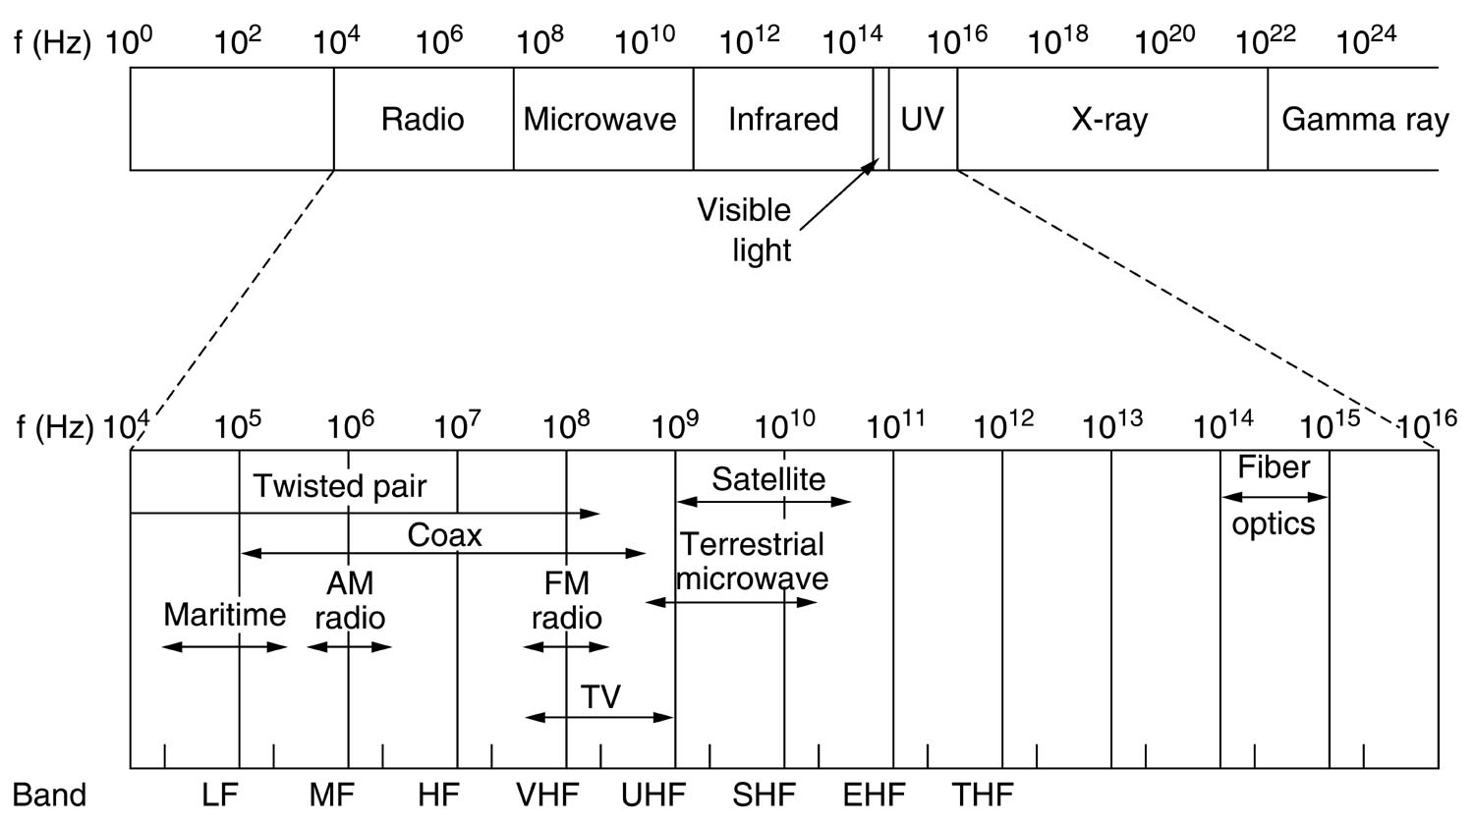
Electromagnetic spectrum

Slide 14
Radio
VLF, LF, MF bands follow ground, pass through buildings easily but have low bandwidth
HF, VHF tend to be absorbed by earth but are bounced by the ionosphere

Slide 15
Microwave
Microwave tends to travel in straight lines
Microwave antennas must be aligned correctly
Severe shortage of spectrum
Higher than 4GHZ is absorbed by water
Advantages over fiber
  No “right of way”
  Inexpensive

Slide 16
Politics and the EM spectrum
Governments regulate frequencies
  Companies wanting frequencies have to beg for them, government officials get to pick
  A lottery used to award frequencies
  Frequencies auctioned off
Some unregulated frequencies
  ISM – Industrial, Scientific, Medical
  Garage door openers, cordless phones, bluetooth, 802.11, etc.

Slide 17
Satellites
Geostationary
Medium earth orbit
Low earth orbit

Slide 18
Geostationary
Satellites orbiting at 35,800 km would appear stationary (Calculated by Arthur C. Clark)
Don’t need to be tracked
Orbital slots
  Satellites at every 2 degrees would leave room only for 180 satellites
  Frequency interference

Slide 19
Medium-Earth orbit satellites
6 hours to orbit
Must be tracked
Used primarily for GPS

Slide 20
Low-Earth orbit
Move fast, need many of them
Iridium
  Launched by Motorola
  66 satellites (originally 77)
Globalstar
  Bent-pipe satellites
  Switching happens on the ground
Teledesic
  Conceived in 1990 by Bill Gates and Craig McCaw
  Work halted in 2002 due to failures of Iridium and Globalstar

Slide 21
Satellites versus Fiber
Satellite benefits
  Single user can put up an antenna, bypassing phone companies’ fiber
  Mobile communication
  Facilitates broadcasting
  Hostile terrain or poor infrastructure
  Areas where laying fiber is expensive
  Rapid deployment (Military)

Slide 22
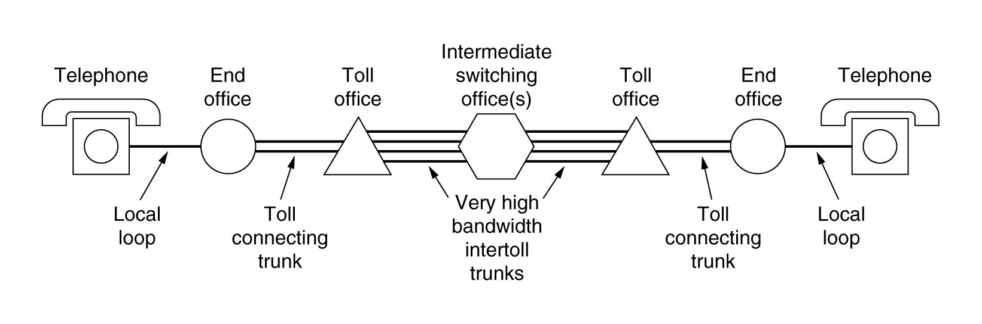
Phones

Slide 23
Modems
Modulator-demodulator
Converts from analog to digital and back again
DC- not good for long distances
AC- uses a sine carrier wave that is modulated in different ways to convey information

Slide 24
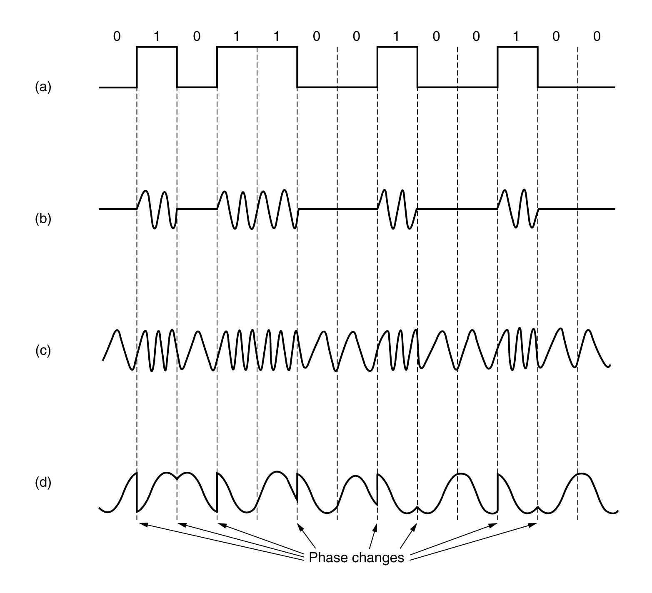
Forms of modulation
Binary signal
Amplitude modulation
Frequency modulation
Phase modulation

Slide 25
Bits, bauds, and stuff
Bandwidth- range of frequencies that pass through a medium
Bauds- number of samples/second
  One baud sends one symbol
Symbol- a piece of information
Bit rate- the number of bits/second * bits/symbol
Can use multiple modulation techniques to transmit multiple bits per baud
56K modems
  4000hz in a phone line
  8000 samples (Nyquist)
  8 bits per sample (7 + 1 control bit that is not usable)
  7*8000 = 56k modem

Slide 26
ADSL
Phone lines limited from 3HZ to 4000HZ by a filter
DSL has no filter
Sensitive to distance
Divides available 1.1MHZ spectrum into 256 channels.
  Channel 0 is POTS (Plain Old Telephone Service)
  Other channels for upstream/downstream (split determined by provider)
Digital Subscriber Line Access Multiplexer (DSLAM) used to recover bit stream and send to ISP

Slide 27
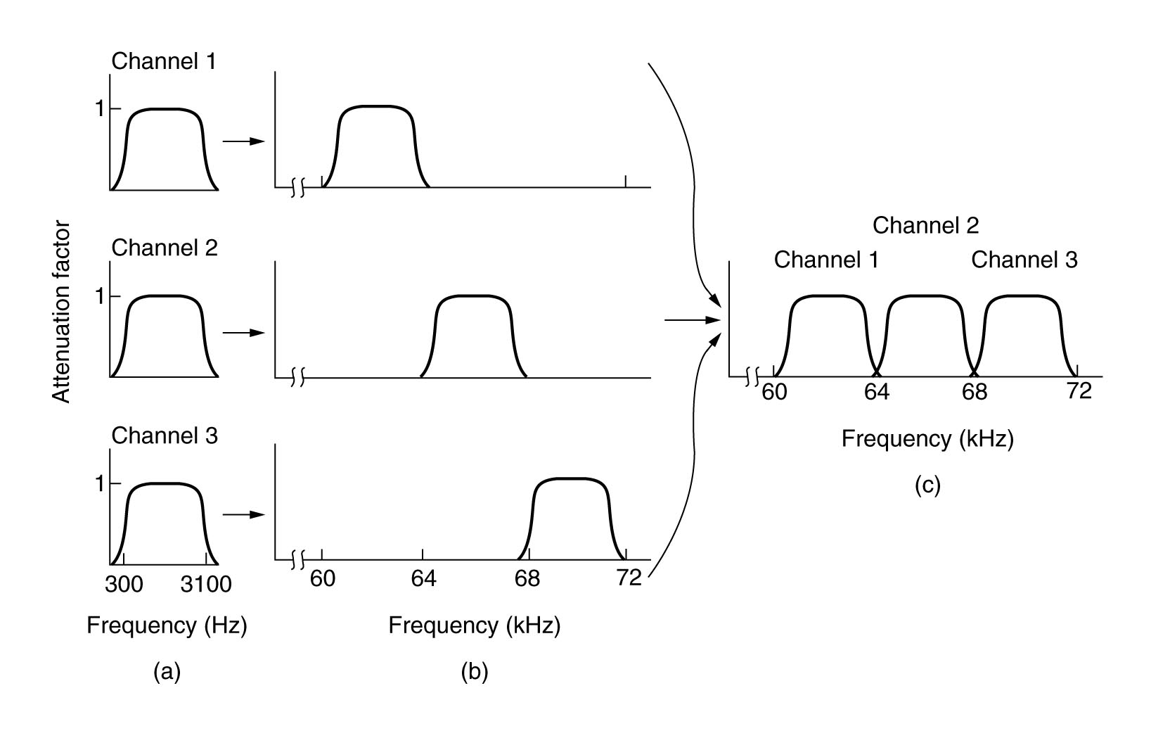
Trunks and Multiplexing
Same cost to install high bandwidth and low bandwidth trunks
Frequency division multiplexing

Slide 28
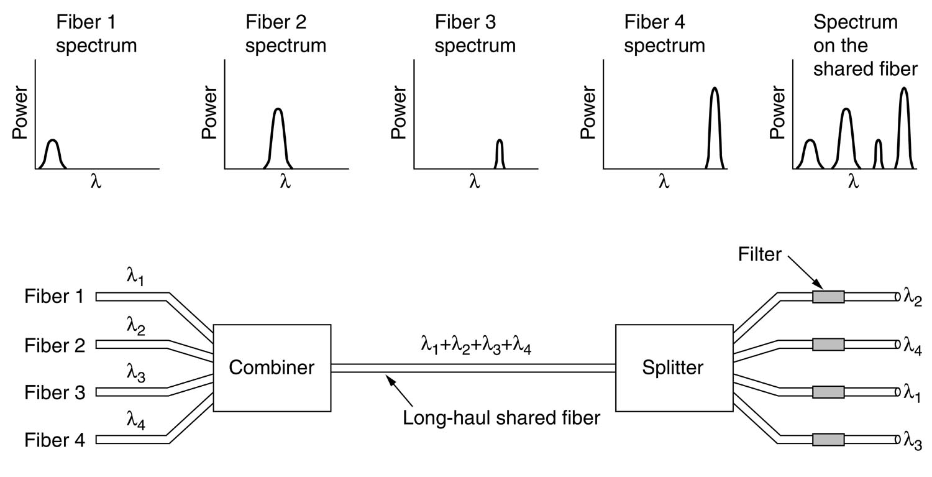
Wavelength division multiplexing
Used for fiber optics, basically the same as FDM

Slide 29
Time division multiplexing
Analog signals digitized by a codec (coder-decoder)
8000Hz/second sampling, converts to 8-bit number
Round-robin used to sample channels
24 channels, 8 bits per channel, 192 bits of data
Bit 193 is of the pattern 01010101…

Slide 30
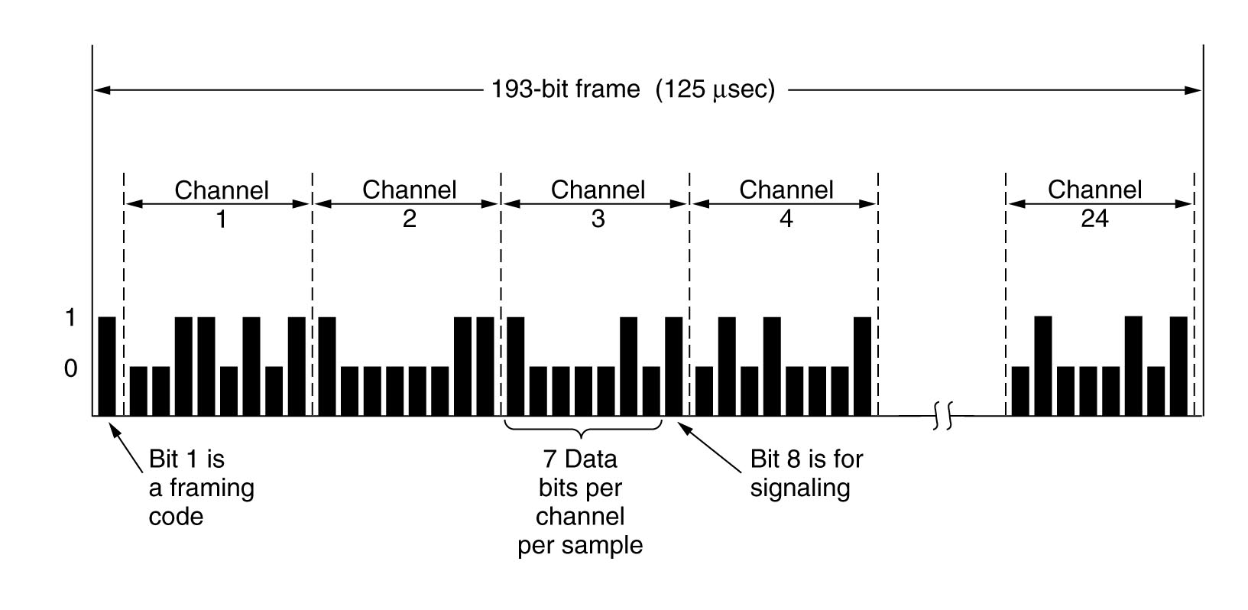
Time division multiplexing

Slide 31
Cable TV
People couldn’t always get TV signal
One receiver
Coax cable used to deliver to homes
Initially, anyone could create a cable network
Companies bought up cable systems and laid new ones
Companies ran cable between cities to connect their networks

Slide 32
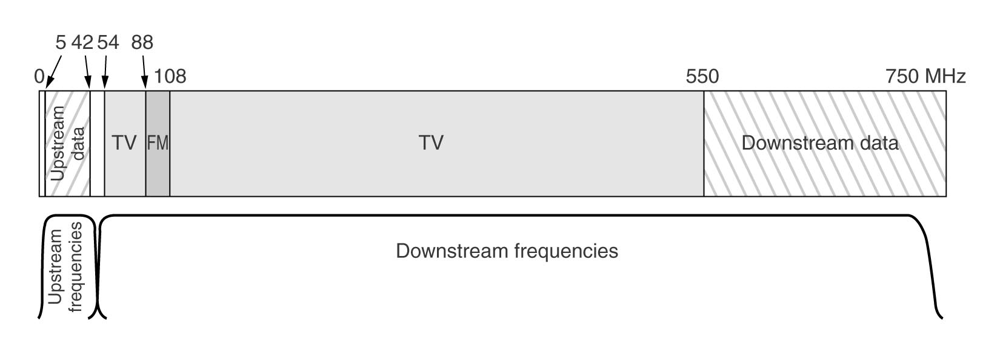
Internet over cable
Coax shared by all houses in neighborhood
TV shows are broadcast
Internet is not; one user could take up lots of bandwidth

Slide 33
ADSL vs. Cable
Full capacity available on ADSL, not on cable
Cable bandwidth is unpredictable
Cable has better availability
Other people can sniff data on cable
Phone lines more reliable than cable
ADSL gives choice of ISP

