Slide 1
The Internet Layer and the IP Protocol

Slide 2
Transport Layer services
Connectionless services
  Routers should only route packets
  Subnets are unreliable; each router should do error control and flow control itself
  No packet state is stored
  Packets sent in any order via any route
  No setup is needed- just send the packets

Slide 3
Transport Layer Services cont.
Connection-oriented services
  Subnets should be reliable
  Quality of Service is important
  Without maintaining connection data, QoS is difficult to achieve
  Path must be established by creating a Virtual Circuit

Slide 4
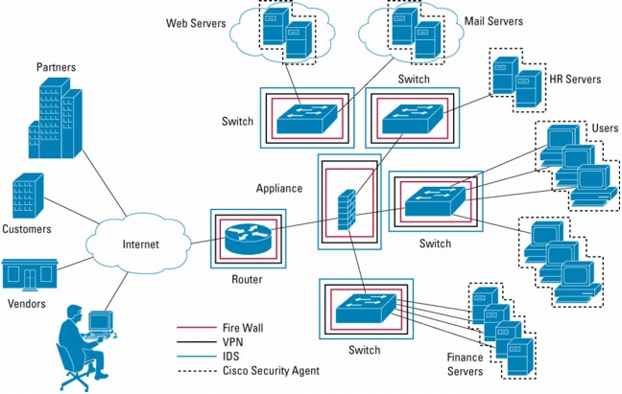
Network devices
Routers, Switches, Hubs, and Bridges connect devices together

Slide 5
Routers
Connect different networks
Very smart- able to route between networks
Have a table that they maintain which is used to route packets
May exchange routing data with other routers
May connect different types of networks (i.e. Ethernet to wireless)
If you can compromise one, you can do many bad things

Slide 6
Switches
Can route traffic between hosts on the same network
Can be chained to other switches or hubs
Routing directly between hosts (reduces collisions, more privacy)
Can be tricked into routing all data to a single host

Slide 7
Hubs
Not as smart as switches
Connects multiple hosts on the same network
Can be chained to other hubs or switches
Broadcasts data to all connections- no routing and lots of collisions
Fairly uncommon these days

Slide 8
Bridges
Basically another name for a switch with only two ports
Used to connect different network segments
May be used to connect different types of networks

Slide 9
The IP Protocol
RFC 791
Provides endpoint to endpoint communication between two hosts
May route between many networks
May choose a different route each time
No reliable delivery

Slide 10
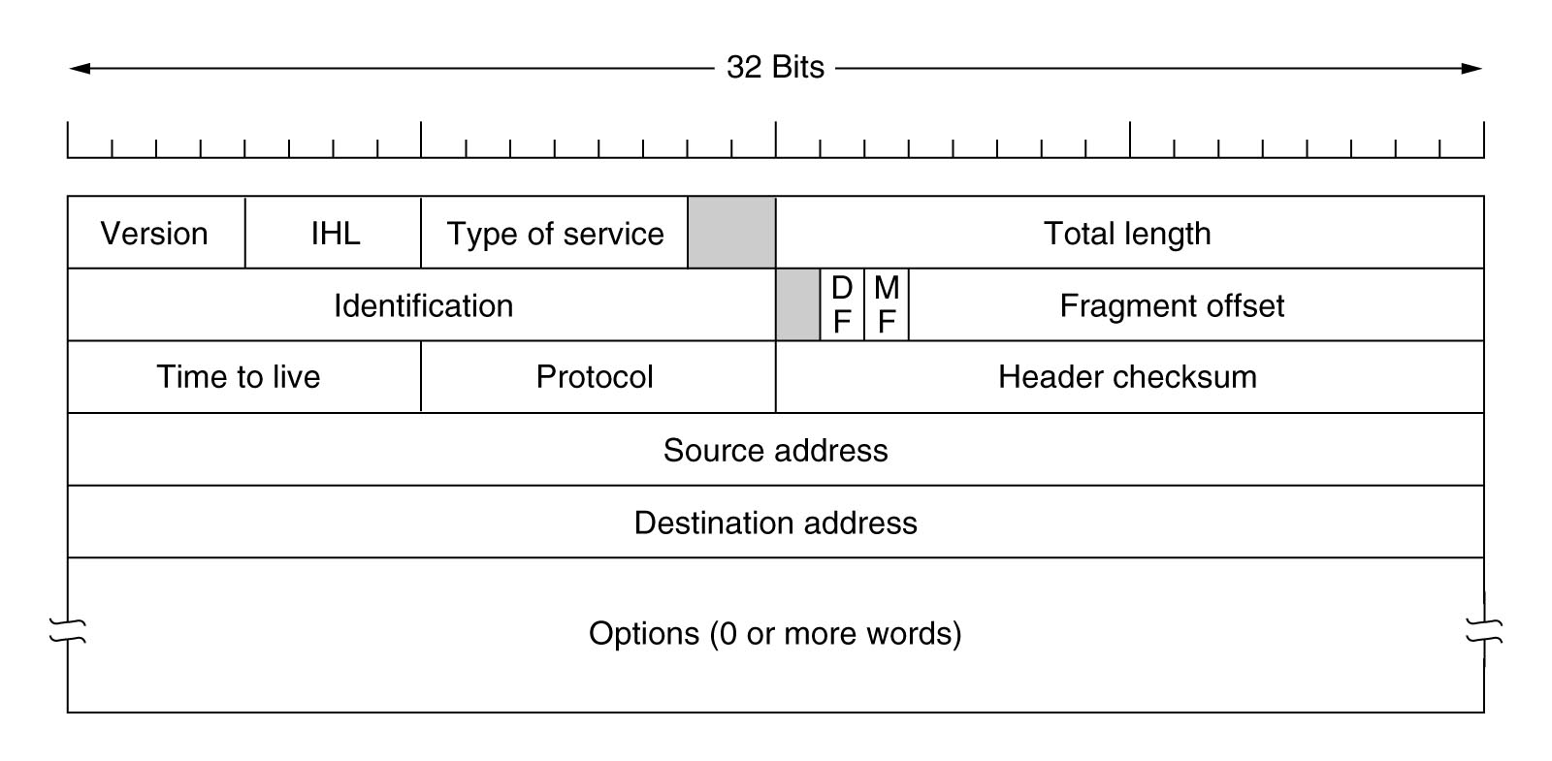
IP Packet

Slide 11
IP Address
IPv4- 32 bits long
Must be unique
Host may have more than one
Encodes the host number and network number

Slide 12
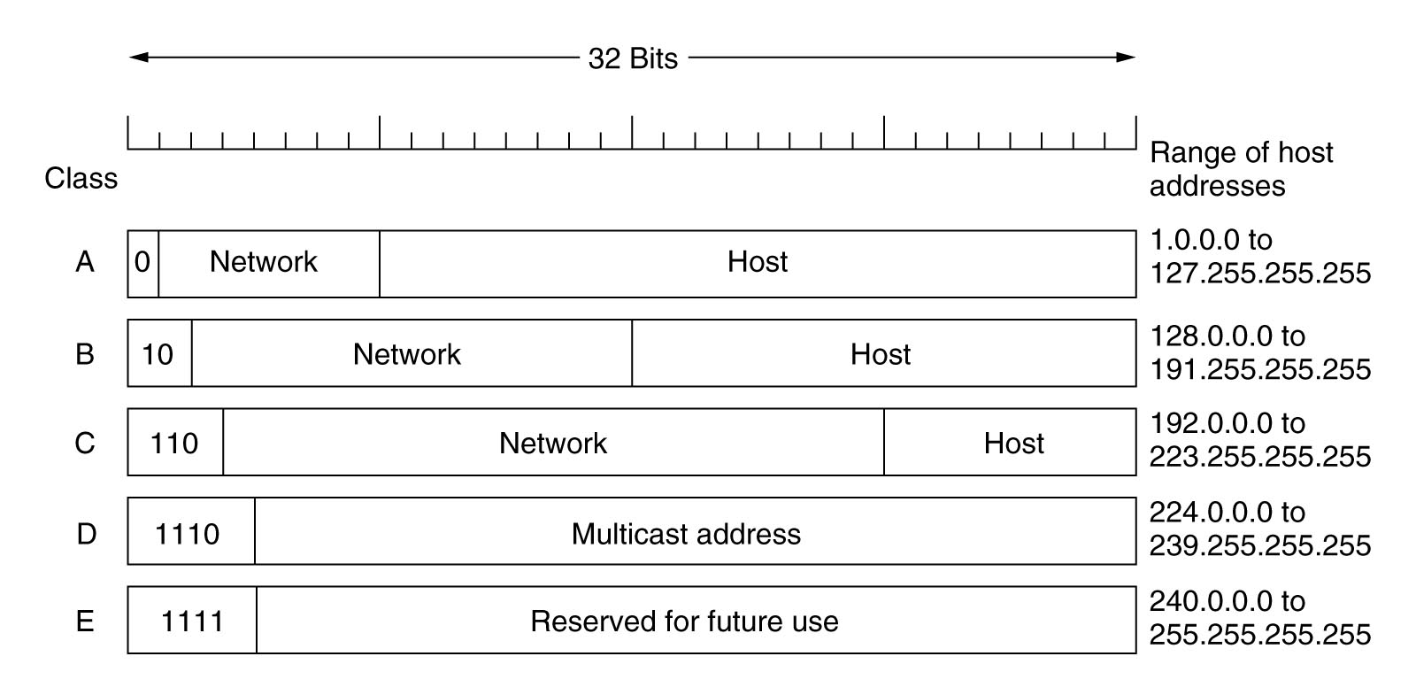
Host and Network Addresses

Slide 13
Reserved IP addresses*
10.0.0.0/8 to 10.255.255.255
172.16.0.0/12 to 172.31.255.255
192.168.0.0/16 to 192.168.255.255
169.254.0.0 to 169.254.255.255
127.0.0.0- loopback
255.255.255.255- broadcast
Routers WILL NOT route to these addresses
*Good to know for the test, just like reserved ports

Slide 14
Subnets and the subnet mask
Lots of hosts on the same network make routing challenging and introduce congestion
Networks can be divided internally into subnets
The Network and Host addresses can be determined via the Subnet Mask
Address and subnet mask may be expressed as:
  192.168.0.1/22 or 255.255.252.0
  The “/22” indicates that the mask is 22 bits long

Slide 15
Routing
Routers used to maintain tables with network class, subnet, and host
Address would be shifted to determine network class
Netmask would be applied to see if it was a host on this network
Packet would be routed accordingly

Slide 16
Classes are not good
Class A- 16 million hosts
Class B- 65,536 hosts
Class C- 256 hosts
Class A is too large, Class C is too small.
Class B is also too large
Problems with routing tables- need to know about all networks. More networks mean bigger tables

Slide 17
Classless InterDomain Routing (CIDR)
RFC 1519
Got rid of classes
Allocate blocks of addresses of any size
Routing is much harder-
  Each routing table entry has a 32-bit mask
  Routing table is scanned for appropriate entry for each incoming address
  Each mask is ANDed with each address and the longest base match is used to send the packet
  This is hard. Very special hardware is used

Slide 18
How routers work
Multicast groups have to propagate over the internet somehow
So do other kinds of routes
How do we connect all the Autonomous Systems (AS) on the internet?
How do we ensure that they know about each other

Slide 19
Determining routes
Routing tables hold CIDR blocks by network address and netmask
Routes determined as follows:
  Create a node mesh (graph) based on all possible routes
  Use a distance-vector algorithm to calculate optimal pathing.
  Dijkstra’s algorithm is commonly used
  Must avoid count-to-infinity problem

Slide 20
Interior and Exterior
AS have two areas to manage routes
  Interior- within the AS
  Exterior- between multiple AS
Different systems/protocols in use mostly built over IP
Commonly referred to as Interior and Exterior Gateway Protocol

Slide 21
Open Shortest Path First
(OSPF)
RFC 2328
Must be:
  Open
  Many metrics for “distance” (physical distance, delay, etc)
  Dynamic
  Routing based on service (not actually used*)
  Load balancing
  Hierarchical systems
  Security
  Tunneling
* For now. . . .

Slide 22
OSPF cont
AS are large and complex
Routers must create a graph and calculate all possible routes
Networks divided into areas, including a backbone (area 0) to which all areas are connected
Types of routers:
  Internal- within one area
  Area border- connect multiple areas
  Backbone- on the backbone
  AS boundary- talk to other AS (different protocol)
Types of routes:
  Intra-Area
  Interarea
  Inter-AS
Not practical to always send every single route to every router
  Route reflectors- all routers can peer with a single one that only manages connection information
  Confederations- subdivide AS into multiple internal AS to reduce interior mesh size

Slide 23
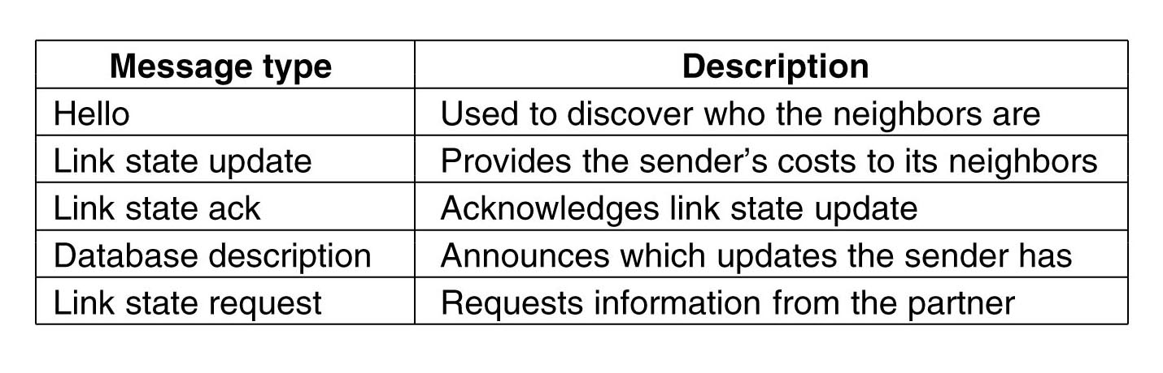
How it works
Exchange information between routers (over IP, protocol number is 89)
Routers send a “HELLO” message when they come online
Message types:

Slide 24
Border Gateway Protocol
Communicates between AS
Goals not the same as interior protocols
  Politics
Kinds of networks
  Stub- only one connection
  Multiconnected- multiple connections
  Transit- backbones

Slide 25
BGP communication
Routers communicate using TCP
  Maintain actual routes used
  Communicate routes with neighbors
  Routers examine paths provided by neighbors and update their own paths
Each route given a “score” representing distance
Routes violating policy get score of infinity
Not practical to communicate every single route

Slide 26
Exchanging routes
Routes sent as Network Layer Reachability Information (NLRI)
  Destination prefix
  Prefix length
  Path of AS to destination
  Next hop attributes
Sending every possible destinatio is bad:
  Create supernets- aggregate many subnets into a single subnet that covers all of them
  Makes multiple networks into a single route advertisement

Slide 27
Network Address Translation (NAT)
RFC 3022
One internet IP address assigned to a network
Within the network, many IP addresses are used
When a packet exits the network, it uses the address of the internet IP
NAT keeps track of the ports used to know how to route packets to the appropriate internal IP

Slide 28
NAT Problems
Violates internet principles- it maintains state in connections
Only one machine can listen on one port
If IP is encoded in a higher layer, NAT won’t know
TCP/UDP is not required, just common, but NAT won’t work without it
Luckily, IPv6 will make it irrelevant

Slide 29
IP encapsulation
IP may encapsulate other IP headers for a variety of reasons
IP tunneling
IPsec

Slide 30
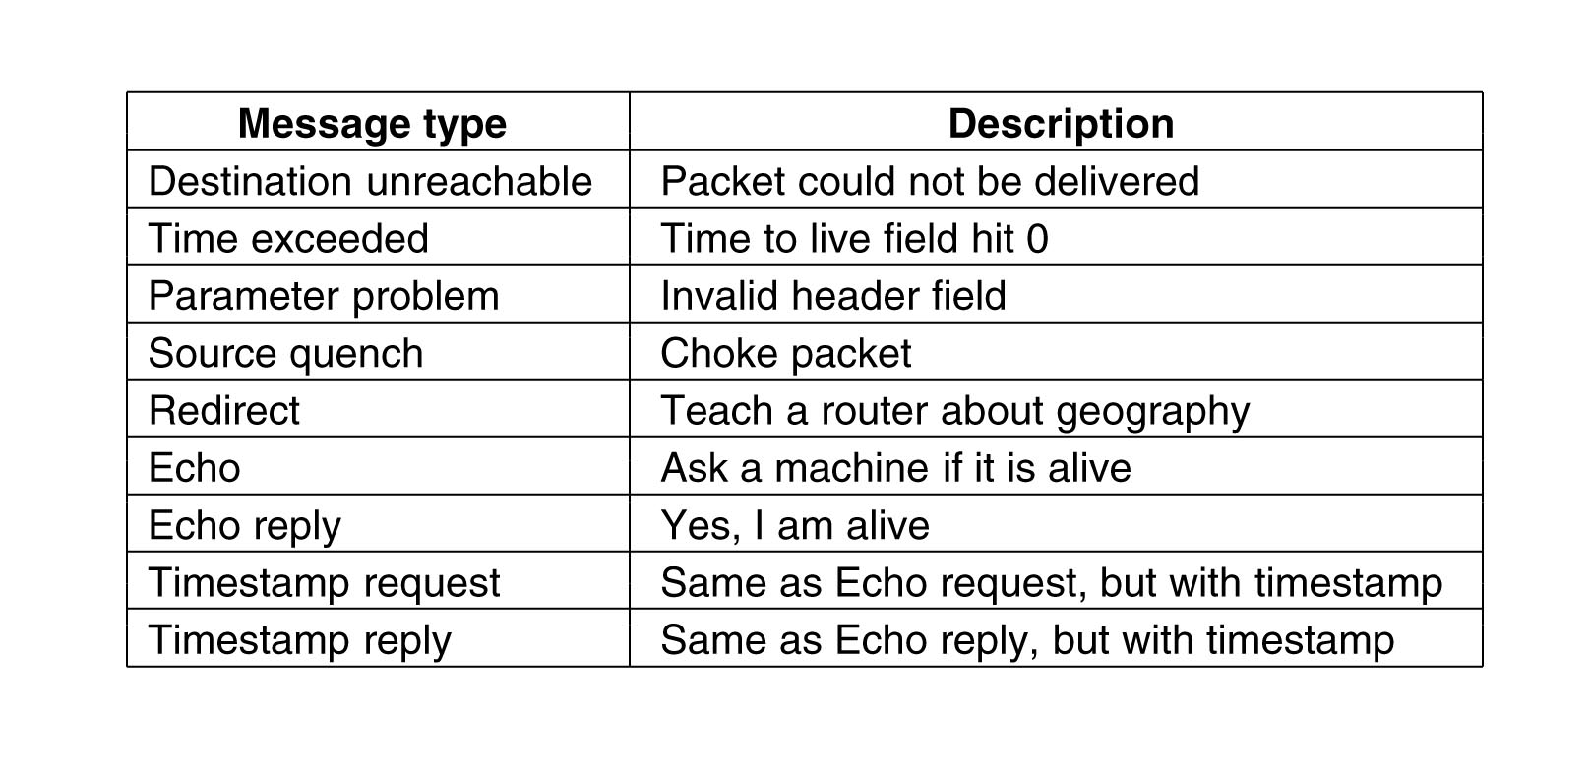
Internet Control Message Protocol (ICMP)
Can send messages between routers, also used for testing networks

Slide 31
Address Resolution Protocol (ARP)
RFC 826
Lower layers don’t understand IP addresses, they use MAC addresses (hardware address)
ARP translates between IP and MAC addresses on local networks
Reverse Address Resolution Protocol (RARP) goes from MAC to IP

Slide 32
Dynamic Host Configuration Protocol (DHCP)
Allows a machine to acquire an IP address from a central server
IP addresses assigned through DHCP are “leased” for a period of time
IP addresses may be mapped to MAC addresses, thus giving a host a “static” IP address

