Slide 1
Content Pipeline

Slide 2
What to talk about
What it is.
Why you should care.
What the big studios do.
What actually matters to you right now.

Slide 3
What is it?
The process by which data is changed from the editing form to the final game form.

Slide 4
3Ds Max / Maya/ PhotoShop
Source Assets
Working Assets
.max / .mb / .psd
FBX Exporter
Other Tools
Intermediate Assets
.xml
.fbx
.tga
.png
FBX Converter
Nvidia Texture Tools
Binary Converter
bin
bin
dds
…
Final Assets
Packager
Final Package

Slide 5
Why does it matter.
Game have a large amount of content.
Take a long time to process
For most of the team this is THE BOTTLENECK
The more time it takes to build the content the slower everything goes.
This means the game is less fun, looks worse, and sound worse.
Content is KING
A game engine is only as good as its pipeline.

Slide 6
What does it look like?
Large 300 GB to 30 GB intermediate to 7 GB final
Diverse - Meshes, textures, sounds, cinematic sequences, object placement, physics meshes, trigger definitions, etc.
Expensive programs – Photoshop, Zbrush, Max/Maya
Made by lots of people (50 artists/designers) compared to 10 devs)
Lots and lots of files (10,000 sounds fxs)

Slide 7
Content Types
Very Diverse but two main categories
Raw assets
Sounds, Textures, Models, Animations
Need to be baked to be useful
Very large and lots of processing
Data assets
Level files, scripts,
Can be used directly easily

Slide 8
Source Files
Files edited by content tools such as 3ds Max, Maya, Photoshop etc.
Can easily be lost
Need a way of tracking files source files

Slide 9
Meta Data
Data about data
Need to store additional data with source assets hard to do in a generic way
Generate a meta data file
In same location
In some kind of database

Slide 10
Intermediate Assets
Can the game load intermediate assets?
How long does it take to process?
Translate Multiple Formats into a single structure

Slide 11
Content Processing
FBX Importer
Xbox360 Mesh
Generator
Generic Mesh
PC Mesh
Dae Importer
iPhone

Slide 12
Build Systems

Slide 13
Builds System
Assets need to be converted form editable form to final form.
Can be done manually but automated system is much better
Rebuild all assets quickly
Integrating new assets is quick and easy
Easy to detects errors
Artists non programmers can import content

Slide 14
Visual Studio Build Rules
+ Built into visual studio
+ Easy to add command line tools.
+ Detects rebuilds
- Harder to do packaging
- Interferes with build code

Slide 15
Using a command line build system
Make, Scons, Jam and others
Very powerful but hard to set up
Not designed for resource3s
Also pretty easy to roll your own

Slide 16
Build System
Set up build rules to build assets
Add assets to sources files (text) or have a nice GUI tool
Have a way to set meta data (format, etc)
Spit out final assets to some directory.
Need to think about packages.

Slide 17
Custom Build System
Not very hard can use whatever language you want
Much easier to make useful tools for system
Use simple data file format for meta data

Slide 18
Dependencies
Dependency checking can be difficult
Ability for resources to find what resource are needed for a particular resource
Find all dependencies in a level or scene file
Building compact levels
Incremental Building

Slide 19
Content System Features
Multiple Resource Types
Creation, Deletion, Editing
Resource Referencing
Resource Relocation
Referential Integrity
Packing and Grouping

Slide 20
Referential Integrity
Asset can be removed rename and deleted.
How do you maintain a reference in a file system?
Absolute Path?
Id System (GUIDS)
Prevent Asset Duplicates and Naming

Slide 21
The Editor

Slide 22
How your game edits levels
For student games this is your primary bottleneck
Critical to have fast turn around
Easy of use less important
Do not have dedicated tools team

Slide 23
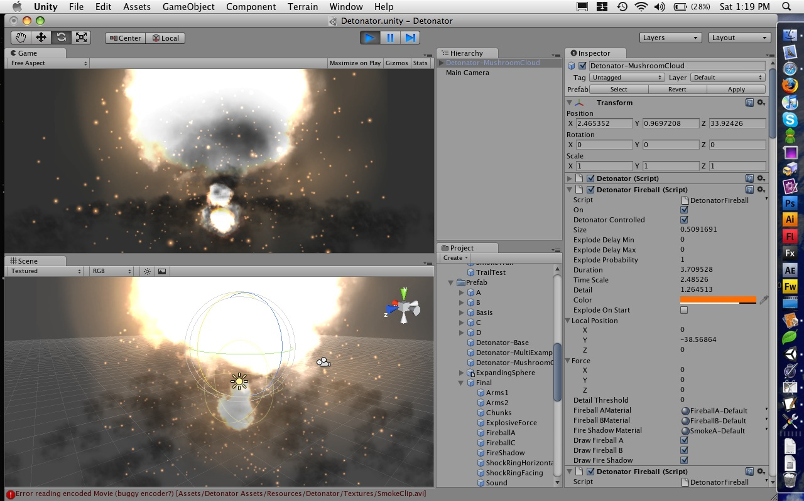
Unity

Slide 24
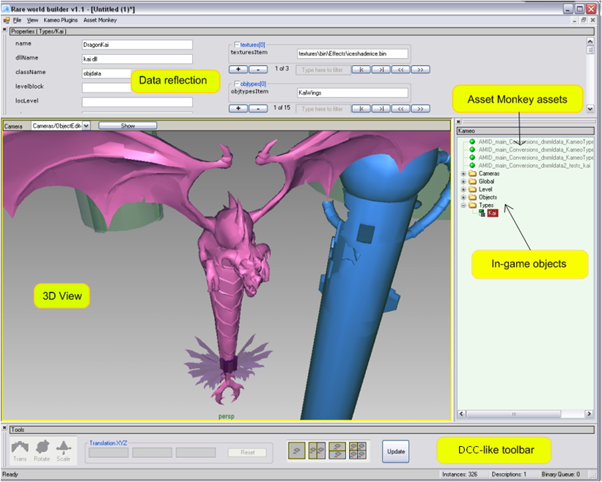
Notes:
World builder enumerates registered structures & assets. Those with 3D representations are rendered in 3D view.

Slide 25
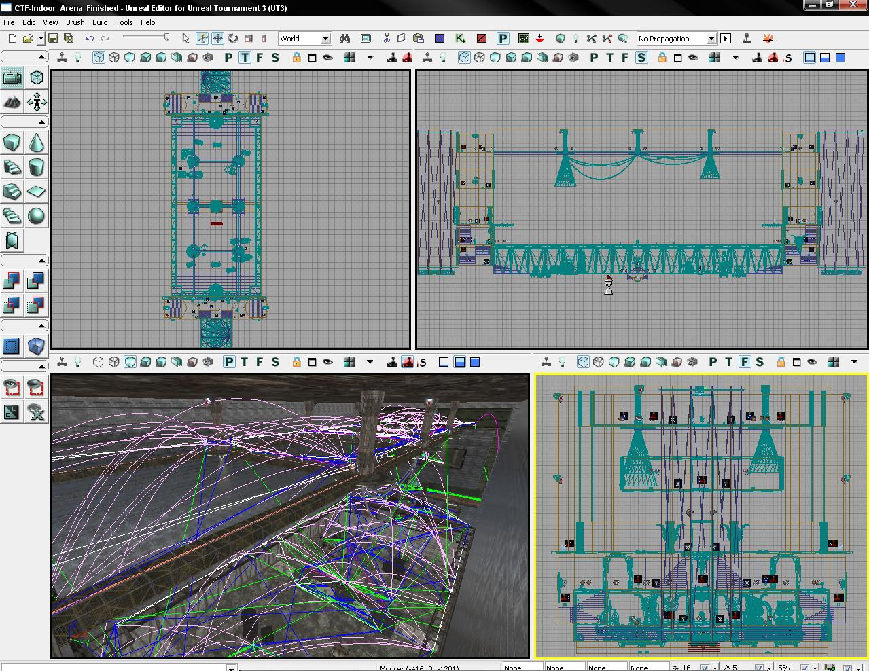

Slide 26
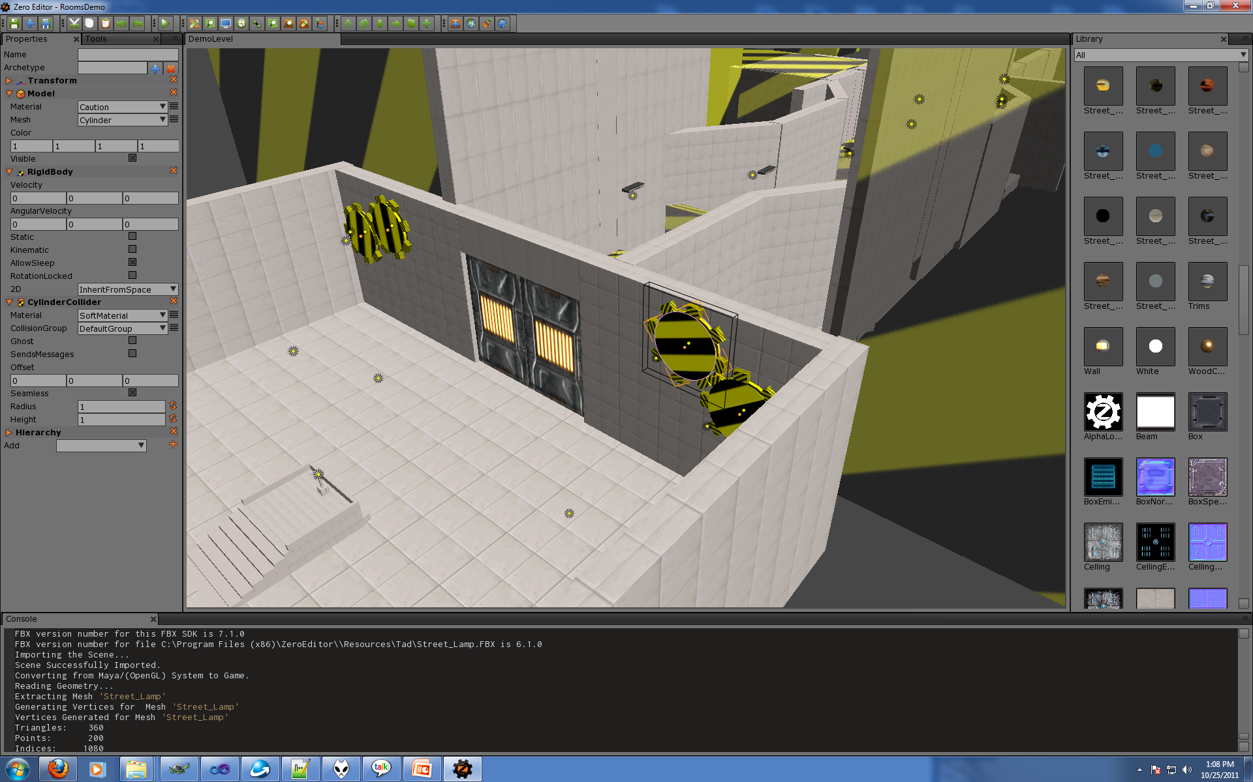

Slide 27
In Game Editor
+ Faster turn around time
+ Complete control
+ WYSIWYG (what you see is what you get)
+ Do not need to write other tool
- More bugs in editor more bugs in game
- Problems with engine blocks content
- Not easy to use modern languages like C#
- Bloats game runtime (longer builds)

Slide 28
Common Elements
Property Grid
Ant Tweak Bar
Scene Tree
Asset Tree
Gizmos
Scale, Rotate, Translate.
Scene view
Sometimes split

Slide 29
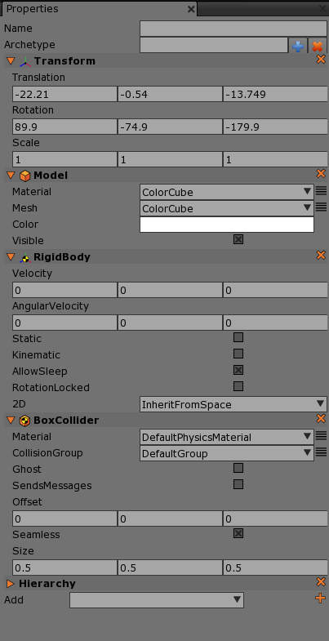

Slide 30
Properties Vs Serialization
Properties are not the same as serialization.
Properties are function calls
GetProperty
SetProperty
Do not just change value in memory
Serialization is just data.

Slide 31
Support In game
Consider using a UI framework
AntTweakBar
CEGUI (Crazy Eddies Gui system for games)
Wrap your game with WxWidgets, Qt, WinForms, C#, Borland

Slide 32
Content Library
Can use windows explorer!

Slide 33
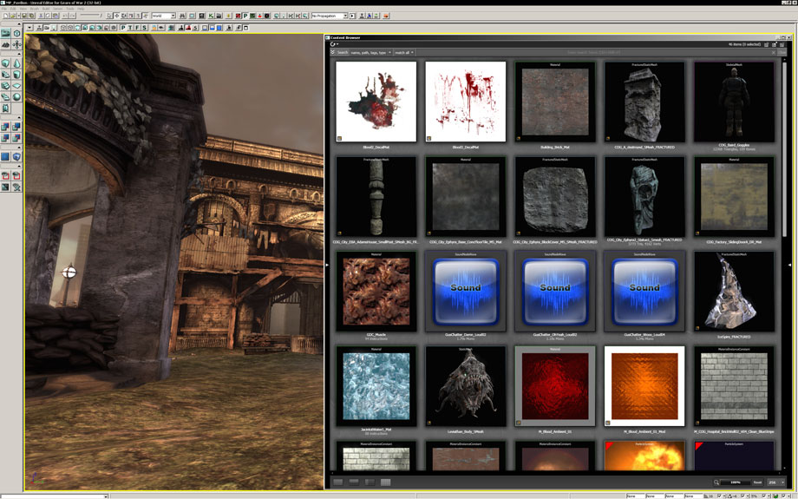

Slide 34
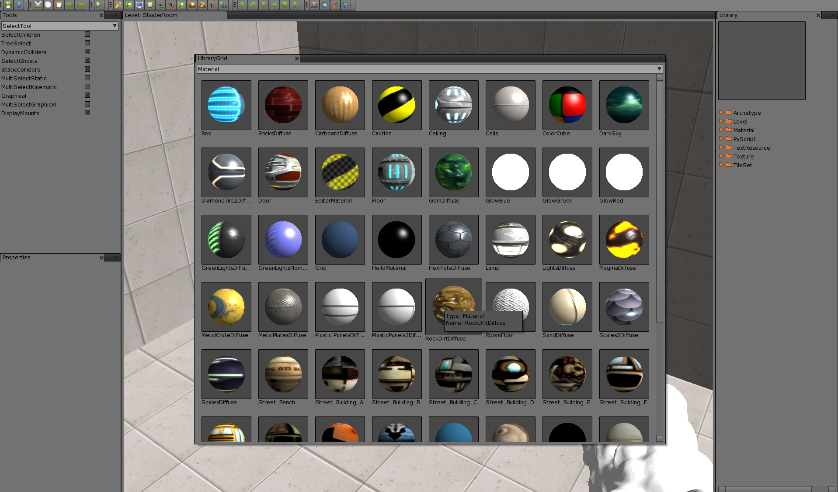

Slide 35
External Editors
Use a 3D Package (Max/Maya/Blender)
Build your own using WxWidgets, Qt, C# , etc
Very little game editing tools out there

Slide 36
Using a 3D Packages
Max, Maya, or Blender can be used as an editor
Max and Maya both support using scripts to build custom Ui and writing custom exporters
Take advantage of the application data attribute system
Example scripts on GameCentral
+ Quick and easy to build
+ Robust UI and Gizmos
- No concept of asset building
- Need access to Maya/Max

Slide 37
Archetypes
An archetype is a prototype or the original model (blueprint, prefab, etc.) for an object.
The factory uses the archetype to build the object and then run time data is modified as needed. (such as position).
Object = Car
Archetype = Gray Model 2 BMW
Instance = Bill’s BMW, that BMW on the corner, etc.

Slide 38
Archetypes
Very important for game editor
Makes it easy to change game without modifying all levels.
What data do you want to have changed per object?
Position, Scale, Rotation?
Can archetype override everything?
Can an instance override individual properties?

Slide 39
Levels
In a level you will want to place an object multiple times.
Use archetypes to alias out the objects so their properties can be adjusted.
The loader then overrides the position, rotation, or whatever else.

Slide 40
Spawners / Triggers / Layers
Consider placing spawners instead of objects.
Triggers for activating game events.
Separate layers for ease of editing
Lighting layer
Game play layer
Level Layer
Can be stored as separate files for better merging
Always should be text

Slide 41
Spaces, Level or World Object
In the game create an object that all the world objects are in.
Can be a composition
When you play a level save the current world and create a new world.
When you are done just jump back to the editor world.

Slide 42
Questions?

