Slide 1
CS380/CS580:
Artificial Intelligence in Games
Week 3
Steve Rabin
steve.rabin@gmail.com
www.aiwisdom.com/dp
TA: Jay Goldblatt (goldblaj@gmail.com)

Slide 2
Project 1
Questions?
Problems?
Observations?

Slide 3
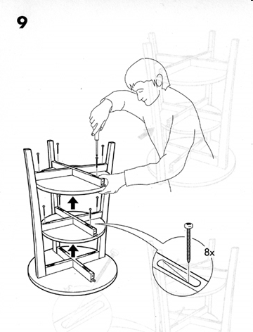
Project 1: State Machines
Turn-In Instructions
Place in your directory, in a directory named "Project1"
  All code, resource files, and exe (do not zip)
  (-10% if I can't double click exe and run)
  (-10% for large unnecessary files: ".ncb" file, hidden subversion directories/files, no Debug/Release dir)
Create a readme.txt and write:
  One paragraph about what you implemented
  One paragraph (and/or bullet points) explaining directions
  One paragraph about your experience working on this project (problems, insights, difficulty, number of hours spent)
  List the 10 features you chose to implement and which file and line number I can find each one (-5% for each missing or each missing listing)
  Thoroughly describe any attempted extra credit along with any special directions to work it or view it
UML diagrams
  Hardcopy on paper

Slide 4
Recommended Reading
Artificial Intelligence for Games
  Chapter 4: Pathfinding

Slide 5
Questions
What purpose does the black dot serve in a UML state machine diagram?
Name four key EVENTS that a state in the State Machine Language (SML) might respond to.
What is the key benefit of the global message response feature in SML.
If a delayed message is scoped to the state and the state never changes from the time the message was sent, will the message be delivered to a global message response if it isn’t handled in the current state?
Why is a Behavior Tree better than a FSM?

Slide 6
Reactive Movement and
Steering Behaviors

Slide 7
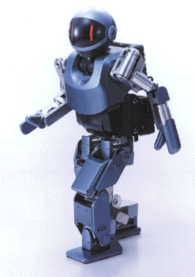
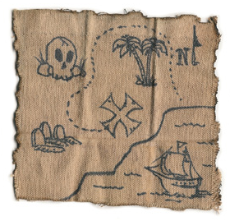
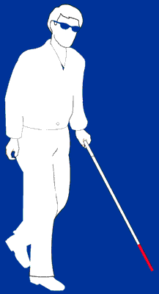
Movement
Two types
  Reactive movement
  Planned movement

Slide 8
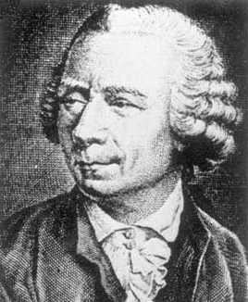
Steering Behaviors:
Physics Model
Simple Vehicle Model
  orientation, mass, position, velocity
  max_force, max_speed
Forward Euler Integration
  steering_force = truncate (steering_dir, max_force)
  acceleration = steering_force / mass
  velocity = truncate (velocity + acceleration, max_speed)
  position = position + velocity

Slide 9
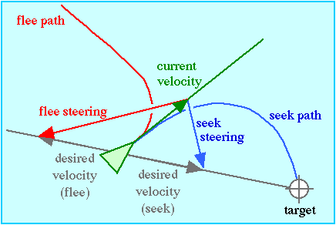
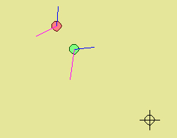
Steering Behaviors:
Seek and Flee
Seek – Steer toward goal
Flee – Steer away from goal
Steering force is the difference between current velocity and desired velocity
  Blue is steering force, magenta is velocity

Slide 10
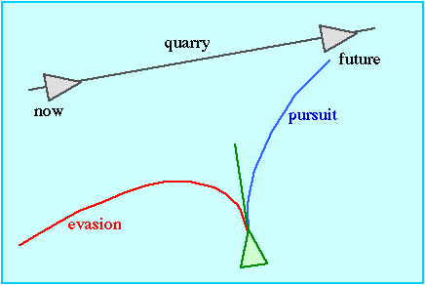
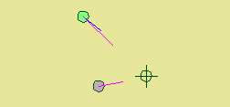
Steering Behaviors:
Pursue and Evade
Based on underlying Seek and Flee
Pursue – Predict future interception position of target and seek that point
Evade – Use future prediction as target to flee from

Slide 11
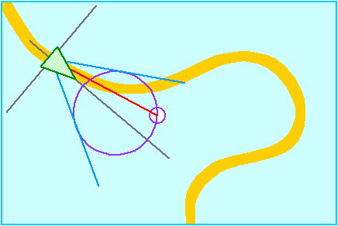
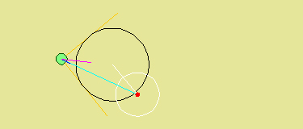
Steering Behaviors:
Wander
Type of random steering with long term order
  Steering is related from one frame to another
  Maintains state
Red dot is wander direction
  Constrained to be on black circle
  Randomly moves within white circle each frame

Slide 12
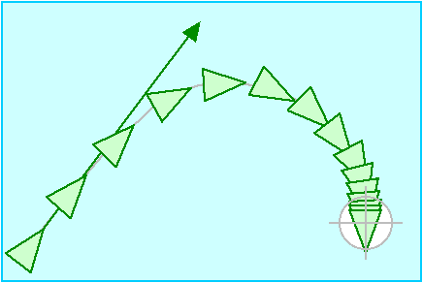
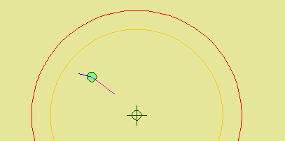
Steering Behaviors:
Arrival
Goal to arrive at target with zero velocity
Red circle is maximum distance before slowing down

Slide 13
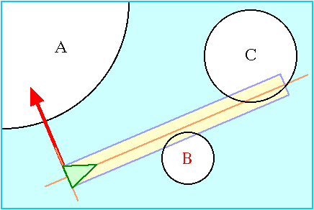
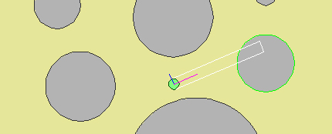
Steering Behaviors:
Obstacle Avoidance
White box is future path
Steering force strictly left or right
Braking force stronger as collision gets closer

Slide 14
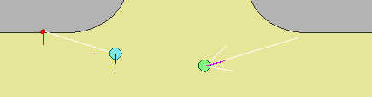
Steering Behaviors:
Containment
General obstacle avoidance
Object is contained within the surface
Blue object has a random probe
Green object has three probes
  More robust
  Three times the work per frame

Slide 15
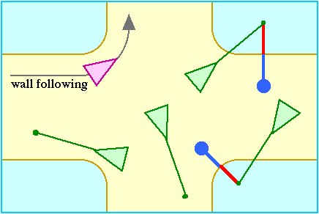
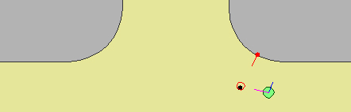
Steering Behaviors:
Wall Following
Move parallel and offset from gray areas
Goal to remain given distance from wall
  Predict object’s future position (black dot)
  Project future position to wall
  Move out from wall set amount from normal
  Seek toward new point (red circle)

Slide 16
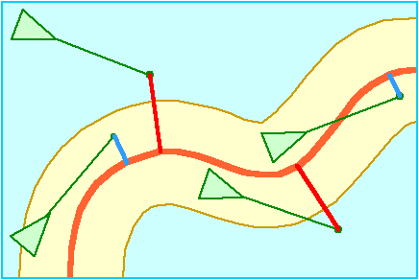
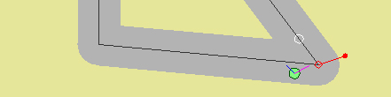
Steering Behaviors:
Path Following
Path is connected line segments with radius
Corrective steering only when varying off of path
  Red dot future predicted position
  Red circle is closest spot on path
  Corrective steering toward white circle farther down path

Slide 17
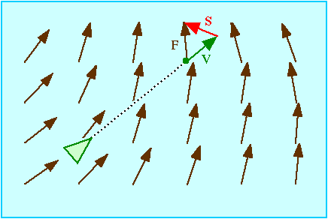

Steering Behaviors:
Flow Field Following
Steer to align motion with local tangent of the flow field
Field could be time-varying
Black circle is predicted future position where sample is taken

Slide 18
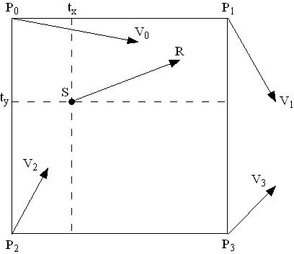
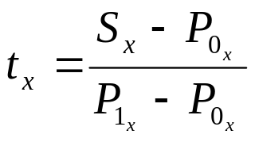
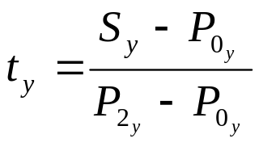
Steering Behaviors:
Flow Field Mathematics (AIW3 Ch3.1)
Bilinear interpolation

Slide 19
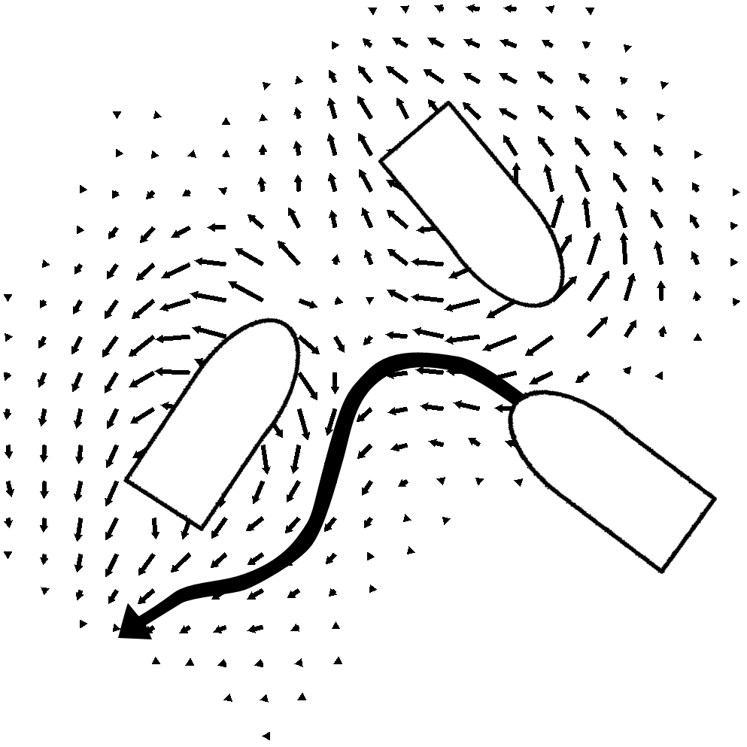
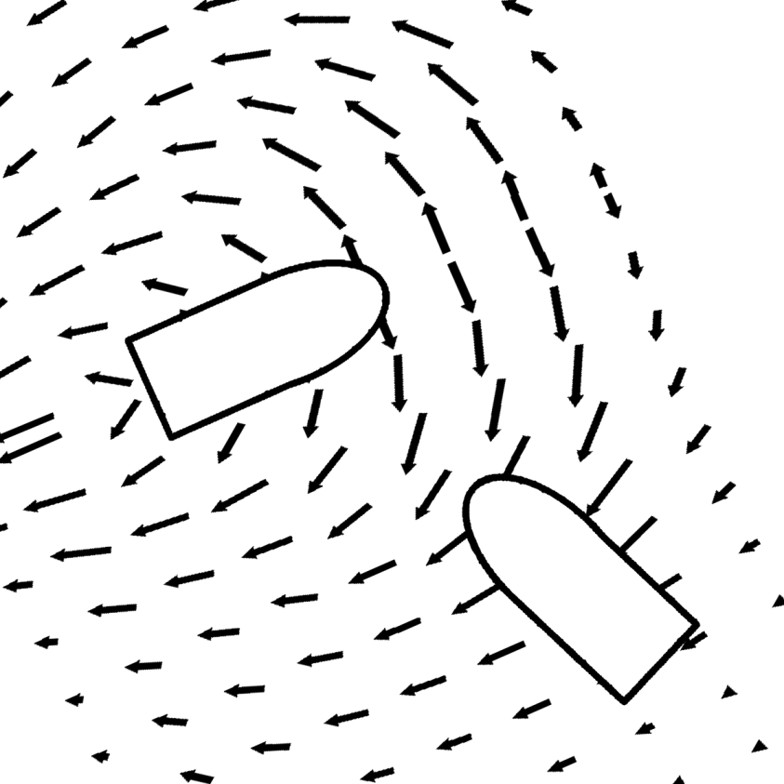
Steering Behaviors:
Avoidance using Flow Fields (Bloodwake)

Slide 20
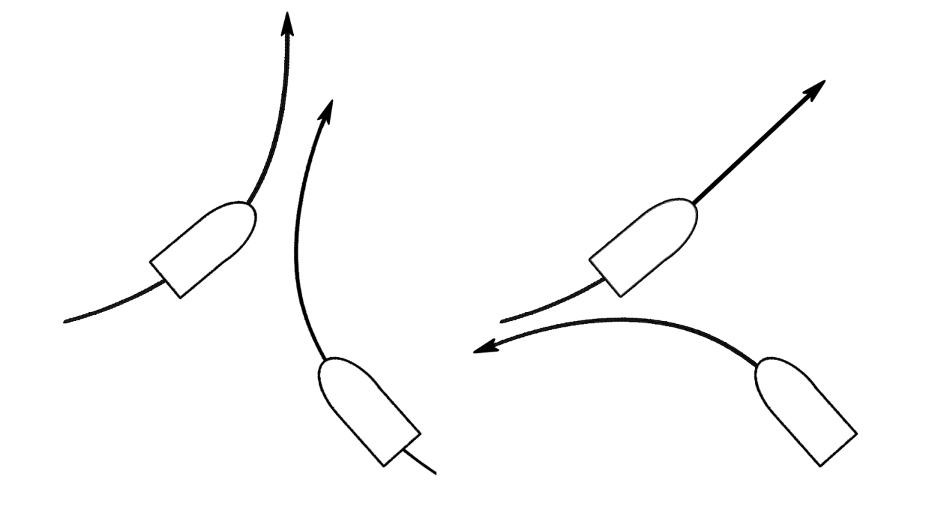
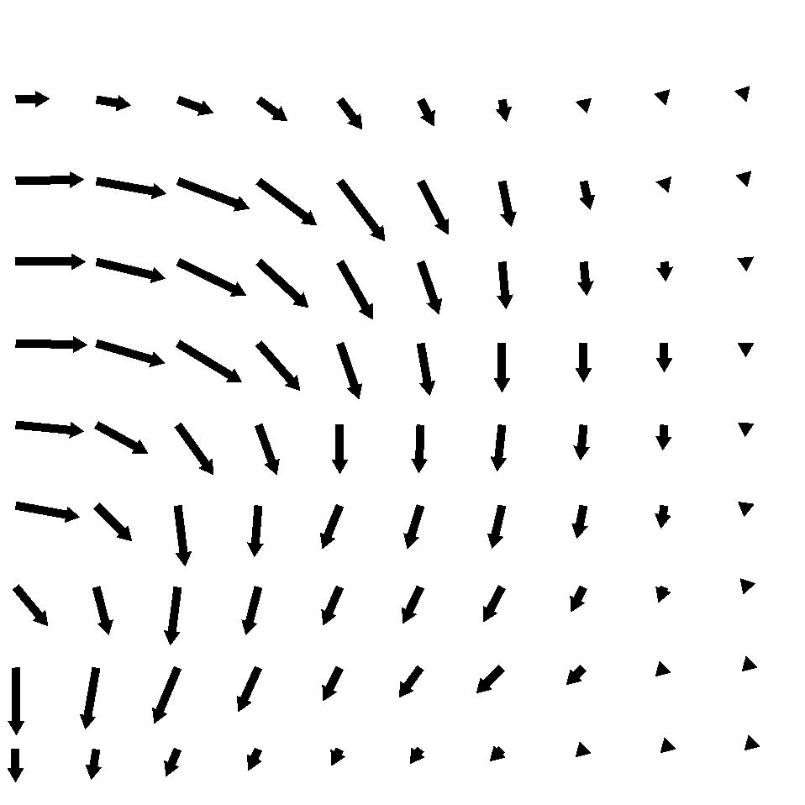
Steering Behaviors:
Avoidance: T-Bone vs Sweeping w/ Flow Field

Slide 21
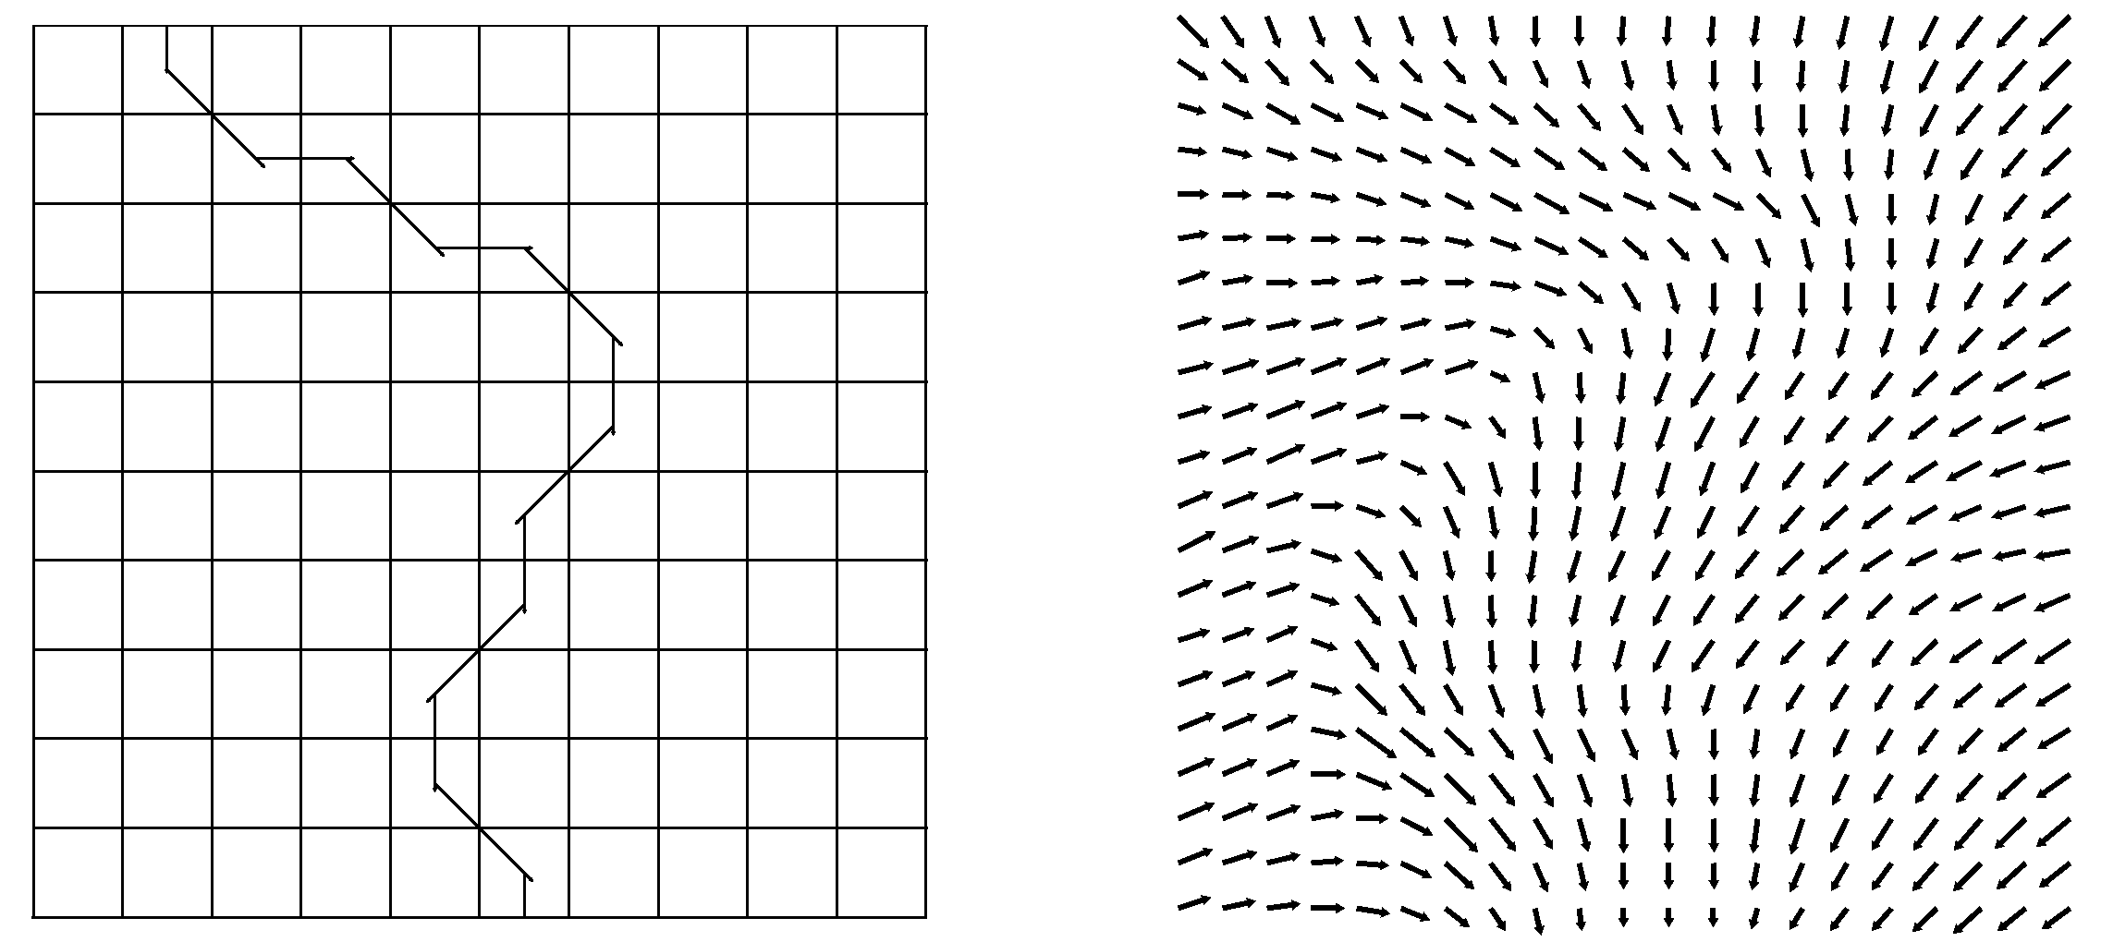
Steering Behaviors:
Path Smoothing via Flow Fields

Slide 22
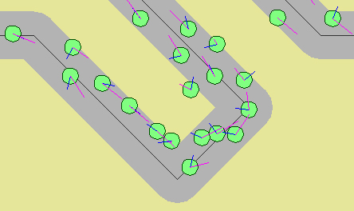
Combined Steering Behaviors:
Group Path Following
Path following with separation steering
  Combined with weighted sum
  Path following has 3 times weight as separation

Slide 23
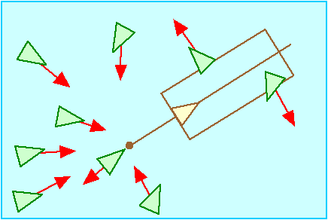

Combined Steering Behaviors:
Leader Following (Group)
Combines separation and arrival
  Arrival target is a point offset slightly behind the leader
  Followers must move out of leader’s future path

Slide 24
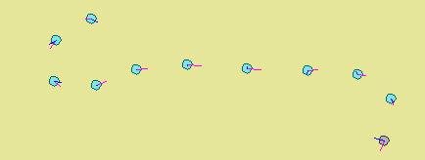
Combined Steering Behaviors:
Leader Following (Queue)
Combines separation and arrival
  Each object has a different leader

Slide 25
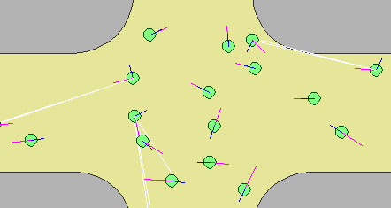
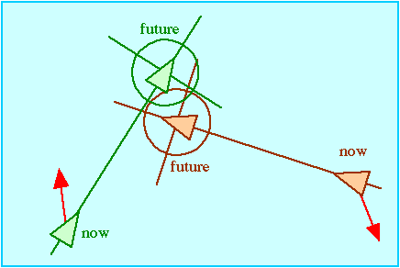
Combined Steering Behaviors:
Unaligned Collision Avoidance
Objects moving in all directions (unaligned)
Combines containment and avoidance
Future collisions predicted and objects steer away from collision site, or speed-up / slow-down

Slide 26
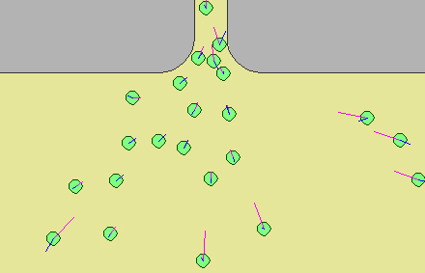
Combined Steering Behaviors:
Queuing
Seek doorway, Avoid gray walls, Separation from each other, Braking if others nearby or in front

Slide 27
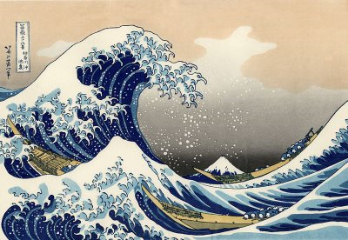
The Wave
Rule:
Rise and raise your arms
  at the same time as the spectators straight in front and behind
  but slightly after the person to the immediate left or right
Upon stretching to full height, return to
the usual seated position.

Slide 28

The Ripple
Rule:
Rise and raise your arms
  slightly after any person near you
Upon stretching to full height, return to
the usual seated position.

Slide 29

The Ripple
(with Reflection)
Rule:
Rise and raise your arms slightly after
any person near you.
Upon stretching to full height, return to
the usual seated position.
People at the edges should rise one more
time immediately after sitting back down.

Slide 30
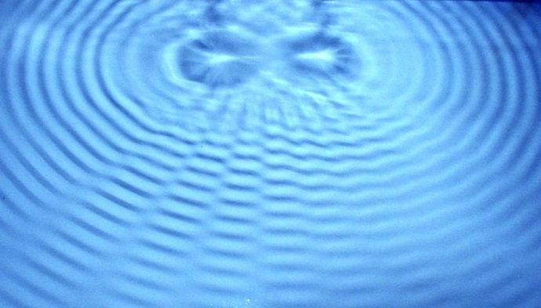
Wave Interference
Rule:
Something to ponder…

Slide 31


Cellular Automata:
Conway’s Game of Life (1970)
IF ALIVE
Less than 2 live neighbors, then DIE
    (as if caused by under-population)
2 or 3 live neighbors, then LIVE
4 or more live neighbors, then DIE
    (as if by overcrowding)
IF DEAD
Exactly 3 live neighbors, then LIVE
    (as if by reproduction)

Slide 32
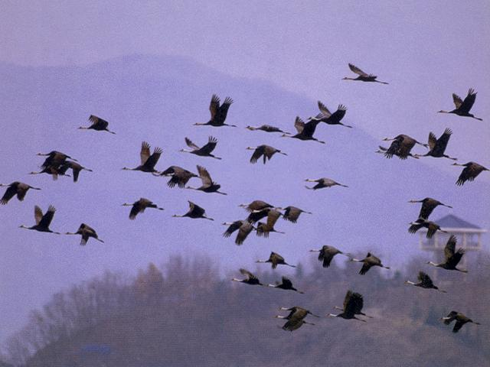
Flocking

Slide 33
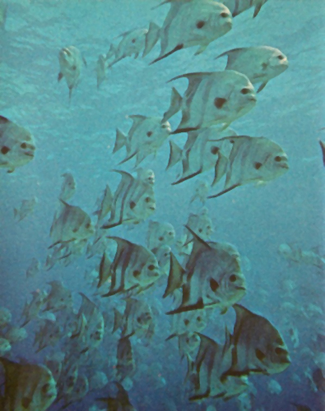
Flocking

Slide 34
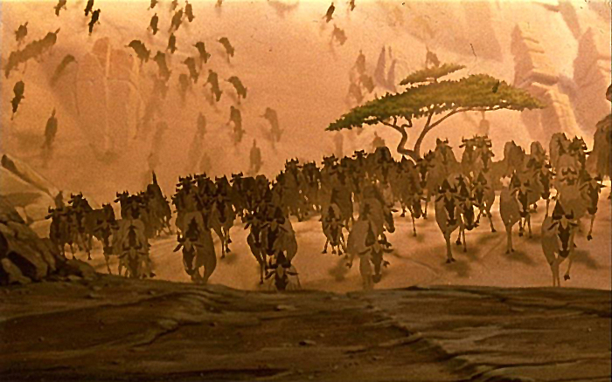
Flocking

Slide 35

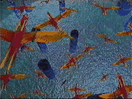
Flocking
First demonstrated by Craig Reynolds in his 1987 SIGGRAPH paper and movie
  “Flocks, Herds, and Schools: A Distributed Behavior Model”
  Film (Stanley and Stella in "Breaking the Ice"
Used to give flocks of birds and schools of fish eerily realistic movement
Won an Oscar in 1997 for his flocking work
  (Scientific and Technical Award)
Flocking is an example of emergent behavior (a-life)
  Simple individual rules result in complex group behavior
  Individual creatures often called “boids”
PS2 technical demo
OpenSteer demo

Slide 36
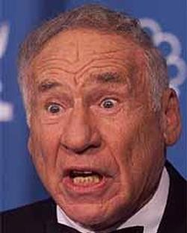
Flocking:
Boids
Term “boids” often used
Two sources for the term boid:
  1. “Boid” is an abbreviation of “birdoid” from flocking birds
  (a bird-like object)
  2. Pronunciation is similar to “bird” with a New York accent. In the Mel Brooks film “The Producers” there was a scene complaining about pigeons on the roof:
  “You used to be able to sit on the stoop like a normal person, but not any more, ‘cause of da BOIDS. Dirty, lousy, stinkin’ BOIDS.”

Slide 37
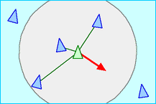
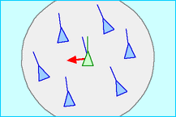
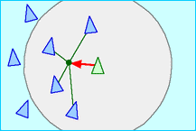
Flocking:
Three simple rules
Separation
Alignment
Cohesion

Slide 38
Flocking:
Other “Rules”
Obstacle avoidance
Changing goals
Wandering
Each boid should have random properties (within a small range)
  Speed
  Acceleration

Slide 39
Flocking:
Computational Difficulties
What if the flock is really big?
What if the objects are irregular?
What if there are “U” shaped obstacles?

Slide 40
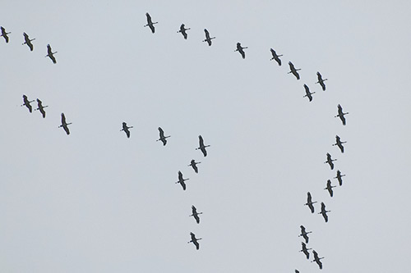
Flocking:
What about this Flock?

Slide 41
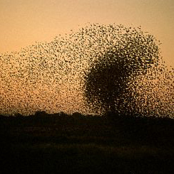
Alternative to Flocking:
Simple Swarms
Computationally simpler
Doesn’t enforce separation or interpenetration
Example
  Hundreds of spiders crawling around, up walls, and dropping from the ceiling
    – Tom Scutt, Tomb Raider series

Slide 42
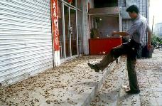
Simple Swarms attacking Player
Outer zone
  If heading toward player: waver heading
  If heading away: steer toward player
Inner zone
  Swirl around player
Flee after random amount of time

Slide 43
Swarm Intelligence
Technique based on collective behavior in decentralized, self-organized systems
  Beni & Wang (1989)
Simple agents interact locally
Global behavior emerges
  Ant colonies
  Bird flocking
  Animal herding
Swarm Robotics
  Combining swarm intelligence with robotics

Slide 44
Swarm Intelligence:
Examples
U.S. military
  Swarm techniques for controlling unmanned vehicles
  Strategic Defense Initiative (tiny pebbles = satellite-based lasers)
NASA
  Swarm technology for planetary mapping
Medical
  Kill cancer tumors with swarming nanobots.
  (1992 paper by M. Anthony Lewis and George A. Bekey)
Movies
  Flocking in Disney's The Lion King was the first movie to make use of swarm technology (the stampede scene).
  Lord of the Rings used emergent behavior during the battle scenes.
Benefits of swarm technology
  Cheap, robust, and simple

Slide 45
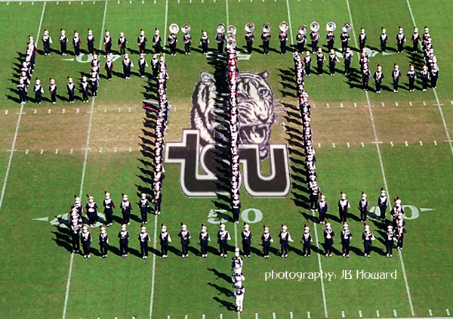
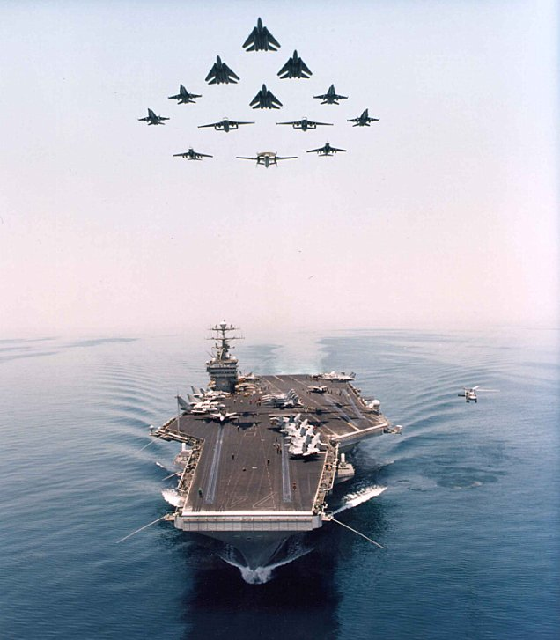

Formations
Mimics military formations
How is it similar to flocking?
How is it different from flocking?
Notes:
How is it similar to flocking?
1. Three flocking rules seem related
How is it different from flocking?
1. Not emergent behavior
2. Each member is told exactly where to go.
3. Someone is leading the formation

Slide 46
Formations
Issues
  Is there a leader?
  Where do individuals steer towards?
  What happens when they turn?
  What happens when they change heading by 180 degrees?
  What happens when there is a narrow pass?
  Formation splitting and reforming?

Slide 47
PID Controller for Steering
Proportional-Integral-Derivative
Feedback-based algorithm
50 year old technique
Used in Need for Speed Underground series to steer cars

Slide 48

PID Controller for Steering
1st term is proportional to the current error
2nd term is proportional to the integral of the error
3rd term is proportional to the derivative of the error
1st is value of current error
2nd is last several values of the error, multiplied by their time-steps, and all added up
3rd is approximated by taking the current error, subtracting previous error, and dividing by time-step

