Slide 1
CS380/CS580:
Artificial Intelligence in Games
Week 5
Steve Rabin
steve.rabin@gmail.com
www.aiwisdom.com/dp
TA: Jay Goldblatt (goldblaj@gmail.com)

Slide 2
Grades
Check them!!!

Slide 3
Questions from Last Week
Pathfinding search spaces?
Pathfinding search algorithms?
Pathfinding terms?

Slide 4
Questions to Ponder
In general, pathfinding search space representations are what kind of data structure?
Name all of the search space representations
Name 3 search space representations that represent the walkable surface area.
If a pathfinding search algorithm is “complete”, then what does it guarantee?
Name 2 search algorithms that are “smart”.
A heuristic estimate is a guess of what?
Why do we care that a heuristic is admissible?
What does it mean for a heuristic to be admissible?
A* is a combination of which two search algorithms?

Slide 5
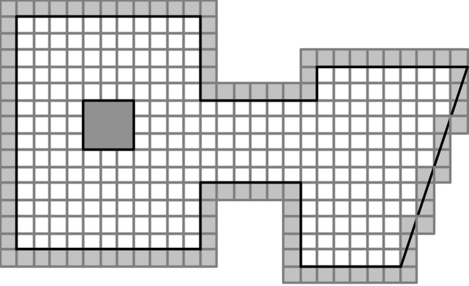
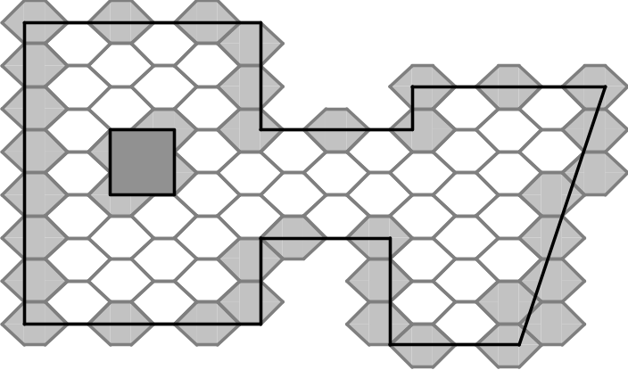
Search Space Representations:
A. _________

Slide 6
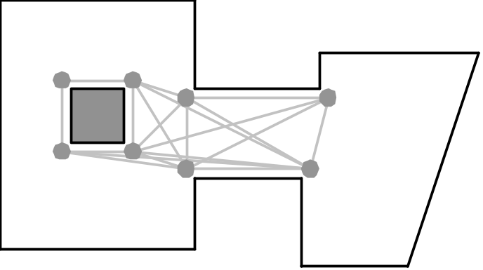
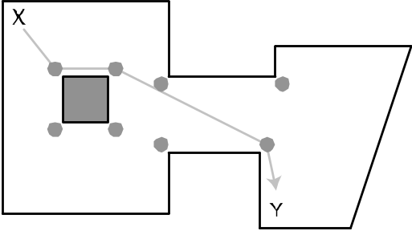

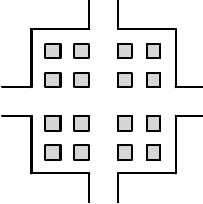
Search Space Representations :
B. _________

Slide 7
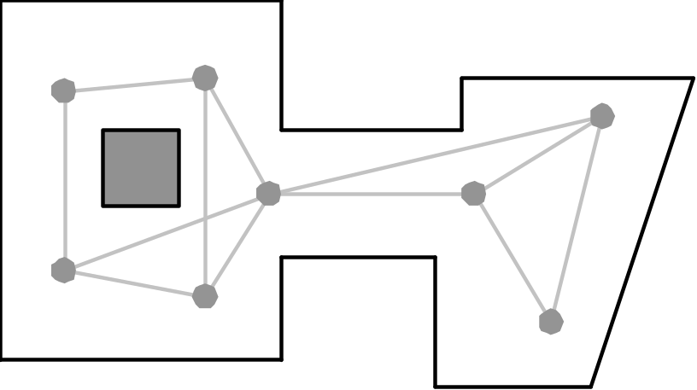
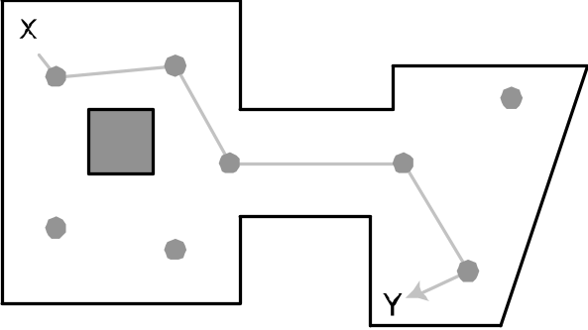
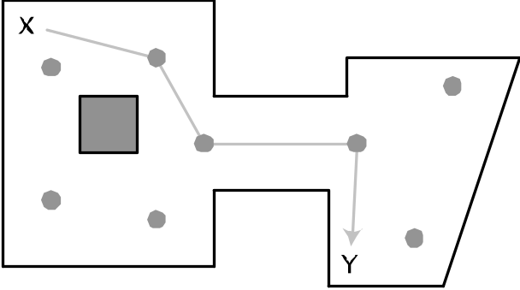
Search Space Representations :
C. _________

Slide 8

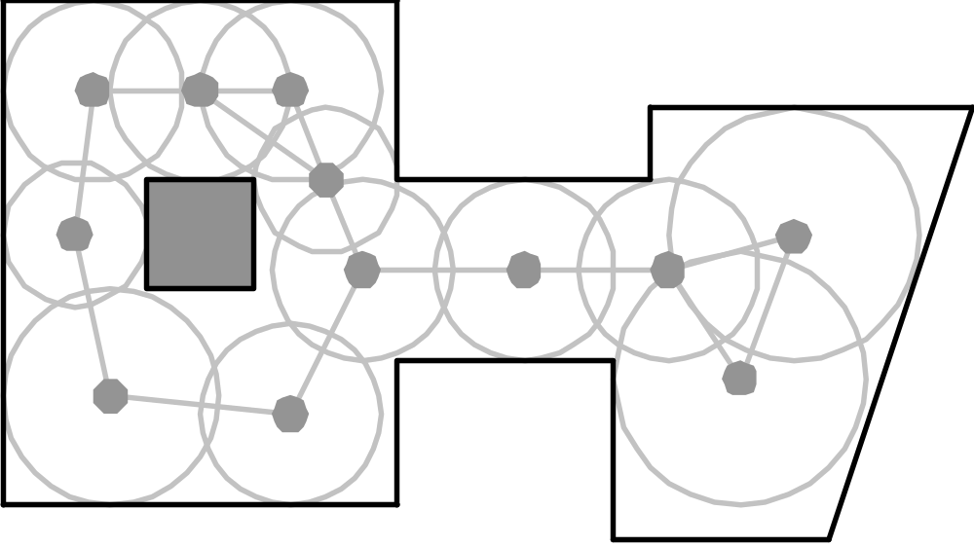
Search Space Representations :
D. _________

Slide 9
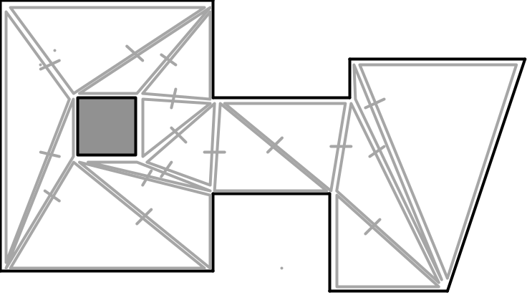
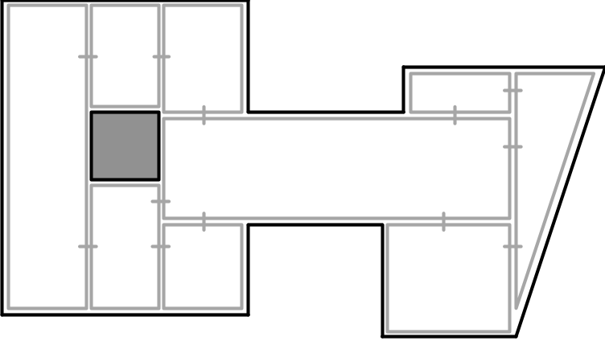
Search Space Representations :
E. _________

Slide 10
Project 2: A* Pathfinding
(due week 6)
Absolute requirement:
  Draw the open list of quads as one color, the closed list of quads as another color, draw the final path, and have Tiny follow the path
Grading
  (20%) Draw one step of A* each frame (use toggle)
  (15%) A path is always found if it exists (completeness)
  (15%) The path is optimal with a heuristic weight of 1.0
  (15%) The path is optimal with a heuristic weight of 0.0, and the search grows in a circular pattern
  (5%) The path uses diagonals and doesn't run into corners
  (5%) Calculate heuristic using Euclidean, Octile, Chebyshev, and Manhattan methods (use toggle)
  (5%) Straightline optimization when possible (use toggle)
  (10%) Rubberband final path where possible (use toggle)
  (10%) Smooth using a Catmull-Rom spline (use toggle)
  (-10%) If it crashes at any time

Slide 11


Project 2:
A* Pathfinding
Extra Credit (bells and whistles)
1 bell = 10% added to project grade
=

Slide 12
Project 2:
A* Pathfinding
Extra Credit
  Implement Floyd-Warshall algorithm (in addition to A*). Must offer on-screen button to toggle on/off.
  Implement Fringe Search (read the paper). Must offer an on-screen toggle to switch between A* and Fringe Search.

Slide 13
Project 2:
A* Pathfinding
Extra Credit
  Be in top 3 fastest class times on a LONG A* search.

Slide 14
Project 2:
A* Pathfinding
Extra Credit
  Implement both a priority queue open list and an unsorted open list. Must offer on-screen button to toggle between.
  Precise rubberbanding taking into account the width of Tiny.

Slide 15
Pathfinding
Search Algorithms

Slide 16
Pathfinding Search Terminology
Search Space – connected graph to be explored
Node – the individual locations of the search space
Start Node – the place where the search will begin
Goal Node – the goal location of the search
Completeness – If a path exists, the search will find it
Heuristic – a function, h(n), that returns an estimate of the cheapest cost from a Node to the Goal Node
Admissible – if h(n) never overestimates the cost of getting to the Goal Node

Slide 17
Open and Closed Lists
Concept of Open and Closed Lists
  Open List: Promising nodes not yet explored
  Closed List: Nodes already explored

Slide 18
Additional Search Algorithms
Depth-First
Iterative Deepening Depth-First
Iterative Deepening A* (IDA*)
Fringe Search

Slide 19
Depth-First
Strategy
  Pick a depth
  Explore all paths at that depth
Benefits
  Complete
  Optimal path found
  Low memory requirement
Improvements?

Slide 20
Iterative Deepening Depth-First
Strategy
  Explore all paths at a particular min depth
    If path found, return path
  Increase depth by 1
    If depth > max depth, no path
  Repeat

Slide 21
Iterative Deepening A*
Proposed by Richard Korf (1985)
Key insight
  Use f(x) as limit (instead of depth)
Strategy
  Explore all paths at a particular min cost
    If path found, return path
  Increase cost by 1
    If cost > max cost, no path
  Repeat

Slide 22
Iterative Deepening A*
Used in some older BioWare games
  Neverwinter Nights
Uses much less memory than A*
Has been shown to explore orders of magnitude more nodes than A*
  Has been shown to be 19x slower than A* on modern PCs and consoles

Slide 23
Fringe Search
Variant of IDA* (invented 2005)
  Stores the frontier (fringe) at the end of each threshold limited search (Now and Later lists)
  Subsequent higher threshold search to restart at that fringe
  Must store fringe + all parent pointers of all nodes examined (Closed list – simplified/compact)
Is estimated to be 10-25% faster than A*
Requires significantly more memory than A*
  4 to 6 times as many nodes as A*
  No Open list to maintain or sort

Slide 24
Diagonal Correctness

Slide 25
Project 2:
A* Pathfinding
START
GOAL

Slide 26
Project 2:
Without Diagonals (Wrong Way)
START
GOAL

Slide 27
Project 2:
With Diagonals (Wrong Way)
START
GOAL

Slide 28
Project 2:
With Diagonals (Right Way)
START
GOAL

Slide 29
Pathfinding Aesthetics

Slide 30
Aesthetic Optimizations
Maximize responsiveness
  How?
Make paths more direct
  Fewer wiggles (rubberbanding)

Slide 31
Project 2: Before Simple (Conservative) Rubberbanding
START
GOAL

Slide 32
Project 2: Look at Node Triplets;
Eliminate Middle if Area is Clear
START
GOAL

Slide 33
Project 2: After Simple (Conservative) Rubberbanding
START
GOAL

Slide 34
Project 2: Look at Node Triplets;
Eliminate Middle if Area is Clear
START
GOAL

Slide 35
Project 2: Look at Node Triplets
Eliminate Middle if Area is Clear
START
GOAL

Slide 36
Project 2: Look at Node Triplets;
Eliminate Middle if Area is Clear
START
GOAL

Slide 37
Project 2:
After Rubberbanding
START
GOAL

Slide 38
Project 2:
Straight Line Optimization
START
GOAL

Slide 39
Project 2:
Straight Line Optimization (test)
START
GOAL

Slide 40
Project 2:
Straight Line Optimization (result)
START
GOAL

Slide 41
Project 2:
Straight Line Optimization
START
GOAL

Slide 42
Project 2:
Straight Line Optimization (test)
START
GOAL

Slide 43
Aesthetic Optimizations:
Smoothed paths
Physics-based
  At movement time – problems?
  On waypoints before movement (demo)
Splines
  Catmull-Rom Spline (Benefits? Problems?)
  Bezier Spline (Benefits? Problems?)

Slide 44
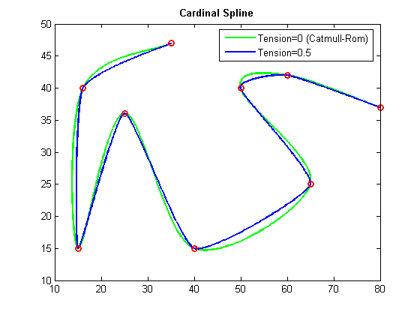
Catmull-Rom Spline
C1 continuity (not C2)
Passes through all control points
http://www.cse.unsw.edu.au/~lambert/splines/CatmullRom.html
http://www.ibiblio.org/e-notes/Splines/Cardinal.htm

Slide 45
Catmull-Rom to Create
In-Between Waypoints
output_point =
point_1 * (-0.5*s*s*s + s*s – 0.5*s) +
point_2 * (1.5*s*s*s + -2.5*s*s + 1.0) +
point_3 * (-1.5*s*s*s + 2.0*s*s + 0.5*s) +
point_4 * (0.5*s*s*s – 0.5*s*s);
Points are waypoints in 3D
s in range [0,1]
  Consider s=0 and s=1
You MUST understand this:
  Creates a new waypoint between point_2 and point_3

Slide 46
Catmull-Rom to Create
In-Between Waypoints (pre-computed)
//s = 0.0
output_point = point_2;
//s = 0.25
output_point = point_1 * -0.0703125 + point_2 * 0.8671875 +
point_3 * 0.2265666 + point_4 * -0.0234375;
//s = 0.5
output_point = point_1 * -0.0625 + point_2 * 0.5625 +
point_3 * 0.5625 + point_4 * -0.0625;
//s = 0.75
output_point = point_1 * -0.0234375 + point_2 * 0.226563 +
point_3 * 0.8671875 + point_4 * -0.0703125;
//s = 1.0
output_point = point_3;

Slide 47
Catmull-Rom in DirectX
D3DXVec2CatmullRom(D3DXVECTOR2* pOut,
CONST D3DXVECTOR2* pV1,
CONST D3DXVECTOR2* pV2,
CONST D3DXVECTOR2* pV3,
CONST D3DXVECTOR2* pV4,
FLOAT s)
D3DXVec3CatmullRom(D3DXVECTOR3* pOut,
CONST D3DXVECTOR3* pV1,
CONST D3DXVECTOR3* pV2,
CONST D3DXVECTOR3* pV3,
CONST D3DXVECTOR3* pV4,
FLOAT s)

Slide 48
Project 2:
After Rubberbanding
START
GOAL

Slide 49
Project 2:
Make Nodes Regularly Spaced
(<= 1.5 away from each other)
START
GOAL

Slide 50
Project 2:
Apply Catmull-Rom Spline
START
GOAL

Slide 51
Project 2:
Apply Catmull-Rom Spline
START
GOAL

Slide 52
Smoothing Waypoints:
Project 2 Directions
Take your generated waypoints list after rubberbanding was OPTIONALLY applied.
Make a new list that has waypoints at least 1.5 grid squares away from each other. Basically, if the distance between any 2 consecutive points is > 1.5, then put a new point between them. Repeat as necessary (recursively?) until all are <= 1.5 from each other.
Make a new list of smoothed points by creating 3 new points in-between every set of waypoints (using 0.25, 0.5, and 0.75 in the spline formula).
Double up on the end-points (see following slides).

Slide 53
Smoothing Waypoints:
Using the Formula
Problem: Get 3 spline points (A, B, C) between waypoints 20 and 21.
Solution:
  New point A: D3DXVec3CatmullRom(A, point19, point20, point21, point 22, 0.25); New point B: D3DXVec3CatmullRom(B, point19, point20, point21, point 22, 0.50);
  New point C: D3DXVec3CatmullRom(A, point19, point20, point21, point 22, 0.75);

Slide 54
Smoothing Waypoints:
Using the Formula (double up at start)
Problem: Get 3 spline points (A, B, C) between waypoints 0 and 1 (0 is first waypoint).
Solution:
  New point A: D3DXVec3CatmullRom(A, point0, point0, point1, point2, 0.25);
  New point B: D3DXVec3CatmullRom(B, point0, point0, point1, point2, 0.50);
  New point C: D3DXVec3CatmullRom(A, point0, point0, point1, point2, 0.75);

Slide 55
Smoothing Waypoints:
Using the Formula (double up at end)
Problem: Get 3 spline points (A, B, C) between waypoints 49 and 50 (50 is last waypoint).
Solution:
  New point A: D3DXVec3CatmullRom(A, point48, point49, point50, point50, 0.25);
  New point B: D3DXVec3CatmullRom(B, point48, point49, point50, point50, 0.50);
  New point C: D3DXVec3CatmullRom(A, point48, point49, point50, point50, 0.75);

Slide 56
Smoothing Waypoints:
Using the Formula
Original Waypoint Path:
  0, 1, 2, 3, 4, 5
Final Smoothed Path:
  0, A_{points:0012,} _{s=0.25}, B_{points:0012,} _{s=0.50}, C_{points:0012,} _{s=0.75},
  1, A_{points:0123,} _{s=0.25}, B_{points:0123,} _{s=0.50}, C_{points:0123,} _{s=0.75},
  2, A_{points:1234,} _{s=0.25}, B_{points:1234,} _{s=0.50}, C_{points:1234,} _{s=0.75},
  3, A_{points:2345,} _{s=0.25}, B_{points:2345,} _{s=0.50}, C_{points:2345,} _{s=0.75},
  4, A_{points:3455,} _{s=0.25}, B_{points:3455,} _{s=0.50}, C_{points:3455,} _{s=0.75},
  5

Slide 57
Project 2:
After Rubberbanding
START
GOAL

Slide 58
Project 2:
Make Nodes Regularly Spaced
(<= 1.5 away from each other)
START
GOAL

Slide 59
Project 2:
Apply Catmull-Rom Spline
START
GOAL

Slide 60
Project 2:
Apply Catmull-Rom Spline
START
GOAL

Slide 61
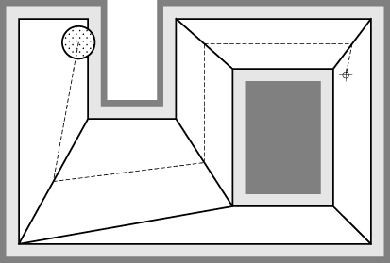
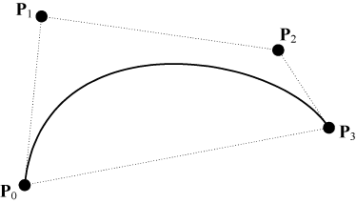
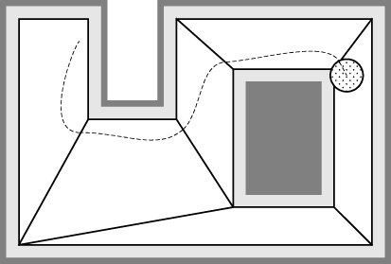
Smoothing with Bezier Splines

Slide 62
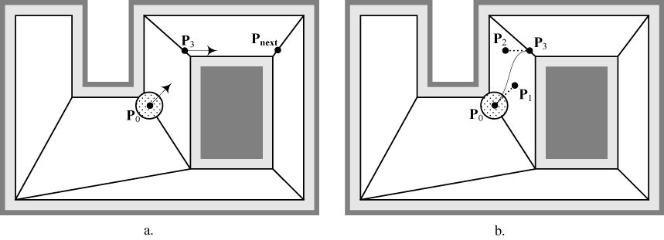
Smoothing with Bezier Splines (2)
P₀ = Current position
P₁ = P₀ + (Normalize(current dir) * K)
P₂ = P₃ – (Normalize(P_{next} – P₃) * K)
P₃ = Next interface

Slide 63
Project 2: A* Pathfinding
(due week 6)
Absolute requirement:
  Draw the open list of quads as one color, the closed list of quads as another color, draw the final path, and have Tiny follow the path
Grading
  (20%) Draw one step of A* each frame (use toggle)
  (15%) A path is always found if it exists (completeness)
  (15%) The path is optimal with a heuristic weight of 1.0
  (15%) The path is optimal with a heuristic weight of 0.0, and the search grows in a circular pattern
  (5%) The path uses diagonals and doesn't run into corners
  (5%) Calculate heuristic using Euclidean, Octile, Chebyshev, and Manhattan methods (use toggle)
  (5%) Straightline optimization when possible (use toggle)
  (10%) Rubberband final path where possible (use toggle)
  (10%) Smooth using a Catmull-Rom spline (use toggle)
  (-10%) If it crashes at any time

Slide 64
A* Speed Optimizations

Slide 65
Heuristic Cost
Guess the distance to the goal
Don't over estimate (to be admissible)
Best heuristic cost algorithm?
  In the general case?
  On a grid?
  What about node-to-node cost?

Slide 66
Heuristic Calculation Options
Manhattan distance
xDiff + yDiff = 9 + 3 = 12

Slide 67
Heuristic Calculation Options
Chebyshev distance
max(xDiff, yDiff) = max(9,3) = 9

Slide 68
Heuristic Calculation Options
Euclidean
sqrt(xDiff² + yDiff²) = sqrt(9²+3²) = 9.48

Slide 69
Heuristic Calculation Options
Octile
min(xDiff,yDiff) * sqrt(2) + max(xDiff,yDiff) – min(xDiff,yDiff) = min(9,3) * 1.41 + max(9,3) – min(9,3) = 10.24

Slide 70
Which are admissible?
(never overestimates the true cost)
Chebyshev distance
Manhattan distance
Euclidean distance
Octile

Slide 71
Which are admissible?
Which one is best?
Chebyshev distance = 9
Manhattan distance = 12
Euclidean distance = 9.48
Octile = 10.24

Slide 72
Open List Sorting
Unsorted Linked List
  Pop: O(n)
  Push: O(1)
  Update: O(n)
Priority Queue (binary tree)
  Pop: O(log n)
  Push: O(log n)
  Update: O(n)
Fibonacci Heap
  Pop: O(log n) *worst case O(n)
  Push: O(1)
  Update: O(n) ???

Slide 73
Overestimating Heuristic Cost
A* combines Best-First and Dijkstra
  Given cost and Heuristic cost
Final cost = Given cost + (Heuristic cost * weight)
  f(x) = g(x) + (h(x) * weight)
  Consider what different weights do
    like 0, 1, and 2
Demo

Slide 74
Cluster Heuristic
From book (p235)
A
B
C
A
x
13
29
Cluster B
13
B
13
x
7
11
12
11
C
29
7
x
8
6
14
15
10
7
13
Precomputed
Table
6
9
8
7
12
10
Cluster A
Cluster C
7
8

Slide 75
Hierarchical Pathfinding
Whiteboard Demo

Slide 76
Other Ideas
Bidirectional pathfinding
  When is it a good idea?
Return partial paths if run out of time
50 NPCs want paths simultaneously
  What’s your strategy?
  Global optimization? http://mrl.nyu.edu/~perlin/experiments/path/
    http://mrl.nyu.edu/~perlin/experiments/path/
Cache failed start-end pairs
Avoid A* altogether
  Test straight line path

Slide 77
A* Speed Enhancements:
Great Ideas
Search Space: Choose one with few nodes
Search Space: Hierarchical pathfinding
Heuristic: Overestimate the heuristic
Heuristic: Optimal heuristic (Euclidean vs Octile)
Heuristic: Cluster heuristic
Heuristic: Keep calculation fast (no sqrt)
A* Not Necessary: Connected zone table
A* Not Necessary: Straight-line test
Fast expanding of nodes
Open list as binary tree
Don’t consider parent node
Implicit closed list (flag in each node)
Fringe search

Slide 78
A* Speed Enhancements:
Terrible Ideas
Work on all paths simultaneously
Bidirectional pathfinding
Cache failed start-end pairs
Return partial paths if run out of time

Slide 79
Precompute All Paths
How would you store it???

Slide 80
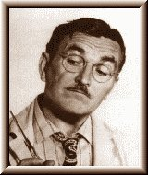
Floyd-Warshall
All-Pairs Shortest Path
Pre-compute ALL paths
Just look up answer in a table!

Slide 81
Floyd-Warshall
All-Pairs Shortest Path Table
A
2
B
 | A | B | C | D | E
A
B
C
D
E
4
3
C
10
D
5
4
E

Slide 82
Floyd-Warshall
All-Pairs Shortest Path O(n³)
int path[][]; //initialize to starting costs
void FloydWarshall()
{
for (k = 1 to n)
{
for each (i,j) in (1..n)
{
path[i][j] = min ( path[i][j],
path[i][k] + path[k][j] );
}
}
}

Slide 83
Floyd-Warshall
All-Pairs Shortest Path Table
A
2
B
 | A | B | C | D | E
A | 0
B |  | 0
C |  |  | 0
D |  |  |  | 0
E |  |  |  |  | 0
4
3
C
10
D
5
4
E

Slide 84
Floyd-Warshall
All-Pairs Shortest Path Table
A
2
B
 | A | B | C | D | E
A |  | 2 | 4
B |  |  |  | 3
C | 4 |  |  | 10
D |  | 3 | 10 |  | 4
E |  |  | 5
4
3
C
10
D
5
4
E

Slide 85
Floyd-Warshall
All-Pairs Shortest Path Table
A
2
B
 | A | B | C | D | E
A | 0 | 2 | 4
B |  | 0 |  | 3
C | 4 |  | 0 | 10
D |  | 3 | 10 | 0 | 4
E |  |  | 5 |  | 0
4
3
C
10
D
5
4
E

Slide 86
Floyd-Warshall
All-Pairs Shortest Path Table
A
2
B
 | A | B | C | D | E
A | 0 | 2 | 4 | ∞ | ∞
B | ∞ | 0 | ∞ | 3 | ∞
C | 4 | ∞ | 0 | 10 | ∞
D | ∞ | 3 | 10 | 0 | 4
E | ∞ | ∞ | 5 | ∞ | 0
4
3
C
10
D
5
4
E

Slide 87
Floyd-Warshall
All-Pairs Shortest Path Table
A
2
B
 | A | B | C | D | E
A | 0 | 2 | 4 | ∞ | ∞
B | ∞ | 0 | ∞ | 3 | ∞
4
3
C
10
D
for (k = 1 to n)
{
for each (i,j) in (1..n)
{
path[i][j] =
min (path[i][j],
path[i][k] + path[k][j]);
}
}
5
4
E

Slide 88
Floyd-Warshall
All-Pairs Shortest Path Table
A
2
B
 | A | B | C | D | E
A | 0 | 2 | 4 | ∞ | ∞
B | ∞ | 0 | ∞ | 3 | ∞
4
3
C
10
D
for (k = 1 to n)
{
for each (i,j) in (1..n)
{ //example i=A, j=D, k=B
path[i][j] =
min (path[i][j],
path[i][k] + path[k][j]);
}
}
5
4
E

Slide 89
Floyd-Warshall
All-Pairs Shortest Path Table
A
2
B
 | A | B | C | D | E
A | 0 | 2 | 4 | 5 | ∞
B | ∞ | 0 | ∞ | 3 | ∞
4
3
C
10
D
for (k = 1 to n)
{
for each (i,j) in (1..n)
{ //example i=A, j=D, k=B
path[i][j] =
min (path[i][j],
path[i][k] + path[k][j]);
}
}
5
4
E

Slide 90
Floyd-Warshall
All-Pairs Shortest Path Table
A
2
B
 | A | B | C | D | E
A | 0 | 2 | 4 | 5 | 9
B | 16 | 0 | 12 | 3 | 7
C | 4 | 6 | 0 | 9 | 13
D | 13 | 3 | 9 | 0 | 4
E | 9 | 11 | 5 | 14 | 0
4
3
C
10
D
5
4
E

Slide 91
Floyd-Warshall
(Represents ideal heuristic)
A
2
B
 | A | B | C | D | E
A | 0 | 2 | 4 | 5 | 9
B | 16 | 0 | 12 | 3 | 7
C | 4 | 6 | 0 | 9 | 13
D | 13 | 3 | 9 | 0 | 4
E | 9 | 11 | 5 | 14 | 0
4
3
C
10
D
5
4
E

Slide 92
Floyd-Warshall Inspired
Next Node Look-up Table
A
2
B
 | A | B | C | D | E
A | A | B | C | B | B
B | D | B | D | D | D
C | A | A | C | A | A
D | E | B | E | D | E
E | C | C | C | C | E
4
3
C
10
D
5
4
E

Slide 93
Floyd-Warshall Inspired
Next Node Look-up Table
Speed of search?
Cost to compute?
What's the downside during runtime?
Which search space representations does it work on?

Slide 94
Company of Heroes
GDC 2007 Presentation

