Slide 1
CS380/CS580:
Artificial Intelligence in Games
Week 7
Steve Rabin
steve.rabin@gmail.com
www.aiwisdom.com/dp
TA: Jay Goldblatt (goldblaj@gmail.com)

Slide 2
Research Proposals Due
Start researching after next week
  Demo and presentation due week 11
  Paper due week 12 (at final)
Text paper or Website???

Slide 3
Questions to Ponder
What quality/property is a good tactical indicator for terrain?
In a combat situation, an influence map is an abstraction of what?
In a combat situation, what can you tell from an influence map?
In planning, ACTIONS have ________ and ________.
What did planning in F.E.A.R use as the heuristic cost?

Slide 4
Project 2 Grades
Posted!
Check each part of your grade
  We make mistakes…

Slide 5
Pathfinding Times:
Long Speed Test (top scores)
RANK | TIME | NAME | NOTES
1 | 701 | Schweiger, Chris | +10%
2 | 1324 | Verholtz, Kevin | +10%
3 | 1762 | Wu, Chia-Wei | +10%
4 | 2314 | Middleditch, Sean
5 | 3512 | Ballard, Colton
6 | 8268 | Zhao, Conghu
7 | 12961 | Maples, Jordan
8 | 15742 | Shedbalkar, Santosh | MEDIAN TIME TO BEAT
9 | 25828 | Sulek, Oliver
10 | 25944 | Davison, Ryan
11 | 26932 | Bae, Kye
12 | 51326 | Ngo, Charlie
13 | 67378 | Liss, Steven
14 | 120644 | Smith-Dalrymple, Gabriel
15 | 5127585 | Srader, Robert
16 | N/A | Young, Brandon

Slide 6
Project 3: Terrain Analysis
Grading
  (10%) Openness Closest Wall
  (10%) Openness Rear Cover
  (10%) Visibility
  (10%) Rear Cover with High Visibility
  (10%) Visible to Player (with 50% sniper spots)
  (10%) Search
  (5%) A* with Analysis
  (35%) Pathfinding with Fog of War
  (-30%) if no faster than median class time
    (you’ll get median exe)
  (0 to -100%) Project 2 requirements regraded
  All Project 2 extra credit still available

Slide 7
Project 3: Terrain Analysis
A* uses Analysis:
  When calculating the given cost, add additional:
    if(useAnalysis)
    {
    givenCost += g_terrain.GetInfluenceMapValue(row, col) * 20;
    }
  Don’t forget to multiply influence value by 20.

Slide 8
Project 3: Fog of War
On every map switch, set all walls to not seen
Only show walls that the agent can see or has seen
On a pathfinding request, use the known walls for the search
While following the path, show any new walls seen
If a new seen wall obscures the current path, repath with all known walls
Questions???

Slide 9
Serious Speed Improvements
Cache all node data in a pre-allocated 2D array
  Build at app init time
  Don’t allocate memory during the search
Do not have an actual Closed list
  Each node has a single enum flag to represent OnOpen, OnClosed, or OnNone
  When path request, init to OnNone only
Use an unsorted Open list
  Push O(1), Pop O(n), Update O(0)
10% speed up (don’t let search backtrack):
  NeighborLoop
  {
  if(neighborNode == parentNode->parent)
  continue;
  }

Slide 10
Esoteric Speed Improvements
Octile equation is really:
  float rowDiff = abs(row0 – row1);
  float colDiff = abs(col0 – col1);
  if( rowDiff < colDiff) { return rowDiff * 0.4142f + colDiff; }
  else { return colDiff * 0.4142f + rowDiff; }
Fast neighbor lookup loop (won’t go off the map):
  const int offsetX[] = { 0, 1, 1, 1, 0, -1, -1, -1};
  const int offsetY[] = {-1, -1, 0, 1, 1, 1, 0, -1};
  for (int i = 0; i < 8; ++i)
  {
  unsigned int neighborRow = parentNode->row + offsetX[i];
  unsigned int neighborCol = parentNode->col + offsetY[i];
  if (neighborRow >= TERRAIN_WIDTH || neighborCol >= TERRAIN_WIDTH)
  continue;
  …
  }

Slide 11
Esoteric Speed Improvements
Don’t recalculate the heuristic if it was already calculated for that node. Extract it back.
  float givenCost = parentNode->givenCost + (isDiagonal ? M_SQRT2 : 1);
  if(neighborNode->status == PathfindingNode::OnNone)
  {
  //Put on Open list
  …
  }
  else if(givenCost < neighborNode->givenCost)
  {
  //Found cheaper way to this node - Update node
  float heuristicCost = neighborNode->finalCost –
  neighborNode->givenCost;
  float finalCost = givenCost + heuristicCost;
  …
  }

Slide 12
Other Speed Improvements?

Slide 13
Game Agents

Slide 14
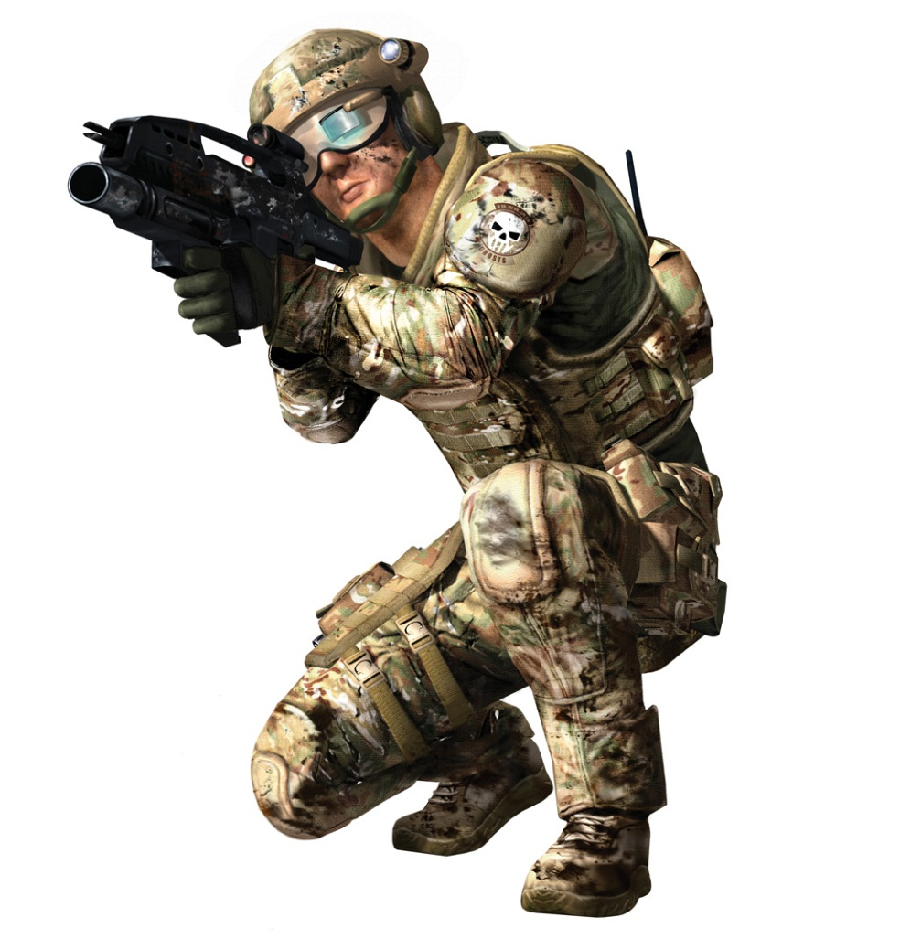
Game Agents
May act as an
  Opponent
  Ally
  Neutral character
Continually loops through the
Sense-Think-Act cycle

Slide 15
Sense-Think-Act Cycle:
Sensing
Agent can have access to perfect information of the game world
  May be expensive/difficult to tease out useful info
Game World Information
  Complete terrain layout
  Location and state of every game object
  Location and state of player
But isn’t this cheating???

Slide 16
Sensing:
Enforcing Limitations
Human limitations?
Limitations such as
  Not knowing about unexplored areas
  Not seeing through walls
  Not knowing location or state of player
Can only know about things seen, heard, or told about
Must create a sensing model

Slide 17
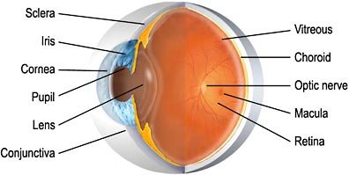
Sensing: Human Vision
Model for Agents
How should we model agent vision?

Slide 18
Sensing: Human Vision
Model for Agents
Get a list of all objects or agents; for each:
  1. Is it within the viewing distance of the agent?
    How far can the agent see?
    What does the code look like?
  2. Is it within the viewing angle of the agent?
    What is the agent’s viewing angle?
    What does the code look like?
  3. Is it unobscured by the environment?
    Most expensive test, so it is purposely last
    What does the code look like?

Slide 19
Sensing:
Human Vision Model for Agents
Player
Wall
View Distance
Enemy

Slide 20
Sensing:
Human Vision Model for Agents
Is it within the viewing angle of the agent?
Viewing Angle
60°
90°
120°
180°

Slide 21
Sensing:
Human Vision Model for Agents
Is it within the viewing angle of the agent?
Viewing Angle
Dot Product
60°
0.866
90°
0.707
120°
0.5
180°
0.0

Slide 22
Sensing:
Human Vision Model for Agents
Is it unobscured by the environment?
  How would you do this better?
  How would you do this perfect?

Slide 23
Sensing:
Human Vision Model for Agents

Slide 24
Sensing:
Human Vision Model for Agents

Slide 25
Sensing:
Human Vision Model for Agents

Slide 26
Sensing:
Human Vision Model for Agents

Slide 27
Sensing:
Human Vision Model for Agents

Slide 28
Sensing:
Human Vision Model for Agents

Slide 29
Sensing:
Human Vision Model for Agents

Slide 30
Sensing:
Human Vision Model for Agents

Slide 31
Sensing:
Human Vision Model for Agents

Slide 32
Sensing:
Human Vision Model for Agents

Slide 33
Sensing:
Human Vision Model for Agents

Slide 34
Sensing:
Human Vision Model for Agents

Slide 35
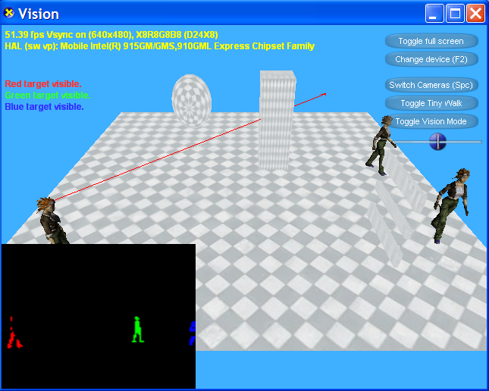
DigiPen Vision Demo

Slide 36
Sensing:
Human Vision Model for Agents
Let's get more real
  Hard to see camouflaged objects
  Hard to see non-moving characters
  Hard to identify peripheral objects
  Hard to identify far away objects
  Vision should be based on head direction, not body direction

Slide 37
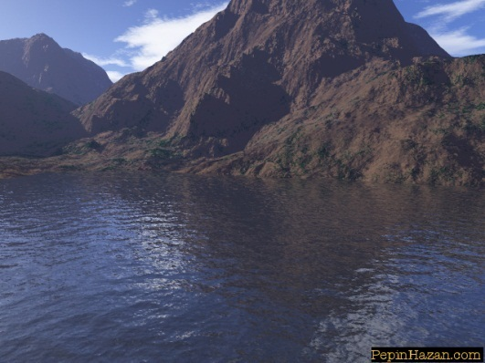
Sensing:
Vision Model
Isn’t vision more than just detecting the existence of objects?
What about recognizing interesting terrain features?
  What would be interesting to an agent?
Demo!

Slide 38
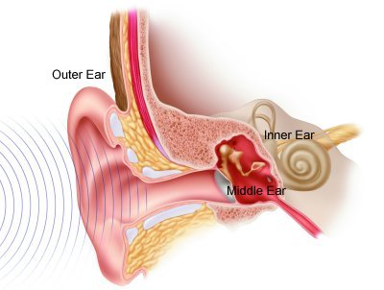
Sensing:
Human Hearing Model
Humans can hear sounds
  Can recognize sounds
    Knows what emits each sound
  Can sense volume
    Indicates distance of sound
  Can sense pitch
    Sounds muffled through walls have more bass
  Can sense location
    Where sound is coming from

Slide 39
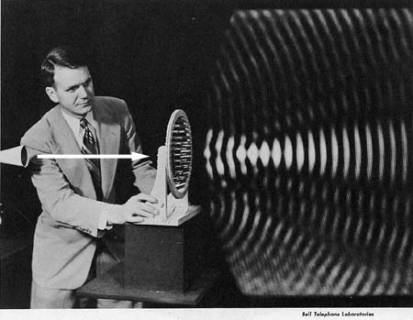
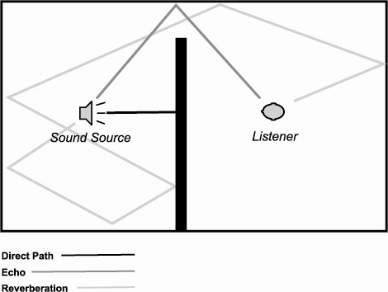
Sensing:
Modeling Hearing
How do you model hearing efficiently?
  Do you model how sounds reflect off every surface?
  How should an agent know about sounds?

Slide 40
Sensing:
Modeling Hearing Efficiently
Event-based approach
  When sound is emitted, it alerts interested agents
Use distance and zones to determine how far sound can travel

Slide 41
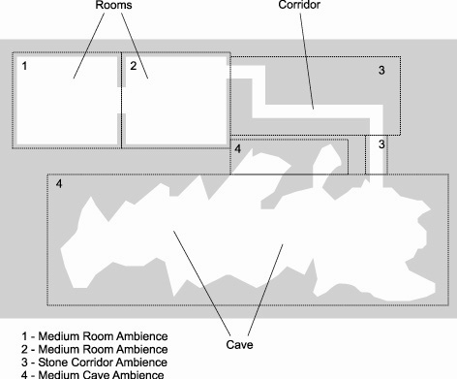
Sensing:
Modeling Hearing Efficiently

Slide 42

Sensing:
Communication
Agents might talk amongst themselves!
  Guards might alert other guards
  Agents witness player location and spread the word
Model sensed knowledge through communication
  Event-driven when agents within vicinity of each other

Slide 43
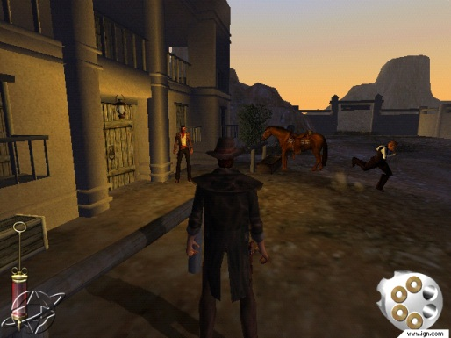
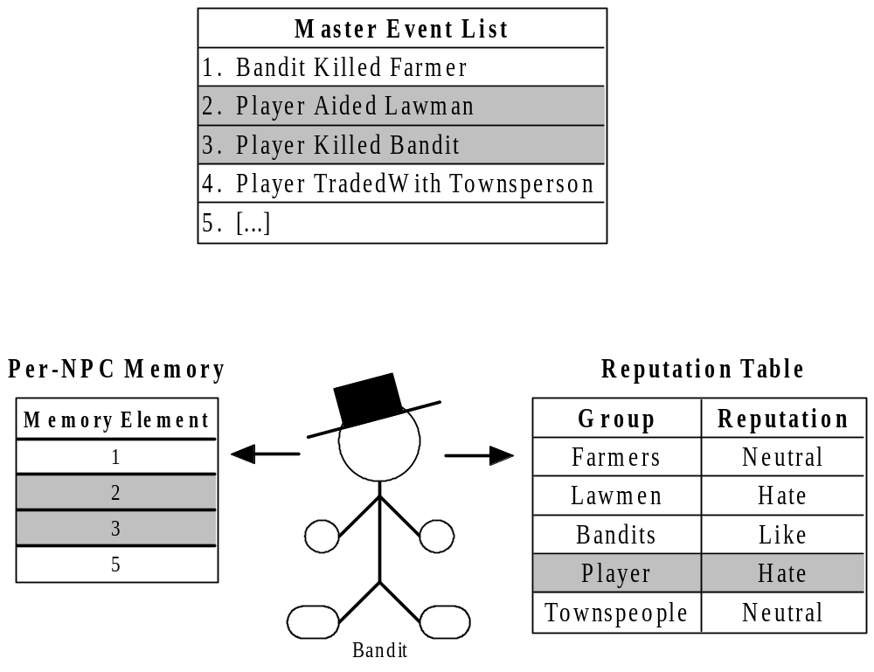
Sensing: Player
Reputation (Gunslinger)
Chapter 8.6 – A Dynamic Reputation System Based on Event Knowledge

Slide 44
Sensing: Player Reputation –
Reputation Event
Subject Group | Player
Verb | DidViolenceTo
Object Group | Bandit
Object Individual | Joe
Magnitude | 75 (Killed)
Where | 50, 20, 138 (In front of Saloon)
When | High noon
Template | KilledBanditTemplate
Reference Count | Known by 11 NPCs
Reputation Effects | Bandits hate player more. Lawmen like player more. Farmers like player more.

Slide 45
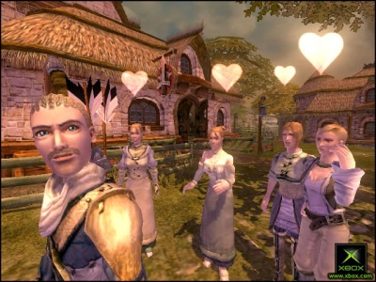
Sensing: Player
Reputation in Fable
Five opinion values are in range [-1,1]
  Morality [Evil, Good]
  Renown [Contemptible, Renowned]
  Scariness [Ridiculous, Scary]
  Agreeableness [Offensive, Agreeable]
  Attractiveness [Ugly, Attractive]

Slide 46
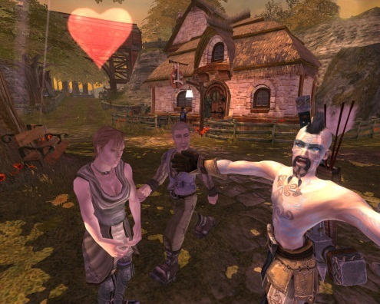
Sensing: Player
Reputation in Fable
Player has hero stats of 5 opinion values
  Player can check at any time
  Player has sense of self
  Unobserved acts have an affect on villagers
Each NPC has a relative opinion
  Only directly witnessed acts or overheard acts
Absolute opinion = hero stats + relative opinion

Slide 47
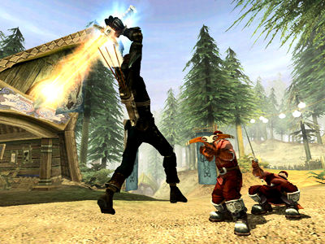
Sensing: Player
Reputation in Fable
Event-driven opinion deeds are posted (like Greg Alt’s article)
  DEED_CRIME_WEAPON_OUT
  DEED_CRIME_VANDALISM
  DEED_EXPRESSION_HEROIC_STANCE
  DEED_EXPRESSION_FLIRT
  DEED_RECEIVE_GIFT_ROMANTIC
  DEED_RECEIVE_GIFT_FRIENDLY
  ...

Slide 48
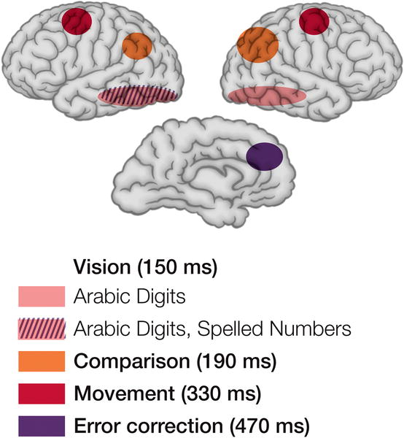
Sensing:
Reaction Times
Agents shouldn’t see, hear, communicate instantaneously
Players notice!
Build in artificial reaction times
  Vision: ¼ to ½ second
  Hearing: ¼ to ½ second
  Communication: > 2 seconds

Slide 49
Sense-Think-Act Cycle:
Thinking
Sensed information gathered
Must process sensed information
Two primary methods
  Process using pre-coded expert knowledge
  Use search to find an optimal solution

Slide 50
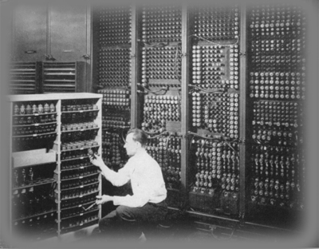
Thinking:
Expert Knowledge
Many different systems
  Finite-state machines
  Behavior Trees
  Production systems
  Planning
  Logical inference
Encoding expert knowledge is appealing because it’s relatively easy
  Can ask just the right questions
  As simple as if-then statements
Problems with expert knowledge
  Not very scalable

Slide 51

Thinking:
Search
Employs search algorithm to find an optimal or near-optimal solution
A* pathfinding common use of search

Slide 52
Thinking:
Machine Learning
If imparting expert knowledge and search are both not reasonable/possible, then machine learning might work
Examples:
  Reinforcement learning
  Neural networks
  Decision tree learning
Not often used by game developers
  Why?

Slide 53
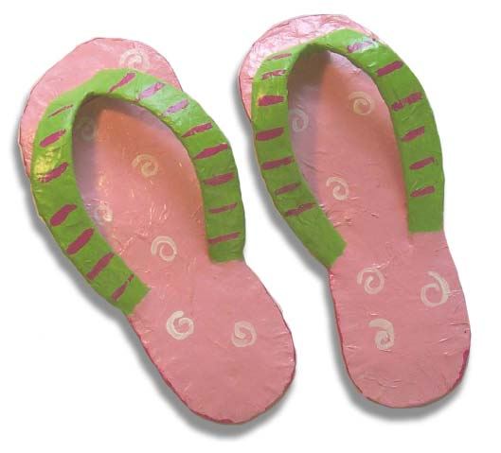
Thinking:
Flip-Flopping Decisions
Must prevent flip-flopping of decisions
Reaction times might help keep it from happening every frame
Must make a decision and stick with it
  Until situation changes enough
  Until enough time has passed
  Baseball example

Slide 54

Sense-Think-Act Cycle:
Acting
Sensing and thinking steps invisible to player
Acting is how player witnesses intelligence
Numerous agent actions, for example:
  Change locations
  Pick up object
  Play animation
  Play sound effect
  Converse with player
  Fire weapon

Slide 55
Acting:
Showing Intelligence
Adeptness and subtlety of actions impact perceived level of intelligence
Enormous burden on asset generation
Agent can only express intelligence in terms of vocabulary of actions
Current games have huge sets of animations/assets
  Must use scalable solutions to make selections

Slide 56
Extra Step in Think Cycle:
Learning and Remembering
Not necessary in many games
  Agents don’t live long enough
  Game design might not desire it

Slide 57
Learning
Remembering outcomes and generalizing to future situations
Simplest approach: gather statistics
  If 80% of time player attacks from left
  Then expect this likely event
Adapts to player behavior

Slide 58

Remembering
Remember hard facts
  Observed states, objects, or players
For example
  Where was the player last seen?
  What weapon did the player have?
  Where did I last see a health pack?
Memories should fade
  Helps keep memory requirements lower
  Simulates poor, imprecise, selective human memory

Slide 59
Remembering within the World
All memory doesn’t need to be stored in the agent – can be stored in the world
For example:
  Agents get slaughtered in a certain area
  Area might begin to “smell of death”
  Agent’s path planning will avoid the area
  Simulates group memory

Slide 60
Game Agent
Cooperation

Slide 61
Game Agent Cooperation
How might agents cooperate?
  With one other NPC?
  In a mob "kung-fu" style?
  In a squad?
  On a baseball team?
  As part of a 5000 person invasion?

Slide 62
Game Agent Cooperation
Three interesting methods
  1. Individuals communicate and arbitrate between themselves
  2. Invisible manager coordinates
  3. Blackboard architecture

Slide 63
Individual Communication
Scalability problem
Requires handshaking and arbitration
Can you imagine doing this with SendMsg and OnMsg?
What is necessary for optimal cooperation?

Slide 64
Manager Cooperation
Agent assignment
  Get list of agents
  Assign each agent a task
Task assignment
  Compose list of tasks
  Prioritize
  Assign tasks to best candidate
Playbook cooperation
  Preplanned assignments based on situation
Exhaustive analysis
  Some permutation of tasks/agents is optimal
    Score every permutation and pick best

Slide 65
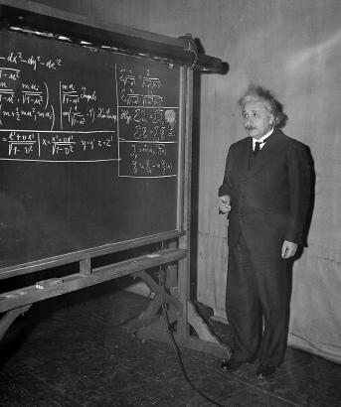
Blackboard Architecture
Complex problem is posted on a shared communication space
  Agents propose solutions
  Solutions scored and selected
  Continues until problem is solved
Alternatively, use concept to facilitate communication and cooperation

Slide 66
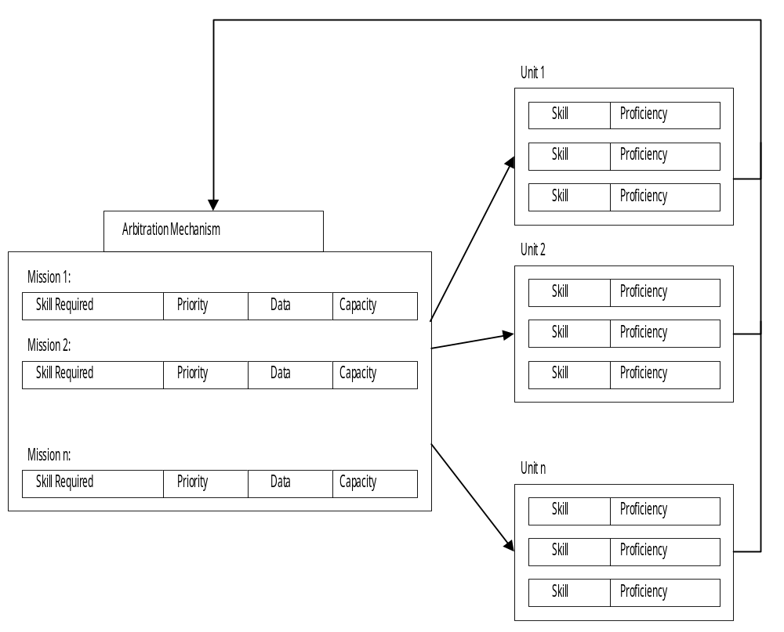
Blackboard Architecture Example
Units compete for missions on blackboard

Slide 67
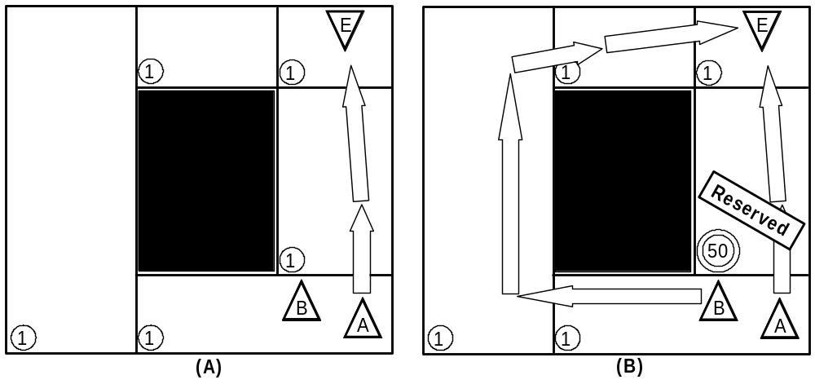
“Blackboard” for Pathfinding

Slide 68
Project 1:
Voting
Baseball
Prey
Rawr
RedLightGreenLight
Soccer
Space Invaders
Spartans Vs Barbarians
Trio

Slide 69
Geek Logic…

