Slide 1
CS380/CS580:
Artificial Intelligence in Games
Week 8
Steve Rabin
steve.rabin@gmail.com
www.aiwisdom.com/dp
TA: Jay Goldblatt (goldblaj@gmail.com)

Slide 2
Questions to Ponder
What is the conceptual “cycle” that agents go through?
Vision can be simulated with what three tests?
In a simplified hearing model, what two factors should be considered to determine if an agent heard a sound?
What is a human’s approximate reaction time (in seconds) for sight or vision?
In the “smell of death” example, what is the terrain is simulating?
What does a blackboard architecture help accomplish?
Jeff Orkin used a blackboard architecture to get agents to pursue the player from different directions. How did he do it?

Slide 3
Learning and Adaptation

Slide 4
Learning and Adaptation
Agenda
Indirect vs direct adaptation
Statistical techniques
  N-gram statistical prediction
  Moving averages
  Player modeling
  Weakness modification learning
Next Week
  Neural networks
  Perceptrons
  Decision tree learning
  Genetic algorithms

Slide 5
AIs that Learn
Why is this desirable?
What does it accomplish?
What games feature AIs that learn?

Slide 6
Fake Learning
How would you fake learning?
Specific games/ideas?

Slide 7
Faking Learning
Applicable in cases when:
  You always know the correct answer
  You can calculate the answer perfectly
Strategy:
  Purposely dumb down the AI in this respect
  Gradually dial up the accuracy with time
Examples:
  FPS – Aiming accuracy
  FPS – Locating health/weapons
  Fighters – Countering player's next move
  RTS – Preparing for where the player will attack

Slide 8
Indirect and Direct Adaptation
Indirect Adaptation
  Game collects statistics that describe events in the game world and uses them to adapt the AI in a preprogrammed way
  Example
    RTS – If player's first assault comes early in a game, AI should focus on military development from the start
Direct Adaptation
  The AI is controlled by a set of parameters that can be optimized directly
  No model is constructed of the game world
  Example
    Neural network to control driving (steering/gas)

Slide 9
Indirect Adaptation
Models must be constructed in-game during gameplay
Must be
  Fast to update
  Fast to query
  Stable and guaranteed to converge
    So the AI doesn't behave erratically

Slide 10
Statistical Learning Techniques
Discuss two main statistical techniques:
  Player modeling
  N-Gram statistical prediction

Slide 11
Moving Averages

Slide 12
Moving Averages:
Estimating Typical Values
Game example
  RTS: Estimate number of seconds from start of game the player usually launches first assault
Two methods to compute moving average
  Single average that is modified each time
  Moving history window

Slide 13
Moving Averages:
Moving History Window
Keep a list of n last values
When a new value is observed
  Push it onto the list
  Pop the last value off the list
    (if history window full)
When an average is needed, sum up the n values and divide by n
How could this be optimized?

Slide 14
Moving Averages:
Moving History Window (optimized)
Keep list of n last values (history window)
Keep sum (S) of all values in window
Average is S/n
When a new value is recorded
  Fix up S
    Add newest value to S
    Subtract oldest value from S
      (only if history window is full)
  Fix up history window
    Add newest value to history window
    Remove oldest value from history window
      (only if history window is full)

Slide 15
Moving Averages:
Estimating Typical Values
Moving Average Equation:
newAve = α · newObservation + (1- α) · ave
  α = Step size parameter
  α usually equal to 1/n
    If 100 observations, α = 1/100
    Keep larger than 1/25 if changes are common
    Keep larger than 1/100 if changes are rare

Slide 16
Moving Averages:
Detecting Changes
The player might change behavior, so how do you detect this?
Have two moving averages and compare
  For example
    One moving average of the last 25 values
    One moving average of the last 100 values
    Compare averages to see if behavior is changing

Slide 17
Estimating Extreme Values
Extreme values can be useful since they represent extremes of risk
Game example
  RTS – Estimate time before which the player is likely to launch an assault with probability of only 1 in 10
    AI can be fairly certain it won't be caught off guard

Slide 18
Player Modeling

Slide 19
Player Modeling:
Overview
Statistical learning technique
Strategy
  Model the player’s behavior
    Record frequency of actions
  Use info to make game harder or easier
    Alternative: Manually set difficulty levels

Slide 20
Player Modeling:
Recording
Record the player’s
  Skills
  Weaknesses
  Preferences
Player model contains
  Numeric attributes or “traits”
  In range [0,1]
Let's brainstorm some traits...

Slide 21
Player Modeling:
Trait Examples
RTS traits
  AvoidsMovingThroughEnemyChokepoints
  AttacksOnTwoFronts
  FortifiesOwnChokepoints
FPS traits
  UsesSmokeGrenades
  AlwaysRuns
  CanDoTrickyJumps

Slide 22
Player Modeling:
Consider Trait Meanings
Trait: UsesSmokeGrenades
Two possible meanings
  Preference (player likes to use them)
  Proficiency (player is good at using them)
Possible better names
  PrefersToUseSmokeGrenades
  GoodAtUsingSmokeGrenades

Slide 23
Player Modeling:
Fine Grained vs. Coarse
Consider trait: UsesSmokeGrenades
Fine grained:
  While retreating
  While entering building
  While covering teammate
Fine grained is
  More costly to design and develop
  More costly to compute

Slide 24
Player Modeling:
Rules of Thumb
1. Every important aspect of gameplay should be captured
2. Design of player model should be tied closely to design of game AI
3. If game AI not designed yet, consider defining player model and building strategies to exploit it

Slide 25
Player Modeling:
Implementation
Observe player
Update record
Use model for AI decisions

Slide 26
Player Modeling:
Step 1 – Observe Player
Option 1: Hardcode observations with events
  Example: CanDoTrickyJumps
    When jump made, detect if difficult and if it was successful
Option 2: Build observation code (state machines) to monitor gameplay
  Decouples logic and keeps it separate and easy to find
Consider sharing tough computations to avoid extra work

Slide 27
Player Modeling:
Step 2 – Update Model
Trait values in range [0,1]
Equation:
  traitValue = α · observedValue + (1- α) · traitValue
  Based upon least mean squares (LMS) training rule commonly used in machine learning
  Recommendation: α between 0.001 and 0.3
Any one observation has limited effect
  More robust in case some observations are faulty

Slide 28
Player Modeling:
Step 3 – Use Model for AI Decisions
Make game harder
  Use as predictive tool
    If AI wants to attack player with a wizard, and player frequently kills wizards with a ranged attack, wizard could preemptively cast spell to protect against ranged attacks
  Look for player deficiencies to exploit
    If player lousy at defending against roundhouse kick, then pick that move more often
  Look for player proficiencies to defend against
    If player always picks up health, try to starve them of it
Make game easier
  Avoid exploiting player deficiencies
    If player never gets shield, don't get shield yourself

Slide 29
Player Modeling:
Hierarchical Player Models
Individual traits can be combined
  How would you make a stealthy trait?
Stealthy trait (abstract) is combo of
  AvoidsCamera (concrete)
  AvoidsGuards (concrete)
  MovesSilently (concrete)
If “Stealthy” trait high
  Make guards more watchful

Slide 30
Player Modeling:
Other Uses
Expose model to player
  Becomes part of gameplay (Fable)
  But might give AI tricks away
Use to help the player by pointing out things they aren’t doing/exploiting
  Fancy AI help system!

Slide 31
Intermission

Slide 32
N-Gram Statistical Prediction:
Your chance to guess...
Sequence | Likely | % | Possible
18181818_

Slide 33
N-Gram Statistical Prediction:
Your chance to guess...
Sequence | Likely | % | Possible
18181818_ | 1 | 99% | 1, 8
1811811818_

Slide 34
N-Gram Statistical Prediction:
Your chance to guess...
Sequence | Likely | % | Possible
18181818_ | 1 | 99% | 1, 8
1811811818_ | 1 | 99% | 1, 8
62562562162_

Slide 35
N-Gram Statistical Prediction:
Your chance to guess...
Sequence | Likely | % | Possible
18181818_ | 1 | 99% | 1, 8
1811811818_ | 1 | 99% | 1, 8
62562562162_ | 5 1 | 66% 33% | 5, 1, 6
9876987_

Slide 36
N-Gram Statistical Prediction:
Your chance to guess...
Sequence | Likely | % | Possible
18181818_ | 1 | 99% | 1, 8
1811811818_ | 1 | 99% | 1, 8
62562562162_ | 5 1 | 66% 33% | 5, 1, 6
9876987_ | 6 | 99% | 6, 7, 8, 9
12312341234512345_

Slide 37
N-Gram Statistical Prediction:
Your chance to guess...
Sequence | Likely | % | Possible
18181818_ | 1 | 99% | 1, 8
1811811818_ | 1 | 99% | 1, 8
62562562162_ | 5 1 | 66% 33% | 5, 1, 6
9876987_ | 6 | 99% | 6, 7, 8, 9
12312341234512345_ | 6 | 99% | 1, 2, 3, 4, 5, 6

Slide 38
N-Gram Statistical Prediction
Used in speech recognition to increase accuracy
  Bi-Gram Model
    blue ____
    toy ____
    raspberry ____
  Tri-Gram Model
    go to _____
    don’t know _____
  Quad-Gram Model
    what is the _____

Slide 39
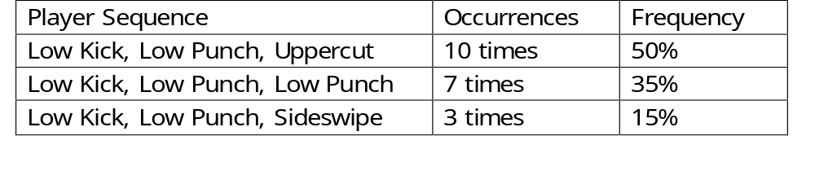
N-Gram Statistical Prediction
N-Gram Technique
  Store history of player moves/actions
  To make a prediction, find instances of the last two moves (Tri-Gram) in the history on-the-fly
    How large should history be?
  Tally each following move
  The most common move is your prediction
    Or roll dice against frequency

Slide 40
N-Gram Statistical Prediction:
Predict the next move
Kick, Punch, Uppercut, Punch, Uppercut, Kick, Punch,
Uppercut, Kick, Kick, Punch, Punch, Kick,
Uppercut, Uppercut, Kick, Punch, Punch, Kick, Punch
Uni-gram, Bi-Gram, Tri-Gram, Quad-Gram
Uni-gram: Punch (7 kick, 8 punch, 5 uppercut)
Bi-Gram: Uppercut (2 kick, 2 punch, 3 uppercut)
Tri-Gram: Punch, Uppercut (2 punch, 2 uppercut)
Quad-Gram: No evidence

Slide 41
N-Gram Statistical Prediction:
Predict chance of uppercut
Kick, Punch, Uppercut, Punch, Uppercut, Kick, Punch,
Uppercut, Kick, Kick, Punch, Punch, Kick,
Uppercut, Uppercut, Kick, Punch, Punch, Kick, Punch
Uni-gram, Bi-Gram, Tri-Gram, Quad-Gram
Uni-gram: 5/20
Bi-Gram: 3/7
Tri-Gram: 2/4
Quad-Gram: 0

Slide 42
N-Gram Statistical Prediction:
Predict next move
Punch, Kick, Punch, Kick, Punch, Kick, Punch, Kick,
Punch, Kick, Punch, Kick, Uppercut, Punch, Kick,
Uppercut, Punch, Kick, Uppercut, Punch, Kick, Uppercut
Punch, Kick, Uppercut, Punch, Kick, Uppercut, Punch, Kick
Bi-Gram for 1st two lines, 2nd two lines, all four lines
1st two lines: Bi-gram: 5 Punch, 1 Uppercut
2nd two lines: Bi-Gram: 0 Punch, 4 Uppercut
All four lines: Bi-Gram: 5 Punch, 6 Uppercut

Slide 43
N-Gram Statistical Prediction
How should statistics be recorded?
  When does the computation occur?
What about modeling fading memory?
What about dealing with changing player behavior?

Slide 44
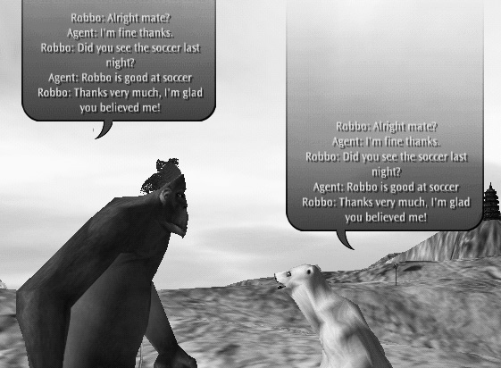
Natural Language Learning

Slide 45
Natural Language Learning
MegaHAL:
  I COULD SHAKE MY TINY FIST AND SWEAR I WASN'T WRONG, BUT WHAT'S THE SENSE IN ARGUING WHEN YOU'RE MUCH TOO BUSY RETURNING TO THE LAVATORY.
Direct question
  User: Who is the smartest person in the world?
  MegaHAL: A PERSON WITH A STICK OF CELERY UNDER HIS ARM?

Slide 46
Naming in Spore
Database of names
  Bi-gram statistics
Start with first 2 letters, grow name statistically
Used to create 1000s of names

Slide 47
Play SNL Video

Slide 48
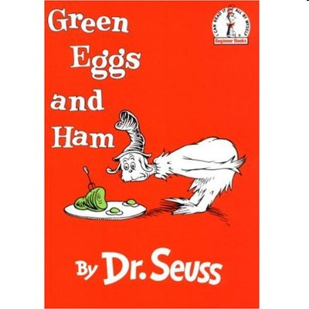
Green Eggs and Ham
Written in 1960
4th best selling children's book of all time
1991 SNL skit was when Dr. Seuss died
Green Eggs and Ham uses only 50 words
  49 of them are single syllable words (anywhere)
  $50 bet from publisher that Dr. Seuss couldn't write a book with only 50 words
  Averages 5.7 words per sentence and 1.02 syllables per word, giving it an exceptionally low Flesch-Kincaid grade level of -1.3

Slide 49
Dr. Seuss Recombinator
In-Class Activity

Slide 50
Recombinator Demo

Slide 51
Sci-Fi Factoid
Intermission Theater

Slide 52
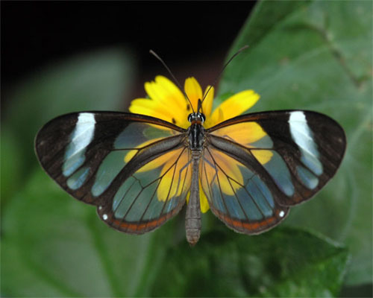
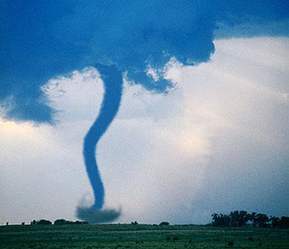
The Butterfly Effect
Idea from chaos theory
Small variations of the initial condition of a dynamical system may produce large variations in long term behavior
"Sensitive dependence upon initial conditions"
  – Edward Lorenz (pioneer of chaos theory, coined "butterfly effect")
Ray Bradbury's short story
"Sound of Thunder" (1952)
  Killing of a butterfly during the time of the dinosaurs causes the future to change in subtle but meaningful ways
A butterfly's wings might cause tiny changes in the atmosphere that might ultimately cause a tornado to appear

Slide 53
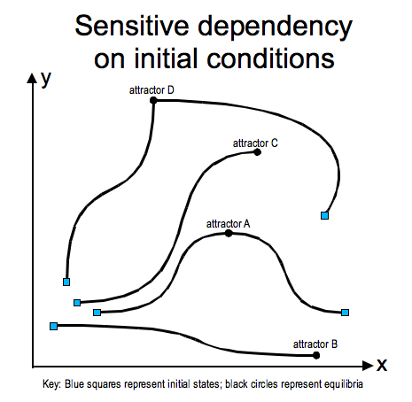
The Butterfly Effect

Slide 54
Economic Factoid
Intermission Theater

Slide 55
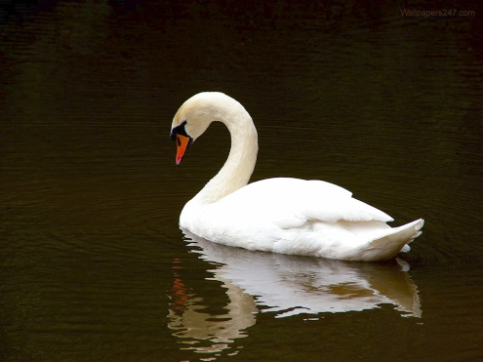
White Swans and Black Swans
The earliest mention of a “black swan” is by a Roman poet in the late 1st century
In 16th century London, a “black swan” was something that was impossible or non-existent
  No one had ever seen a black swan…

Slide 56
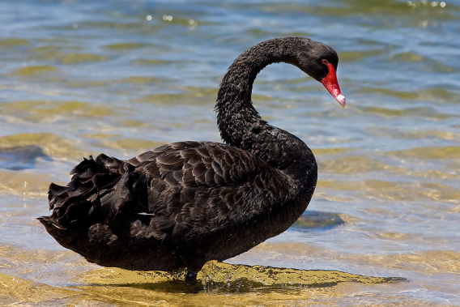
Black Swans
In 1697, black swans were discovered in Western Australia by a Dutch expedition
The term changed:
  A perceived impossibility might later be disproven

Slide 57
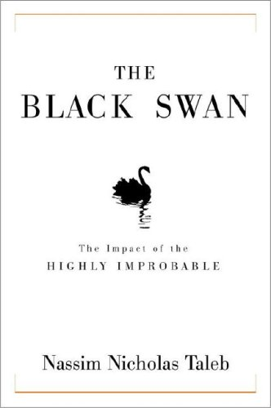
A Black Swan Event
It is an Outlier
  Nothing in the past can convincingly point to its possibility
It has an Extreme Impact
It seems Retrospectively Predictable
  We concoct explanations for its occurrence after the fact
The rise of the Internet, personal computers, World War I, 9/11, penicillin, human beings
How do you predict a black swan event?

Slide 58
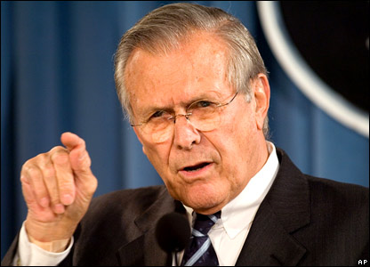
Unknown Unknowns
“There are known knowns; there are things we know that we know.
There are known unknowns; that is to say, there are things that we now know we don’t know.
But there are also unknown unknowns; there are things we do not know we don’t know.”
Unknown Known: Abu Ghraib – disavowed beliefs, suppositions and obscene practices we pretend not to know about

Slide 59

Las Vegas Casino
Risks…
  What are the Known Knowns?
  What are Known Unknowns?
  What would be an Unknown Unknown?

Slide 60

Las Vegas Casino:
4 Black Swan Events
Owner’s daughter kidnapped
Disgruntled construction worker
IRS forms
The star act

Slide 61
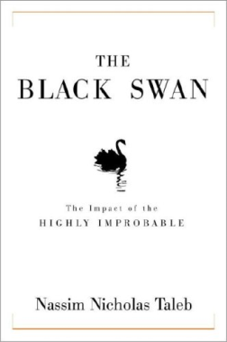
A Black Swan Event
A small number of Black Swans explains almost everything in our world, from the success of ideas and religions, to the dynamics of historical events, to elements of our own personal lives
Almost all major scientific discoveries, historical events, and artistic accomplishments
What are some Black Swan Events in the video game industry? (positive or negative)

Slide 62
A Black Swan Event:
Guarding Against Them…
Redundancy in design of systems
  Consider nature and biological systems
  Because if you only have one and it fails, then you’re screwed
Don’t put most of your eggs in one basket if it has a very small chance of failing
Imagine you have a high mortgage and a car payment (loaded with debt)
  If a Black Swan Event hits you, you’re toast

Slide 63
A Black Swan Event:
Encouraging Good Ones…
Meet lots of people
Expose yourself to many ideas
Take advantage of opportunities
Take many risks with little downside
Investing in innovation
  Google’s 20% time
  Venture capitalists
    (fixed downside, limitless upside)
Hedge 80% on safest path, 20% on risk with huge upside
Notes:
Informal Learning:
Learning with no particular outcome in mind
Learning for learning sake
Learning that mightn't look like learning
Learning directed by the individual, not the workplace
Learning with no set time, no set place

Slide 64
Back to Your Regularly Scheduled Lecture

Slide 65
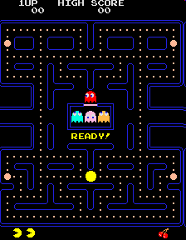
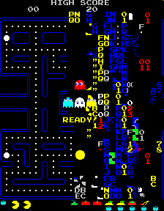
Pac-Man Golden Path
Screen crash at the 256th level....

Slide 66
"Golden Path" Problem
Unintended weaknesses might slip into a shipping game
If weakness is discovered by player, the game is ruined
Also known a “Black Swan”
How can we fix this?

Slide 67
Weakness Modification Learning
Technique developed by Jack van Ryswyck (University of Alberta) in collaboration with EA Canada for the FIFA soccer franchise

Slide 68
Weakness Modification Learning
Problem
  Players will repeatedly exploit a weakness
    Known as the “Golden Path” problem
Strategy
  Determine when a weakness occurs
    Next time alter behavior slightly when it looks like it'll happen again
  Ensure “history does not repeat itself”
  Small change in past results in big change in future
Is this a statistical learning technique?
Soccer Example

Slide 69
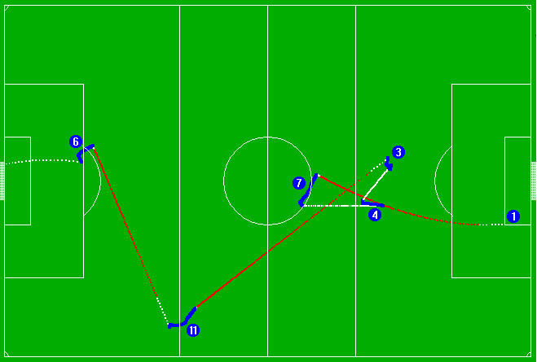
Weakness Modification Learning:
Soccer Example (van Ryswyck)

Slide 70
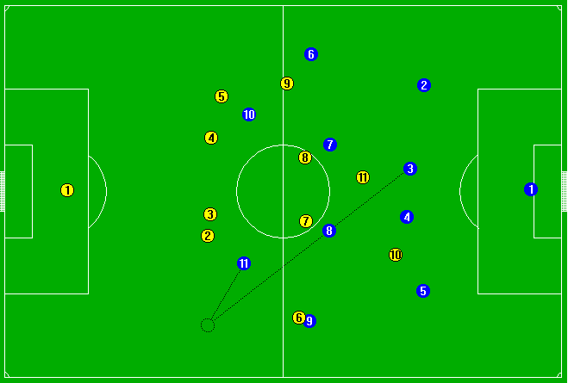
Weakness Modification Learning:
Soccer Example (van Ryswyck)

Slide 71
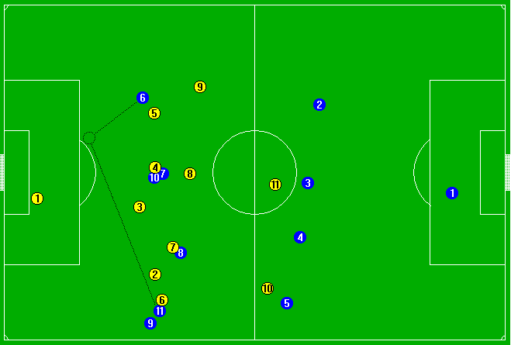
Weakness Modification Learning:
Soccer Example (van Ryswyck)

Slide 72
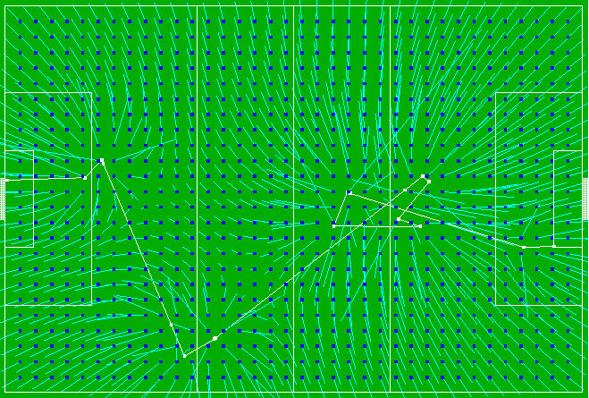
Weakness Modification Learning:
Soccer Example (van Ryswyck)

Slide 73
Weakness Modification Learning
AI does not win more often
AI retains behavioral flavor
  Does not change large scale perceived behavior
Learning done with one example!

Slide 74
Actual Golden Paths
FIFA 07
  "Came across this by accident, when ever u get hold of the ball, don't run/sprint with it just head in the direction of goal the player who is marking u will turn around and run along with u and not attempt to tackle u. leaving u free to run into box and slide it into goal, works everytime bar hitting the post or shooting it wide... its that bad your goal keeper can also score... also works on the 360 demo...."
  – CheekieMonkiee, GameSpot Forum
Madden 09
  “Want to know how to win in Madden 09... EVERY time? Pick Tampa playbook go to shotgun formation.. pick any formation that has HB direct snap. hold right trigger presnap, press button of WR... snap the ball and the receiver will start the play with the ball. u can even snap the ball to the WR when hes in motion.”
  – sonasty

