Slide 1
CS380/CS580:
Artificial Intelligence in Games
Week 9
Steve Rabin
steve.rabin@gmail.com
www.aiwisdom.com/dp
TA: Jay Goldblatt (goldblaj@gmail.com)

Slide 2
Questions to Ponder
1. Describe indirect learning.
2. Describe direct learning.
3. In player modeling, UsesRocketLauncher is a ______.
4. UsesRocketLauncher can have a value in what range?
5. In player modeling, these things we’re tracking could describe a player’s ______, ______, or _______.
6. Using a Bi-Gram, find the probabilities for possible next actions in the following sequence:
kick, punch, kick, sideswipe, punch, kick, kick, kick, punch, punch, kick, kick, punch, kick, …

Slide 3
Research Project
Work on this!
Talk to me if you need any guidence
Demos should illustrate the research
  Show the result of the algorithm
  Show how the algorithm works
Papers
  Professional, yet friendly
  Indistinguishable from a Game Programming Gems or AI Game Programming Wisdom article

Slide 4
Quick and Dirty Intro to Neural Networks

Slide 5
Neural Networks
What are they?
  Based on biological neurons in the brain
  NNs are complex non-linear functions that relate one or more input variables to an output variable
  NNs are a series of identical non-linear processing elements (analogous to neurons) connected together in a network by weights (analogous to synapses).

Slide 6
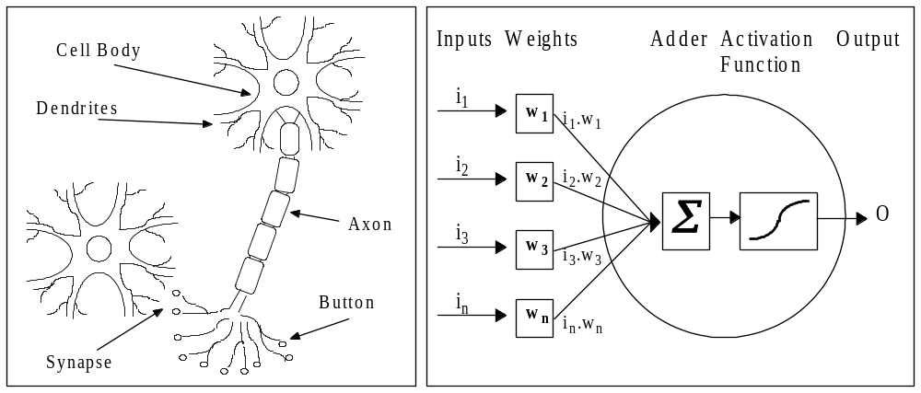
Neural Networks

Slide 7
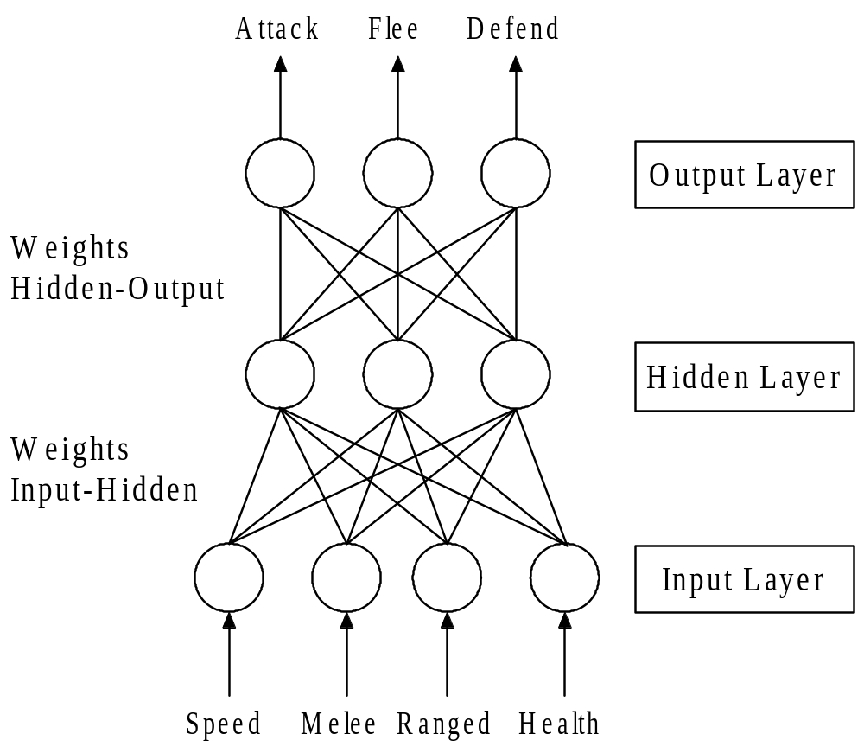
Neural Networks

Slide 8
Neural Networks
Must be trained to produce a particular function
  Show it examples of inputs and outputs
  Weights adjusted to minimize error between output and desired output (Backpropagation)
  Can require hundreds or thousands of examples
  Computationally intensive
  For games, training must be done offline
    Not guaranteed to learn the right thing
    Requires too many examples
Blazingly fast once it is trained and frozen

Slide 9
Neural Networks
What are neural networks really good at?
  Face and fingerprint recognition
  Handwriting recognition
  Gesture recognition
NNs excel at taking noisy data and processing it to produce a match
Game success stories
  Colin McRae Rally 2.0: Steering racing cars
  Forza Motorsport "Drivatar"
  Creatures: Control and learning
Bottom line:
  Statistically, game developers are not using NNs

Slide 10
Perceptrons
Perceptron network is simpler version of a NN
  Single-layer neural network
  Easier to train than an NN or decision tree
  Each perceptron outputs a “yes” or “no”
    Either it gets stimulated enough to trigger, or it does not
  Can learn Boolean decisions such as attack or don’t attack
  Drawback: Can only learn simple (linearly separable) functions

Slide 11
Perceptrons:
Black & White Example
Three inputs used to determine if Creature was hungry
  hunger, tasty food, unhappiness
If Creature ate and received positive or negative feedback, then weights were adjusted, thus facilitating learning

Slide 12
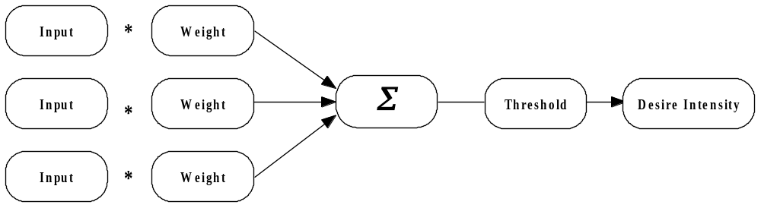
Perceptrons:
Black & White Example
Inputs
  Hunger
  Tasty food
  Unhappiness

Slide 13
Perceptrons:
Black & White Example
Desire Sources |  |  |  |  |  | Actual | Intended (Feedback)
Hunger |  | Tastiness |  | Unhappiness
Value | Weight | Value | Weight | Value | Weight
0.8 | 0.500 | 0.8 | 0.500 | 0 | 0.500 | 0.8 | 1.000
0.8 | 0.564 | 0.2 | 0.564 | 0 | 0.500 | 0.564 | 1.000
0.1 | 0.599 | 0.6 | 0.573 | 0 | 0.500 | 0.404 | 0.200
0 | 0.597 | 0 | 0.560 | 1 | 0.5 | 0.5 | 0.002
0.3 | 0.597 | 0.4 | 0.560 | 1 | 0.450 | 0.853 | 0.400
- | 0.58341 | - | 0.542 | - | 0.4047 | - | -

Slide 14
Decision Tree
Relates inputs from game world to an output representing something you want to predict
  Series of rules arranged in a tree structure
Example: Will bot survive engagement with player?
  Is bot’s health low?
    Yes: will not survive
    No: check next question
  Is bot’s ammunition low?
    Yes: will not survive
    No: will survive
Important for learning
  Algorithms exist to create decision trees in near real-time (ID3)
Yes
Health
Low?
No
Die
Yes
Ammo
Low?
No
Die
Live

Slide 15
Decision Tree Learning:
Black & White Example
What objects will satisfy a Creature’s desire to eat?
Scenario
  Creature eats something
  Creature gets either positive or negative feedback
    Player can stroke or slap Creature
    Certain objects are tastier than others
  Decision tree is created that reflects feedback and past experience
  Decision tree influences future decisions to eat a particular object

Slide 16
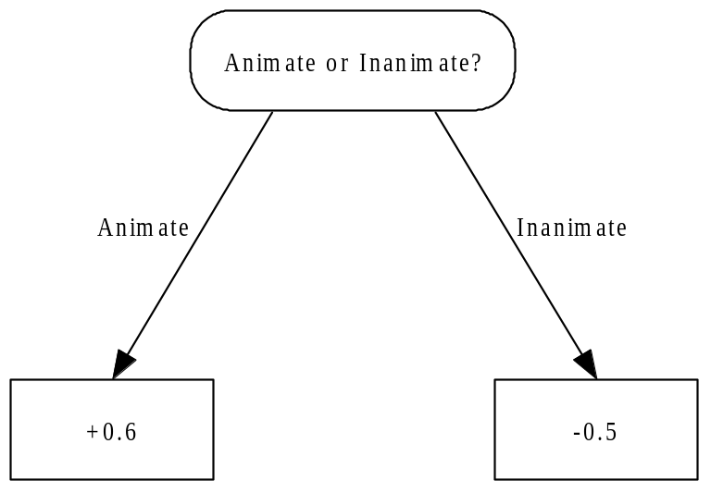
Decision Tree Learning:
Black & White Example
What Creature Ate | Feedback (how tasty)
A big rock | -1.0
A small rock | -0.5
A small rock | -0.4
A tree | -0.2
A cow | +0.6

Slide 17
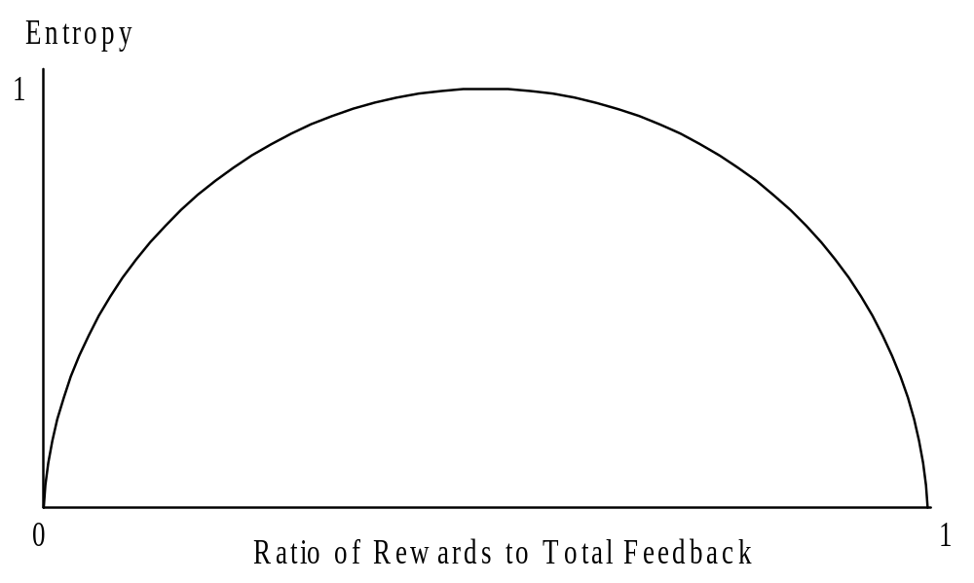
Decision Tree Learning:
Minimizing Entropy
Pick decisions that minimize entropy
  Random outcomes result in entropy of 1

Slide 18
Decision Tree Learning:
Anger Decision Tree
What Creature Attacked | Feedback from Player
Friendly, weak, Celtic | -1.0
Enemy, weak, Celtic | +0.4
Friendly, strong, Norse | -1.0
Enemy, strong, Norse | -0.2
Friendly, weak, Greek | -1.0
Enemy, medium, Greek | +0.2
Enemy, strong, Greek | -0.4
Enemy, medium, Aztec | 0.0
Friendly, weak, Aztec | -1.0

Slide 19
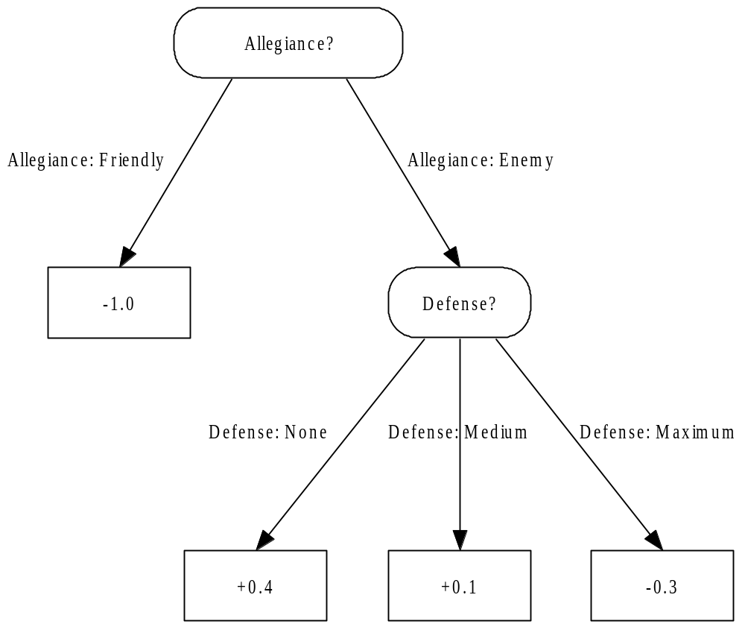
Decision Tree Learning:
Anger Decision Tree

Slide 20
Decision Tree Learning:
Anger Decision Tree
What Creature Attacked | Feedback from Player
Friendly, weak, Celtic | -1.0
Enemy, weak, Celtic | +0.4
Friendly, strong, Norse | -1.0
Enemy, strong, Norse | -0.2
Friendly, weak, Greek | -1.0
Enemy, medium, Greek | +0.2
Enemy, strong, Greek | -0.4
Enemy, medium, Aztec | 0.0
Friendly, weak, Aztec | -1.0

Slide 21
Decision Tree Learning:
Anger Decision Tree
What Creature Attacked | Feedback from Player
Friendly, weak, Celtic | -1.0
Enemy, weak, Celtic | +0.4
Friendly, strong, Norse | -1.0
Enemy, strong, Norse | -0.2
Friendly, weak, Greek | -1.0
Enemy, medium, Greek | +0.2
Enemy, strong, Greek | -0.4
Enemy, medium, Aztec | 0.0
Friendly, weak, Aztec | -1.0

Slide 22
Genetic Algorithms

Slide 23
Genetic Algorithms
Based on evolutionary principals
  Collection of genes forms a chromosome
  All combinations of genes defines the search space
  A chromosome defines a point in the search space
Technique
  Create a population of chromosomes
  Select the best chromosomes
  Mate best chromosomes to create a new generation
    Crossover
    Mutation
    Elitism
GAs outperform many other techniques when search space contains many optima

Slide 24
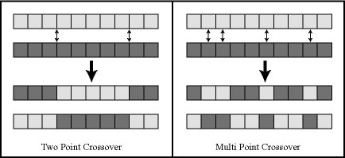
Genetic Algorithms:
Crossover

Slide 25
Genetic Algorithms
Extremely interesting and fascinating technology
What is it used for?
  Optimization technique to find a solution
  Most useful when the search space is poorly understood
Unfortunately, not very useful for game development
  Too slow for real-time
  Not guaranteed to find an optimal solution
  Can be used during development to discover the best combination of settings
    If game changes slightly during tuning, GA result is likely invalid

Slide 26
Genetic Algorithms
Demo
Genome encoding:
  Steering | Throttle | Steering | Throttle | …

Slide 27
Movie Time!

Slide 28
Gesture Recognition
What kind of algorithm can do this?
Generalizing from examples?
  How?
Comparing against examples?
  How?

Slide 29
Gesture Recognition:
Steps
Record gesture
  Must know when gesture starts and stops!
  Holding a button or passing a threshold
Process Gesture
  Position independence
  Size independence
  Irregularities
  Redundant data
  Feature extraction
Apply matching algorithm

Slide 30
Gesture Recognition:
Processing
processing

Slide 31
Gesture Recognition:
Processing
Normalize size
Target length
Target segments

Slide 32
Gesture Recognition:
Nearest Neighbor
Example 1
Example 2
Example 3
Which example best
matches the player's???
Player Move

Slide 33
Gesture Recognition:
Nearest Neighbor
error = 0°
error = 90°
error = 90°
Example 1
Example 2
Example 3

Slide 34
Gesture Recognition:
Nearest Neighbor
error = 45°
error = 45°
error = 0°
Example 1
Example 2
Example 3

Slide 35
Gesture Recognition:
Nearest Neighbor
error = 45°
error = 0°
error = 0°
Example 1
Example 2
Example 3

Slide 36
Gesture Recognition:
Nearest Neighbor
0+45+45=90
90+45+0=135
90+0+0=90
Example 1
Example 2
Example 3
Player Move

Slide 37
Gesture Recognition:
Nearest Neighbor
0+452+452=4050
902+452+0=10125
902+0+0=8100
Example 1
Example 2
Example 3
Square the
individual error,
then sum!!!
Player Move

Slide 38
Gesture Recognition
Compare the vectors and perform nearest neighbor

Slide 39
Gesture Recognition
Demo!

Slide 40
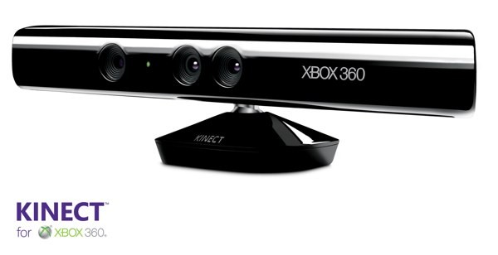
Microsoft’s
Kinect
$149.99 at retail
  Sold 10M+ so far
  $56 worth of parts
    $17 for PrimeSense motion detector
$500M ad campaign during Christmas
  Ad spending was $100 per Kinect sold

Slide 41
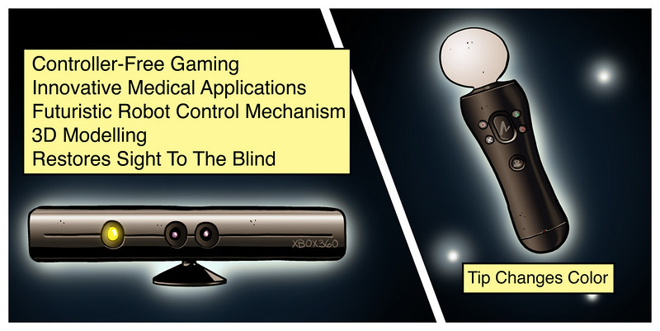


Slide 42
“Microsoft exec caught in privacy snafu, says Kinect might tailor ads to you”
From Engadget.com:
Microsoft's Dennis Durkin voiced an interesting idea at an investment summit last week – the idea that the company's Kinect camera might pass data to advertisers about the way you look, play and speak. "We can cater what content gets presented to you based on who you are," he told investors, suggesting that the Kinect offered business opportunities that weren't possible "in a controller-based world."

Slide 43
“Microsoft exec caught in privacy snafu, says Kinect might tailor ads to you”
“And over time that will help us be more targeted about what content choices we present, what advertising we present, how we get better feedback. And data about how many people are in a room when an advertisement is shown, how many people are in a room when a game is being played, how are those people engaged with the game? How are they engaged with a sporting event? Are they standing up? Are they excited? Are they wearing Seahawks jerseys?”
– Microsoft's Dennis Durkin

Slide 44
“Microsoft exec caught in privacy snafu, says Kinect might tailor ads to you”
From Engadget.com:
…but moreover it's explicitly against the privacy policy Microsoft presents Kinect users. "Third party partners use aggregated data to deliver Kinect experiences (games or applications), to understand how customers use their Kinect experiences, and to improve performance or even to help plan new experiences," the Kinect Privacy and Online Safety FAQ reads, but also "They are not permitted to use the information for marketing purposes such as selling you games or services, or for personalizing advertising."

Slide 45
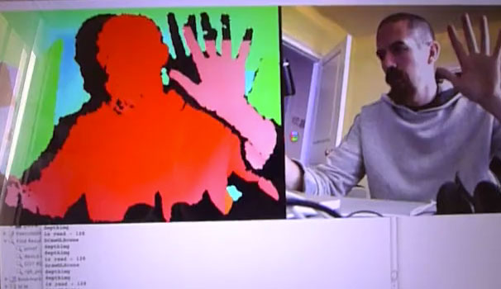
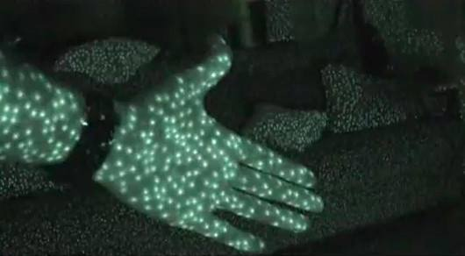
Kinect:
Depth Camera

Slide 46
Kinect:
Depth Camera
http://www.youtube.com/watch?v=nvvQJxgykcU&feature=player_embedded

Slide 47
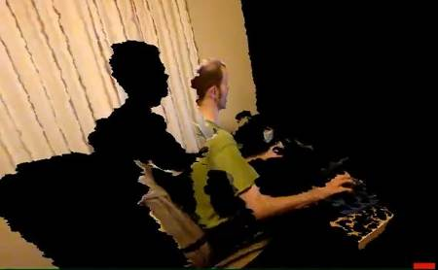
Kinect:
Depth Camera
http://www.youtube.com/watch?v=7QrnwoO1-8A

Slide 48
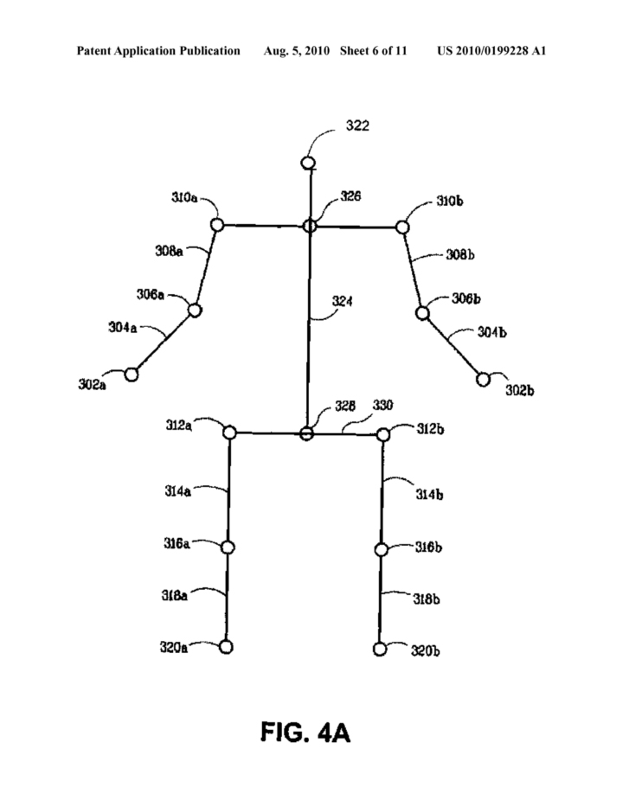
Kinect:
Your Bones

Slide 49

Kinect:
Skeleton Patent
“To determine whether a target or object in the scene corresponds to a human target, each of the targets may be flood filled and compared to a pattern of a human body model. Each target or object that matches the human body model may then be scanned to generate a skeletal model associated therewith. The skeletal model may then be provided to the computing environment such that the computing environment may track the skeletal model, render an avatar associated with the skeletal model, and may determine which controls to perform in an application executing on the computing environment based on, for example, gestures of the user that have been recognized from the skeletal model. A gesture recognizer engine, the architecture of which is described more fully below, is used to determine when a particular gesture has been made by the user.”

Slide 50
Kinect:
Skeleton from a Point Cloud
Recorded hundreds of people moving in front of depth camera
Manually hand labeled a skeleton on top of every frame
Recorded similar mocap data to movements
Machine learning to match noisy data to a skeleton (with probabilities)

Slide 51
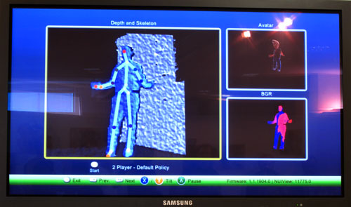
Kinect: Skeleton

Slide 52
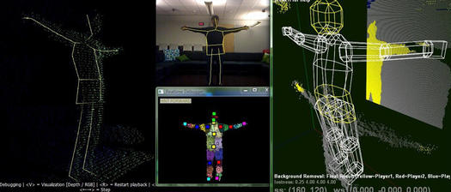
Kinect Step 1:
(from Popular Mechanics, Jan 2010)
As you stand in front of the camera, it judges the distance to different points on your body. In the image on the far left, the dots show what it sees, a so-called "point cloud" representing a 3-D surface; a skeleton drawn there is simply a rudimentary guess. (The image on the top shows the image perceived by the color camera.)

Slide 53
Kinect Step 2:
(from Popular Mechanics, Jan 2010)
Then the brain guesses which parts of your body are which. It does this based on all of its experience with body poses. Depending on how similar your pose is to things it's seen before, Natal can be more or less confident of its guesses. In the color-coded person (bottom center), the darkness, lightness, and size of different squares represent how certain Natal is that it knows what body-part that area belongs to.

Slide 54
Kinect Step 2 (continued):
(from Popular Mechanics, Jan 2010)
(For example, the three large red squares indicate that it’s highly probable that those parts are “left shoulder,” “left elbow” and “left knee"; as the pixels become smaller and muddier in color, such as the grayish pixels around the hands, that’s an indication that Natal is hedging its bets and isn’t very sure of its identity.)

Slide 55
Kinect Step 3:
(from Popular Mechanics, Jan 2010)
Then, based on the probabilities assigned to different areas, Natal comes up with all possible skeletons that could fit with those body parts. (This step isn't shown in the image, but it looks similar to the stick-figure drawn on the left, except there are dozens of possible skeletons overlaid on each other.) It ultimately settles on the most probable one. Its reasoning here is partly based on its experience, and partly on more formal kinematics models that programmers added in.

Slide 56
Kinect Step 4:
(from Popular Mechanics, Jan 2010)
Once Natal has determined it has enough certainty about enough body parts to pick the most probable skeletal structure, it outputs that shape to a simplified 3D avatar [image at right]. That’s the final skeleton that will be skinned with clothes, hair, and other features and shown in the game.

Slide 57
Kinect Step 4:
(from Popular Mechanics, Jan 2010)
Once Natal has determined it has enough certainty about enough body parts to pick the most probable skeletal structure, it outputs that shape to a simplified 3D avatar [image at right]. That’s the final skeleton that will be skinned with clothes, hair, and other features and shown in the game.

Slide 58
Kinect Gesture Recognition?
Microsoft doesn’t distribute any code to recognize poses or gestures
  Maybe because it’s a patent minefield…
The Kinect SDK just outputs raw skeleton poses
  Up to individual developers to figure out how to use raw skeleton data

