Slide 1

Viewing & Perspective
CSE167: Computer Graphics
Instructor: Steve Rotenberg
UCSD, Fall 2005

Slide 2
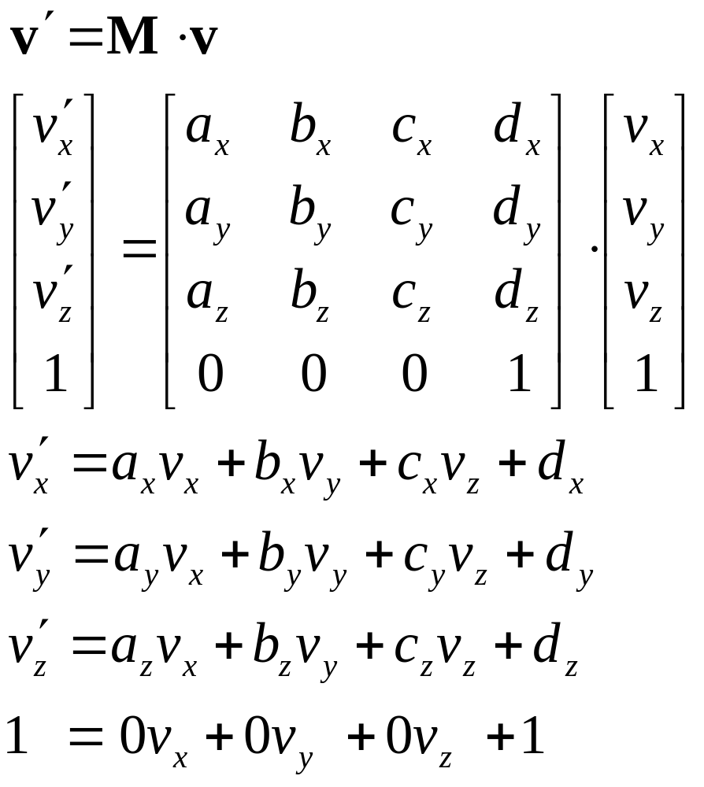
Homogeneous Transformations

Slide 3
3D Transformations
So far, we have studied a variety of useful 3D transformations:
  Rotations
  Translations
  Scales
  Shears
  Reflections
These are examples of affine transformations
These can all be combined into a single 4x4 matrix, with [0 0 0 1] on the bottom row
This implies 12 constants, or 12 degrees of freedom (DOFs)

Slide 4
ABCD Vectors
We mentioned that the translation information is easily extracted directly from the matrix, while the rotation/scale/shear/reflection information is encoded into the upper 3x3 portion of the matrix
The 9 constants in the upper 3x3 matrix make up 3 vectors called a, b, and c
If we think of the matrix as a transformation from object space to world space, then the a vector is essentially the object’s x-axis transformed into world space, b is its y-axis in world space, and c is its z-axis in world space
d is of course the position in world space.

Slide 5
Example: Yaw
A spaceship is floating out in space, with a matrix W. The pilot wants to turn the ship 10 degrees to the left (yaw). Show how to modify W to achieve this.

Slide 6
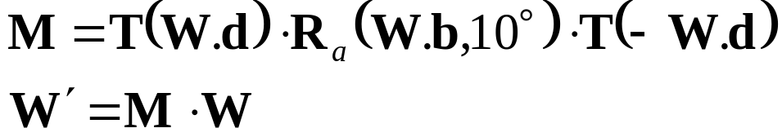
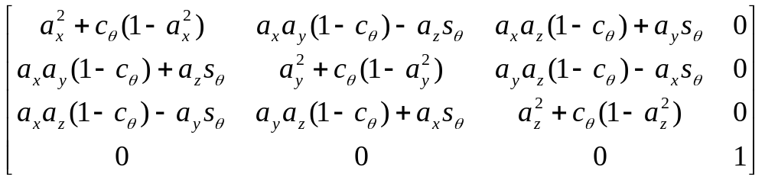
Example: Yaw
We simply rotate W around its own b vector, using the ‘arbitrary axis rotation’ matrix:
where R_{a}(a,θ)=

Slide 7
Spaces
So far, we’ve discussed the following spaces
  Object space (local space)
  World space (global space)
  Camera space

Slide 8
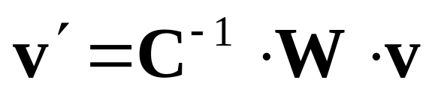
Camera Space
Let’s say we want to render an image of a chair from a certain camera’s point of view
The chair is placed in world space with matrix W
The camera is placed in world space with matrix C
The following transformation takes vertices from the chair’s object space into world space, and then from world space into camera space:
Now that we have the object transformed into a space relative to the camera, we can focus on the next step, which is to project this 3D space into a 2D image space

Slide 9
Image Space
What we really need is a mapping from 3D space into a special “2.5D” image space
For practical geometric purposes, it should be thought of as a proper 2D space, but each vertex in this space also has a depth (z coordinate), and so mathematically speaking, it really is a 3D space…
We will say that the visible portion of the image ranges from -1 to 1 in both x and y, with 0,0 in the center of the image
The z coordinate will also range from -1 to 1 and will represent the depth (1 being nearest and -1 being farthest)
Image space is sometimes called normalized view space or other things…

Slide 10
View Projections
So far we know how to transform objects from object space into world space and into camera space
What we need now is some sort of transformation that takes points in 3D camera space and transforms them into our 2.5D image space
We will refer to this class of transformations as view projections (or just projections)
Simple orthographic view projections can just be treated as one more affine transformation applied after the transformation into camera space
More complex perspective projections require a non-affine transformation followed by an additional division to convert from 4D homogeneous space into image space
It is also possible to do more elaborate non-linear projections to achieve fish-eye lens effects, etc., but these require significant changes to the rendering process, not only in the vertex transformation stage, and so we will not cover them…

Slide 11
Orthographic Projection
An orthographic projection is an affine transformation and so it preserves parallel lines
An example of an orthographic projection might be an architect’s top-down view of a house, or a car designer’s side view of a car
These are very valuable for certain applications, but are not used for generating realistic images

Slide 12
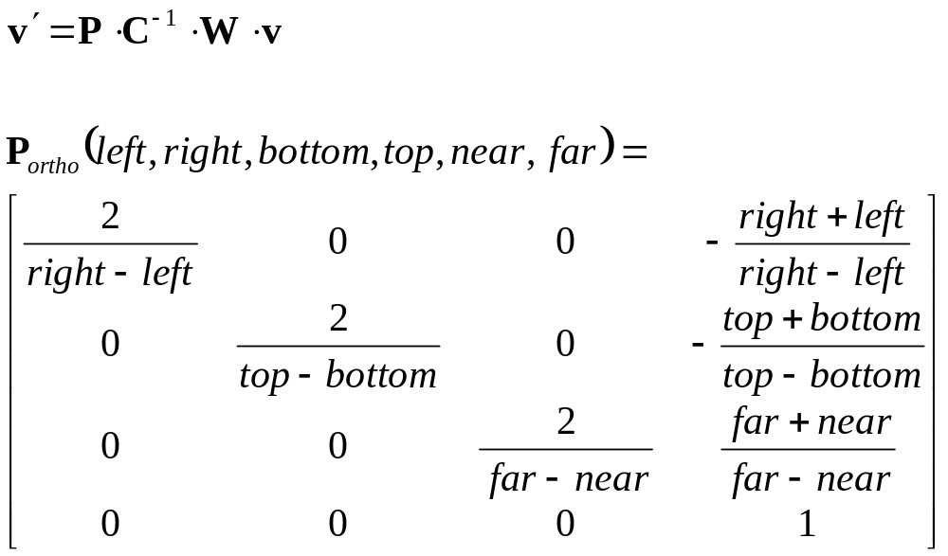
Orthographic Projection

Slide 13
Perspective Projection
With a perspective projection, objects become smaller as they get further from the camera, as one normally gets from a photograph or video image
The goal of most real-world camera lens makers is to achieve a perfect perspective projection
Most realistic computer generated images use perspective projections
A fundamental property of perspective projections is that parallel lines will not necessarily remain parallel after the transformation (making them non-affine)

Slide 14
View Volume
A camera defines some sort of 3D shape in world space that represents the volume viewable by that camera
For example, a normal perspective camera with a rectangular image describes a sort of infinite pyramid in space
The tip point of the pyramid is at the camera’s origin and the pyramid projects outward in front of the camera into space
In computer graphics, we typically prevent this pyramid from being infinite by chopping it off at some distance from the camera. We refer to this as the far clipping plane
We also put a limit on the closest range of the pyramid by chopping off the tip. We refer to this as the near clipping plane
A pyramid with the tip cut off is known as a frustum. We refer to a standard perspective view volume as a view frustum

Slide 15
View Frustum
In a sense, we can think of this view frustrum as a distorted cube, since it has six faces, each with 4 sides
If we think of this cube as ranging from -1 to 1 in each dimension xyz, we can think of a perspective projection as a mapping from this view frustrum into a normalized view space, or image space
We need a way to represent this transformation mathematically

Slide 16
View Frustum
The view frustum is usually defined by a field of view (FOV) and an aspect ratio, in addition to the near and far clipping plane distances
Depending on the convention, the FOV may represent either the horizontal or vertical field of view. The most common convention is that the FOV is the entire vertical viewing angle
The aspect ratio is the x/y ratio of the final displayed image
For example, if we are viewing on a TV that is 24” x 18”, the aspect ratio would be 24/18 or 4/3
Older style TV’s have a 4/3 aspect ratio, while modern wide screen TV’s use a 16/9 aspect. These sizes are common for computer monitors as well

Slide 17
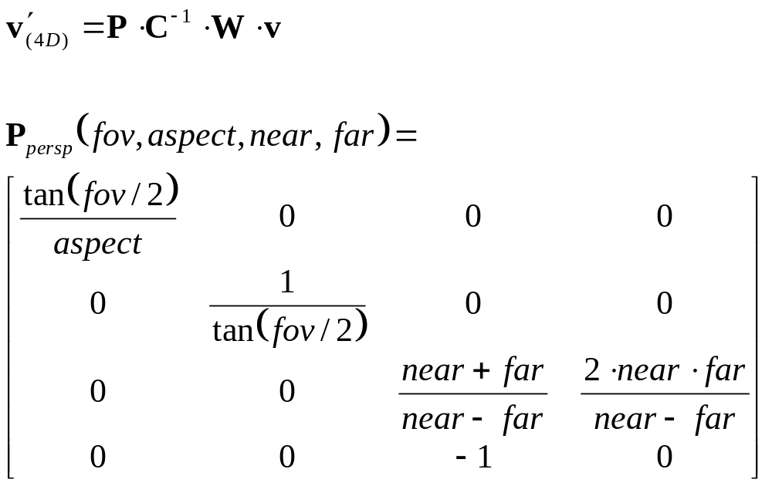
Perspective Matrix

Slide 18
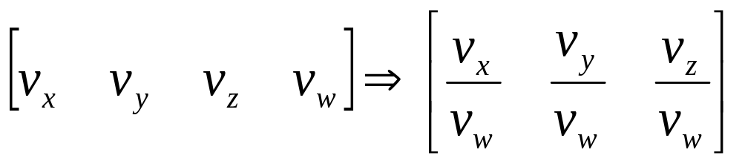
Perspective Matrix
If we look at the perspective matrix, we see that it doesn’t have [0 0 0 1] on the bottom row
This means that when we transform a 3D position vector [v_{x} v_{y} v_{z} 1], we will not necessarily end up with a 1 in the 4th component of the result vector
Instead, we end up with a true 4D vector [v_{x}′ v_{y}′ v_{z}′ v_{w}′]
The final step of perspective projection is to map this 4D vector back into the 3D w=1 subspace:

Slide 19
Perspective Transformations
It is important to make sure that straight lines in 3D space map to straight lines in image space
This is easy for x and y, but because of the division, it is possible to have nonlinearities in z
The perspective transformation shown in the previous slide assures a straight line mapping, but there are other perspective transformations possible that don’t preserve this

Slide 20
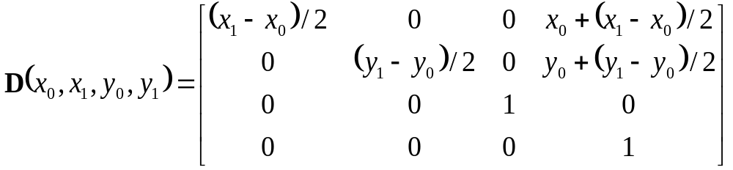
Viewports
The final transformation takes points from the -1…1 image space and maps them to an actual rectangle of pixels (device coordinates)
We can define our final device mapping from normalized view space into an actual rectangular viewport as:
The depth value is usually mapped to a 32 bit fixed point value ranging from 0 (near) to 0xffffffff (far)

Slide 21
Spaces
Object space (3D)
World space (3D)
Camera space (3D)
Un-normalized view space (4D)
Image space (2.5D)
Device space (2.5D)

Slide 22
Matrices in GL
GL has several built in routines that cover just about all of the matrix operations we’ve covered so far
GL allows the user to specify a transformation and projection to apply to all vertices passed to it
Normally, GL applies a 4-step transformation process:
  Object space to camera space (model-view)
  Project to 4D space
  Divide by ‘w’ (project to image space)
  Map to device coordinates
Even though the first two steps could be combined into one, they are often kept separate to allow clipping and lighting computations to take place in 3D camera space

Slide 23
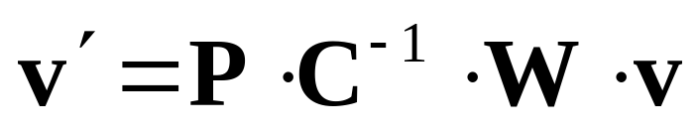
glMatrixMode()
The glMatrixMode() command allows you to specify which matrix you want to set
At this time, there are two different options we’d be interested in:
  glMatrixMode(GL_MODELVIEW)
  glMatrixMode(GL_PROJECTION)
The model-view matrix in GL represents the C⁻¹·W transformation, and the projection matrix is the P matrix

Slide 24
glLoadMatrix()
The most direct way to set the current matrix transformation is to use glLoadMatrix() and pass in an array of 16 numbers making up the matrix
Alternately, there is a glLoadIdentity() command for quickly resetting the current matrix back to identity

Slide 25
glRotate(), glTranslate(), glScale()
There are several basic matrix operations that do rotations, translations, and scaling
These operations take the current matrix and modify it by applying the new transformation before the current one, effectively adding a new transformation to the right of the current one
For example, let’s say that our current model-view matrix is called M. If we call glRotate(), the new value for M will be M·R

Slide 26
glPushMatrix(), glPopMatrix()
GL uses a very useful concept of a matrix stack
At any time, there is a ‘current’ matrix
If we call glPushMatrix(), the stack pointer is increased and the current matrix is copied into the top of the stack
Any matrix routines (glRotate…) will only affect the matrix at the top of the stack
We can then call glPopMatrix() to restore the transform to what it was before calling glPushMatrix()

Slide 27
glFrustum(), gluPerspective()
GL supplies a few functions for specifying the viewing transformation
glFrustum() lets you define the perspective view volume based on actual coordinates of the frustum
glPerspective() gives a more intuitive way to set the perspective transformation by specifying the FOV, aspect, near clip and far clip distances
glOrtho() allows one to specify a orthographic viewing transformation

Slide 28
glLookAt()
glLookAt() implements the ‘look at’ function we covered in the previous lecture
It allows one to specify the camera’s eye point as well as a target point to look at
It also allows one to define the ‘up’ vector, which we previously just assumed would be [0 1 0] (the y-axis)

Slide 29
GL Matrix Example
// Clear screen
glClear(GL_COLOR_BUFFER_BIT,GL_DEPTH_BUFFER_BIT);
// Set up projection
glMatrixMode(GL_PROJECTION);
glLoadIdentity();
gluPerspective(fov,aspect,nearclip,farclip);
// Set up camera view
glMatrixMode(GL_MODELVIEW);
glLoadIdentity();
gluLookAt(eye.x,eye.y,eye.z,target.x,target.y,target.z,0,1,0);
// Draw all objects
for(each object) {
glPushMatrix();
glTranslatef(pos[i].x,pos[i].y,pos[i].z);
glRotatef(axis[i].x,axis[i].y,axis[i].z,angle[i]);
Model[i]->Draw();
glPopMatrix();
}
// Finish
glFlush();
glSwapBuffers();

Slide 30
Instances
It is common in computer graphics to render several copies of some simpler shape to build up a more complex shape of entire scene
For example, we might render 100 copies of the same chair placed in different positions, with different matrices
We refer to this as object instancing, and a single chair in the above example would be referred to as an instance of the chair model

Slide 31
Instance Class
class Instance {
Model *Mod;
arVector3 Position;
arVector3 Axis;
float Angle;
public:
Instance() {Mod=0; Axis.Set(0,1,0); Angle=0;}
void SetModel(Model *m) {Mod=m;}
void Draw();
};
void Instance::Draw() {
if(Mod==0) return;
glPushMatrix();
glTranslatef(Position.x,Position.y,Position.z);
glRotatef(Axis.x,Axis.y,Axis.z,Angle);
Mod->Draw();
glPopMatrix();
}

Slide 32
Camera Class
class Camera {
Vector3 Eye;
Vector3 Target;
float FOV,Aspect,NearClip,FarClip;
public:
Camera();
void DrawBegin();
void DrawEnd();
};

