Slide 1
Flocking
- Santosh Shedbalkar

Slide 2
Origin
1986 Craig Reynolds presented a SIGGRAPH paper called “Flocks, Herds, and Schools: A Distributed behavioral model”.
This paper explores an approach based on simulation as an alternative to scripting the paths of each bird individually.
Each simulated bird is implemented as an independent actor that navigates according to its local perception of the dynamic environment, the laws of simulated physics that rule its motion, and a set of behaviors programmed into it.

Slide 3
Applications
Computer Animation
Social network simulation and modeling opinion flow.
Aerospace engineering.
Distributed systems analysis, search, and optimization.

Slide 4
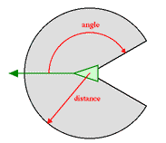
How it works
Each boid has direct access to the whole scene's geometric description, but flocking requires that it reacts only to flockmates within a certain small neighborhood around itself.

Slide 5
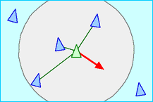
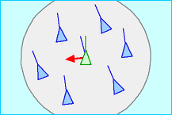
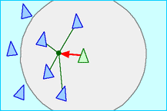
How it works
3 Simple rules
Separation: Steer to avoid
crowding local flockmates
Alignment: Steer towards the
average heading of local
flockmates
Cohesion: Steer to move toward
the average position of local
flockmates

Slide 6
Algirithmic Complexity
No central control; each bird behaves autonomously
A basic implementation of a flocking algorithm has O(n²) complexity - each bird searches through all other birds to find those who falls into its environment.
An Improved version: Bin-Lattice Spatial subdivision. It has a complexity of O(nk)

Slide 7
Conclusion
Flocking is an emergent behavior where 3 simple individual rules: Separation, Alignment, and Cohesion; result in a complex group behavior.
Flocking also has applications outside of the computer animation field.

Slide 8
Demo

