Slide 1

Joshua Claeys
jclaeys@digipen.edu
DigiPen Institute of Technology 2010
Notes:
DigiPen Insitute of Technology 2010

Slide 2
Overview
Visual Debugging
The major components
Scenes
The “Update Loop”
  Integration
  Broad Phase
  Narrow Phase - Collision Detection
  Resolution - (Constraints vs. Impulses)
Continuous vs. Discrete Collision Detection
Collision vs. Contact
Fix your time step
Making your gameplay programmer happy
Extra Features
Containers
DigiPen Institute of Technology 2010

Slide 3
Before we get started
Make sure you have a strong math library before writing your engine
  Make sure to test your math library. You will be doing your team a big favor
Know your coordinate system
  Pick one you're comfortable with and use that
In case you have already forgotten… Test your math library!
DigiPen Institute of Technology 2010

Slide 4
Before we get started (continued)
Modular Design
  We will go over this throughout the presentation, but it is important to have the flexibility to easily change how your engine updates
Are we doing real physics?
  Video game physics is not necessarily real physics.
    We need to cheat to make things look how we want them to look
    We must deal with floating point imprecision
    We have to do everything in 1/60th of a second(really less)
DigiPen Institute of Technology 2010

Slide 5
Visual Debugging
Debug Drawing
  At least have the functionality to draw lines and points with different colors
  Points could be either a cross of 3 lines, or a sphere around the point
Pause, Step, and continue
  Lets you step the simulation one frame at a time
Pick good textures for your sandbox
  Any color of debug lines is visible on wood
DigiPen Institute of Technology 2010

Slide 6
The Major Components
Rigid Body
  Manages the movement of objects
Collider
  The physical representation of the object (how the object collides with others)
  Without the Rigid Body component, it is considered static
If you do not have a component based engine, I suggest wrapping these two components
DigiPen Institute of Technology 2010

Slide 7
Rigid Body
class RigidBody
{
  //…
  Vec3 mCenterMass; //Current center of mass
  Vec3 mVelocity; //Current velocity
  Vec3 mForceAccumulator; //All accumulated forces (gravity)
  Vec3 mAngularVelocity; //Angular velocity
  Mat3 mOrientation; //Current orientation
  real mInverseMass; // 1.0f / mass
  //Inverse Inertia Tensor is the objects resistance to rotation
  Mat3 mInvInertiaTensorM; //Model space
  Mat3 mInvInertiaTensorW; //World space
  //…
}
DigiPen Institute of Technology 2010

Slide 8
Collider
class Collider
{
  //…
  u32 mId; //Each collider should have a unique id
  Aabb mAabb; //The objects bounding box
  real mVolume; //The volume of the object
  Vec3 mHalfExtents; //Vector from center to corner
  Vec3 mPosition; //Relative position
  Mat3 mOrientationMtx; //Relative orientation
  PhysicsMaterial* mMaterial; //More on this later
  //…
}
DigiPen Institute of Technology 2010

Slide 9
Scenes
Manages the updating of all objects
  You can have multiple scenes
  Scenes do not interact with each other
Why would I want multiple scenes?
  Level editor -> Testing and back to the level editor
  Threading
  Independent rooms with portals in-between
    Think Metroid Prime
DigiPen Institute of Technology 2010

Slide 10
Scenes (continued)
class Scene
{
  //…
  void Update(real dt);
  //Dynamic objects
  InList<Collider> mDynamicColliders;
  //Static objects
  InList<Collider> mStaticColliders;
  //Rigid Bodies
  InList<RigidBody> mRigidBodies;
  //Broad phase algorithms
  BroadPhase* mDynamicBroadPhase;
  BroadPhase* mStaticBroadPhase;
  //…
}
DigiPen Institute of Technology 2010

Slide 11
The Update Loop
Three things need to happen during the update loop
  Integrate all objects
  Check for collisions between objects
  Resolve the collisions to an acceptable state
DigiPen Institute of Technology 2010

Slide 12
Integration
Integration is a fancy way of saying move every object from its last known position to its new one (as well as updating velocity)
This can be done any number of ways
  Euler, Leapfrog, RK2, Verlet, RK4, etc…
Better integrators are used to conserve more energy, which leads to more accuracy
  Things such as soft bodies will not work with Euler
Disadvantage to a good integrator is it's normally slower than the less accurate ones
  If you do more iterations with a faster integrator, you can potentially get more accuracy from it
DigiPen Institute of Technology 2010

Slide 13
Integration (continued)
Simple integration example:
  Note* You might want to make this a non-member function for ease of swapping integrators
void RigidBody::IntegrateEuler(real dt)
{
//Integrate velocity
mVelocity += mForceAccumulator * mInverseMass * dt;
//Integrate position
mCenterMass += mVelocity * dt;
//Integration orientation is for another lecture
}
DigiPen Institute of Technology 2010

Slide 14
The Update Loop – 1st Attempt
//Integrate all objects
IntegrateObjects(mColliders);
//Walk each object in the scene
for(uint A = 0; A < mColliders.size(); ++A)
{
//Walk each object after the current object
for(uint B = A + 1; B != mColliders.size(); ++B)
{
//Check if there was a collision.
if(DetectCollision(mColliders[A], mColliders[B]) == true)
{
//Resolve the collision
ResolveCollision(A,B);
}
}
}
DigiPen Institute of Technology 2010

Slide 15
The Update Loop (continued)
What is wrong with this code?
  N^2 Algorithm
    It is checking every object against every other object for collision
  No Collision Information
    When we check an object for collision, we simply get back, “It collided!” We need some more information to pass to the resolution (contact point / normal, penetration)
  No Flexibility with Resolution
    We didn’t store the collision, so we can’t iterate over them later
So what can we do to make this better?
  Lets first get rid of the N^2 first
DigiPen Institute of Technology 2010

Slide 16
Broad Phase
The Broad Phase limits the number of pairs of objects that need to be checked for collision
Common broad phase algorithms:
  Sweep and Prune (SAP)
  Axis Aligned Bounding Box Tree (AABB Tree)
  Octree
  K-Dimensional Tree (KD Tree)
  Binary Search Partition Tree (BSP Tree)
  Hierarchical Grid (H-Grid)
  etc…
What should you start out with?
DigiPen Institute of Technology 2010

Slide 17
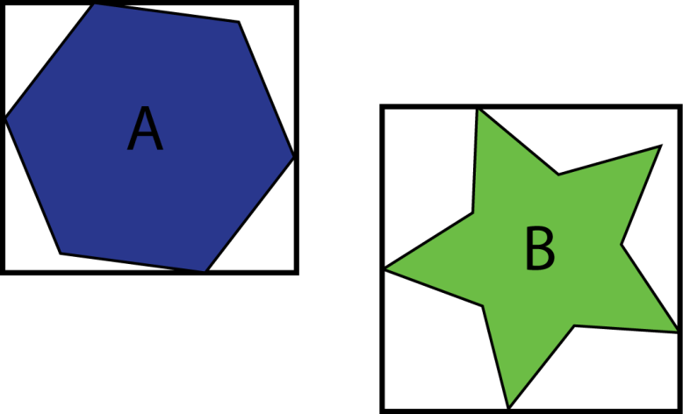
Broad Phase (continued)
What algorithm should you use?
  Start off with N^2
    You can do a quick and simple Aabb or bounding sphere test to get a fairly large speed improvement
  Once you get the rest of your engine in place and running, broad phase should be the first thing you optimize
  AABB Tree is very good for static objects and ray casting
    Professional engines have recently toyed with dynamic AABB Trees with great success
  Sweep and Prune is very powerful for a large amount of dynamic objects, but tricky to implement
    Terrible for ray casting, even with stabbing numbers
      However, if you aren’t ray casting multiple times a frame, it should be fine
Make sure you can easily swap out broad phases
  Have a BroadPhase interface class
DigiPen Institute of Technology 2010

Slide 18
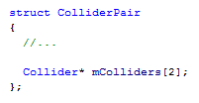
Broad Phase (continued)
Two (really three) types of broad phases
  Dynamic
    Designed for moving objects
    Updated every frame
  Static
    Designed for non-moving objects
    Usually built once when the world is created
  “Ray Cast”
    A specialized broad phase for fast ray casting
Getting information from your Broad Phase.
  Dynamic – Pass in an empty array of collider pairs. The broad phase should fill it out with object pairs that are close enough to be tested for collision
  Static – Pass in and array of all the dynamic objects as well as an empty array of collider pairs. The broad phase should fill it out with possible collisions
DigiPen Institute of Technology 2010

Slide 19
The Update Loop – 2nd Attempt
//Integrate all objects
IntegrateObjects(mColliders);
//Query the broad phase for possible collisions
ObjectPairVector possibleCollisions;
mDynamicBroadPhase->GetCollisions(&possibleCollisions);
mStaticBroadPhase->GetCollisions(&mColliders, &possibleCollisions);
//Walk through each possible collision
for(uint i = 0; i < possibleCollisions.size(); ++i)
{
Object* A = possibleCollisions[i].A;
Object* B = possibleCollisions[i].B;
if(DetectCollision(A, B) == true)
{
//Resolve the collision
ResolveCollision(A,B);
}
}
DigiPen Institute of Technology 2010

Slide 20
Narrow Phase
Collision Detection
  Did these two collide?
  Give me information about the collision
DigiPen Institute of Technology 2010

Slide 21
Collision Detection
Collision detection involves algorithms for checking for intersection of two given solids
  We need to know a little more about what happened:
    What was the normal for the collision?
    What was the depth of the interpenetration?
    Where relative to the bodies did the collision happen?
  Once we have the answers to these questions we can resolve the collision
DigiPen Institute of Technology 2010

Slide 22
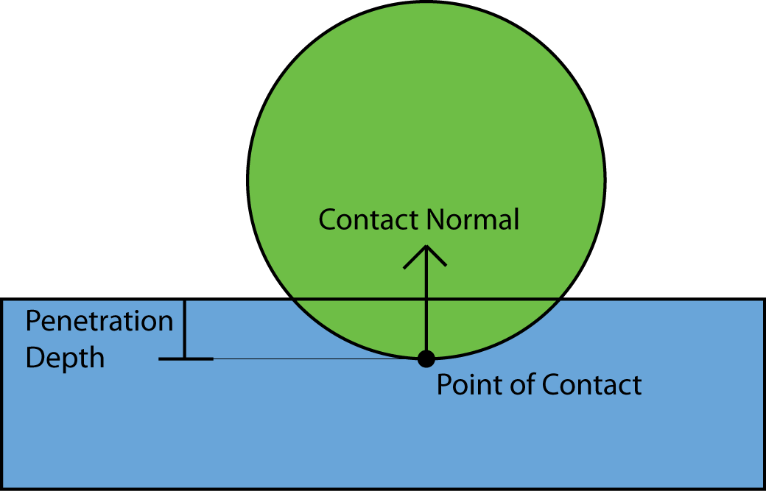
Collision Detection (continued)
struct CollisionData
{
//The colliding objects
Collider* Objects[2];
Vec3 ContactPoint;
Vec3 Normal;
real Penetration;
//…
};
DigiPen Institute of Technology 2010

Slide 23
Collision Resolution
Collisions can be resolved a number of ways
  Impulses, Constraints, Penalty Forces, etc...
If you want to make life easy on yourself, use impulses
  Why Impulses?
    The math is simpler
    A change in momentum is visible instantly to the player
    In the context of game physics they are analogous to forces
DigiPen Institute of Technology 2010

Slide 24
Constraints
If Impulses are easier, why would I want to use constraints?
  Allows you to model:
    Ropes
    Hinges
    Motors
    Etc…
  Most of what Little Big Planet does in their game is done through constraints
Constraints are “magic”
DigiPen Institute of Technology 2010

Slide 25
The Update Loop – 3rd Attempt
//Integrate all objects
IntegrateObjects(mColliders);
//Query the broad phase for possible collisions
ObjectPairVector possibleCollisions;
mDynamicBroadPhase->GetCollisions(&possibleCollisions);
mStaticBroadPhase->GetCollisions(&mColliders, &possibleCollisions);
//Walk through each possible collision
for(uint i = 0; i < possibleCollisions.size(); ++i)
{
Object* A = possibleCollisions[i].A;
Object* B = possibleCollisions[i].B;
CollisionReport report;
//Check if the two objects collided
if(DetectCollision(A, B, &report) == true)
{
//Allocate a copy of the report and store it elsewhere
//NOTE* You should use a memory manager for these allocations as there
//will be a large amount of them per frame
StoreCollisionReport(new CollisionReport(report));
}
}
//At a later time…
for(uint i = 0; i < mCollisionReports.size(); ++i)
{
ResolveColision(CollisionReports[i]);
}
DigiPen Institute of Technology 2010

Slide 26
Two Types of Collision Detection
Continuous Collision Detection (CCD)
Discrete Collision Detection (DCD)
DigiPen Institute of Technology 2010

Slide 27
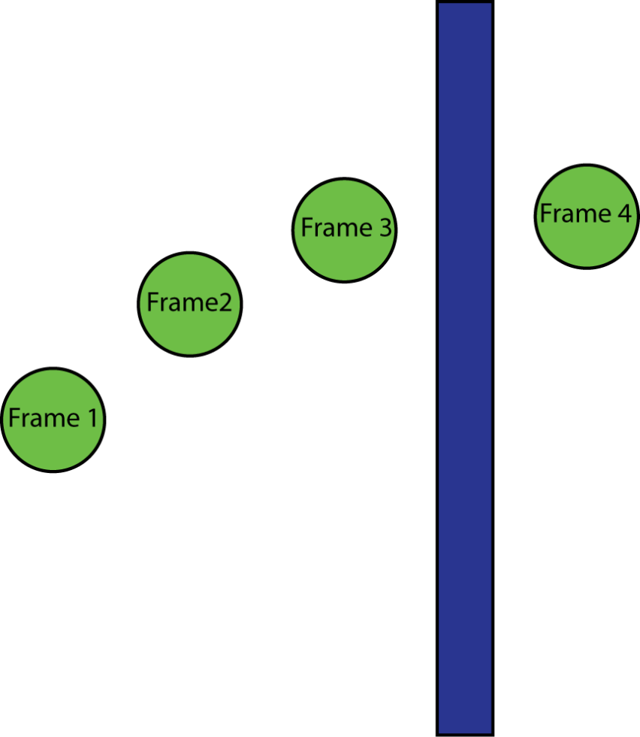
Collision Detection (CCD)
Continuous Collision Detection
The Problem
    In games, objects teleport around; our eyes just interpret it as movement
    When objects are moving too fast (or are
    too small, they can pass through
    objects
DigiPen Institute of Technology 2010

Slide 28
Collision Detection (CCD)
Basic Algorithm
  1)Integrate objects
  2)Detect collisions, if none found then end
  3)Rewind the simulation to the earliest Time of Collision (TOC)
  4)Resolve the earliest collision
  5)Repeat from step 1
DigiPen Institute of Technology 2010

Slide 29
Collision Detection (CCD)
Pros
  Physically accurate, though not necessarily precise
  No interpenetration since simulation is rewound to the time of collision (TOC should replace penetration depth in the CollisionReport)
Cons
  TOC calculations are slow:
    Swept collision detection, which is hard
    Bisection of the frame, basically a binary search for the closest time of at which they collide, SLOW
DigiPen Institute of Technology 2010

Slide 30
Collision Detection (DCD)
Discrete Collision Detection
Basic Algorithm
  1) Integrate all objects by timestep
  2) Check for collisions
  3) Resolve all collisions simultaneously
DigiPen Institute of Technology 2010

Slide 31
Collision Detection (DCD)
Pros
  Physically plausible
  Very easy to implement
  Flexible
  Much faster than CCD
  Don't have to implement accurate rewind
Cons
  Inherently and purposefully inaccurate
DigiPen Institute of Technology 2010

Slide 32
CCD vs. DCD Conclusion
In the end, you need to be worrying about other more important things, so continuous collision detection is not worth it
Use Discrete
  Except for bullets if your game needs them
DigiPen Institute of Technology 2010

Slide 33
Collisions vs. Contacts
Both cases must be handled or else!
  Things like Jitter, Drift or Bouncing will occur
It can be hard to determine what is a collision vs. what is just a contact so here are a few possible solutions
DigiPen Institute of Technology 2010

Slide 34
Collisions vs. Contacts (continued)
Solution 1: Micro Collisions
  Choose for yourself a velocity threshold. Anything below the threshold is a contact, anything above is a collision.
This can involve a lot of tweaks but it will work… mostly.
DigiPen Institute of Technology 2010

Slide 35
Collisions vs. Contacts (continued)
Solution 2: Non-Convex Rigid Bodies with Stacking's integration scheme
  Store off position and velocity at the top of the frame
  Forward integrate by ∆t
  Detect Collisions for this state
  Revert Position and Velocity
  Process collisions with old data
  Now integrate velocity
  Process contacts
  Integrate position
DigiPen Institute of Technology 2010

Slide 36
Fix your time step
For increased accuracy you should really fix your time step
This buys you:
  Increased accuracy, since you won't have ∆t spikes in your game
  A more consistent, verging on deterministic, engine
  Allows you to use the Verlet integrator
DigiPen Institute of Technology 2010

Slide 37
Fix your time step (continued)
What I mean by fix your time step
  ∆t for each frame is a constant value
Accumulate time elapsed. Consume said time in chunks of your time step
This causes us to run a little less than a frame ahead of our engine
  We must interpolate between objects based on time requested
    Or else Temporal Aliasing will occur
DigiPen Institute of Technology 2010

Slide 38
Fix your time step (continued)
For a more detailed description and sample code, see the article entitled “Fix Your Timestep” on Gaffer On Games
DigiPen Institute of Technology 2010

Slide 39
Gameplay
Make others want to use your engine
Ray / Volume Casting
Ghosts
Regions
Collision filtering / grouping
Character Controller
Callbacks / Messages
  On Collision (with collision data)
  On Separation
  On Sleep
  On Entering / Exiting a region
DigiPen Institute of Technology 2010

Slide 40
Gameplay (continued)
In a game there are normally two types of collision response
  Physical
    Handled by your physics engine
  Logical
    Handles by everyone else
    Game logic has to run when two objects collide, like bullet and enemy, but most of this shouldn't be handled in physics
    Instead think about posting a message or event, then let the rest of the engine deal with what just happened
DigiPen Institute of Technology 2010

Slide 41
Ray Casting
What is Ray Casting?
  A Ray is defined by a point in space and a direction
    P + td, t >= 0
  When you “cast” a ray in the scene, it will return the first object hit
    Modifications can be made such as retrieving multiple objects or adding a filter to the ray to ignore certain objects
What is Ray Casting used for?
  Line of Sight (LOS)
  Fast moving objects (bullets)
  Continuous Collision Detection (CCD)
  Movement for AI (feelers)
DigiPen Institute of Technology 2010

Slide 42
Volume Casting
Volume casting is similar, but instead of getting the first thing a ray touches, we get all objects inside of a given volume at a given position
  We can also cast a swept volume, which is casting a volume along a ray or segment
Uses:
  Box selecting objects in rts games. This is done by casting a frustum into the world
  Checking how many or what objects are around another object
  Much more…
DigiPen Institute of Technology 2010

Slide 43
Ghosts
Ghosts collisions are when two objects collide, but they are not resolved
  A message is sent out for game logic saying that they “collided”
What are they good for?
  Triggers
  Game logic
DigiPen Institute of Technology 2010

Slide 44

Regions
Regions are similar to ghosts
  If an object is intersecting it, it sends a message, but does not resolve the collision
  Regions can/should be a component on the object
What’s the difference?
  Regions can have effects applied to them
    Different gravity
    Drag
    Buoyancy
    Etc…
Below is an object with a Box Collider
  When anything is inside it, it applies a buoyancy effect, making it float
DigiPen Institute of Technology 2010

Slide 45
Collision Filtering / Grouping
Ways to make specific objects not collide with each other
  Each object has a bit field on it
    Each flag corresponds to a group/type
  Two object’s bit fields are masked before collision detection
    If there are no overlapping bits, there is no collision
Example
  You want coins to collide with everything but enemies and themselves
DigiPen Institute of Technology 2010

Slide 46
Character Controller
Does what it says it does, controls the character
  It can/should be another component
  It’s hard to do
  Depends on your game
  You may have multiple controllers for your game
    One for different types of objects that control differently
DigiPen Institute of Technology 2010

Slide 47
Callbacks / Messaging
At the end of the frame, you need to let the game logic know what happened
  Object A and B collided
  Object C entered region “water”
  Object D went to sleep
This can be done by
  Messaging system
  Callbacks
Do not send any messages or call any callbacks until you’re done updating the scene
  No logic should happen during the physics loop
    Slow logic could possible happen in here and people could start blaming the physics engine for being slow
DigiPen Institute of Technology 2010

Slide 48
The Update Loop – 4th Attempt
//Integrate all objects
IntegrateObjects(mColliders);
//Query the broad phase for possible collisions
ObjectPairVector possibleCollisions;
mDynamicBroadPhase->GetCollisions(&possibleCollisions);
mStaticBroadPhase->GetCollisions(&mColliders, &possibleCollisions);
//Walk through each possible collision
for(uint i = 0; i < possibleCollisions.size(); ++i)
{
CollisionReport report;
//Check if the two objects collided
if(DetectCollision(possibleCollisions[i].A, possibleCollisions[i].B, &report) == true)
{
//Allocate a copy of the report and store it elsewhere
//NOTE* You should use a memory manager for these allocations as there will be a large amount of them per frame
StoreCollisionReport(new CollisionReport(report));
}
}
//At a later time…
for(uint i = 0; i < mCollisionReports.size(); ++i)
{
ResolveColision(CollisionReports[i]);
}
//When you are all done...
DispatchMessages();
DigiPen Institute of Technology 2010

Slide 49
Extra Features
Sleeping
Islands
Contact Graph
Composite Objects
Materials
Lexicographic Indices
DigiPen Institute of Technology 2010

Slide 50
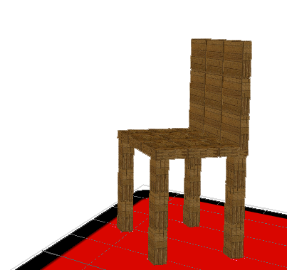
Sleeping
When objects are resting on the ground, they are wasting cpu cycles
So when we detect an object that
hasn’t moved in a while, we put it
to sleep (stop updating it)
Don’t do it at the start
  It will hide bugs
  Make a way to turn it off
DigiPen Institute of Technology 2010

Slide 51
Islands and Contact Graphs
An Island is a set of objects and constraints that are dependent on each other
  Used to solve constraint systems independently and to check for sleeping.
  Nice for threading
  There are a lot of weird issues with sleeping that islands help resolve
A contact graph is similar, but has directionality in how objects touch
  Used for stacking and shock propagation with impulses
DigiPen Institute of Technology 2010

Slide 52
Composite Objects
Connecting multiple objects together like this chair
  Composed of 4 legs, a seat, and a back
Good alternative to arbitrary mesh’s
  Easy concavity
This is not a simple task
  Do not consider this initially,
  but later as a more advanced feature
  Use getters / setters!
DigiPen Institute of Technology 2010

Slide 53
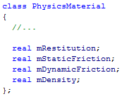
Materials
Objects share these materials
  stored as a pointer to the material
Data
  Restitution is a value between 0 and 1 determining the amount of energy retained on a collision
    0.0 being no energy retained
    1.0 being all energy retained (bounces forever)
  Static and Dynamic Friction
  Density
DigiPen Institute of Technology 2010

Slide 54
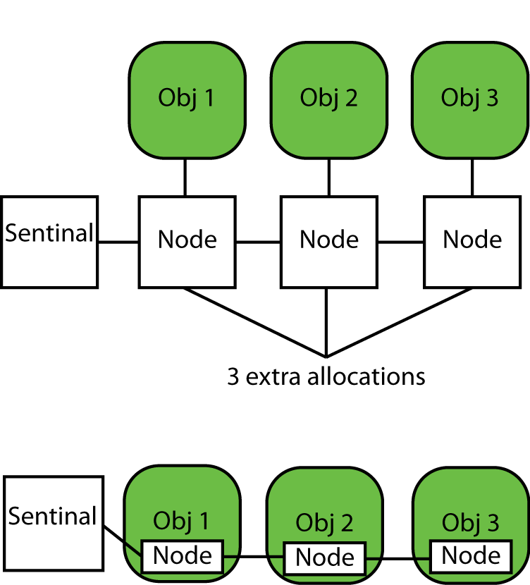
Containers
InList is super awesome
  Constant time add / remove
  No extra allocations
  The “Node” is stored
  as a member variable
  of the object
DigiPen Institute of Technology 2010

Slide 55
Lexicographic Index
Take two 32 bit unsigned Id’s (such as the colliders id), and store them as a 64 bit unsigned integer
  Smaller number in the upper 32 bits
  Larger number in the lower 32 bits
Uses?
  It gives a pair of colliders a unique Id
  A pair manager needed for Sweep and Prune
DigiPen Institute of Technology 2010

Slide 56
Lexicographic Index (continued)
u64 GetLexicographicId(u32 id1, u32 id2)
{
u64 id = 0;
if(id1 < id2)
{
id |= (static_cast<u64>(id1) & 0xffffffff) << 32;
id |= (static_cast<u64>(id2) & 0xffffffff);
}
else
{
id |= (static_cast<u64>(id2) & 0xffffffff) << 32;
id |= (static_cast<u64>(id1) & 0xffffffff);
}
return id;
}
DigiPen Institute of Technology 2010

Slide 57
Questions?
DigiPen Institute of Technology 2010

Slide 58
References
Ted Rivera “Physics Engine Architecture for Games” 2008
Alex Miller “Physics Engine Architecture” 2009
Chris Peters
Guendelman et al. “Nonconvex Rigid Bodies with Stacking”. SIGGRAPH 2003
Fiedler, Glenn. “Fix Your Timestep”. 2006. http://gafferongames.wordpress.com/game-physics/fix-your-timestep/
DigiPen Institute of Technology 2010

