Slide 1
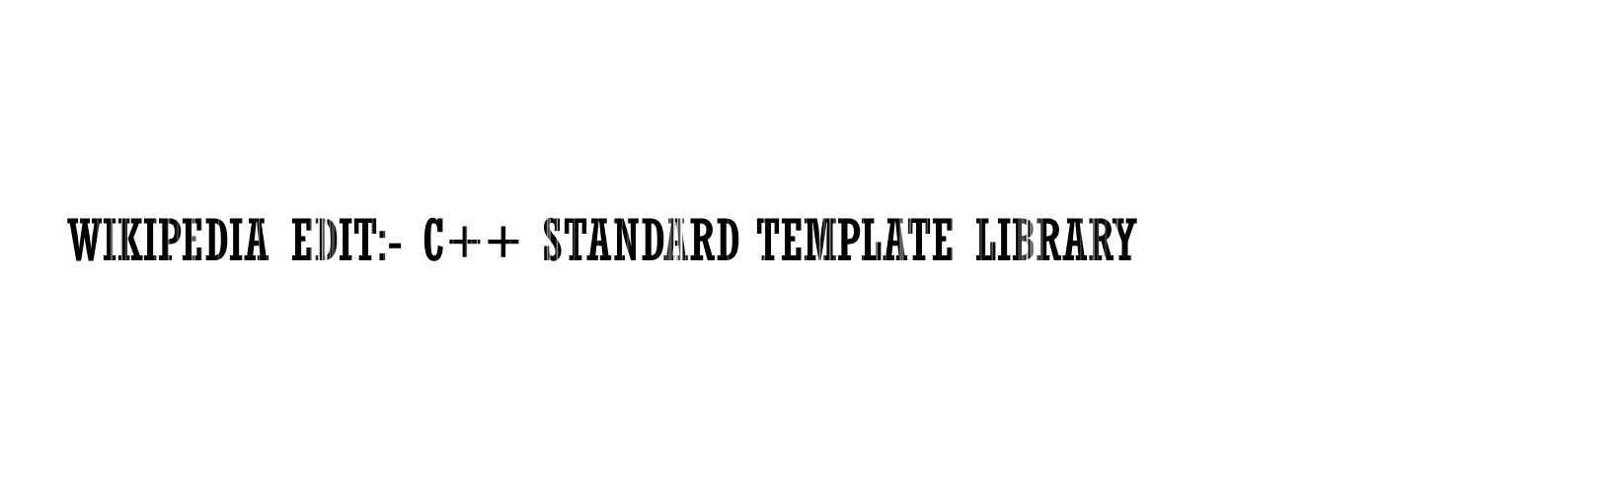
Palash Sharma & Saurav Shekhar
GROUP 7

Slide 2

We thank Prof. Amitabha Mukherjee and Prof. Nitin Saxena for giving us an opportunity for contribute to Wikipedia.
We would also like to thank our team members for giving valuable inputs regarding the edits needed.

Slide 3

The Standard Template Library, or STL, is a C++ library of container classes, algorithms, and iterators; it provides many of the basic algorithms and data structures of computer science.

Slide 4
Poorly structured lead sections.
Inconsistently styled text
Articles might not have been updated for long time
Articles may not have a good finish
No good references are provided
Self referencing

Slide 5
Grammatical errors
Inconsistent information
Opinion based articles
References not provided

Slide 6
Is quite informative but needs a bit of polishing.
Not updated with the recent versions.
Information about some containers was not upto the mark.
Section on ‘Algorithms’ was very small.

Slide 7
Added the containers that are used for a hash implementation <hash_set> and <hash_map>.
Information added about priority_queue implementation and about singly linked list implementation (slist).

Slide 8
Major portion of the edit is made in the section “Algorithms”. Original article simply stated that one can perform searching and sorting operations. Information about the type of operations performed and the algorithms they use was added. Various other types of operations like random_shuffle, next_permutation and other set operations. These examples were added.
External link for C++ reference was added.

Slide 9


