Slide 1
Agenda
ITIL defined
What is ITIL?
Why use ITIL?
ITIL Processes, Lifecycle
ITIL Highlights
Moving forward
Resources

Slide 2
ITIL Defined
ITIL ≡ “Information Technology Infrastructure Library”
Books that describe best practices for IT Service Management
Published by the UK government

Slide 3
What is ITIL?-1
Think of it as an ‘instruction manual’ for effective IT Service
You can take the parts of it that you need
Framework of “suggestions” and suggested processes for managing IT services
Customer focused
Focus on providing the value to customers

Slide 4
What is ITIL?-2
Provides approaches/models/etc.
E.g. Continual Service Improvement (CSI)
Validated across many other organizations
Non-prescriptive (can use parts)–”ITIL-lite”

Slide 5
ITIL - Wikipedia
“The Information Technology Infrastructure Library (ITIL), is a set of practices for IT service management (ITSM) that focuses on aligning IT services with the needs of business…..ITIL describes procedures, tasks and checklists that are not organization-specific, used by an organization ….” (Wikipedia)

Slide 6
Why use ITIL?-1
Customer expectations have increased
To work better individually and together
Some things we are doing already, but with varying approaches
Defining of processes, across IT groups
Defining of roles
Tracking requests, managing asset inventory
Notes:
ITIL is the most broadly accepted set of best practises for IT operations

Slide 7
Why use ITIL?-2
Improve Customer Service
Check with customers to ensure needs are being met
Ensure value provided
Co-operation between Helpdesks
Be proactive
Examine existing processes, define, document
Look at roles and ownership

Slide 8
Why use ITIL?-3
Ensure accountability
Ensure communications
Between IT staff and clients
Between IT staff in different locations
Opportunity to do things better
Change management
Maintaining systems, services

Slide 9
Related Goals
Collaboration between IT support groups
Knowledge base
Knowledge sharing
Request tracking
Consistent user experience
Cost savings (bulk purchases, cooperation, etc.)
Accountability, Service Quality

Slide 10
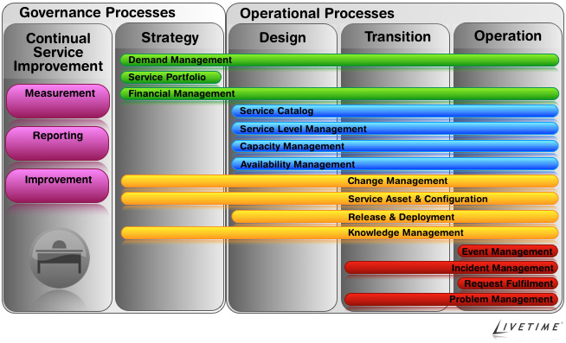
ITIL Lifecycle/Processes High Level Overview
ITIL “Lifecycle”
5 stages
Multiple processes per stage
Natural life cycle of a service from pre-birth (planning) to retirement and replacement
Many processes are familiar:
Change Management
Asset Management
Incident and Problem Management

Slide 11
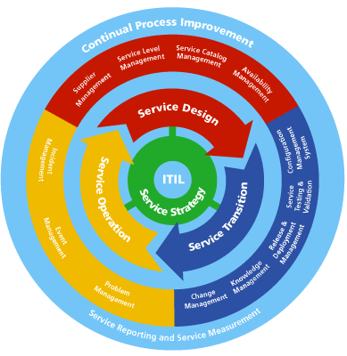
ITIL Lifecycle
Lifecycle of a service, from ‘cradle’ to ‘grave’
Stages (each stage includes multiple processes):
Service strategy
Service gets approved
Service transition
Service is tested
Service design
Service is designed
Service operation
Coordinate and carry out activities and processes required to deliver the service and manage them at agreed levels
Continual Service Improvement (CSI)
Continually align and re-align IT services to changing needs

Slide 12
Deming Cycle and ITIL
Dr. William Edwards Deming
Responsible for much of Japan’s success is manufacturing and business
Deming Cycle vs. ITIL Lifecycle
Deming Cycle | ITIL Lifecycle Stage
Plan | Service Strategy & Design
Do (Implementing) | Service Transition & Operation
Check (Auditing) | Continual Service Improvement
Act (Improving) | Continual Service Improvement

Slide 13
ITIL Highlights
Lifecycle, Stages and Processes, CSI
Service Desk (Help desk) functions
Roles, Ownership
Measuring/Metrics
Asset Management
SLAs, Customers and Users
Change Management
Knowledge Management
Communication

Slide 14
Lifecycle Stages and Processes
Implement processes that make the most sense or are the most useful for an organization
Allows reassessment of
how things are done
if current processes are meeting client/business needs

Slide 15
Why Define Processes?
Documented, available, processes:
IT Staff
Better understanding (IT staff) of how something is done
Fewer mistakes
Useful for new employees or when a staff member is away
Can manage expectations easier, when processes are predictable
IT Clients
Better understanding (clients) of how to get something done (how to request a service/work)
Better service-things are done the same way every time (regardless of who performs them)
Coordinated work across the organization

Slide 16
Process Owner
Process Owner is accountable for
the process
identifying process improvements

Slide 17
Examples of Service Desk/Help Desk Processes
ITIL uses the term “Service Desk” for Help desk
Processes, currently done in RT (Service Operation Stage)
Incident Management
Problem Management (link with incidents)
Request Fulfillment (create work flow)
Access Management (create work flow)
Event Management (link with problems)

Slide 18
What the service desk does
Provide first-line investigation/diagnosis
Log, ownership & resolution (where possible) of incidents & service requests
Escalate incidents & service requests to other parties to resolve within agreed timescales
Keep users informed of progress
Close resolved incidents, service requests, etc.
Conduct satisfaction surveys
Processes in place (e.g. Questions to ask, escalation process, workflow for certain types of requests)

Slide 19
Incident/Event Management
Unplanned incident related to an event
Analyze and report on afterwards
What happened
Root cause analysis
Fix if possible
Known error database (available to front line staff for future incidents that come in)

Slide 20
Service Catalogue
Service catalogue
Contains services that have been chartered (approved, money available to develop)
(Some of these services are live, some may still be in development)
Available to clients
Could be interactive (request service directly from the catalogue)
Lists how long it will take to fix problems (e.g. email, network)

Slide 21
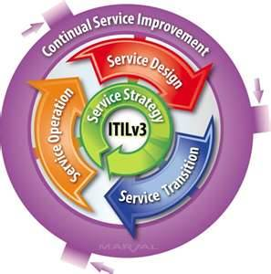
CSI Continual Service Improvement
What is the vision?
Business vision, mission, goals, objectives
Where are we now?
Baseline assessments
Where do we want to be?
Measureable targets
How do we get there?
Service & Process Improvement
How did we get there?
Measurement and metrics
How do we keep the momentum going?
Revisit the vision (see 1. above and continue)
Notes:
Plan (Planning)-Service Strategy & Design
Do (Implementing)-Service Transition & Operation
Check (Auditing) & Act (Improving)-Continual Service Improvement

Slide 22
Defining of roles
Service owners responsibilities:
Understands the service and its components
Provides & coordinates technical support for the service
Represents the service in change management activities
Represents the service across the organization
Is responsible for continual improvement of the service and management of change in the service
Communication about the service to clients (e.g. upgrade notices, upgrade benefits)

Slide 23
Defining of roles
Service desk manager responsibilities
Manages service desk staff
Takes overall responsibility for dealing with incidents and service requests at the service desk
Acts as the escalation point for difficult calls.
Problem manager responsibilities
Responsible for allocating the appropriate technical staff or teams for problem investigation
Ensures known error DB is up to date and reliable
Roles vs. People (one person could have multiple roles): Process/Service Owners

Slide 24
Ownership
Service Desk (Helpdesk)
Owns incidents or service requests that come into the service desk
Service Desk staff are collectively responsible for the incident/service request from when it comes in until it is closed
Process Owners
Accountable for the process and identifying improvements
Service owners (described above)

Slide 25
Measuring/Metrics
Technology metric s
Availability of a server, performance of network
Service metrics
Email, web service
Process metrics
%age decrease in # of failed changes (change management)
Maintaining customer satisfaction
How quickly incidents/problems are resolved

Slide 26
Managing Asset Inventory
Asset (and configuration) management is a process in the Service Transition Stage
Provides accurate information on the IT infrastructure assets being utilized to deliver the current levels of service
Identifies assets that are ‘out of service’, but may still be contractually supported
Tracks and supports the value of IT assets utilized
Provides input into financial management’s understanding of the real cost of ‘IT’

Slide 27
SLA(Service Level Agreements)
Service Level Agreements need to specify
Service hours
Availability/Reliability
Security
Support desk information
Reporting and review information
Expectations are well defined and managed
Need to formalize SLAs for various areas

Slide 28
Customers and Users
Customers pay for the service
Agree on the service level targets and SLAs
Specify the service
Pay for the service
Customers could be internal or external to the organization
Users
Users consume what the customer purchases
Notes:
Examples: SLAs with an area where you provide service (the chair/dean/principle/director may negotiate and pay for the SLA, but the users of the service include many other people)
Students are customers

Slide 29
Change Management
Change Management Processes
Identify and address RISKS
How would it affect users/systems/etc., What can we do to make sure this is less disruptive, Etc.
Back out (roll back) plan
Communication plan
Ahead of time, ensure no conflicts
Approval process
Business owner (e.g. group director) sign off
Prioritize
Testing
Ownership of the change
Notes:
e.g. Reboot a domain controller

Slide 30
Knowledge Management
Knowledge required to manage IT services
Knowledge base
Documents of past experiences
Internal/external (self help)
SLAs
Technical manuals
Project documents, references, etc.
Service measurement data and targets

Slide 31
Communicating Well
Operational (helpdesk, etc.) communication
Performance reporting
Within projects
Change management
Emergencies
Etc.

Slide 32
Moving forward
ITIL is one framework to draw from
Mesh with university priorities
Best practices for Waterloo can draw from
ITIL
What has worked for Waterloo in the past
Other frameworks

Slide 33
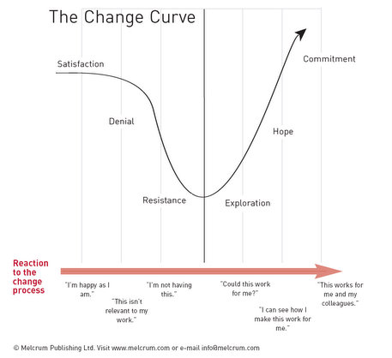
3 Pillars of Success
Communication
Training
Necessary to have an understanding of why changes are happening
Management Involvement, Mentoring and Support

Slide 34
IT Service Best Practices Project
Expect to start in early 2013
Hope to review existing procedures and best practices used across campus and also industry best practice models such as ITIL
Collaborative
Could work with:
RT Investigation Project
Asset Management Project
Communication and training

Slide 35
Resources
ITIL for Dummies, Peter Farenden
Service Management For Dummies, Judith Hurwitz, Robin Bloor, Marcia Kaufman, Fern Halper
ITIL Wikipedia article
Deming-Wikipedia article

Slide 36
ITIL Applied
Michael Tennant

Slide 37
Pharmaceuticals
4 Locations, 3k+ staff, 90k devices, 3 data centres
Challenges
Service Delivery Problems
Outages due to upgrades, changes, etc.
Poor support for business stakeholders
Lack of consistent processes and procedures
Non Compliance with regulations
SOX, ISO, FDA, etc.

Slide 38
Pharmaceutical- ITIL
Application Management
Define application development standards and processes
Incident Management
Define and publish procedures for support
Change Management
Change Advisory Board (CAB) with cross company representation
Validation of change documentation before change occurs (Service Validation and Testing)

Slide 39
Pharmaceutical- Results
Delivery - Speed to Market
Product cycle (concept to Shelf) shortened 30%
Reduction of Outages
Unplanned outages virtually eliminated
Planned outages non-intrusive to business
Compliance – back in scope
Validation, planning, testing and Documentation satisfied requirements

Slide 40
Call Centre
155 Locations, 7 business units, 150,000+ staff, 1million+ devices, 5 data centres
Challenges
Service Delivery Problems
Outages due to upgrades, changes, etc.
Poor support for business stakeholders
Lack of consistent processes and procedures
Non Compliance with regulations
SOX, ISO, FDA, client regulations, etc.

Slide 41
Call Centre - ITIL
Service Portfolio Management
Create Service Catalogue, SLA’s, OLA’s, UC’s
Incident Management
Define and publish procedures for support
Change Management
CAB with cross company representation
Validation of change documentation before change occurs (Service Validation and Testing)

Slide 42
Call Centre- Results
Service – Stakeholder Satisfaction
1st call resolution increased 30% to 70%
Satisfaction surveys increased 25-85%
Reduction of Outages
Unplanned eliminated (1/day – 1/ ~2 months)
Planned outages non-intrusive to stakeholders
Compliance – back in scope
Validation, planning and Documentation satisfied requirements

Slide 43
UW- CECA
Application Management
Defined application development standards and processes
Defined service validation and testing approach
Incident Management
Defined procedures for support (in progress)
Change Management
In progress

Slide 44
Thank you!
Questions?

