Slide 2
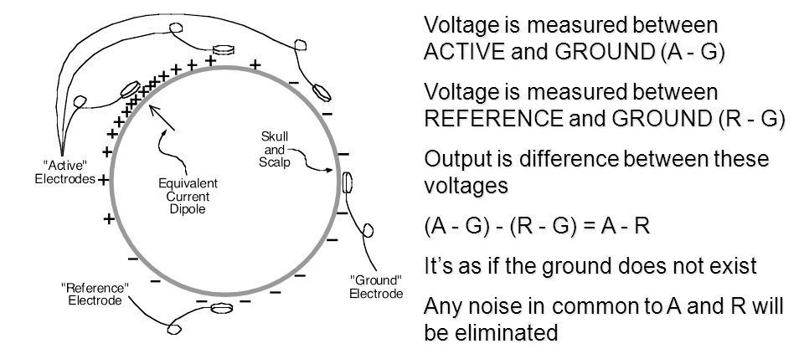
Measuring EEG
EEG is recorded as a potential for current to pass from one electrode to another
For each channel, you need active, reference, & ground electrodes (in a typical system)
Notes:
Current = flow of charged particles (electrons or protons) through a conductor
Usually refers to current flowing in the direction of positively charged particles
Voltage = potential for electrical current to flow from one place to another

Slide 3
Measuring EEG
Always think of EEG as a difference between the active and reference electrodes
Why the reference(s) you choose to use is so important
Notes:
Current = flow of charged particles (electrons or protons) through a conductor
Usually refers to current flowing in the direction of positively charged particles
Voltage = potential for electrical current to flow from one place to another

Slide 4
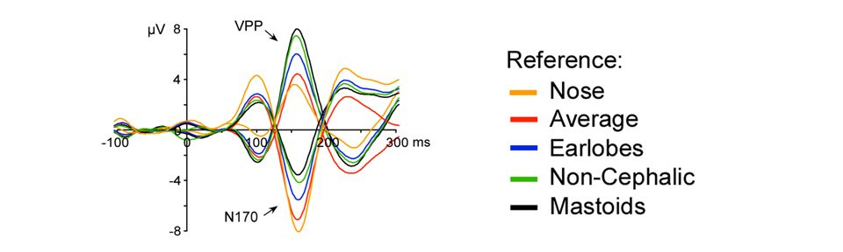
Measuring EEG
Ideal: Active electrode placed at site where voltage is changing; reference electrode placed at neutral site
Reality: There is no neutral site
EEG can look very different with different references

Slide 5
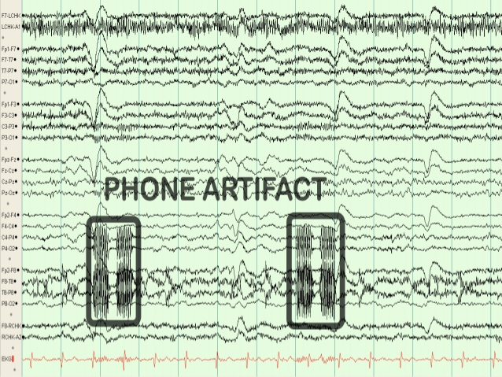
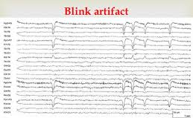
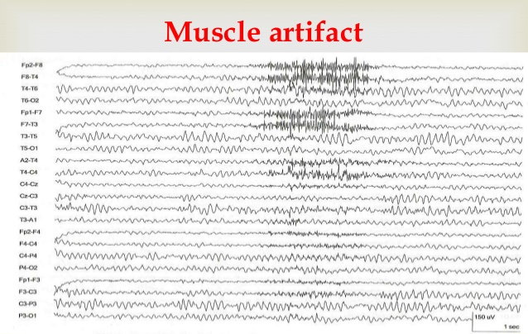
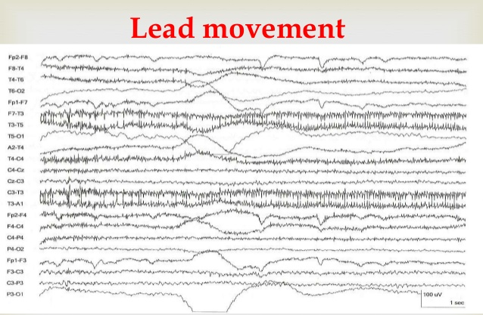
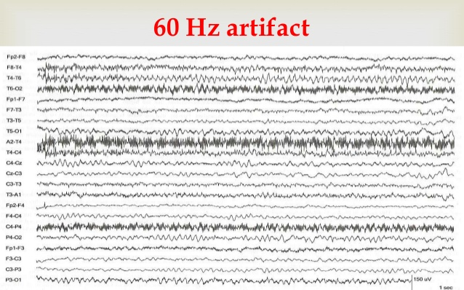
Importance of Clean Data
There is NO substitute for clean data
Many artifacts can be avoided by good data collection procedures

Slide 6
Importance of Clean Data
Artifacts can be problematic
↓ SNR
Some can be systematic, occurring in some conditions more than others & being loosely time-locked to the stimulus so they are not eliminated by averaging
Ocular artifacts (blinks & eye movements) can change the sensory input
Artifact removal/correction always has a cost
Rejection = less trials = ↓ SNR
Filters can distort data
Regression & ICA can remove brain signal

Slide 7
Typical Order of Operations
Re-reference
However, some artifact correction procedures require this after artifact correction
Filter
Epoch
[Baseline Correction]
Sometimes, don’t want to use a baseline correction procedure
Artifact Rejection
Artifact Correction (e.g., blinks and eye movement)
[Baseline Correction]
Artifact correction can affect baseline so needs to be repeated
Artifact Rejection
Notes:
Brackets mean optional

Slide 8
Thank You!
Email me if you have any questions: ssheldon@ualberta.ca

Slide 9
Some Basics of Neuroscience
Resting membrane potential
-70 mV on inside of cell
Action potentials
Triggered when membrane potential goes sufficiently positive
Starts at axon hillock and travels down axon
Rarely contributes to scalp EEG
Postsynaptic potentials (PSPs)
Neurotransmitter binds with receptor, opens ion channels
Excitatory: Positive charges move into cell
Inhibitory: Negative charges move into cell
The origin of most EEG signals

Slide 10
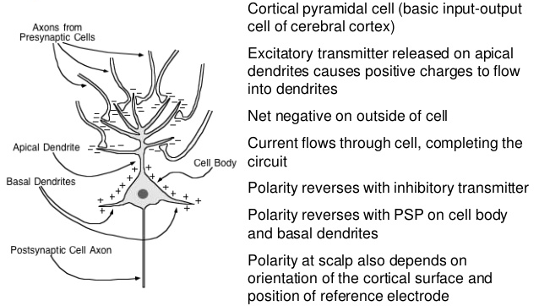
Some Basics of Neuroscience

Slide 11
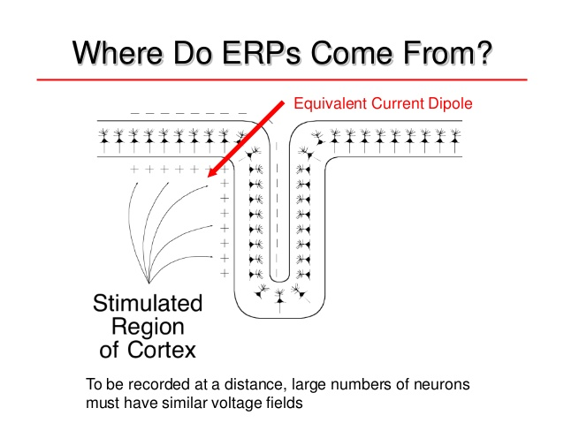
Some Basics of Neuroscience

Slide 12
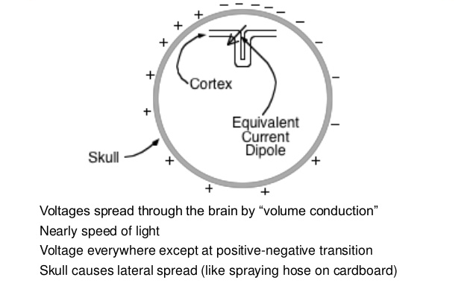
Some Basics of Neuroscience

