Slide 1
Introduction to EEG Data Processing
Sarah Sheldon

Slide 2
Matlab Code on Github: https://github.com/ssheldo/EEG_process_talk
Practice_EEG_Analysis.m demonstrates principles using functions created for processing and analysis (functions found in Kyle_EEG_analysis folder)
Code in Processing_Pipeline folder is for EEG experiments and uses eeglab (https://github.com/sccn/eeglab)
outline.m has signal processing examples and demonstrations of principles

Slide 3
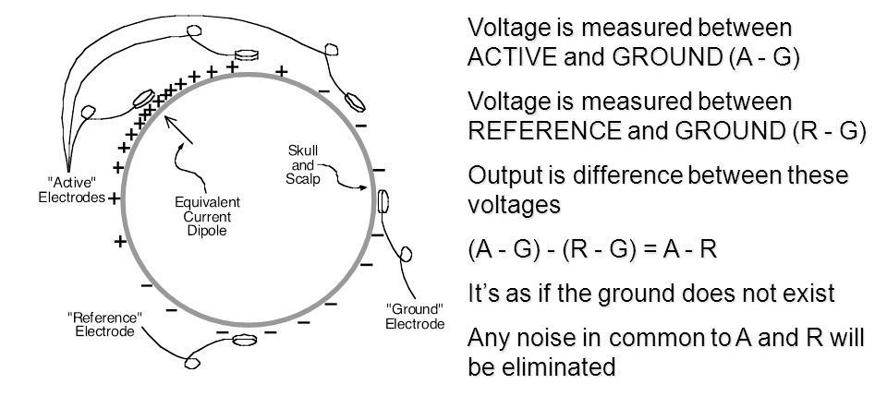
Measuring EEG
EEG is recorded as a potential for current to pass from one electrode to another
For each channel, you need active, reference, & ground electrodes (in a typical system)
Notes:
Current = flow of charged particles (electrons or protons) through a conductor
Usually refers to current flowing in the direction of positively charged particles
Voltage = potential for electrical current to flow from one place to another

Slide 4
Measuring EEG
Always think of EEG as a difference between the active and reference electrodes
Why the reference(s) you choose to use is so important
Notes:
Current = flow of charged particles (electrons or protons) through a conductor
Usually refers to current flowing in the direction of positively charged particles
Voltage = potential for electrical current to flow from one place to another

Slide 5
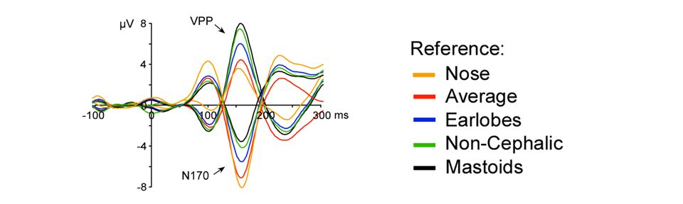
Measuring EEG
Ideal: Active electrode placed at site where voltage is changing; reference electrode placed at neutral site
Reality: There is no neutral site
EEG can look very different with different references

Slide 6
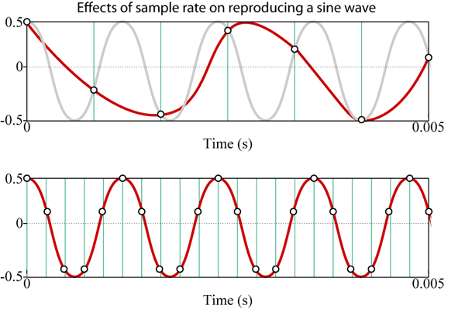

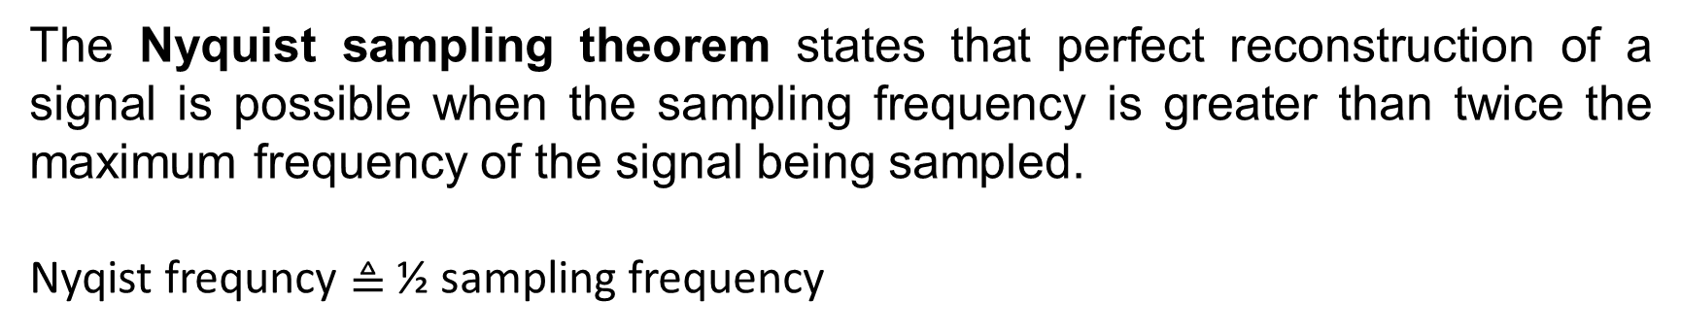

Sampling
The Nyquist sampling theorem states that perfect reconstruction of a signal is possible when the sampling frequency is greater than twice the maximum frequency of the signal being sampled.
Nyqist frequncy $≜$ ½ sampling frequency
Sampling at lower rates will cause aliasing – higher frequencies get transformed into artifactual low frequencies
$$F_{s}<2B$$
$$F_{s}>2B$$

Slide 7
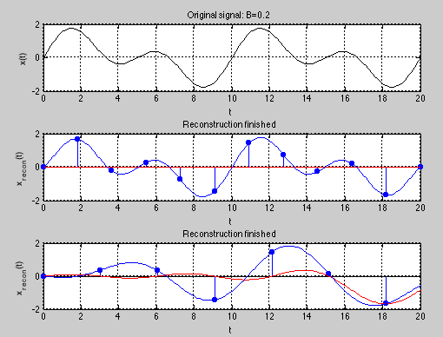
Sampling
Examples:
ex1_sampling.m
- Hint: click on plot
ex1_samplingPractice.m
Hints:
use frequencies < 1,
click just on the bottom plot
try Ts < or > 2*highest frequency
Notes:
Interpolation is used to reconstruct the original signal from the samples

Slide 8
Typical Order of Operations
Re-reference
However, some artifact correction procedures require this after artifact correction
Filter
Epoch
[Baseline Correction]
Sometimes, don’t want to use a baseline correction procedure
Artifact Rejection
Artifact Correction (e.g., blinks and eye movement)
[Baseline Correction]
Artifact correction can affect baseline so needs to be repeated
Artifact Rejection
Notes:
Brackets mean optional
Can see in preprocessing code

Slide 9
Typical Order of Operations
Re-reference
However, some artifact correction procedures require this after artifact correction
Filter
Epoch
[Baseline Correction]
Sometimes, don’t want to use a baseline correction procedure
Artifact Rejection
Artifact Correction (e.g., blinks and eye movement)
[Baseline Correction]
Artifact correction can affect baseline so needs to be repeated
Artifact Rejection
Notes:
Brackets mean optional
Can see in preprocessing code

Slide 10
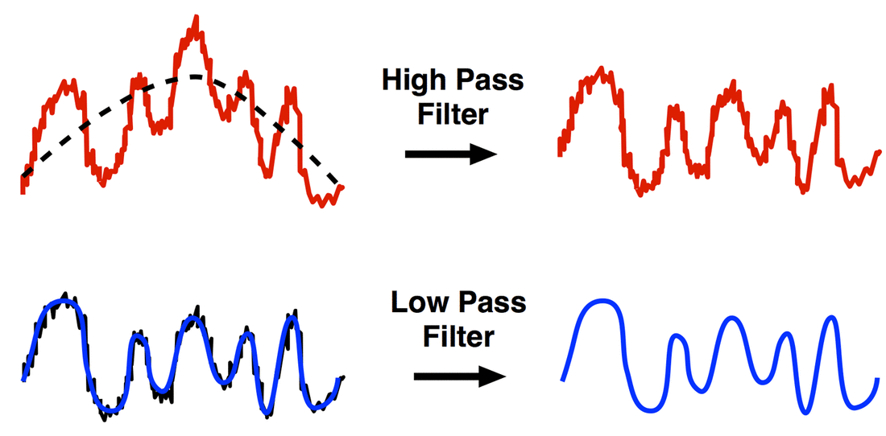
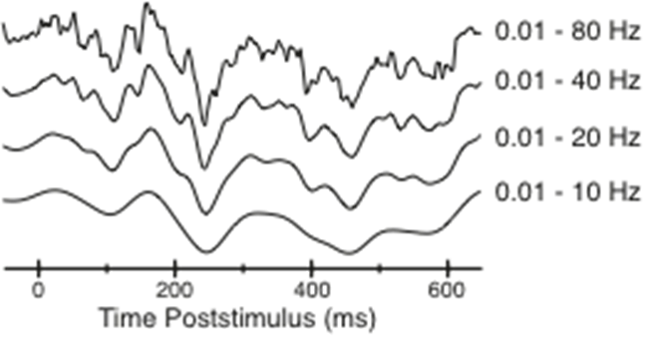
Filters
Most common class of filters:
Low-pass filter – attenuate high frequencies & pass low frequencies
High-pass filter – attenuate low frequencies & pass high frequencies
Band-pass filter – attenuate both high & low frequencies, passing only an intermediate frequency range
Notch filter – attenuate some narrow frequency band (e.g., 60 Hz) & pass everything else
Variation in Cutoffs
Notes:
Other
Adaptive
Kalman
Ricker wavelet - ‘Mexican-hat’

Slide 11
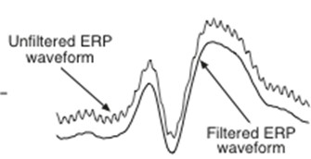
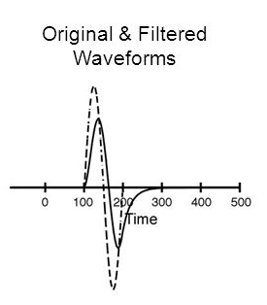
Filters
Low-pass filters help reduce induced electrical & EMG noise
Reduces temporal precision because the voltage value at each time point becomes a weighted average of voltage values from previous & subsequent time points
The lower the cutoff frequency of the filter, the more temporal precision is lost

Slide 12
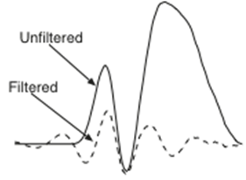
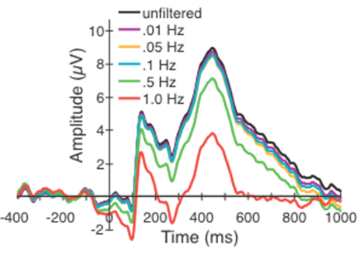
Filters
High-pass filters are used to reduce slow changes in voltage caused by skin potentials & other gradual changes in the voltage offset
Can cause significant amplitude reduction in slow components (& distortion of fast components) when the cutoff exceeds ~0.1 Hz

Slide 13
Filters
Examples:
Practice_EEG_Analysis.m
- Uses built-in filter function
Filtering_Practice.m
- Practice in frequency domain

Slide 14
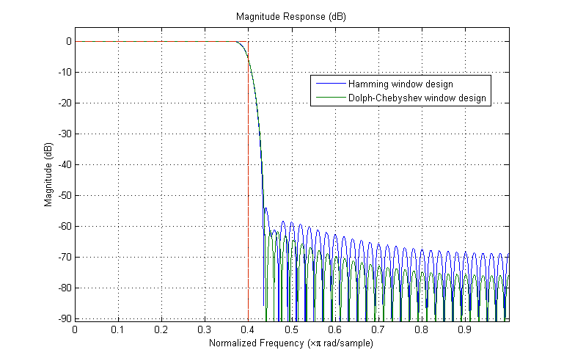
Filtering
Matlab has a lot of built-in functions if you have the Digital Signal Processing Toolbox ($$)
Fc = 0.4; N = 100; % FIR filter order
Hf = fdesign.lowpass('N,Fc',N,Fc);
Hd1 = design(Hf,'window','window',@hamming,'SystemObject',true);
Hd2 = design(Hf,'window','window',{@chebwin,50},'SystemObject',true);
hfvt = fvtool(Hd1,Hd2,'Color','White');
legend(hfvt,'Hamming window design','Dolph-Chebyshev window design')

Slide 15
Typical Order of Operations
Re-reference
However, some artifact correction procedures require this after artifact correction
Filter
Epoch
[Baseline Correction]
Usually not necessary in time-frequency analysis
Artifact Rejection
Artifact Correction (e.g., blinks and eye movement)
[Baseline Correction]
Artifact correction can affect baseline so needs to be repeated
Artifact Rejection
Notes:
Brackets mean optional
Can see in preprocessing code

Slide 16
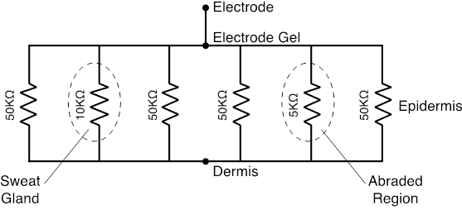
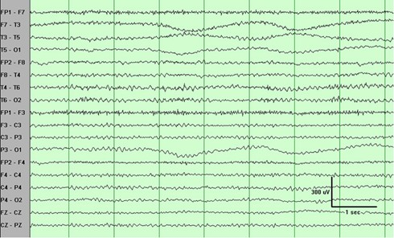
Baseline Correction
Needed because skin hydration, skin potentials, & static electric charges can cause offset voltage to drift gradually
Baseline correction is better for eliminating EEG offset than high-pass filters
It is more precise & filtering can create systematic differences across conditions

Slide 17
Baseline Correction
In baseline correction, you establish a baseline interval within your epoch
At least 100 ms long
At least 20% of the duration of the overall epoch
An even multiple of 100 ms (to contain both the positive & negative phases of an alpha cycle)
For stimulus events, the baseline interval normally precedes the stimulus.
The further from the baseline period, the more the voltage will drift away from the mean voltage during the baseline (increase variance)
For each channel, the average of all the samples within the baseline interval is subtracted from every sample in the segment.
This baseline value establishes a new zero-voltage value.

Slide 18
Typical Order of Operations
Re-reference
However, some artifact correction procedures require this after artifact correction
Filter
Epoch
[Baseline Correction]
Sometimes, don’t want to use a baseline correction procedure
Artifact Rejection
Artifact Correction (e.g., blinks and eye movement)
[Baseline Correction]
Artifact correction can affect baseline so needs to be repeated
Artifact Rejection
Notes:
Brackets mean optional
Can see in preprocessing code

Slide 19
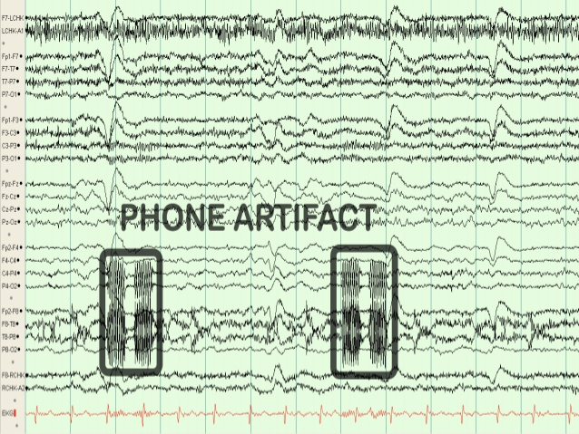
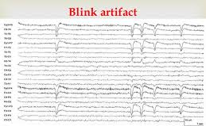
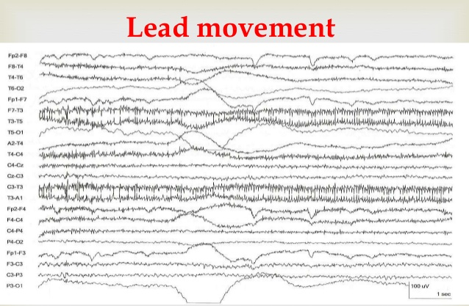
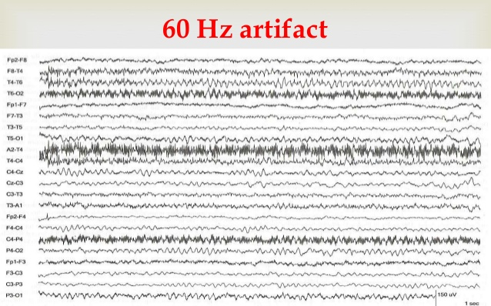
Importance of Clean Data
There is NO substitute for clean data
Many artifacts can be avoided by good data collection procedures

Slide 20
Importance of Clean Data
Artifacts can be problematic
↓ SNR
Some can be systematic, occurring in some conditions more than others & being loosely time-locked to the stimulus so they are not eliminated by averaging
Ocular artifacts (blinks & eye movements) can change the sensory input
Artifact removal/correction always has a cost
Rejection = less trials = ↓ SNR
Filters can distort signal
Regression & ICA can remove brain signal

Slide 21
Artifact Examples
Scroll through subject’s data:
load('EEG_data_ex1.mat')
pop_eegplot(EEG_ex1)
What are the artifacts?
Scroll through subject’s data:
load('EEG_data_ex2.mat')
pop_eegplot(EEG)
Compare to ex1

Slide 22
Thank You!
Email me if you have any questions: ssheldon@ualberta.ca

Slide 23
Some Basics of Neuroscience
Resting membrane potential
-70 mV on inside of cell
Action potentials
Triggered when membrane potential goes sufficiently positive
Starts at axon hillock and travels down axon
Rarely contributes to scalp EEG
Postsynaptic potentials (PSPs)
Neurotransmitter binds with receptor, opens ion channels
Excitatory: Positive charges move into cell
Inhibitory: Negative charges move into cell
The origin of most EEG signals

Slide 24
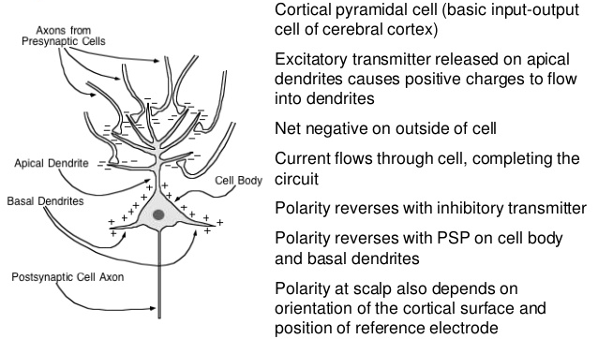
Some Basics of Neuroscience

Slide 25
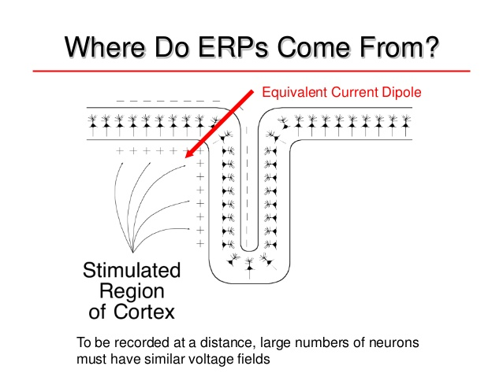
Some Basics of Neuroscience

Slide 26
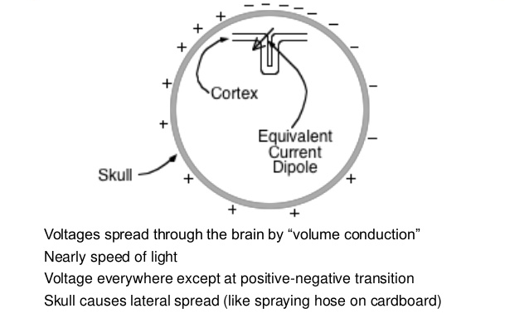
Some Basics of Neuroscience

Slide 27
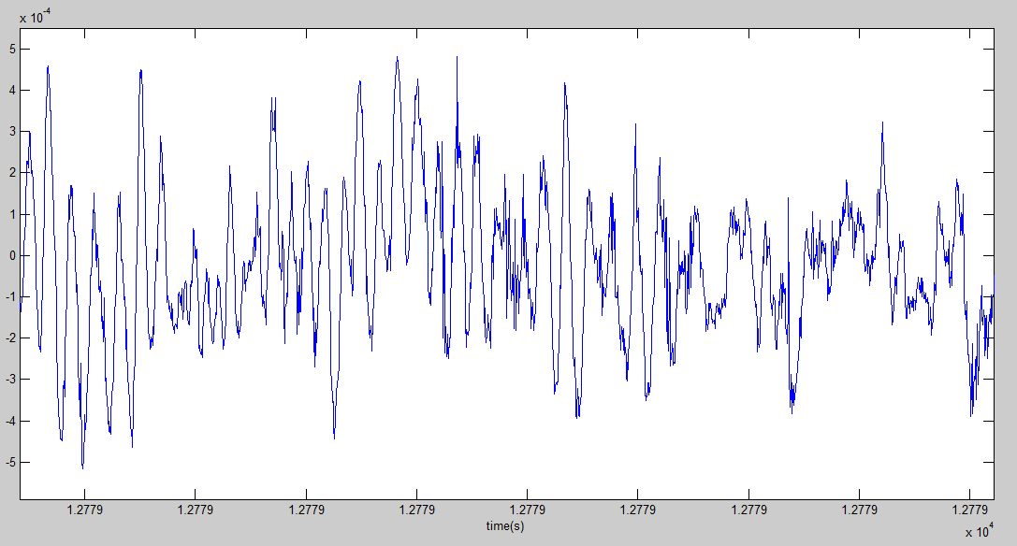
How do we describe time-varying signals?
Convert to frequency domain
Wavelet decomposition
Wigner distribution
Fourier transform
Notes:
What does stationary mean – statistics are invariant over time.
- how do we analyze it?

Slide 28
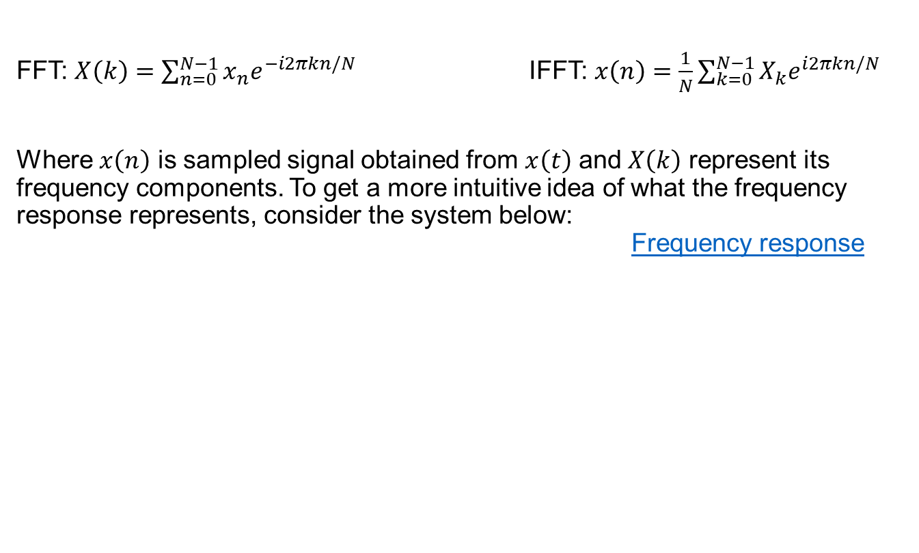
Time domain signal and its frequency spectrum
Y = fft(X,n) returns the n-point DFT.
fft(X) is equivalent to fft(X, n) where n is the size of X in the first non-singleton dimension. If the length of X is less than n, X is padded with trailing zeros to length n. If the length of X is greater than n, the sequence X is truncated. When X is a matrix, the length of the columns are adjusted in the same manner.
y = ifft(X,n) returns the n-point inverse DFT of vector X.
FFT: $X\left(k\right)=\sum_{n=0}^{N−1}{x_{n}e^{−i2πkn/N}}$ IFFT: $x\left(n\right)=\frac{1}{N}\sum_{k=0}^{N−1}{X_{k}e^{i2πkn/N}}$
Where $x\left(n\right)$ is sampled signal obtained from $x\left(t\right)$ and $X\left(k\right)$ represent its frequency components. To get a more intuitive idea of what the frequency response represents, consider the system below: Frequency response

Slide 29
Time domain signal and its frequency spectrum
First 4 Fourier components for the square wave function:
Amplitude: how big is circle
Phase: offset in position on circle
wikipedia

Slide 30
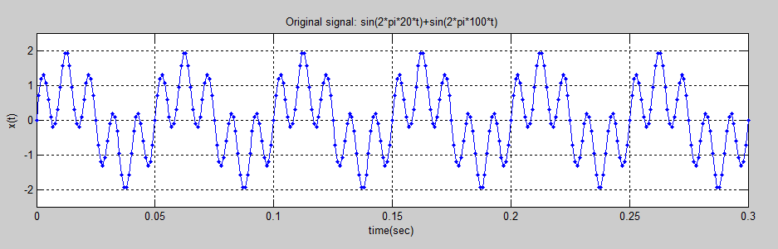
FFT and IFFT examples
F1=20;
F2=100;
Fs = 1000; % Sampling frequency
Ts = 1/Fs; % Sampling time
t=0:Ts:.3;
x=sin(2*pi*F1*t)+sin(2*pi*F2*t);
L=numel(x);
Notes:
First, lets make a signal that is the sum of two sinusoids

Slide 31
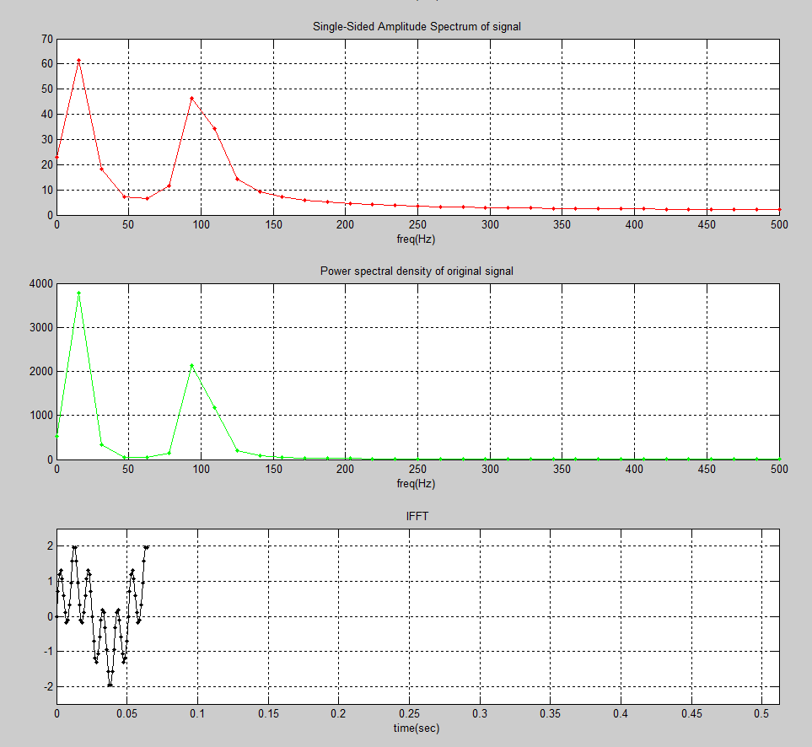
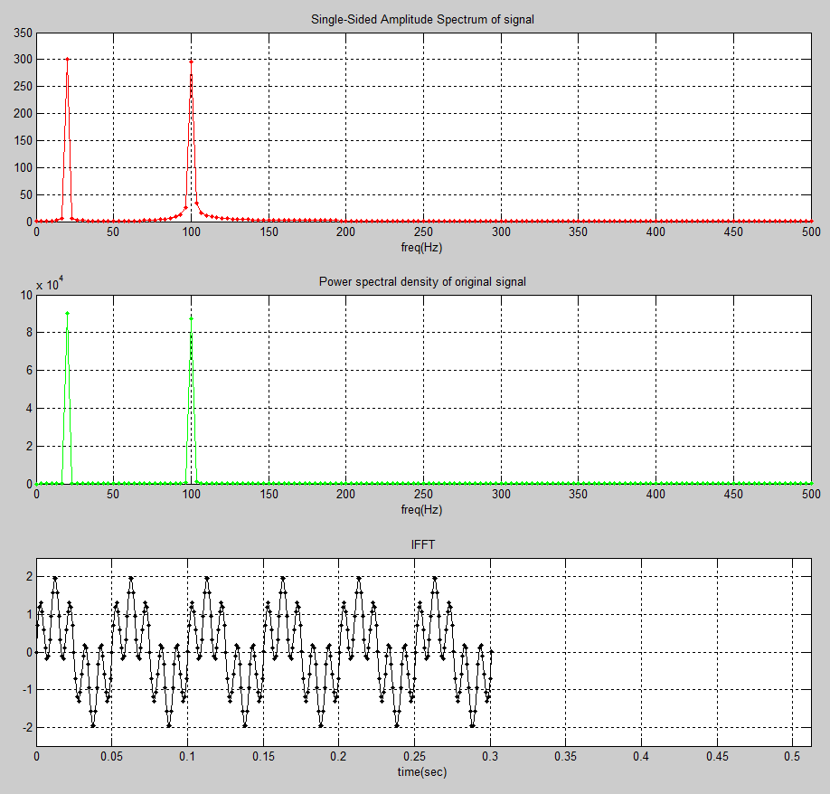
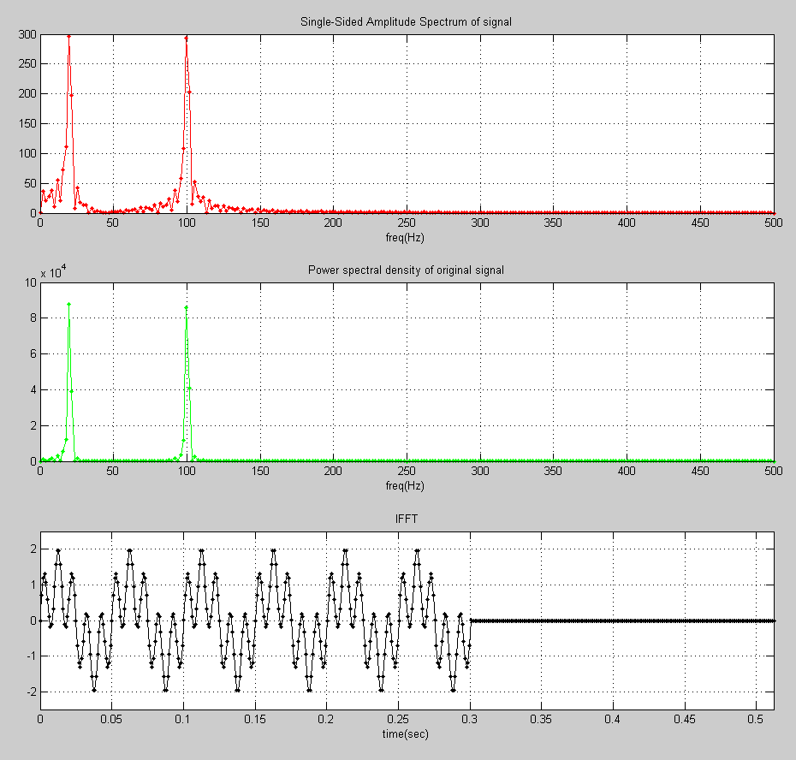
FFT and IFFT examples
L=301 number of samples.
64-point fft 301-point fft 512-point fft
( Truncated (N=L) ( Zero padded)
Higher variance in FFT peaks
Sharp FFT peaks
FFT is ‘noisy’
Partial reconstruction in t
Full reconstruction in t
iFFT has zeros

Slide 32
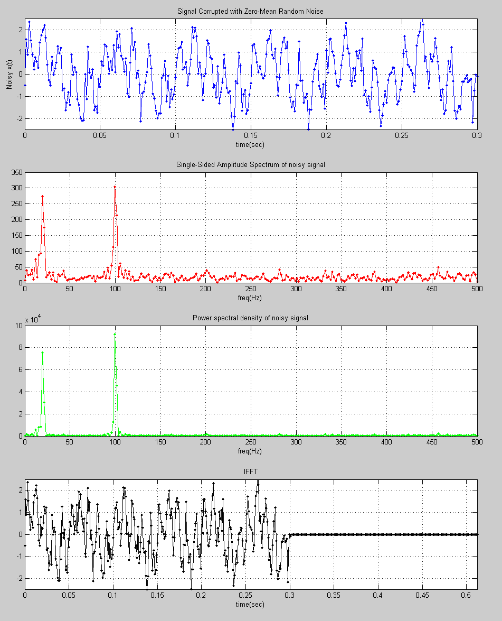
FFT and IFFT examples
F1=20;
F2=100;
Fs = 1000; % Sampling frequency
Ts = 1/Fs; % Sampling time
t=0:Ts:.3;
x=sin(2*pi*F1*t)+sin(2*pi*F2*t);
NFFT = pow2(nextpow2(L));
% Signal plus Zero-Mean Random Noise
noisy_x = x+.5*randn(1,nemel(x));
plot(t,noisy_x,'.-');
fft_noisy_x = fft(noisy_x,NFFT);
plot(f,2*abs(fft_noisy_x(1:NFFT/2+1)),'r.-')
plot(f,4*p2(1:NFFT/2+1),'g.-')
plot((0:1/(NFFT-1):1)*NFFT*Ts,real(ifft_noisy_x),'k.-')

Slide 33
FFT and IFFT examples
Try: ex2_FFT_IFFT.m
Step through it
Plot fft_x, why does it look like that?
Plot the amplitude spectrum using abs()
It is symmetric; so just use the 1st half:
Try: ex2_FFT_IFFTPractice.m
Number samples/sec > nyquist?
Number samples/sec < nyquist?
Number FFT < number samples?
Number of iFFT < number FFT?

