Slide 1
Data with NO entrainers

Slide 2
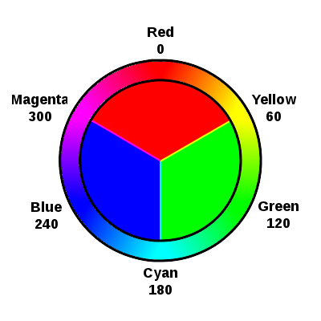
Overall
Yellow 2 Cyan (Green)
Cyan 2 Magenta (Blue)
Magenta 2 Yellow (Red)

Slide 3
Overall
Yellow 2 Cyan (Green)
Cyan 2 Magenta (Blue)
Magenta 2 Yellow (Red)

Slide 4
Overall
Yellow 2 Cyan (Green)
Cyan 2 Magenta (Blue)
Magenta 2 Yellow (Red)

Slide 5
Overall
Yellow 2 Cyan (Green)
Cyan 2 Magenta (Blue)
Magenta 2 Yellow (Red)

Slide 6
Overall
Yellow 2 Cyan (Green)
Cyan 2 Magenta (Blue)
Magenta 2 Yellow (Red)

