Slide 1
BTW Data Analysis-Sensor Data
Sijun Shen
July 15th, 2019

Slide 2
Data elements
Two datasets
Motion data: gravity acceleration, user acceleration, quaternion, angle, angle rate, etc
Location data: GPS location, heading of the cell phone movement
Three frames for x, y, and z axes
Phone frame: x to the side, z to the screen, and y to the camera
Reference frame: x to magnetic north, z to vertical, and y to west (I guess)
Vehicle frame: x to the direction of the vehicle, z to vertical, and y to the left size of the direction of the vehicle

Slide 3
Quaternion
(motion data)
Vehicle heading
(motion and location data)
Phone frame
Reference frame
Vehicle frame
Vertical z is not considered

Slide 4
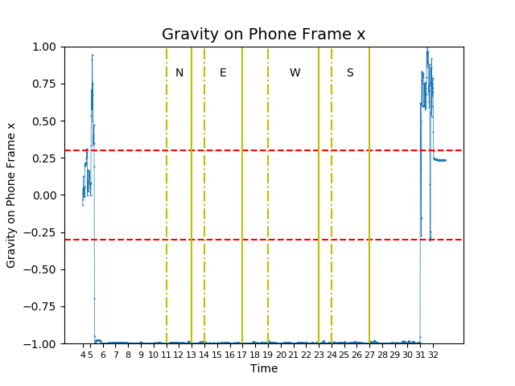
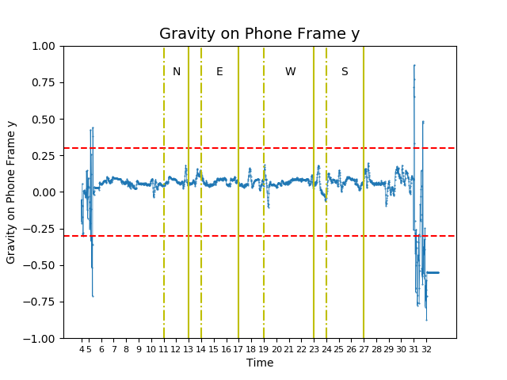
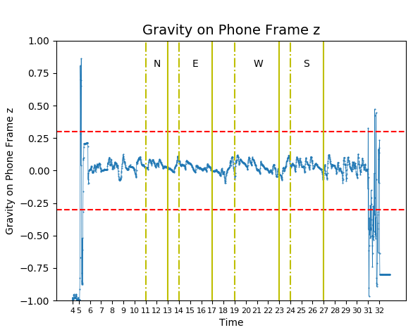
Gravity on phone frame x, y, and z

Slide 5
Quaternion
(motion data)
Vehicle heading
(motion and location data)
Phone frame
Reference frame
Vehicle frame
Vertical z is not considered

Slide 6
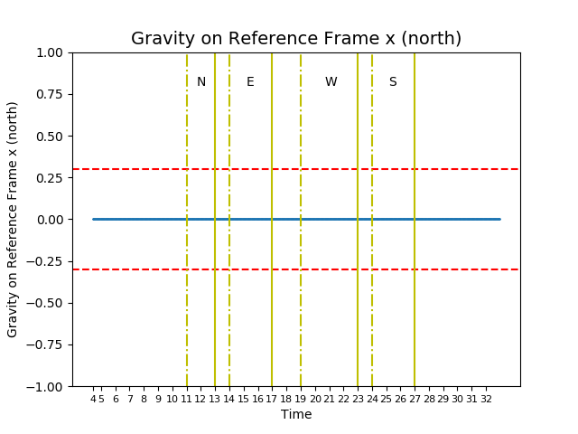

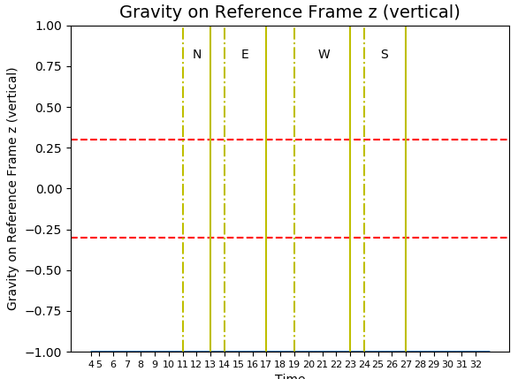
Gravity on reference frame x, y, and z

Slide 7
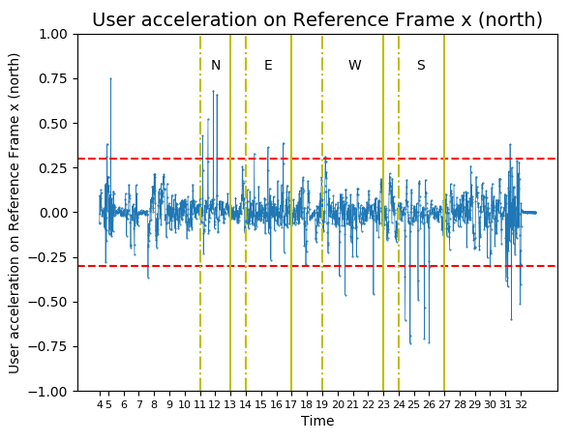
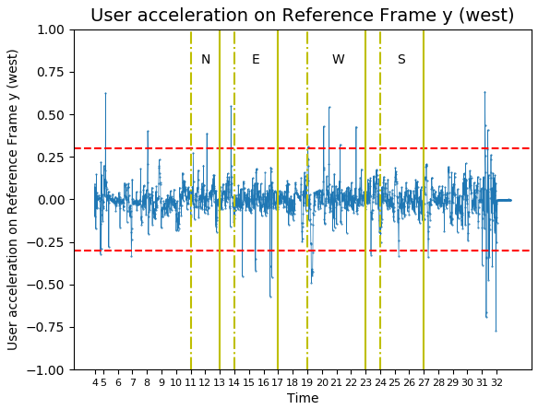
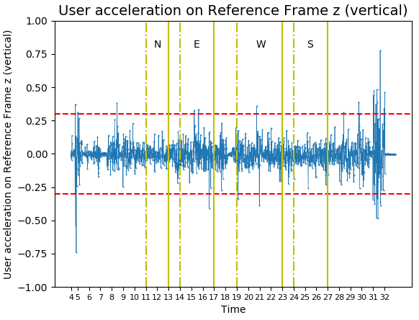
User acceleration on reference frame x, y, and z

Slide 8
Quaternion
(motion data)
Vehicle heading
(motion and location data)
Phone frame
Reference frame
Vehicle frame
Vertical z is not considered

Slide 9
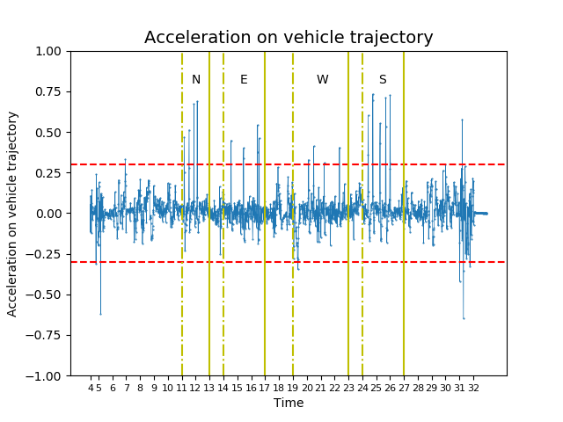
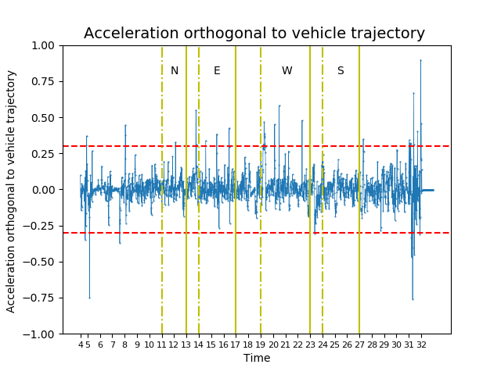
User acceleration on vehicle frame

Slide 10
Challenges
Phone was fixed on a handling when tested.
Vibration
Length of the handling
Height of the phone
Driver handling behavior separation from vehicle accelerations

Slide 11
Suggestions
Sentinace report suggests using raw instead of preprocessing data generated by linear acceleration estimation APIs
They compared their results with Inertial Measurement Units (IMU)
Next steps
Low pass filter
Collect more data
Consult experts
Use third-party API/SDK

