Slide 1
UML 2 Java
By:
Daniel Malý, Sam Sherar, Lee Smith

Slide 2
What we implemented…
Add/Remove Classes
Add Attributes/Methods to classes
Add Relationships/Cardinalities between classes & movement of points
Alter Java code to incorporate the relationships
Deleting elements
Allow change modifiers to classes methods and attributes
Abstract/Static/Final/Transient
Allow undo/redoing of actions by the user
Changing fonts & canvas size
Saving, loading files, opening new documents
Export diagram to .java skeleton code
Export diagram to image (.png, .gif, .jpg) & print

Slide 3
Demonstration
Now we’ll switch to the program running…

Slide 4
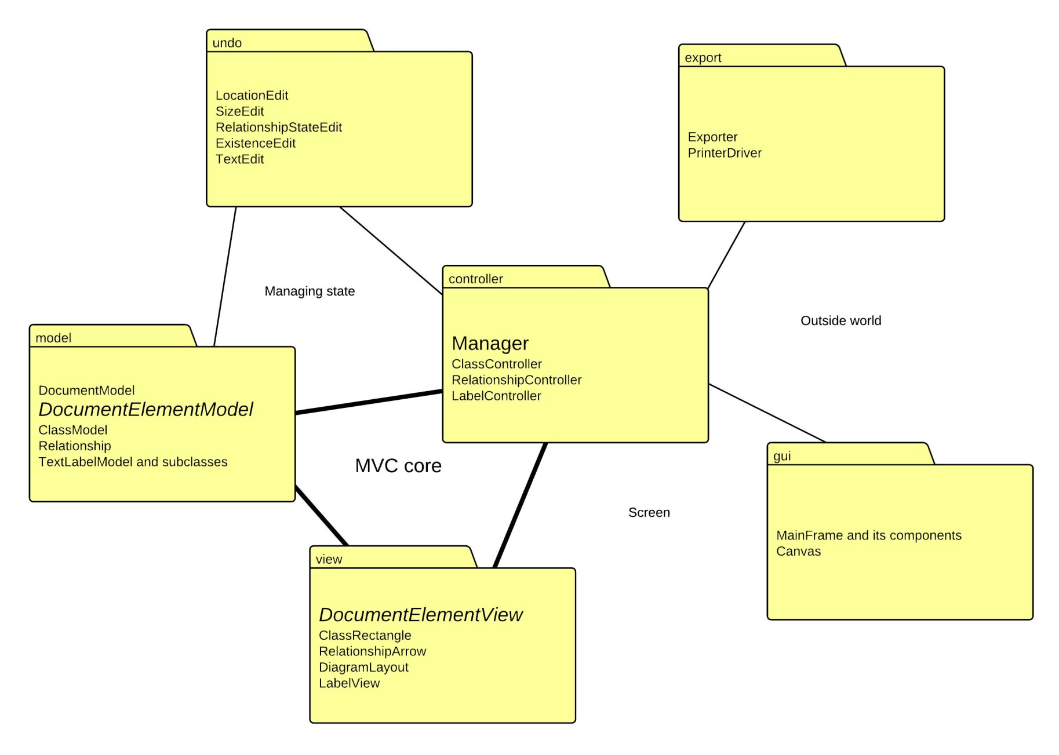
Brief overview of the design

Slide 5
Future development?
It’s almost a worthy alternative to BlueJ’s designer
Design framework is built to support many more features
We want to take it a bit further!

