Slide 1
UML 2 Java
By:
Daniel Malỳ, Sam Sherar, Lee Smith

Slide 2
What we implemented…
Add/Remove Classes
Add Attributes/Methods to classes
Add Relationships/Cardinalities between classes & movement of points
Allow change modifiers to classes methods and attributes
Abstract/Static/Final/Transient
Allow undo/redoing of actions by the user
Export diagram to .java skeleton representation
Export diagram to image (.png, .gif, .jpg)

Slide 3
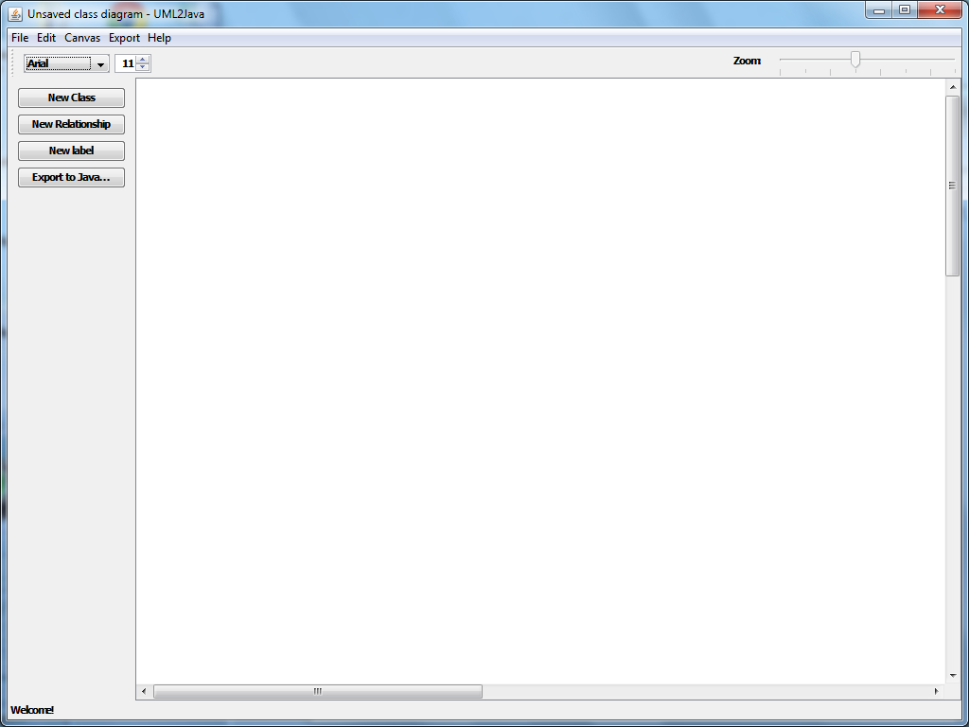
Our User Interface

