Slide 1

The Technology Value Stream
A Presentation by Alexis Yang | CSD 380 | 1 June 2024

Slide 2
What is the Technology Value Stream?
In DevOps, we typically define our technology value stream as the process required to convert a business hypothesis into a technology-enabled service or feature that delivers value to the customer.
Idea -> User Story (Agile) -> Code -> Version Control

Slide 3
What is Deployment Lead Time?
Deployment lead time is a subset of the value stream. This value stream begins when any engineer in the value stream checks a change into version control and ends when that change is successfully running in production, providing value to the customer and generating useful feedback and telemetry.
Instead of large batches of work being processed sequentially through the design/development value stream and then through the test/operations value stream (such as when we have a large-batch waterfall process or long-lived feature branches), our goal is to have testing, deployment, and operations happening simultaneously with design/development, enabling fast flow and high quality. This method succeeds when we work in small batches and build quality into every part of our value stream.

Slide 4
Phase 1
The first phase of work that includes design and development is akin to Lean Product Development and is highly variable and highly uncertain, often requiring high degrees of creativity and work that may never be performed again.
Phase 2
The second phase of work, which includes testing, deployment, and operations, is akin to Lean Manufacturing. It strives to be predictable and mechanistic, with the goal of achieving work outputs with minimized variability (e.g., short and predictable lead times, near zero defects).

Slide 5
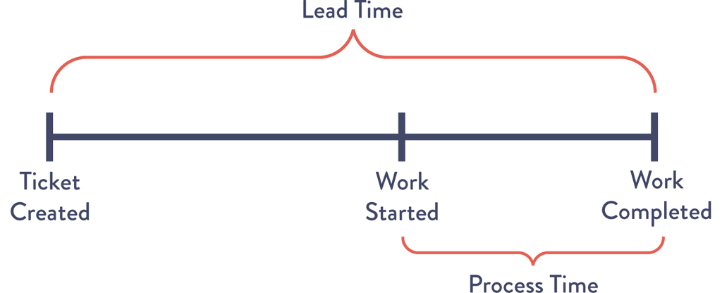
Lead Time vs. Processing Time
In the Lean community, lead time is one of two measures commonly used to measure performance in value streams, with the other being processing time (sometimes known as touch time or task time).
The proportion of process time to lead time serves as an important measure of efficiency—achieving fast flow and short lead times almost always requires reducing the time our work is waiting in queues.

Slide 6
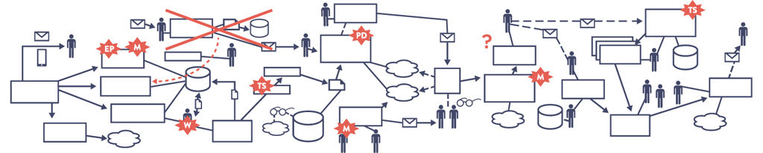
The Common Scenario: Deployment Lead Times Requiring Months
Common in large, complex organizations that are working with tightly coupled, monolithic systems.
Scarce integration test environments.
Long test and production environment lead times.
High reliance on manual testing.
Multiple required approval processes.

Slide 7
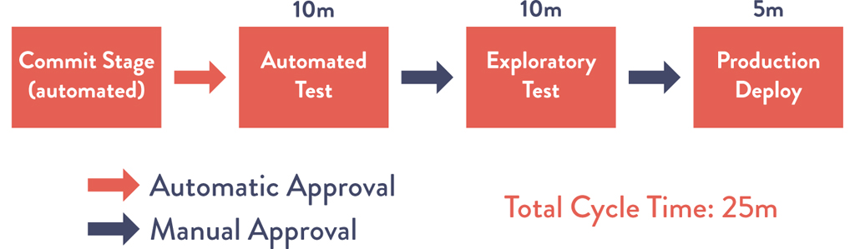
Our DevOps Ideal: Deployment Lead Times of Minutes
Developers receive fast, constant feedback on their work, enabling them to quickly and independently implement, integrate, and validate their code and have the code deployed into the production environment (either by deploying the code themselves or by others).
Continually check small code changes into our version control repository.
Perform automated and exploratory testing against it.
Deploy it into production.
Modular, well-encapsulated, loosely coupled architecture.
High degrees of autonomy.
Failures are small and contained and do not cause global disruptions.

Slide 8
Citation
Kim, Gene, et al. The DevOps Handbook: How to Create World-Class Agility, Reliability, & Security in Technology Organizations. 2nd ed., IT Revolution Press, 2021.

